Slide 1
Cross-Site Request Forgery (CSRF) and CORS
IT&C 210 – S27

Slide 2
Cross-Site Request Forgery (CSRF)
“An attack that impersonates a trusted user and sends a website unwanted commands.” (MDN)
<img src="https://www.example.com/api.php?operation=delete&id=2384"/>
<a href="https://cls.example.com/login?returnTo=https://nefarious.org/getcredential"> Login </a>

Slide 3
Cross-Origin Resource Sharing (CORS)
Could be called “Cross-Origin Request Security” because that’s what it’s really for.
Special headers sent in the HTTP request and response plus a special “preflight” request.

Slide 4
Walkthrough / Demo: CSRF and CORS
https://byu-itc-210.github.io/walkthrough/CSRF-CORS

Slide 5

Demo1: A Naïve REST Server
Bing Image Creator: “A drawing of a naïve server.”

Slide 6
Problem: Cannot be accessed across sites.

Slide 7
CORS Preflight Headers
Request Headers (automatically filled in by the browser)
Access-Control-Request-Headers
Indicates headers that will be included in the request
Access-Control-Request-Method
Indicates which method will be in the content request
Origin
Indicates the origin of this request (host of the page making the request)
Response Headers
Access-Control-Allow-Method
Acceptable methods (e.g. GET, POST, PUT, DELETE)
Access-Control-Allow-Headers
Response headers that can be exposed to JavaScript
Access-Control-Allow-Origin
Acceptable origin for the request
Access-Control-Allow-Credentials
Cookies may be submitted to this URL
Access-Control-Max-Age
Number of seconds this preflight request can be cached by the browser
Varies
The inbound headers that would change the output of this preflight.

Slide 8
CORS Regular Headers
Request Headers (automatically filled in by the browser)
Origin
Indicates the origin of this request (host of the page making the request)
Response Headers
Access-Control-Allow-Origin
Acceptable origin for the response
Access-Control-Allow-Credentials
Cookies may be returned from this URL

Slide 9
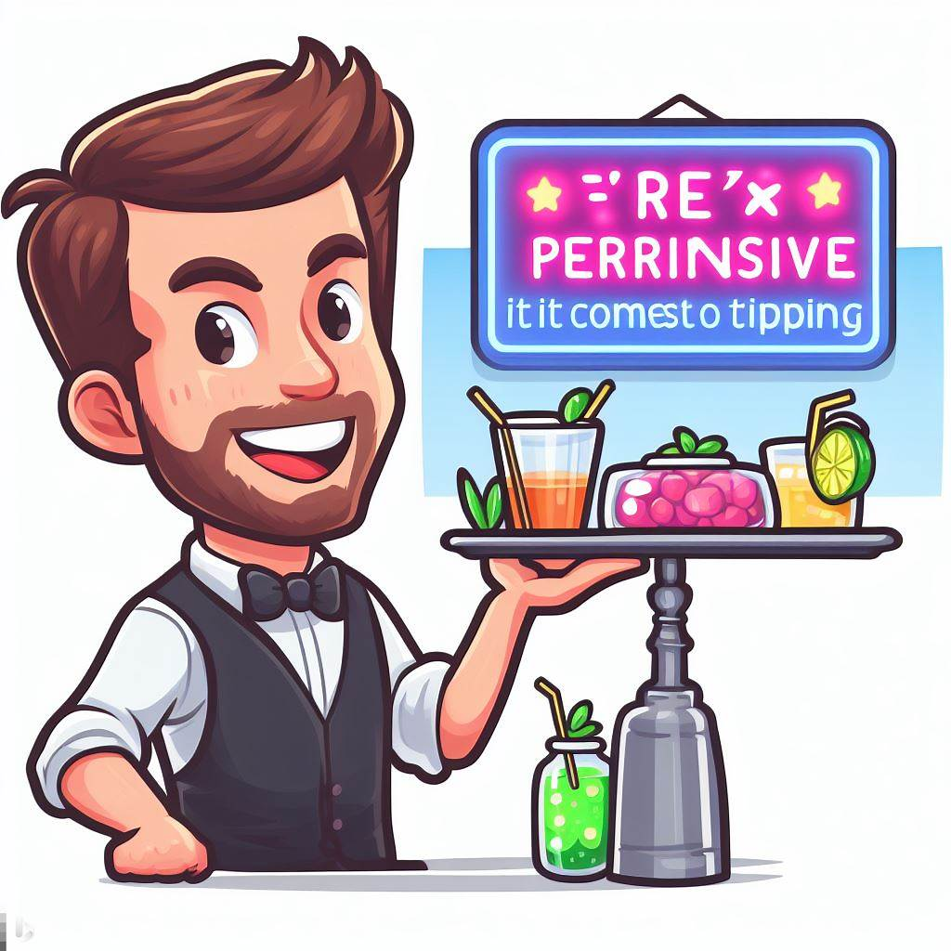
Demo2: A Permissive REST Server
Bing Image Creator: “Draw a permissive server.”

Slide 10
Problem: Cross-Site Request Forgery (CSRF)

Slide 11
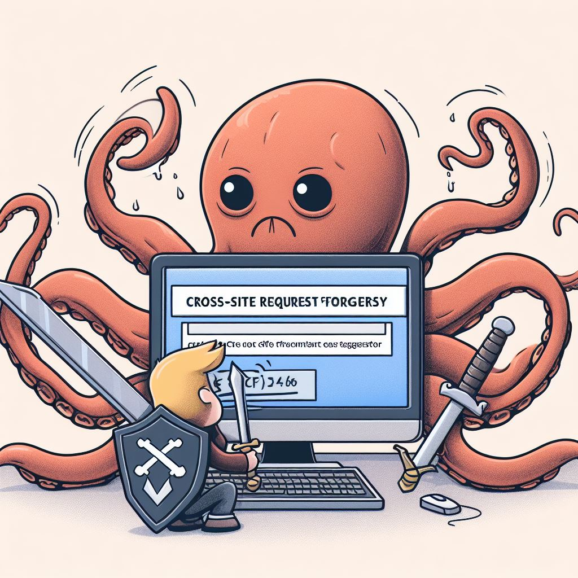
Protecting against CSRF
Stick with single origin (no CORS headers)
Limit the scope of your credentials (cookies and tokens)
E.g. Tie the token to one and only one Origin
Use CORS Carefully
Only permit the origins and methods that are expected
Implement the REST pattern in your APIs
No changes to the data with a GET request
Bing Image Creator

Slide 12

Demo3: Secure Cookies
Bing Image Creator

Slide 13
Problem: Fails if third-party cookies are disabled.

Slide 14
Managing Authentication Tokens in JavaScript
Retrieve a token with an authentication request
A login call as with RestSpace.dicax.org.
A token received from Oauth
Formats: JSON Web Token (JWT) or URL Query formatted token. Either way it has a Message Authentication Code (MAC) to prevent forgery.
JavaScript controls the token
Stores it for the length of the session
Presents it in a request header with each request
Authorization: Bearer <token>
Periodically updates tokens since they tend to expire.
Authentication-Info: Bearer-Update <token>
See: https://en.wikipedia.org/wiki/Message_authentication_code

Slide 15

Demo4: Authentication Tokens
Bing Image Creator

Slide 16
Problem: Sharing Authentication Tokens Across Tabs

Slide 17
Where to store an Authentication Token
It depends on your application:
sessionStorage is not shared across tabs.
localStorage is shared across the origin but it also persists across browser sessions (closing the browser will not log you out)
Clever use of sessionStorage with localStorage events will share the token across tabs but clear when you close the browser.
An example is in the readings.
There are libraries and frameworks that implement this strategy.

Slide 18
Study Questions
What factors can make a site vulnerable to a CSRF attack? (Cross-site cookies, data changes on GET requests, etc.)
What do CORS headers do?
What does the browser do if a website doesn’t respond to an OPTIONS preflight request?
What does the browser do if CORS headers aren’t included on a cross-site request?
What are the advantages of managing tokens with JavaScript as compared with using cookies?

