Slide 1
Web Caching
IT&C 210B – S28

Slide 2
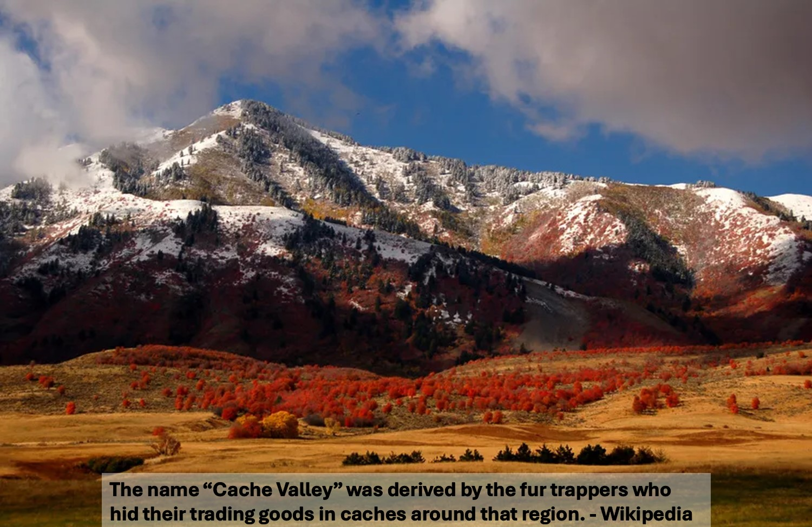
Cache
Noun: a collection of items of the same type stored in a hidden or inaccessible place.

Slide 3
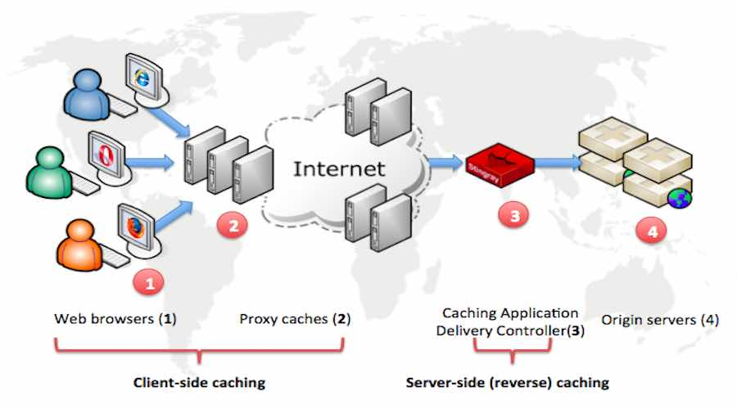
https://fossbytes.com/how-web-caching-works-introduction
Notes:
Proxy caches aren’t used much anymore because they don’t work with encrypted connections. Thus, the caching that does happen is at 1, 3, and 4 in the diagram.

Slide 4

Cache Item State
Fresh – can be reused
Stale – Possibly can be reused
Bing Image Creator

Slide 5

Cache Headers: Server to Browser
Date:
The date and time that the page was received – in UTC
Last-Modified:
The Date/Time that the resource was last modified.
Expires:
A Date/Time after which the resource should be refreshed (see also Cache-Control: max-age)
Vary
Indicates which response headers will modify the output. For example “Content-Type”, or “Accept-Language.”
Cache-Control:
private, no-store, no-cache, max-age=60, must-revalidate, proxy-revalidate, immutable must-understand, stale-if-error
ETag:
A unique value generated by the server that changes if anything changes in the resource.
Bing Image Creator
Notes:
Cache-Control:
private – intended just for the recipient don’t cache for others
no-store – don’t keep a copy
no-cache – don’t use a cached copy, use this once
max-age – cached copy is stale after these many seconds
must-revalidate – cached copy is immediately stale and should be revalidated before using
proxy-revalidate – a proxy cache must revalidate before using its copy
Immutable – this thing never changes

Slide 6
Cache Headers: Browser to Server
Cache-Control:
max-age=0, no-cache, no-store, no-transform, only-if-cached
Pragma: no-cache
Deprecated HTTP 1.0 header that is equivalent to Cache-Control: no-cache
If-Modified-Since: <date>
Return the item if it has been modified since the specified date
Otherwise, return “304 Not Modified”
If-None-Match: <etag>
Return the item if the ETag doesn’t match.
Otherwise, return “304 Not Modified”
Bing Image Creator

Slide 7

HEAD Request
Verbs discussed so far:
GET, POST, PUT, DELETE
OPTIONS preflight request for CORS
HEAD verb
Returns the headers that a GET would return but without the body.
Lets the browser determine whether a stale cached copy can be reused by comparing the Last Modified date and/or the eTag.

Slide 8
Heuristic Caching
When a server doesn’t specify “Expires:” or “Cache-Control: max-age” then the browser has to decide when something is stale.
Typically, the browser will compare the “Date:” header to the “Last-Modified:” header to estimate how often the entity changes.
Heuristic: “Proceeding to a solution by trial and error or by rules that are only loosely defined.” (Bing Dictionary)

Slide 9
Other Notes
Refreshing/Reloading the page
Regular refresh (click the refresh button or press F5)
Reloads the page. Only retrieves a new copy of the page or resources if the browser determines them to be stale.
Hard Refresh (ctrl-refresh button, ctrl-F5, or ctrl-shift-R
Bypasses caching and gets a fresh copy from the server
Caching Appliances
A server placed between the internet and a web server that caches content thereby reducing the load on the web server. It also handles HTTPS encryption thereby offloading that processing from the web server
Content Delivery Network (CDN)
A caching system with distributed cache servers across the internet.

Slide 10
Study Questions
What are the advantages of caching?
What problems can caching cause when not properly managed?
What would be the differences in cache strategy between a banking application and a news site?
Open a page from one of your lab applications, and examine the headers using the browser inspector. What cache headers do you see?

