Slide 1
Virtualization & Containers Serverless Hosting
IT&C 210B – S30

Slide 2
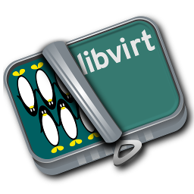
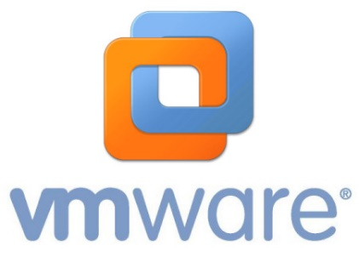
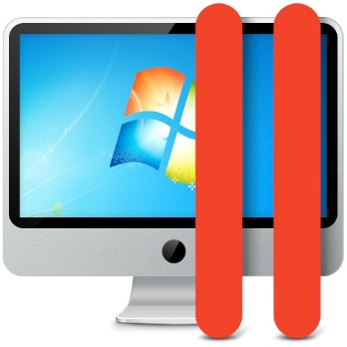
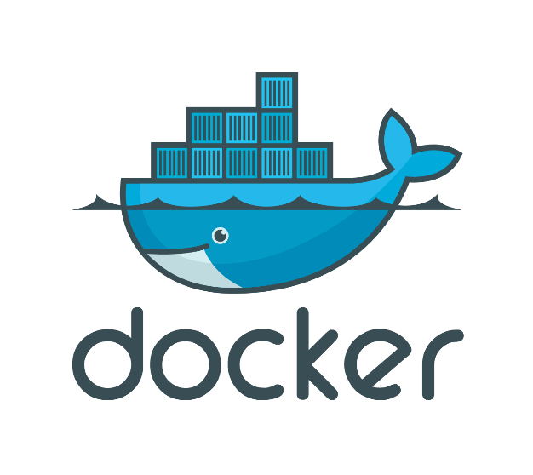

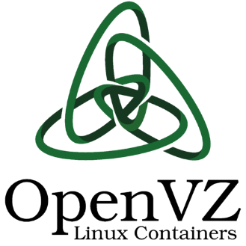
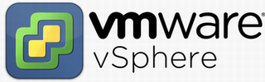
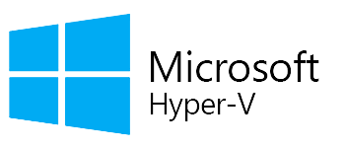
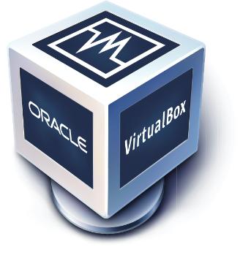
Virtualization
Oracle VirtualBox

Slide 3
Virtualization Defined
“Virtualization is the process of running a virtual instance of a computer system in a layer abstracted from the actual hardware.”
To software running on a virtualized machine, it appears they are on their own dedicated machine.
Benefits:
Flexibility in OSs that can run on one machine
Segment large systems into parts for security and for ease of management (e.g., supporting different users like we do with our live servers)
Notes:
https://opensource.com/resources/virtualization

Slide 4
Types of Virtualization
Virtual Machines
Containers
Hypervisors
Notes:
Virtual Machines are something you’re all familiar with! (you use two of them for this class) You’ve seen and experienced their practical uses and can probably imagine more. Containers are useful for lots of things, but largely used in development. Your live servers are all containers! You didn’t think we gave each of you a physical server, did you? ;) Hypervisors are ubiquitous throughout the industry! Our own IT infrastructure is supported by two main hypervisors.

Slide 5
Virtual Machines
App A
App A
App B
Bins/ Libs
Bins/ Libs
Bins/ Libs
Application
Guest OS
Guest OS
Guest OS
Bins/Libs
Virtualization Software
Host OS
Host OS
Host Hardware
Host Hardware
Traditional Machines
Virtual Machines
Virtualization layer presents virtual hardware including I/O, CPU, and Memory which is mapped to actual hardware on the host operating system.
Notes:
Virtual Machines are something you’re all familiar with (and likely the only kind of virtualization you know)
Pros:
Multiple OS’s exist on the same machine, but isolated from one another
Cheaper than owning x physical PC’s (don’t need to buy new hardware!)
Cons:
Significant overhead (host OS + virtualization software + guest OS + app + .... Etc.)
Resource bottlenecks more likely

Slide 6
Containers
App A
App A
App B
Bins/ Libs
Bins/ Libs
Bins/ Libs
App A
App A
App A
App B
App B
App A
App A
Guest OS
Guest OS
Guest OS
Virtualization Software
Virtualization Software
Bins/ Libs
Bins/ Libs
Host OS
Host OS
Host Hardware
Host Hardware
Virtual Machines
Containers
Virtualization software projects the operating system as if it were dedicated to each container when, in fact, it’s shared.
Notes:
Pros:
Less resource-intensive than VMs (bins/libs are shared acrosscontainers)
Containers easily built/destroyed
Easily portable (build an app in a container and you don’t have to worry about the host OS)
Cons:
Not as isolated (if that’s important to you)
Potential dependency issues if container is moved
Not a full operating system (if that’s what you want!)

Slide 7



Containers pt. 2
OS vs App containers
OS containers share elements of the host OS, but provide an isolated user workspace
App containers provide an isolated environment typically used by a single application
Notes:
The 210 live servers are an example of an OS container. From the user perspective, they are essentially indistinguishable from a VM. From a management perspective they are a more efficient use of resources.
(OpenVZ, LXC). They each get their own IP address as you know, which is a good example of how they act as if they are a full “OS” even though they are all leveraging the resources of the host OS.
Docker is an example of an app container service. Some companies/developers choose to develop their apps in app containers to make deployment easier (as it is a controlled environment).
(docker, rkt). They do not receive their own IP address, since they are designed to be at the application level, not the OS-level.

Slide 8
Hypervisors
App A
App A
App B
Bins/ Libs
Bins/ Libs
Bins/ Libs
App A
App A
App B
Guest OS
Guest OS
Guest OS
Bins/ Libs
Bins/ Libs
Bins/ Libs
Virtualization Software
Guest OS
Guest OS
Guest OS
Host OS
Virtualization Software
Host Hardware
Host Hardware
Virtual Machines
Hypervisors
A Hypervisor runs directly on the host hardware. Typically, it does not have a UI or has a minimal one. Rather the UI is provided by one of the guest operating systems or on another system entirely that connects to the virtualization API.
Notes:
Pros:
Much more efficient way to run VMs! (eliminate the redundant Host OS)
Basically all the other Pro’s of VMs
Cons:
Have to give up physical hardware to the use of a hypervisor (no functioning host OS)
This kind of varies with implementation. e.g. Hyper-V can display a VM as if it were a host (you can manage your hypervisor through the VM), but ESX can only be interfaced with remotely
Technically, VMware Workstation/Fusion/Virtualbox are “type 2 hypervisors” (hypervisors that run on top of a host OS)… but for the sake of learning I wouldn’t think about them that way.

Slide 9

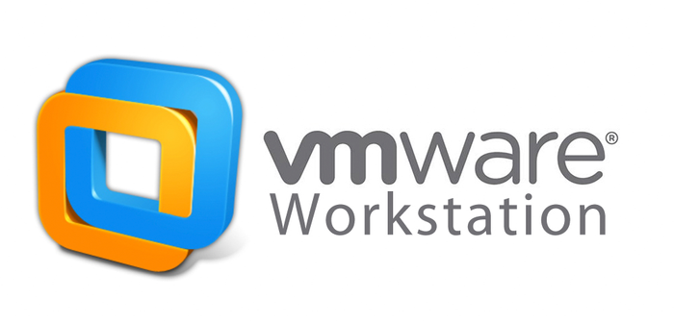

Hypervisors pt. 2
Type 1 vs. Type 2 hypervisors
Type 1 is what is generally called a hypervisor and it runs directly on the hardware
Type 2 is virtualization software that runs VMs on top of a host OS. It’s the same as what we previously called a “Virtual Machine.”
Server
Notes:
You may notice that Hyper-V is a Type 1, but it seems like it should be a Type 2 because it ”comes with” Windows. However, Hyper-V isn’t actually installed on the host OS (i.e., Windows). The setup converts the original OS in something like a VM and puts the hypervisor below. This is what is called the root or parent partition of Hyper-V. That's why you experience the same speed in what you see as the "real machine" and the virtual machines. - https://superuser.com/questions/836116/hyper-v-appears-to-runs-on-top-of-the-host-os-so-why-is-it-considered-a-native
Note: speed may vary!

Slide 10
Virtualization Summary
App A
App A
App B
Bins/ Libs
Bins/ Libs
Bins/ Libs
App A
App A
App B
App A
App A
App A
App B
App B
App A
App A
Guest OS
Guest OS
Guest OS
Virtualization Software
Bins/ Libs
Bins/ Libs
Bins/ Libs
Virtualization Software
Bins/ Libs
Bins/ Libs
Guest OS
Guest OS
Guest OS
Host OS
Host OS
Virtualization Software
Host Hardware
Host Hardware
Host Hardware
Virtual Machines
Containers
Hypervisor (Type 1)

Slide 11

Serverless Computing

Slide 12
Serverless Computing
“… a cloud computing execution model in which the cloud provider allocates machine resources on demand, taking care of the servers on behalf of their customers. "Serverless" is a misnomer in the sense that servers are still used by cloud service providers to execute code for developers. However, developers of serverless applications are not concerned with capacity planning, configuration, management, maintenance, fault tolerance, or scaling of containers, VMs, or physical servers.”
(Wikipedia: Serverless Computing)

Slide 13
Serverless Characteristics
No need to provision a server. You simply manage the functions.
Functions can be triggered by HTTP requests, by timers (according to a schedule), by a change in a file, by a queue manager, and other specialty events (e.g. GitHub WebHooks).
When an event happens, the function host loads the corresponding code (quickly) and executes the function.
When demand is high, the function host may load multiple copies of the function on different servers.

Slide 14
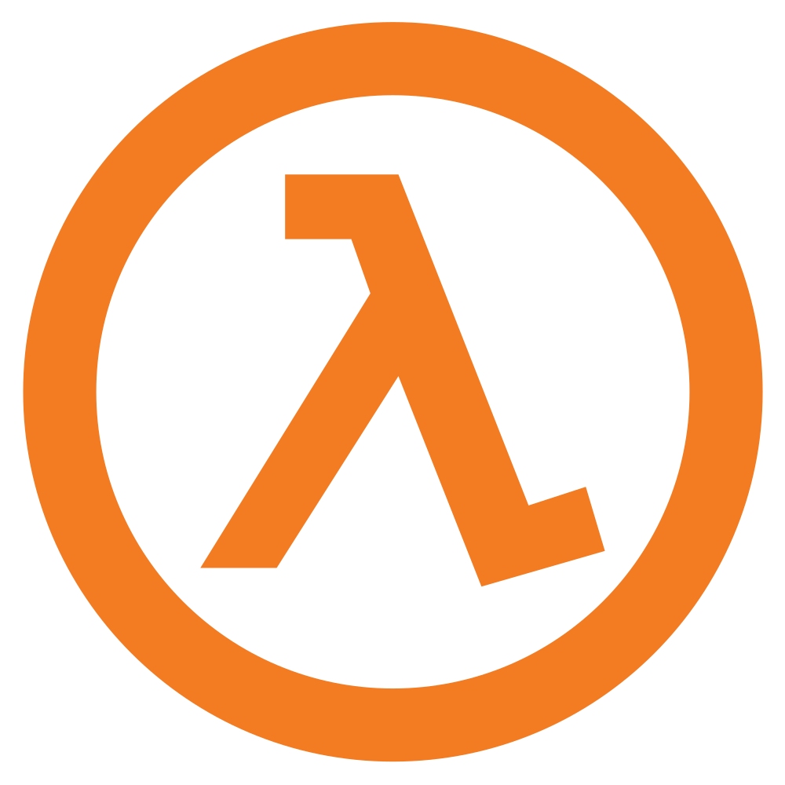
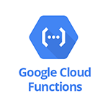
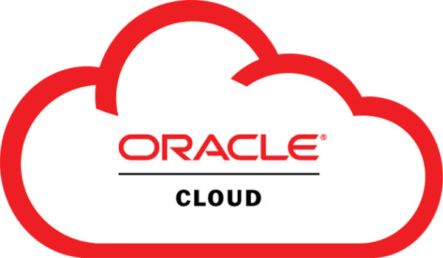
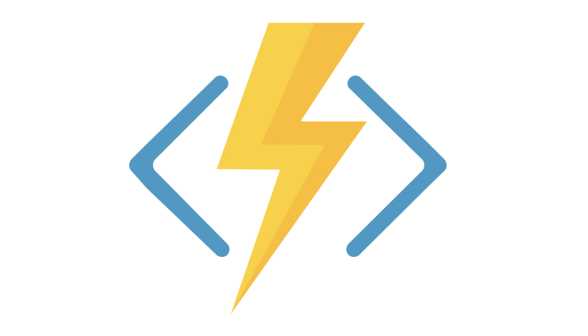
Examples
AWS Lambda – Popularized the concept.
Node.js, Python, Java, Ruby, and C#
Google Cloud Functions
Node.js, Java, Python, and Go.
Oracle Cloud Functions
Python, Go, Java, Ruby, and Node.js
Azure Functions
C#, Java, JavaScript, TypeScript, PowerShell, Python

Slide 15
Concept: Function as a Service (FaaS)
A new entrant in the cloud computing hierarchy.
Advantages
Solution can be available 24/7 but you only pay for usage.
Insulates the developer from lots of deployment headaches.
Scales easily and automatically from very low demand to extremely high demand.

Slide 16
Azure Functions we use in this class
TA Help Queue
echo.dicax.org
dns.itc210.net
restspace.dicax.org
scripture.dicax.org
scriptboard.dicax.org
I use FaaS because it lets me keep these up at all times and yet the total cost of all these combined is less than 75 cents a month.

Slide 17
Disadvantages of Serverless
New technology, runtime libraries may be immature.
Each implementation is proprietary – hard to move applications from, for example, Amazon Lambda to Azure Functions. Vendor lock-in may be a concern.
There is a small latency with the first call after a period of idleness because the code has to be loaded.
Recent claims that, at large scale, serverless costs more than conventional cloud hosting.

Slide 18
Study Questions
Define the three types of virtualization
What are the pros and cons of each one?
Given a scenario, justify why one virtualization method is better to use than another.
What are some advantages of serverless or FaaS hosting?
What are some disadvantages?
What would be a good candidate for serverless hosting?

