Slide 1
Social Media and Web Analytics
IT&C 210B S32

Slide 2

Social Media

Slide 3
What is Social Media?
A set of networked technologies that supports social interactions.
Social media is about “transforming monologue (one-to-many) into dialog (many-to-many).”¹
¹ www.webpronews.com/blogtalk/2007/06/29/the-definition-of-social-media

Slide 4
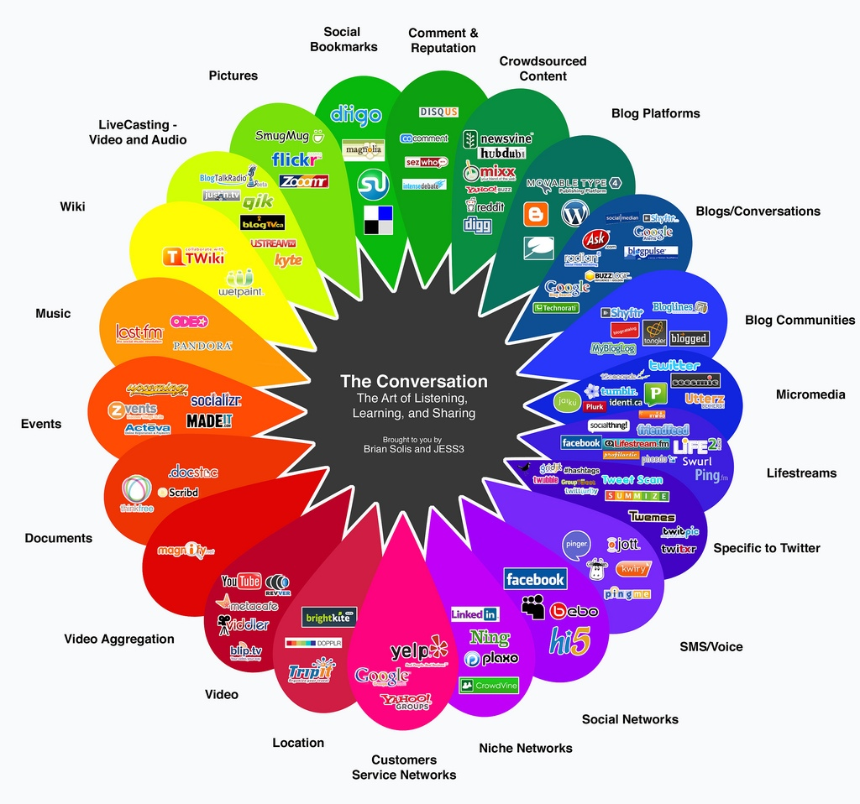
Notes:
Social media is a great business because your members provide the content for free. You don’t have to pay for it anywhere. However, that means its financial basis is advertising. Therefore, operators’ interest is focused on keeping your attention which may not be the best service.

Slide 5
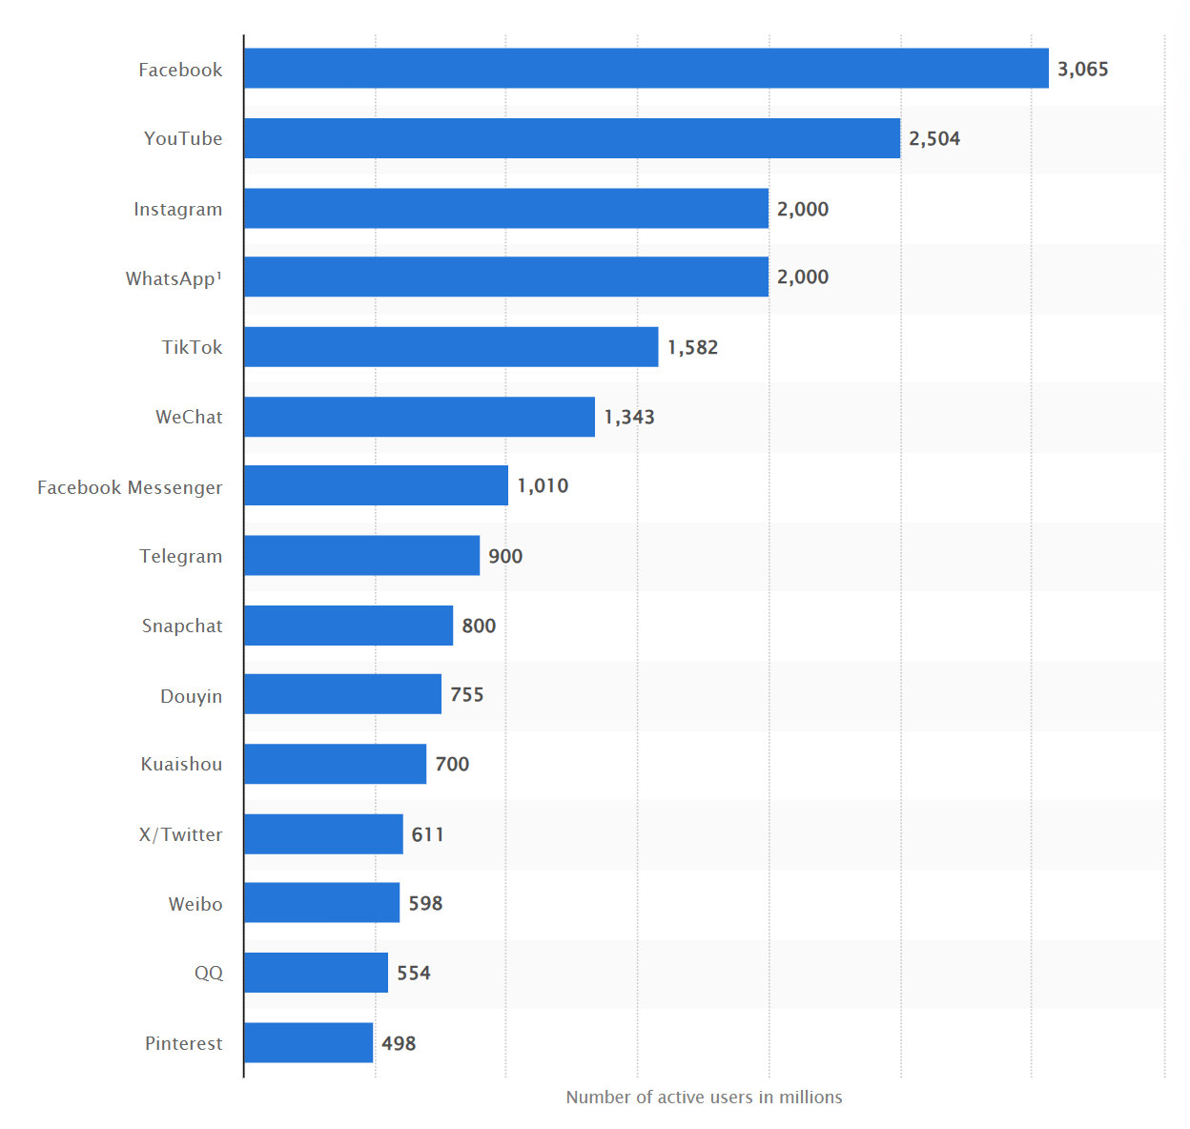
Active Monthly users as of April 2024
LinkedIn is 310
https://www.statista.com/statistics/272014/global-social-networks-ranked-by-number-of-users/

Slide 6
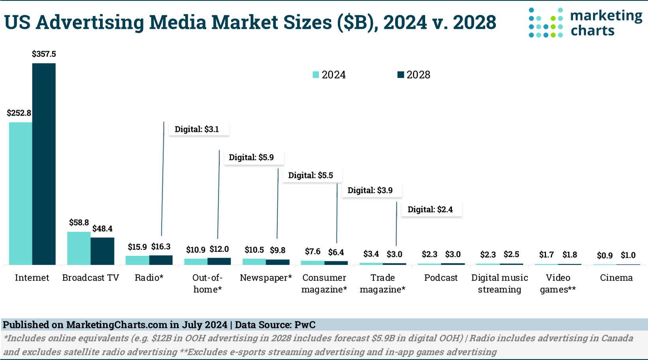
https://www.marketingcharts.com/advertising-trends/spending-and-spenders-233738
Notes:
Note the huge growth in

Slide 7
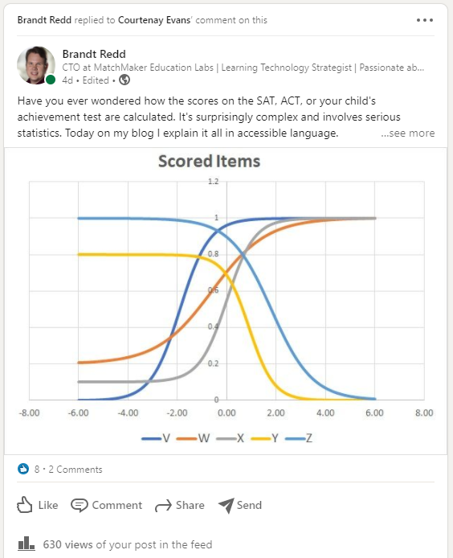
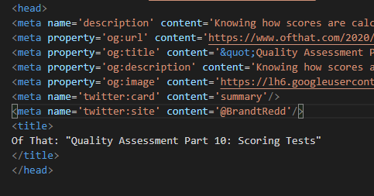
Preparing a Web Page for Social Media Sharing
Demo

Slide 8
Social Media Meta Tags
Open Graph Protocol, Official Reference: https://ogp.me/
Facebook Meta Tag Reference: https://developers.facebook.com/docs/sharing/webmasters/
X (formerly Twitter) Meta Tag Reference: https://developer.twitter.com/en/docs/twitter-for-websites/cards/guides/getting-started

Slide 9

Web Analytics

Slide 10

Patterns are left behind
Notes:
One key characteristic of technology-mediated communication is that it can (and typically does) capture detailed data on social interactions.
Just like footprints left on the sand tell a story about walking a dog on the beach, our digital footprints tell stories about our online behaviors and interactions.
The mass of data created by social media has the potential to usher in a golden age of social science and data-driven decision making.
However, to put this social data to good use by researchers, as well as non-technical community managers and decision makers,
we need usable and powerful tools that support social media data analysis.
10

Slide 11



Slide 12
Why Analyze Data?
Track people to see how effective marketing campaigns are
How to allocate resources (e.g., mobile vs desktop; where to invest marketing $s)
Track interest types of people
Assess the impact of what you’re doing.
Notes:
What questions can be answered with website data? What insights can you gain?
Who is your “real” audience?
What are they interested in?
Where do they come from?
What technologies are they using to access your content?
Who is most likely to make purchases (or do other things you care about)?
How are you doing compared to last month/year?
How do you compare to other competitors?
What errors might your site have?

Slide 13
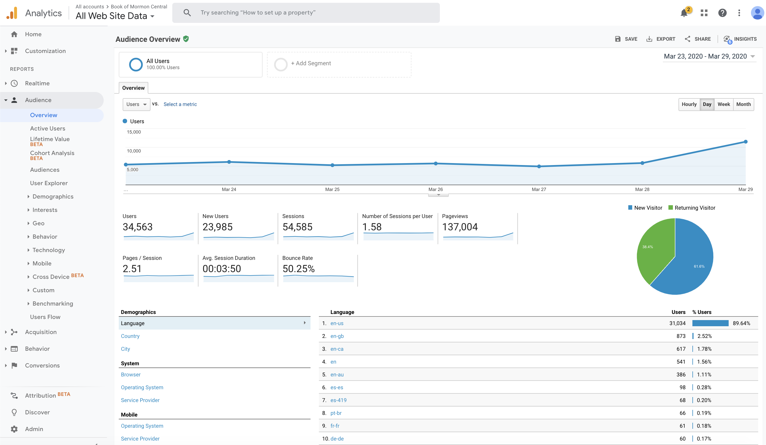
Google Analytics
Notes:
Tools such as Google Analytics allow you to mine your website for data. You can access the Google Analytics sample data account here: https://support.google.com/analytics/answer/6367342?utm_source=GA%20Education&utm_medium=affiliate&utm_content=GA%20blog&utm_campaign=Demo%20Account

Slide 14
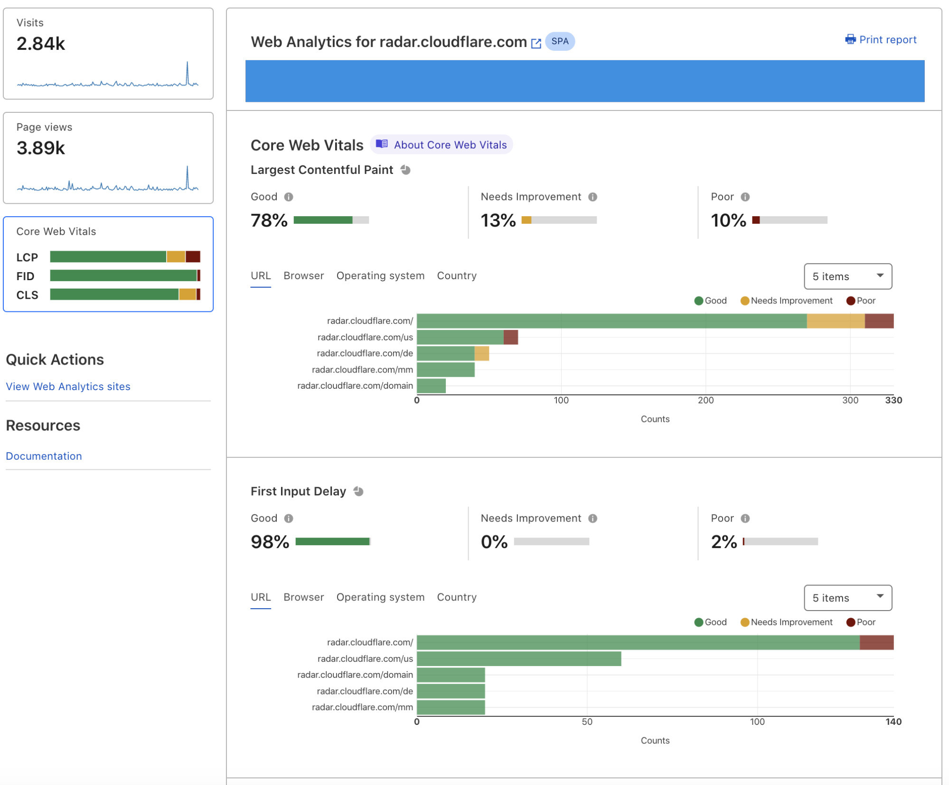

Slide 15
Where does data come from?
Client-side data collection
Google Analytics, CloudFlare Web Analytics, Adobe Digital Marketing Suite
Server-side data collection
Webalizer, AWStats, CloudFlare CDN
Application data (e.g., database queries, APIs)
Facebook Insights, Twitalyzer (via Twitter API)
Other: network traffic monitors, mobile analytics tools, ISPs

Slide 16
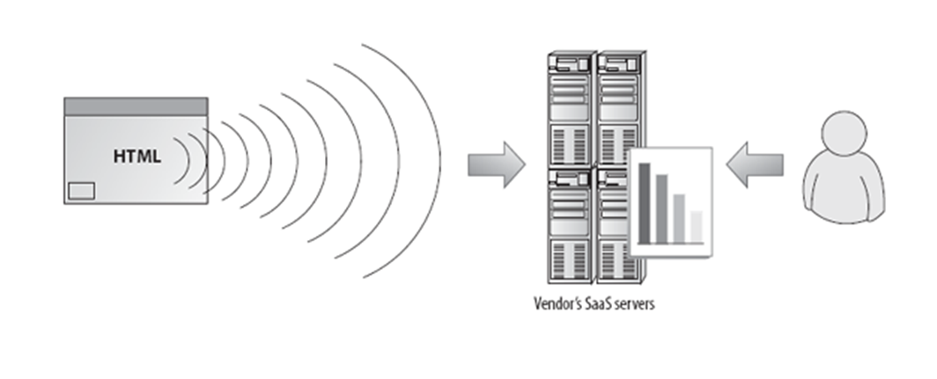
Client-Side Data Collection
JavaScript Tag on each page
Notes:
Image and text from Advanced Web Metrics with Google Analytics™, Second Edition
By Brian Clifton - Chapter 2.
“Page tags collect data via the visitor's web browser and send information to remote data-collection servers. The analytics customer views reports from the remote server (see Figure 2.1). This information is usually captured by JavaScript code (known as tags or beacons) placed on each page of your site. Some vendors also add multiple custom tags to collect additional data. This technique is known as client-side data collection and is used mostly by outsourced, Software as a Service (SaaS) vendor solutions.”

Slide 17
Google Analytics Data Collection
User gets unique code from Google Analytics
Javascript code embedded on each page that collects data from:
HTTP request header
Browser/System information (via DOM)
First-party Cookies
Due to the use of tracking cookies. Google Analytics may require GDPR (cookie) permission from the user.
Notes:
See http://code.google.com/apis/analytics/docs/concepts/gaConceptsOverview.html for details.

Slide 18
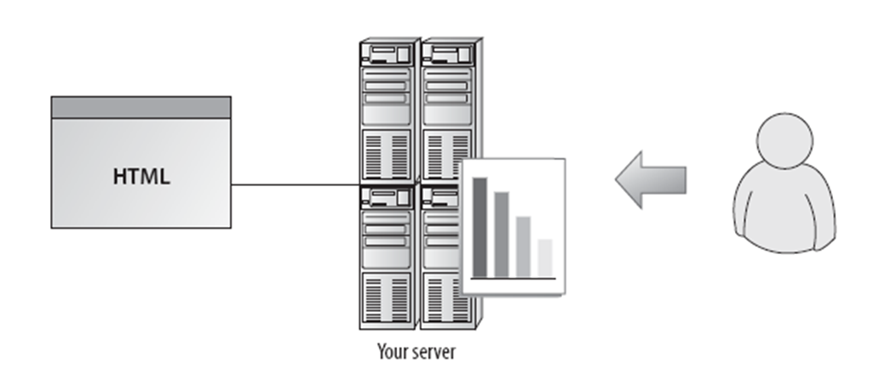
Server-Side Data Collection
Notes:
Image and text from Advanced Web Metrics with Google Analytics™, Second Edition
By Brian Clifton - Chapter 2.
Logfiles refer to data collected by your web server independently of a visitor's browser: The web server logs its activity to a text file that is usually local. The analytics customer views reports from the local server, as shown in Figure 2.2. This technique, known as server-side data collection, captures all requests made to your web server, including pages, images, and PDFs, and is most frequently used by stand-alone licensed software vendors.

Slide 19
Comparison
Client-side data capture
Server-side data capture
Must install code on each page (slower & may make errors when putting it on)
Tracks client-side events (Javascript, AJAX, Flash)
Breaks when Javascript and/or cookies are disabled
Privacy browser add-ins may interfere
Analytics vendor collects data and may use it for more than just your purposes.
Misses “hits” accessed via caches or proxy devices
Tracks completed requests (not just initiated requests)
Not blocked by firewalls (as can happen with client-side)
Captures non-Webpage requests (e.g. REST APIs, images, etc.)
Your team updates software and stores data
Notes:
Data partially from Table 2.1. Page tag versus logfile data collection in book cited above.
Client-side data capture is much more common.

Slide 20
Inaccurate data
Server-side Problems
Dynamically assigned IP addresses: cannot tell if this is the same user.
Client cached page: server doesn’t get the count if resource is served from the cache.
Counting robots & spiders: tools that index your web content being counted as if they were users.
Client-side Problems
Setup errors with Javascript Tags: the wrong tags could count the wrong resource.
Logging Javascript interferes with content.
Firewalls block logging reports.
Problems for Both
Cookies deleted or not supported: hard to track users.
Users sharing computers: multiple users with different use patterns.
Users using many devices: hard to follow or correlate use across devices.

Slide 21
Privacy Issues
Google Analytics is free because Google retains the right to use the data themselves.
Do you want Google to know exactly how many pageviews your site gets and from what locations?
Check your service agreements, server-side analytics tools may also grant the provider rights to use your data.
The most confidential answer is to deploy an analytics tool dedicated to your site.

Slide 22
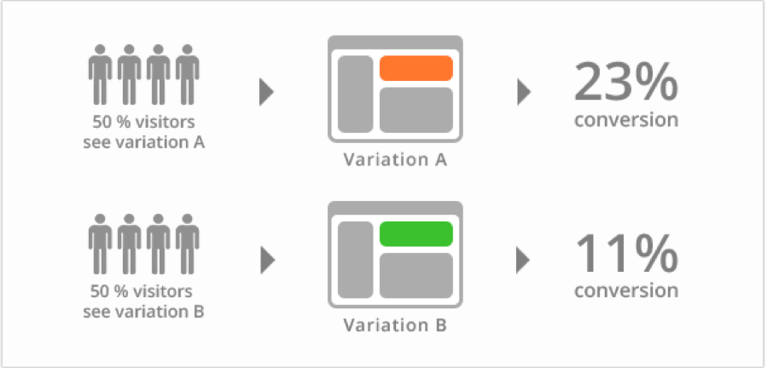
AB Testing
Notes:
AB testing is conducting real-time experiments online by providing 2 versions of the same site and seeing which one performs better. Google Analytics allows you to run A/B tests.

Slide 23
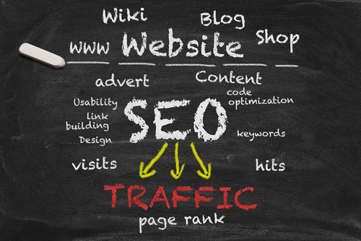
Search Engine Optimization
See https://moz.com/beginners-guide-to-seo for a great introduction to SEO.

Slide 24
Study Questions
What is social media?
What is the difference between client- and server-side analytics?
What are the sources of analytics data?
What errors are there in the data for:
Client-side analytics tools
Server-side analytics tools
What privacy issues should you consider when choosing analytics tools?
List several reasons to use analytics tools.

