Slide 1
Interpreted and Compiled Languages, C# with Razor
IT&C 210B – S35

Slide 2
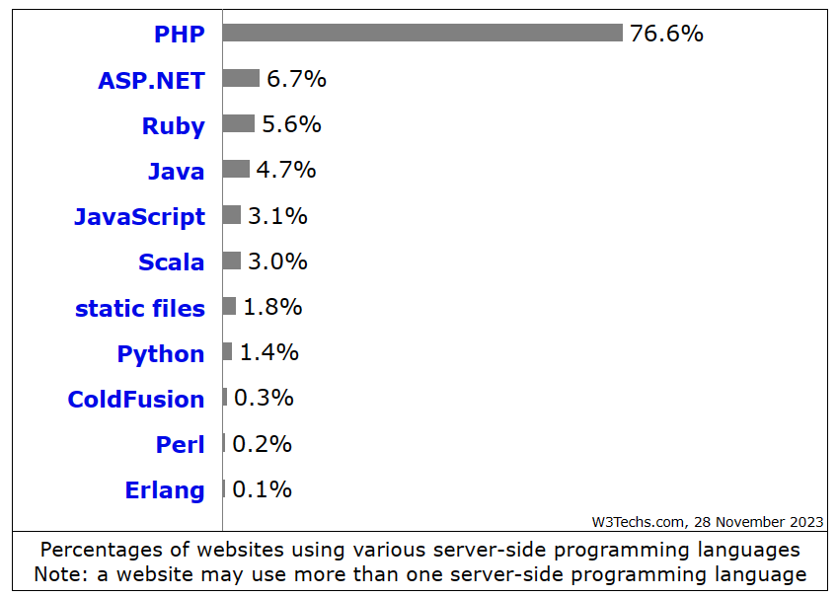
Most Popular Server-Side Frameworks by Number of Sites

Slide 3
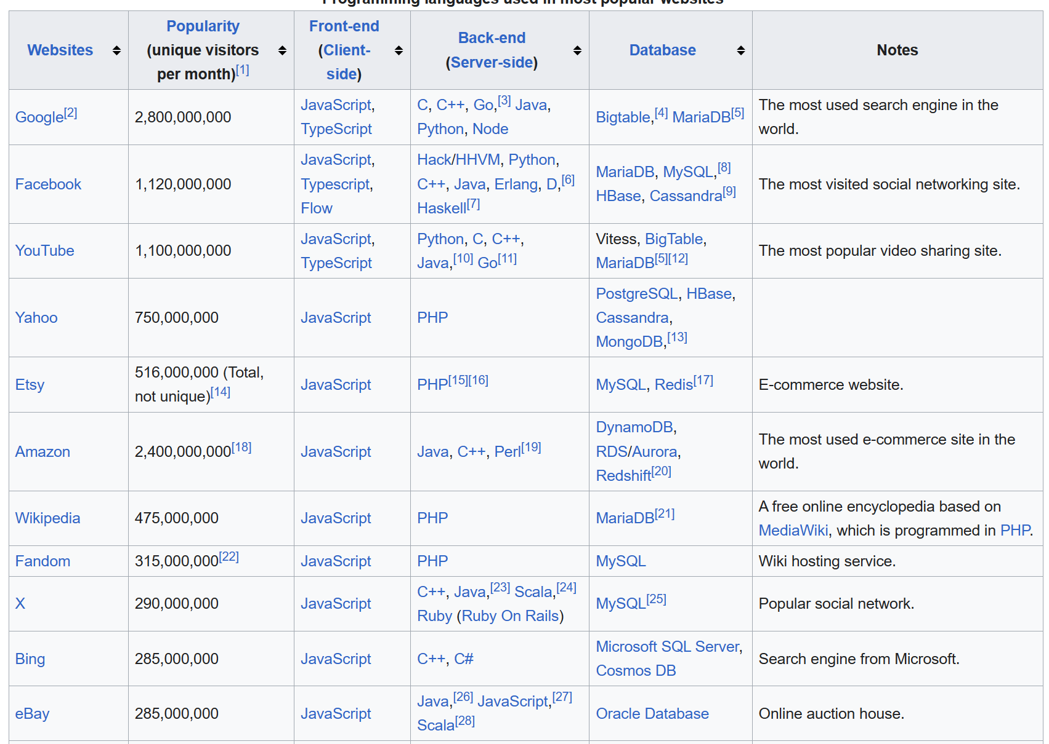
The Most Heavily Trafficked Websites
https://en.wikipedia.org/wiki/Programming_languages_used_in_most_popular_websites

Slide 4
Top Back-End Languages / Frameworks
Compiled
Interpreted
C++ / Various Custom Frameworks
C# / ASP.Net
Java / JSP, Spring, others
Go / Gin, Beego, others
PHP
Ruby on Rails
JavaScript / Node+Express
Python / Django, Flask

Slide 5
Advantages of Interpreted Languages
Instant updates – faster testing
Simpler development environments
Popular, lots of support and examples
Same front-end and back-end language (with JavaScript/Node)
Platform independence – portability
Debugging may be easier to set up

Slide 6
Advantages of Compiled Languages
Compile-time error checking
Paired with strong typing in most languages
Robust debugging environments (once you get it set up)
Robust support for multi-threaded environments
Makes better use of multi-core processors
Performance, performance, performance!

Slide 7

Performance Demo
Bing Image Creator

Slide 8
Language Performance
Sieve Primes to 1,000,000 per 15 seconds.
173 Python
366 JavaScript
8977 C#
Performance Boost
366 ÷ 173 = 2.1 JavaScript is approximately 2x faster than Python
8977 ÷ 366 = 24.5 C# is approximately 25x faster than JavaScript
In Perspective
15 ÷ 173 = 0.087 second
15 ÷ 366 = 0.041 second
15 ÷ 8977 = 0.0016 second

Slide 9

Dave Plummer’s Software Drag Race
Uses roughly the same Sieve benchmark but with number of sieves per minute
Also requires compact memory by requiring one bit (not byte) per prime in the array.
Top 5 video
https://www.youtube.com/watch?v=pSvSXBorw4A
Source code
https://github.com/PlummersSoftwareLLC/Primes
Current Results
https://plummerssoftwarellc.github.io/PrimeView

Slide 10
C#, Razor, ASP.Net
C# - Language
Razor – C# code embedded in HTML
ASP.Net – Back-End Framework

Slide 11
.NET Framework / .NET Core
.NET (dot Net) is Microsoft’s modern platform for application development.
.NET Framework is proprietary and runs on Windows
.NET Core is open source and runs on Windows, macOS, Linux, iOS, Android and more.
Multiple languages
C#, Visual Basic, C++, F#, and others
.NET compiles to an intermediate machine code, MSIL. At load time a Just-In-Time (JIT) compiler converts MSIL into the native machine language. Thus, one compiled program can run natively on multiple platforms including x86, ARM, RISC-V, and even microcontrollers.

Slide 12
.NET Application Models
Console App – Portable across Windows, Linux, and MacOS
ASP.Net – Web
MAUI – Graphical User Interface on Android, iOS, Windows, macOS
Unity – Game Development for PC, Mac, Consoles, Mobile

Slide 13

RAZOR Website Demo

Slide 14
Review Questions
Why are compiled languages so much faster than interpreted languages?
When compiled languages are so much faster, why are interpreted languages like Python and JavaScript so popular?
If you were writing small program to do some data conversion for yourself which language would you pick? Why?
If you were building a large-scale application which language would you pick? Why?

