Slide 1
New and Emerging Web Standards IT&C 210B – S37

Slide 2

Invention and Standards

Slide 3
Technological Advances
Many stakeholders develop web technologies
Browser creators
Companies with a vested interest in the Web
Standards organizations (e.g., W3C)
Individuals with a passion
New technologies are created to solve a problem or realize untapped potential
New technologies often build on old ones
Notes:
Many parties are involved in advancing web technologies including browser vendors (and the companies/organizations who support them), companies who sell (or plan to sell) web-related content or services that requires new advances (e.g., games), standards bodies such as the W3 who oversee “open” web-related standards, and individuals with a passion.
New technologies are created to solve a problem, or to realize an untapped potential. For example, jQuery was created to make Javascript easier, particularly for people new to web development. People and organizations innovate in order to make money, make a name for themselves, and/or out of a passion for the topic.
Note that new technologies typically rely on old technologies, though they may replace some as well. Think of a web framework (e.g., Bootstrap), which may rely on common web libraries (e.g., jQuery), which rely on languages (e.g., Javascript), which rely on other existing technologies such as IP/TCP and the rest of the network stack, browsers, etc.

Slide 4
Questions to ask about new technologies
Has someone tried to solve my problem before? (the answer most likely is YES)
What problem is a technology designed to solve?
What alternative solutions are there?
What limitations does the solution have?
How does it relate to other technologies?
Is it developed enough to use?

Slide 5

Open vs. Closed Standards
Open standards – publicly available to read and implement, free, and vendor neutral
E.g., HTML, CSS, WebRTC
Closed standards – owned by company, may or may not be publicly available or free to use
E.g., Flash (Adobe), AWS (Amazon), Quicktime (Apple)
Open Container Standard?
https://www.opencontainers.org
An open standard may still be encumbered by patents
E.g. H.264 (the video encoding behind MP4)
But patents have expired on other formats
E.g. AAC (M4A) and MP3
And patents may be offered under a “free” license.
E.g. AV1
Notes:
An example of an open versus closed standards approach is playing out in 2018 in the “container” space. See https://www.opencontainers.org/ to watch it unfold. The IoT space is also going forward. Another area is platforms for developing mobile apps (e.g., open standards and tools vs., say Apple’s closed tools). See https://www.youtube.com/watch?v=r8ltmwWVuQs for a fun video about OCI.
AV1 is a video coding format created to compete with H.264/MP4. The creators and known patent holders have granted a royalty-free license for its use. This is in contrast to H.264 (AVC) which requires a patent license for implementation. However, implementers worry that there might be an applicable patent that has not been identified. The project started in 2016, standard was established in 2018, a reference encoder was released in 2019. However, hardware assist of the sort available for H.264 is lacking.

Slide 6
Open Standards
Benefits
Challenges
The WWW is an open standards success story because it has led to so much competition
Open standards lead to…
High levels of competition, and thus innovation
Reduction of vendor “lockin” (and monopoly prices)
Better interoperability across systems
Lack of incentives to create and improve open-standards
Slow to develop, since developed by committee
Competing open-standards (e.g., XHTML, HTML5)
May have problems or be too immature

Slide 7



Standardization is Messy
The HTML5 Story:
The W3C formed a committee.
In 2004, standards development work broke down and they suspended meetings.
A consortium of companies formed the “Web Hypertext Application Technology Working Group” (WHATWG) and worked independently on the HTML5 standard.
HTML5 development proceeded at WHATWG with major browsers incorporating pre-standardization features.
Draft finalized in 2011 and handed back to W3C.
Standard approved by the W3C committee in 2014.
But WHATWG continued to make enhancements to a “living standard.”
The W3C formally ceded governance of HTML5 to WHATWG in 2019.

Slide 8
HTML5 Failed to pick Video and Audio Standards
HTML5 includes Video and Audio tags but the formats have not been standardized by WHATWG or W3C.
Until recently, no single audio or video format would support all mainstream browsers
https://en.wikipedia.org/wiki/HTML5_video
https://en.wikipedia.org/wiki/HTML5_audio
Now, due to licensing deals, MP3, M4A, and MP4 are pretty consistently supported.

Slide 9
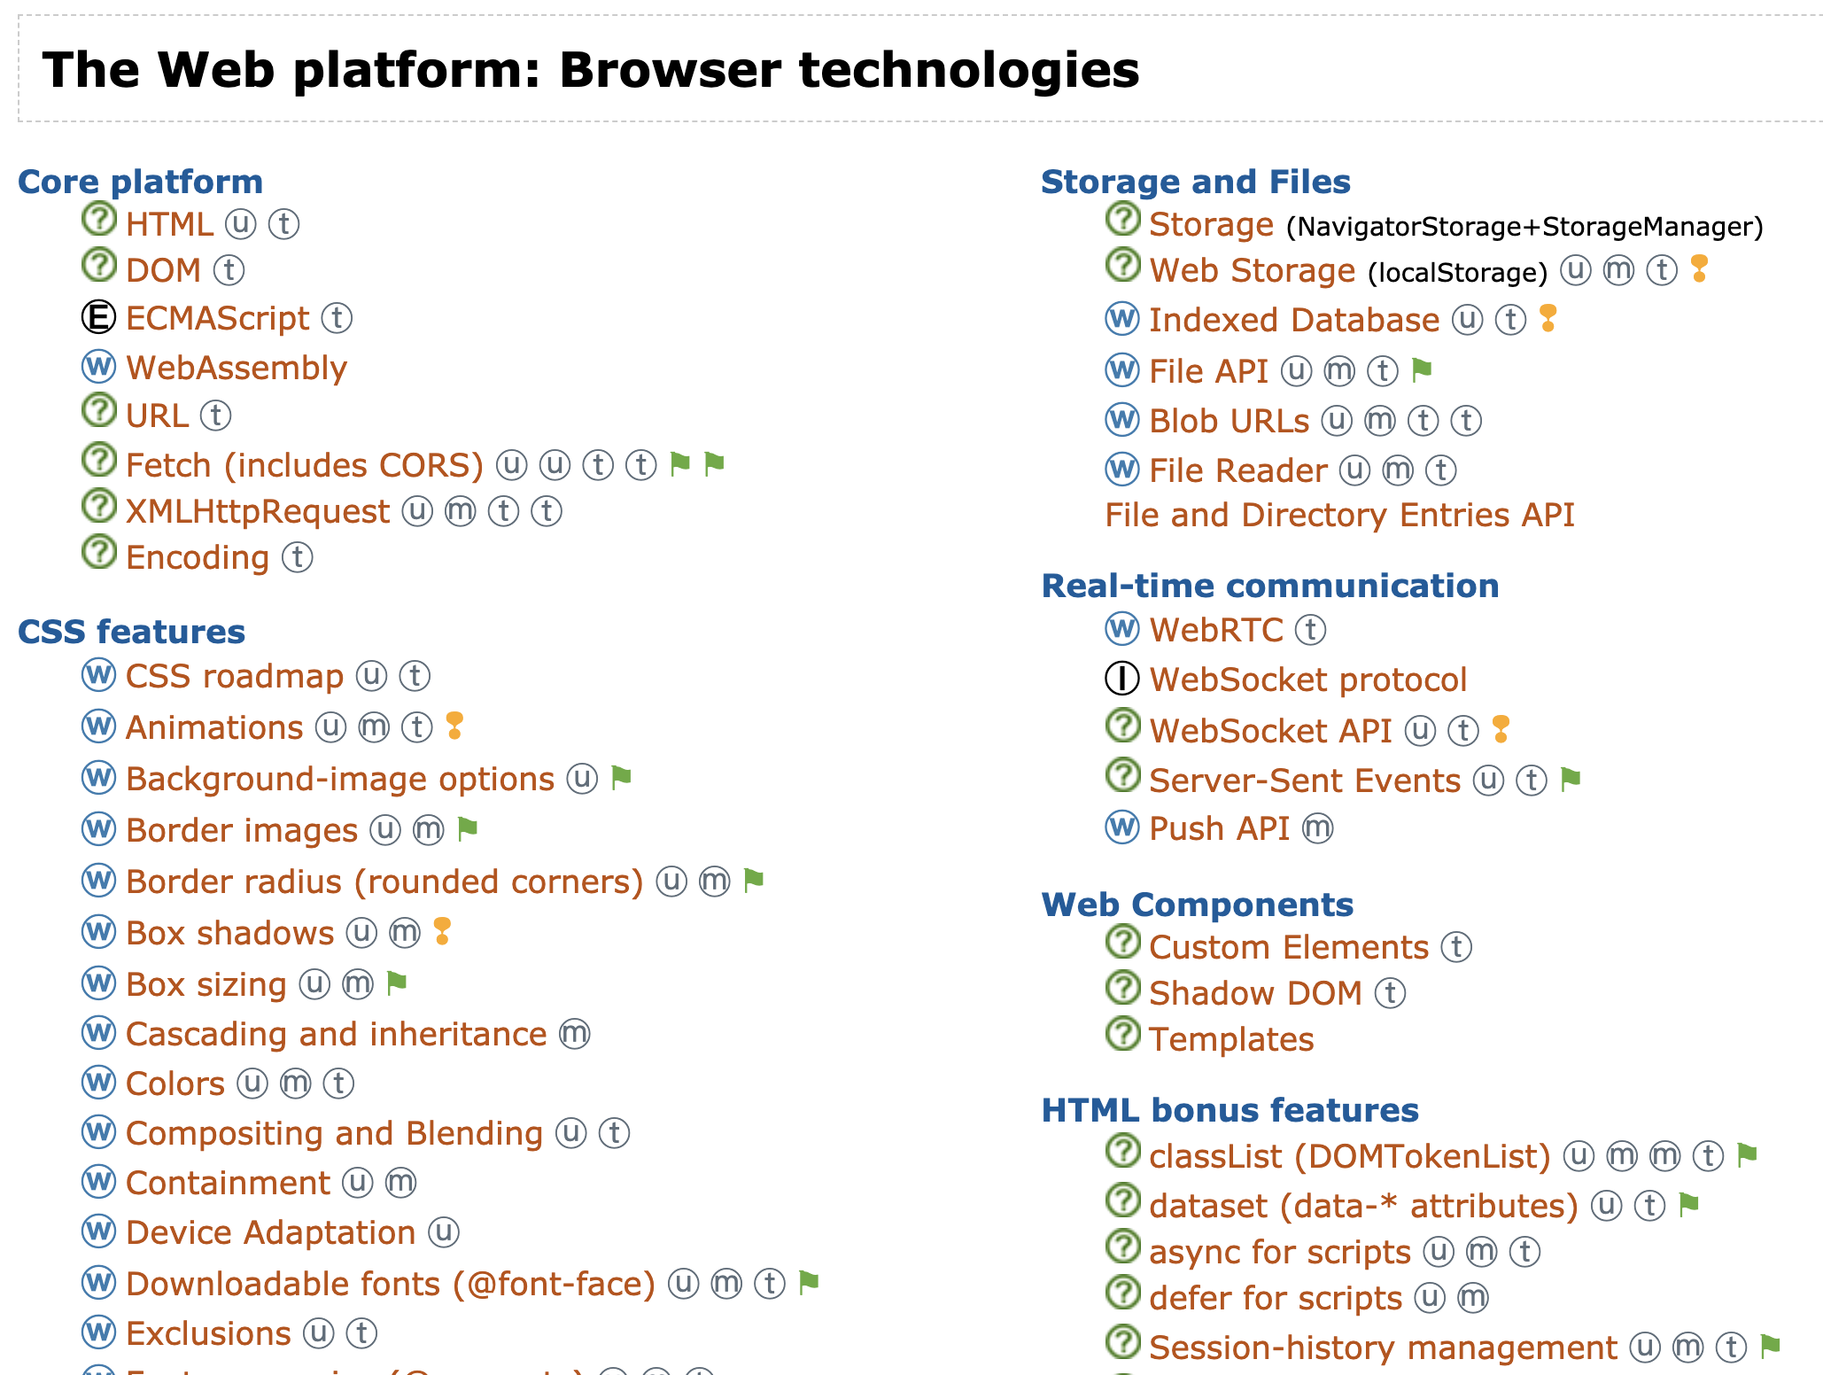
https://platform.html5.org
Notes:
See http://platform.html5.org/ for more…
Makes sure you look at what is currently supported using sites like caniuse (linked to on platform.html5.org – see legend at bottom).

Slide 10
Some of the Latest Web Standards
SVG (Scalable Vector Graphics)
Canvas (Raster Graphics and Drawing)
Web RTC
WebGL (GPU Access from the Web)

Slide 11
SVG
Scalable Vector Graphics (SVG) and Canvas are open standards for drawing and modifying web-based graphics – especially 2D graphics
Replacement for Flash (In part; also see Canvas)
SVG is vector-based
SVG elements (i.e., graphics) are DOM elements and can be created and manipulated in JavaScript.
Notes:
Because SVG is vector-based it scales nicely (e.g., you can print off files with SVG graphics and they’ll look good, not pixelated)
See https://css-tricks.com/lodge/svg/ for lots of videos on SVG
There is an SVG 2 standard that is in the process of getting created: https://www.w3.org/TR/SVG2/

Slide 12
SVG Demo
Hello, world!

Slide 13

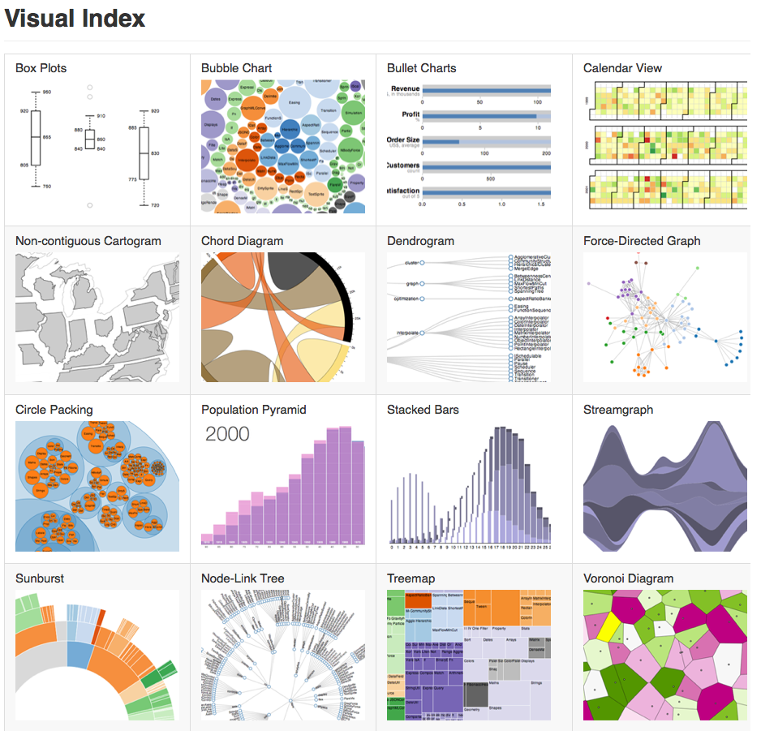
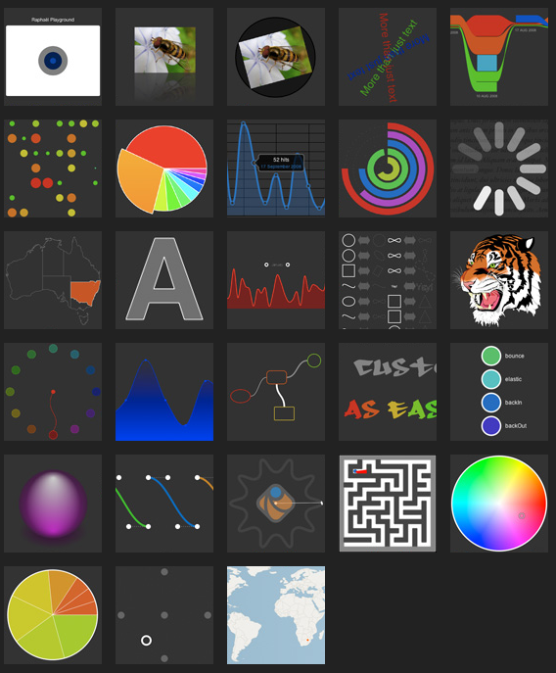
SVG Libraries
d3js.org
raphaeljs.com
Notes:
See http://raphaeljs.com/ and http://d3js.org/ for two examples of SVG-based visualizations.

Slide 14
Canvas
2D Bitmap-Based Graphics
A Canvas is a single DOM element
Like SVG, the canvas can be manipulated in JavaScript.

Slide 15
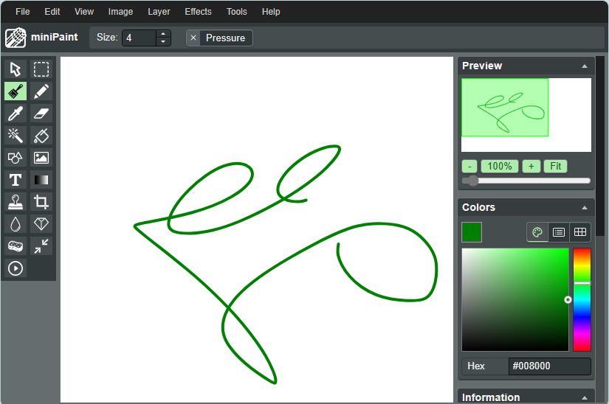
Canvas Demo
https://viliusle.github.io/miniPaint

Slide 16


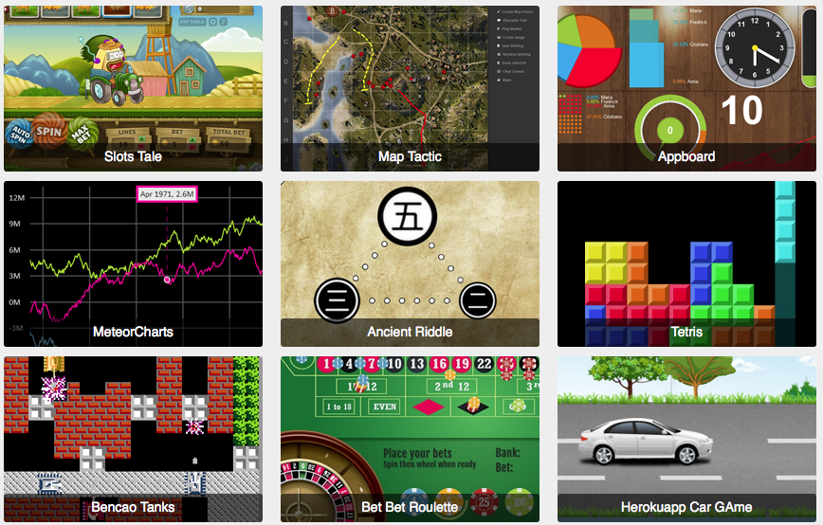
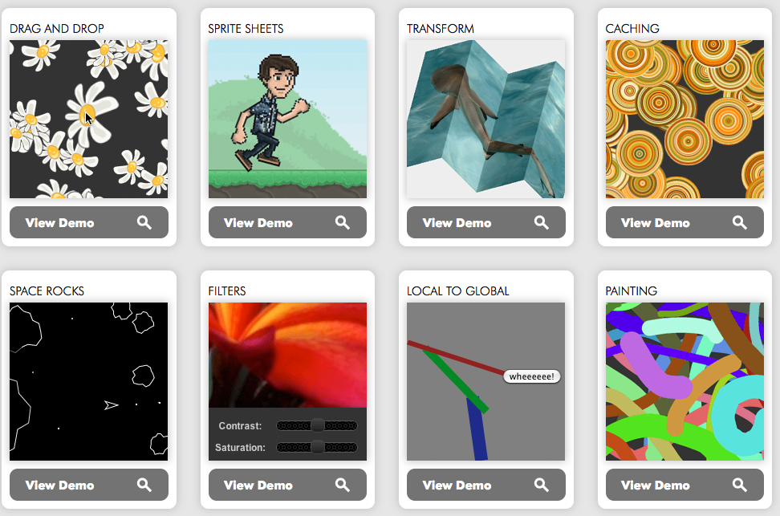
Canvas Libraries

Slide 17
Web RTC
Web RTC – real-time communication protocol with no plugins required for audio/video/data
supports direct peer-to-peer communication
Currently supported by Chrome, Edge (Chromium version), Firefox, Opera
WebRTC 1.0 Working Draft Standard
Utilized by: Google Meetings, Join.me, Facebook Messenger, Google Voice, Discord, Amazon Chime, GotoMeeting
See https://www.webrtc-experiment.com/ for other examples
Notes:
See https://www.webrtc-experiment.com/ for some nice demos.
https://www.cubeslam.com/
https://www.webrtc-experiment.com/Translator/
https://www.webrtc-experiment.com/Pluginfree-Screen-Sharing/#22904705489672494

Slide 18
WebRTC Demo
<div>
<video id="vid1" muted autoplay style="width: 15em; height: 15em;"></video>
<button onclick="capture()">Capture</button>
<script>
async function capture() {
let mediaStream = await navigator.mediaDevices.getDisplayMedia(
{video: {cursor: "always"}, audio: false});
document.getElementById("vid1").srcObject = mediaStream;
}
</script>
</div>

Slide 19
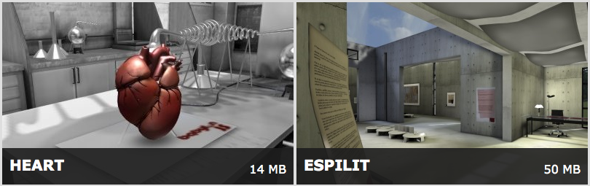
WebGL & WebGPU for 3D Rendering
WebGL and WebGPU – graphics run on your GPU instead of CPU, making it much faster for 3D rendering and other visually-intensive tasks
Three.js and Babalon.js
Notes:
Visit https://threejs.org/examples/ for examples
See https://gpuweb.github.io/gpuweb/ for the new WebGPU specification

Slide 20
WebGL Demo
https://webglsamples.org/aquarium/aquarium.html

Slide 21
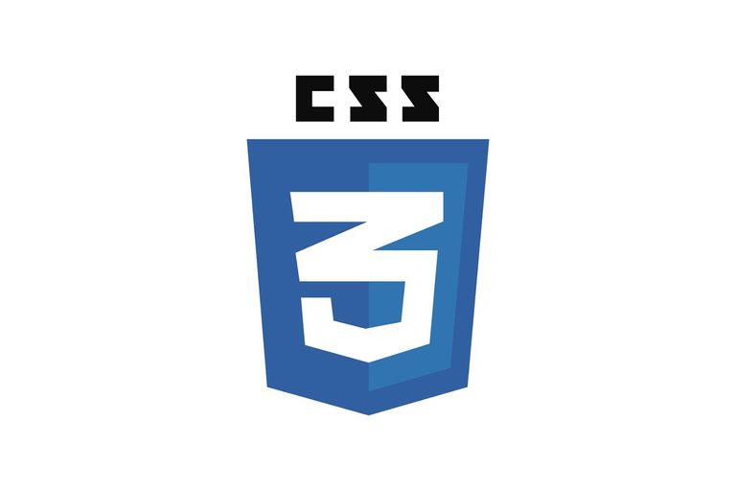
Ongoing CSS Development
CSS3 is now broken into “modules” – each of which is approved individually (e.g., flexbox; grids)
New functionality for improved graphics, interactivity (e.g., animation), etc.

Slide 22
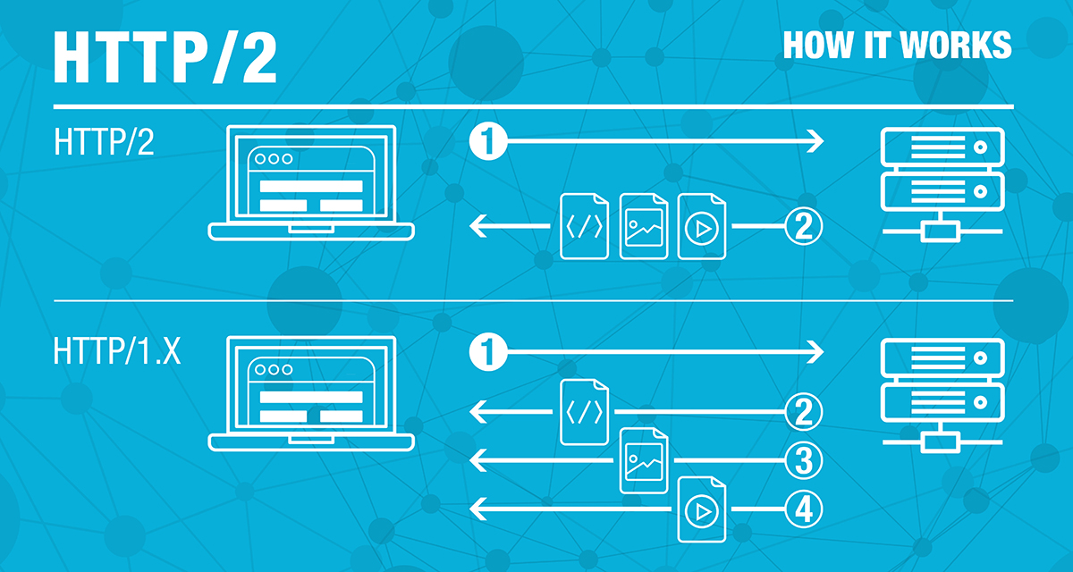
HTTP/2 is a faster implementation of HTTP(S)
It uses binary headers
It allows multiple requests to be made at the same time over a single connection.
See: https://en.wikipedia.org/wiki/HTTP/2
Diagram: https://coolicehost.com/http2-protocol.html
Notes:
See https://developer.mozilla.org/en-US/docs/Web/CSS/CSS3 for an overview of how CSS3 is implemented.
Latest “snapshot” of CSS was in January 2018 and can be found here: https://www.w3.org/TR/css-2018/
See http://codepen.io/pens/ for people’s projects

Slide 23

Other New(er) and Emerging Web Standards
WebSocket (2010)
Stateful connection between browser and server.
Allows push notifications from server to browser.
Web Components (2018)
Create your own custom HTML tags
MathML Core (2024)
Mathematics markup for complex formulas

Slide 24
More: WebAssembly
WebAssembly (2019)
Portable binary code that runs on the browser.
Compiled Languages other than JavaScript running on the browser.
Cannot directly access the DOM or WebGL. Rather, it must call JavaScript which then accesses other functions. Nevertheless, some impressive stuff has been done this way.
https://www.webassemblygames.com/

Slide 25
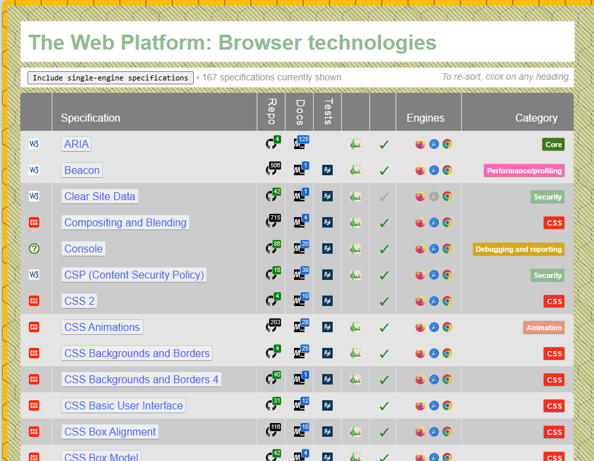
Even More
Directory of Browser Technologies at https://html-now.github.io/
Find out what works at https://caniuse.com
Touch Events
Vibration
Animations
Cryptography
And so on…

Slide 26
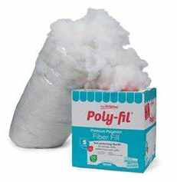
Polyfills
A polyfill is a JavaScript module that adds features to a browser before standardization and native implementations are complete.
Historically: SVG, MathML, Web Components all had polyfill implementations before the final versions came out.
See: https://developer.mozilla.org/en-US/docs/Glossary/Polyfill

Slide 27
Also See…
Web Fundamentals (Google)
Mozilla Developer Network (Mozilla)
Codepen demos

Slide 28
Study Questions
What factors lead to tech change?
What is an open standard and what are the benefits and challenges of using them?
What is WebRTC?
What are SVG and Canvas used for? How are they different?
What is WebGL and when would it be used?
What is common about using each of these? What is distinct?

