Slide 1
GitHub Pages and Jekyll IT&C 210 X1

Slide 2

“No Additional Cost” hosting of static websites.
Automatically generated from the designated branch of a GitHub repo.
Update the site simply by committing or merging to that branch.
Uses Jekyll for page rendering.
Completely free if your repository is public (meaning your source code is visible on GitHub).

Slide 3
Static Website
No Server-Side Code (no PHP, no Node.js, ASP.net etc.)
But you can have build scripts like the default Jekyll or Vue or other static site generators.
Browser-side code is fine (JavaScript etc.)
Through JavaScript, you can still make use of web services (e.g. REST interfaces) hosted by other sites.
You can use browser storage.
There’s an impressive amount you can do without server-side code!

Slide 4
Limits
Strictly static content.
Total site content no larger than 1GB
Soft bandwidth limit of 100GB/month
Soft limit of 10 builds per hour.
Must not be used for e-commerce or commercial (paid) services.
Guidelines
If your site gets popular enough to exceed the bandwidth, consider using a CDN in front of the GitHub pages site.
If you don’t meet the other requirements (too much content, frequent content updates, commercial serves) find a different hosting solution.

Slide 5

Static site generator written in Ruby
“Blog Friendly” – an excellent blogging platform
Uses the Liquid template engine
Supports data-driven site generation
Renders MarkDown and Textile into HTML
Can generate data formats such as JSON and XML
Convenient Docker containers – you don’t have to install Ruby

Slide 6
Creating a GitHub Pages Repo (Without a Custom Domain Name)
Repository name should be “<orgname>.github.io”
E.g. myorg.github.io
It can be another name if you use a custom domain.
If the project name is the same as the owning user or organization then the URL will be at the root of the domain.
Example:
GitHub Organization: myproject
Repository Name: myproject.github.io
URL: https://myproject.github.io

Slide 7
Creating a GitHub Pages Repo
If the project name is NOT same as the owning user or organization, AND you don’t use a custom doman, then the URL will be on a path from the root.
Example:
GitHub Organization: Obadiah
Repository Name: myproject.github.io
URL: https://obadiah.github.io/myproject

Slide 8
Custom Domains on GitHub Pages
Register your domain on any domain registrar.
Get DNS services – often provided free of charge by the registrar.
Follow the GitHub instructions here: https://docs.github.com/en/pages/configuring-a-custom-domain-for-your-github-pages-site
The repo doesn’t have to have a “.github.io” suffix like those on a GitHub domain and you can have several of these in the same organization. (This is not clear in the documentation.)

Slide 9
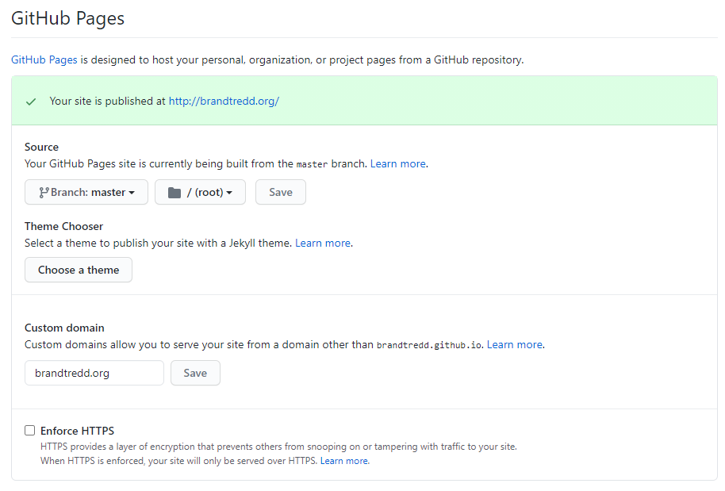
In the repository settings, turn on GitHub pages. You can also configure a custom domain name.

Slide 10
Developing a Site
To make a page go live, you have to commit the changes, push to GitHub, and wait for the site to be re-generated. This can be tedious if you’re trying to get something working.
Alternative is to install Jekyll locally
Install Ruby first
Then a bunch of Gems
Tedious on Mac or Linux even more difficult to get working on Windows
Instructions can be found on the web
Better option: Use Docker Desktop and load the Jekyll docker image – quick and easy.
Starfossen’s github-pages image is an excellent choice.
https://github.com/Starefossen/docker-github-pages

Slide 11
Github Pages / Jekyll Examples
Class website – https://byu-itc-210.github.io
EdMatrix.org – https://edmatrix.org
Brandt’s Bollard Blog – https://bollard.brandtredd.org

Slide 12
Demo
Starting template is on GitHub at: https://github.com/BYUJekyllDemo/BYUJekyllDemo.github.io
View the produced GitHub Pages site at: https://byujekylldemo.github.io/

Slide 13
References
Getting Started with GitHub Pages
Jekyll Documentation

