Slide 1
Addressing the IP Address Shortage

Slide 2
Problem
2^32 = 4,294,967,296 Possible IP Addresses
Many IP addresses are wasted due to subnet overhead.
The number of devices connected to the internet is expected to exceed 30 billion in 2024.
How is this possible? It seems like we should have used up all IP addresses a long time ago!

Slide 3
Four Ways to Remedy IP Address Shortage
Network Address Translation (NAT)
Dynamic Address Assignment (DHCP)
Classless Inter-Domain Routing (CIDR)
IPv6 – Change the Address Space

Slide 4
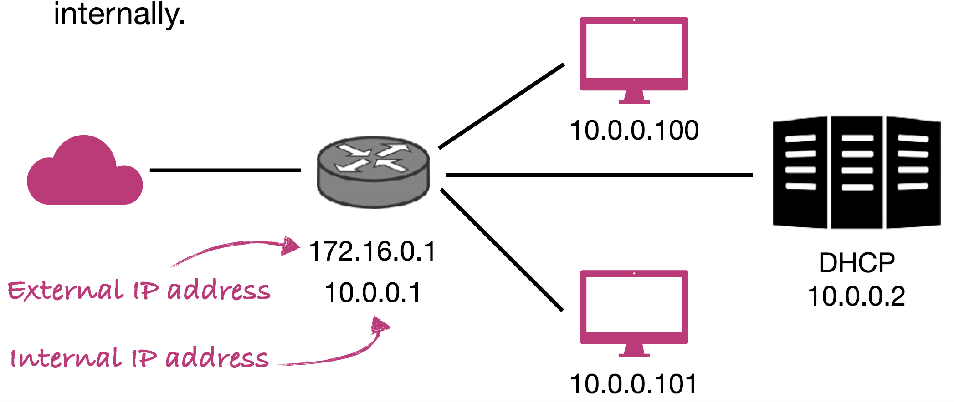
Network Address Translation (NAT) “hide” lots of devices behind one Public IP Typically uses the port number on the router to determine which internal host.
Notes:
Network Address Translation is a method for connecting multiple devices to the Internet when there is just one “public” IP address. Think of it like a company that has one main phone number, with many ”internal” extensions that can be used.
The DHCP Server shown in the image helps assign dynamic IP addresses to the various hosts.

Slide 5
Private IP Address Ranges
Network ID | Address Range | Number of Addresses | Notes
10.0.0.0/8 | 10.0.0.0 - 10.255.255.255 | 16,777,216 | Mostly used for corporate internal networks.
172.16.0.0/12 | 172.16.0.0 - 172.31.255.255 | 1,048,576 | Least commonly used. A good candidate for when you need something distinct.
192.168.0.0/16 | 192.168.0.0 - 192.168.255.255 | 65,536 | Commonly used for home networks, but usually with a /24 subnet mask.
169.254.0.0/16 | 169.254.0.0 - 169.254.255.255 | 65,536 | Autoconfiguration range. (Usually means DHCP has failed.)
127.0.0.0/8 | 127.0.0.0 - 127.255.255.255 | 65,536 | Loopback address (talking to yourself). Typically, you use 127.0.0.1 but 255 addresses are available.
Notes:
Note: you’ll be using the loopback often in your labs since you have the same IP address for your server and client running on your same virtual machine.
Also note that your IP address at home or when you are on the IT networks likely has a private address – since it is getting assigned by your ISP or the IT network.
Lab computers are 192.168 etc, remember from htaccess?

Slide 6
DHCP (Dynamic Host Configuration Protocol)

Slide 7
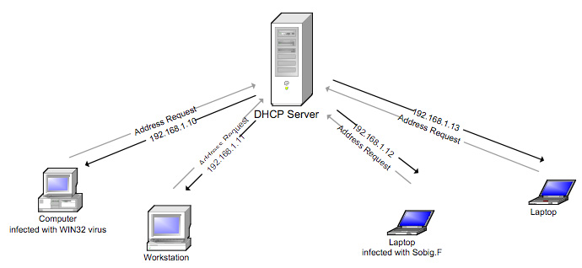
DHCP* Dynamically Assigns an Address to a Computer.
*DHCP = Dynamic Host Configuration Protocol
Notes:
Static addresses don’t change, while dynamic are assigned on the fly by ISPs or routers or DHCP servers (e.g., on your local network). Notice that the IP addresses begin with 192.168 because that is a “private” reserved block of addresses.

Slide 8
DHCP Supplies to the Computer…
An IP Address: Typically in a private range but ISPs provide public addresses via DHCP.
The Subnet Mask: So that devices can tell what part is the network ID and what part is the computer address.
Lease Timeout: The time at which a device must renew the address or get a new one.
Default Gateway: The IP address, on the local network, of a router that can get to other networks.
DNS Server Addresses: Address of a provided DNS server to translate domain names into addresses.
Optionally
DNS Suffix: Added to host names that don’t include a top-level domain.
Extended information such as Microsoft NetBIOS and Active directory info.

Slide 9
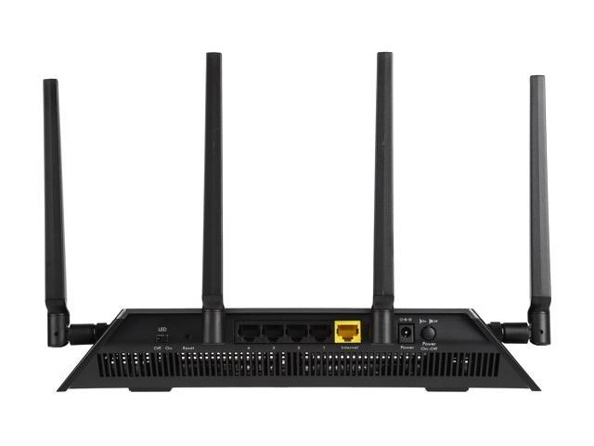
Typical Home Router
Wireless Access Point
Switch (LAN Ports)
Router (WAN Port)
Firewall
NAT
DHCP
Notes:
A home router is actually multiple devices combined into one box.

Slide 10
CIDR (Classless Inter-Domain Routing)

Slide 11
Anatomy of an IPv4 Address
IP Address: 169.232.46.133 10101001.11101000.00101110.10000101
Subnet Mask: 255.255.240.0 11111111.11111111.11110000.00000000
Network ID: 169.232.32.0 10101001.11101000.00100000.00000000
Host ID: 0.0.14.133 00000000.00000000.00001110.10000101
Network ID
Host ID
CIDR* “Slash” Notation
20 = number of 1’s in the subnet mask. May range between 1 (unlikely) and 31.
IP Address: 169.232.46.133/20
*CIDR = Classless Inter-Domain Routing

Slide 12
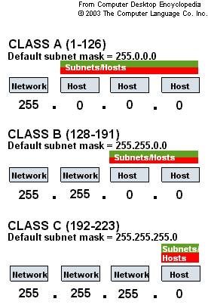
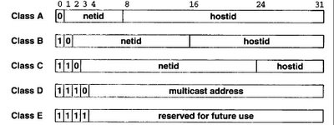
Classful IP Address Assignment
Abandoned in 1993 in favor of CIDR in order to avoid wasting so many IP addresses.
Notes:
Originally, classful addressing was used. There were 3 main classes of IP addresses: A, B, and C. There were 126 Class A networks, each of which could handle 2^24 hosts on their networks. There were far more Class B networks, but they could only handle 2^16 hosts. Likewise, there were many more Class C addresses, but they could only handle 2^8 hosts. This “classful” addressing scheme was not a very efficient way to allocate IP addresses, since they had to be allocated in just 3 different sized blocks. As a result, the Classless Inter-Domain Routing (CIDR) addressing scheme was invented, which allows an IP address to

Slide 13
Classless Inter-Domain Routing (CIDR
CIDR (Classless Routing)
Subnet Classes (Classful Routing)
Each subnet has a custom subnet mask.
Subnet mask can be any size between 1 and 31 bits.
Allows network administrators to optimize address allocations within their space.
Current state of the practice
Three pre-defined subnet classes (8, 16, and 24 bits).
Subnet class is dictated by the first 8 bits of the IP address.
Fixed-size allocations leads to wasted addresses.
Abandoned in 1993

Slide 14
IPv6 Internet Protocol Version 6

Slide 15
IPv6: More Addresses
IETF Draft Standard since 1998
IP addresses are expanded to 128 bits
Yields a possible 2.4 x 10³⁸ Possible addresses.
In comparison, there are roughly 7.4 x 10²⁷ grains of sand on earth.
Subnet mask is fixed. The first 64 bits are the Network ID and the second 64 bits are the Host ID.
Address Notation
Numbers are hexadecimal where IPv4 notation uses decimal.
2001:0db8:0000:0000:0000:8a2e:0370:7334
Network ID
Host ID
You can omit one string of zeros from the address. This is the same as above.
2001:0db8::8a2e:0370:7334

Slide 16
If it’s been around for more than 20 years, why hasn’t IPv6 caught on?
Requires expensive upgrades to every router on the internet.
Core routers, ISP routers, home routers and more.
Early deployments were plagued by bugs and incompatibility.
IPv4 is familiar and convenient.
Network Address Translation alleviated the pressure to convert.
Nevertheless:
A majority of core traffic on the internet now goes over IPv6. It’s usually translated to IPv4 at the edges.
The IANA has essentially run out of IPv4 addresses to give to Internet Service providers. So, new providers will be moving to IPv6.
June 6, 2012, the Internet Society held the “World IPv6 Launch Day” where IPv6 went from isolated tests to permanent deployment.

Slide 17
Summary: Addressing a Shortage of IPv4 Addresses
Network Address Translation (NAT)
Many devices share the same public IP address
Dynamic Address Assignment (DHCP)
Only give addresses to devices that are actively connected.
Limit the period (lease time) for which the device owns the address.
More efficient use of addresses.
Classless Inter-Domain Routing (CIDR)
Recovers wasted IP addresses letting organizations customize subnet sizes as needed.
IPv6 – Change the Address Space
Enough addresses to last a very long time.

Slide 18
IP Addressing Demo

Slide 19
Demo
ipconfig (Windows)
ipconfig
ipconfig /? (displays help)
ipconfig /all
ipconfig /release (releases all DHCP address reservations)
ipconfig /renew (renews all DHCP address reservations)
ipconfig /flushdns (clears the local DNS cache)
ipconfig /displaydns (displays the cache of DNS lookups)
ifconfig (Linux)
route print (windows)
route (Linux)

Slide 20
What your computer needs to know in order to connect to the internet.
IP Address: 192.168.123.48
Subnet Mask: 255.255.255.0
Default Gateway: 192.168.123.1
DNS Servers: 208.67.222.222 208.67.220.220
You can configure these manually, but your computer typically gets them from a DHCP server.
Look at your own address, is it public or private?
Now go to http://www.whatismyip.com and see if your public address is the same. If they’re different (most likely) it will be the address of a router performing Network Address Translation (NAT) on your connection.

Slide 21
What if my computer is connected to more than one network?
It will have one address for each network it is connected to.
An internal software router decides which network each packet should go to.
Routers always have multiple IP addresses, one for each port.

Slide 22
Internal Routing
Layer 3: Which Network Adapter should be used by this packet?
Is the address local to one of my adapters?
Can the adapter deliver to this address?
Is it the lowest metric of those that can deliver?
Layer 2: Shared Medium (Ethernet, Wi-Fi, CSMA/CD)
Which MAC address should I send the packet to?
Sending direct or to a gateway?
If on the local network use the IP address of the packet.
If not, use the IP address of the default gateway.
Check the MAC address cache.
Broadcast an ARP query (Address Resolution Protocol)
Layer 2: Point to Point Protocol (PPP)
Just send the packet and let the router at the other end figure out the next hop.

Slide 23
References
RFC 1518 - An Architecture for IP Address Allocation with CIDR
RFC 1519 - Classless Inter-Domain Routing (CIDR): an Address Assignment and Aggregation Strategy
RFC 2373 - IP Version 6 Addressing Architecture
Notes:
Remember, standards and protocols are what make the Internet work. They’re simply things we all agree on.

Slide 24
Study Questions
What are the two parts of an IP address?
How do you divide the IP address into the two parts?
What are four ways for dealing with the shortage of IPv4 addresses?
Does the classless inter-domain routing (CIDR) system save or waste more IP addresses when compared with the “classful” system.
What organization coordinates the assignment of IP addresses?
Can you keep your IP address when your computer moves between networks?
How many unique IP addresses are there in IPv4 and IPv6 (roughly)?

