Slide 1
Installing and Booting Operating Systems
BYU IT&C 344 – S01

Slide 2
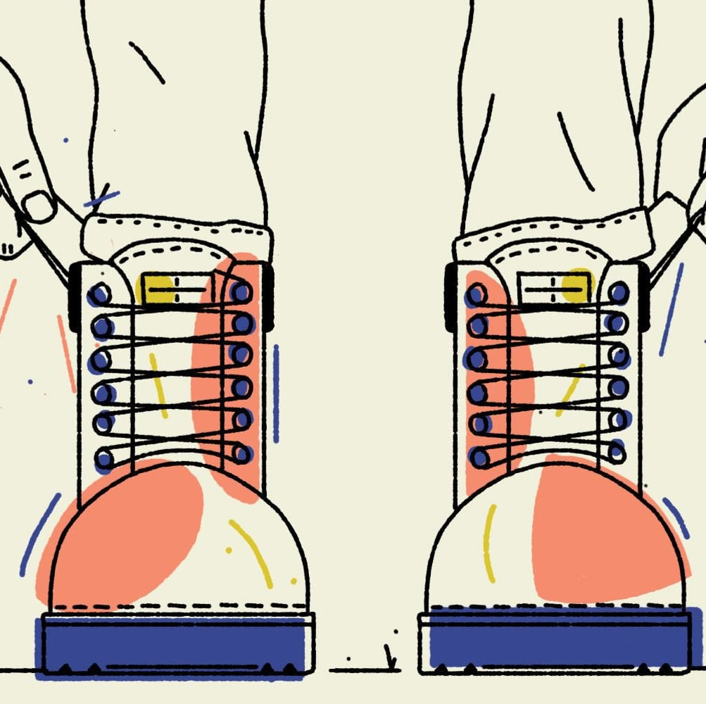
Booting an Operating System
“Boot” is short for “Bootstrap”
“Bootstrap” refers to pulling oneself up by their bootstraps (which is, of course, impossible).
https://www.huffpost.com/entry/pull-yourself-up-by-your-bootstraps-nonsense_n_5b1ed024e4b0bbb7a0e037d4

Slide 3
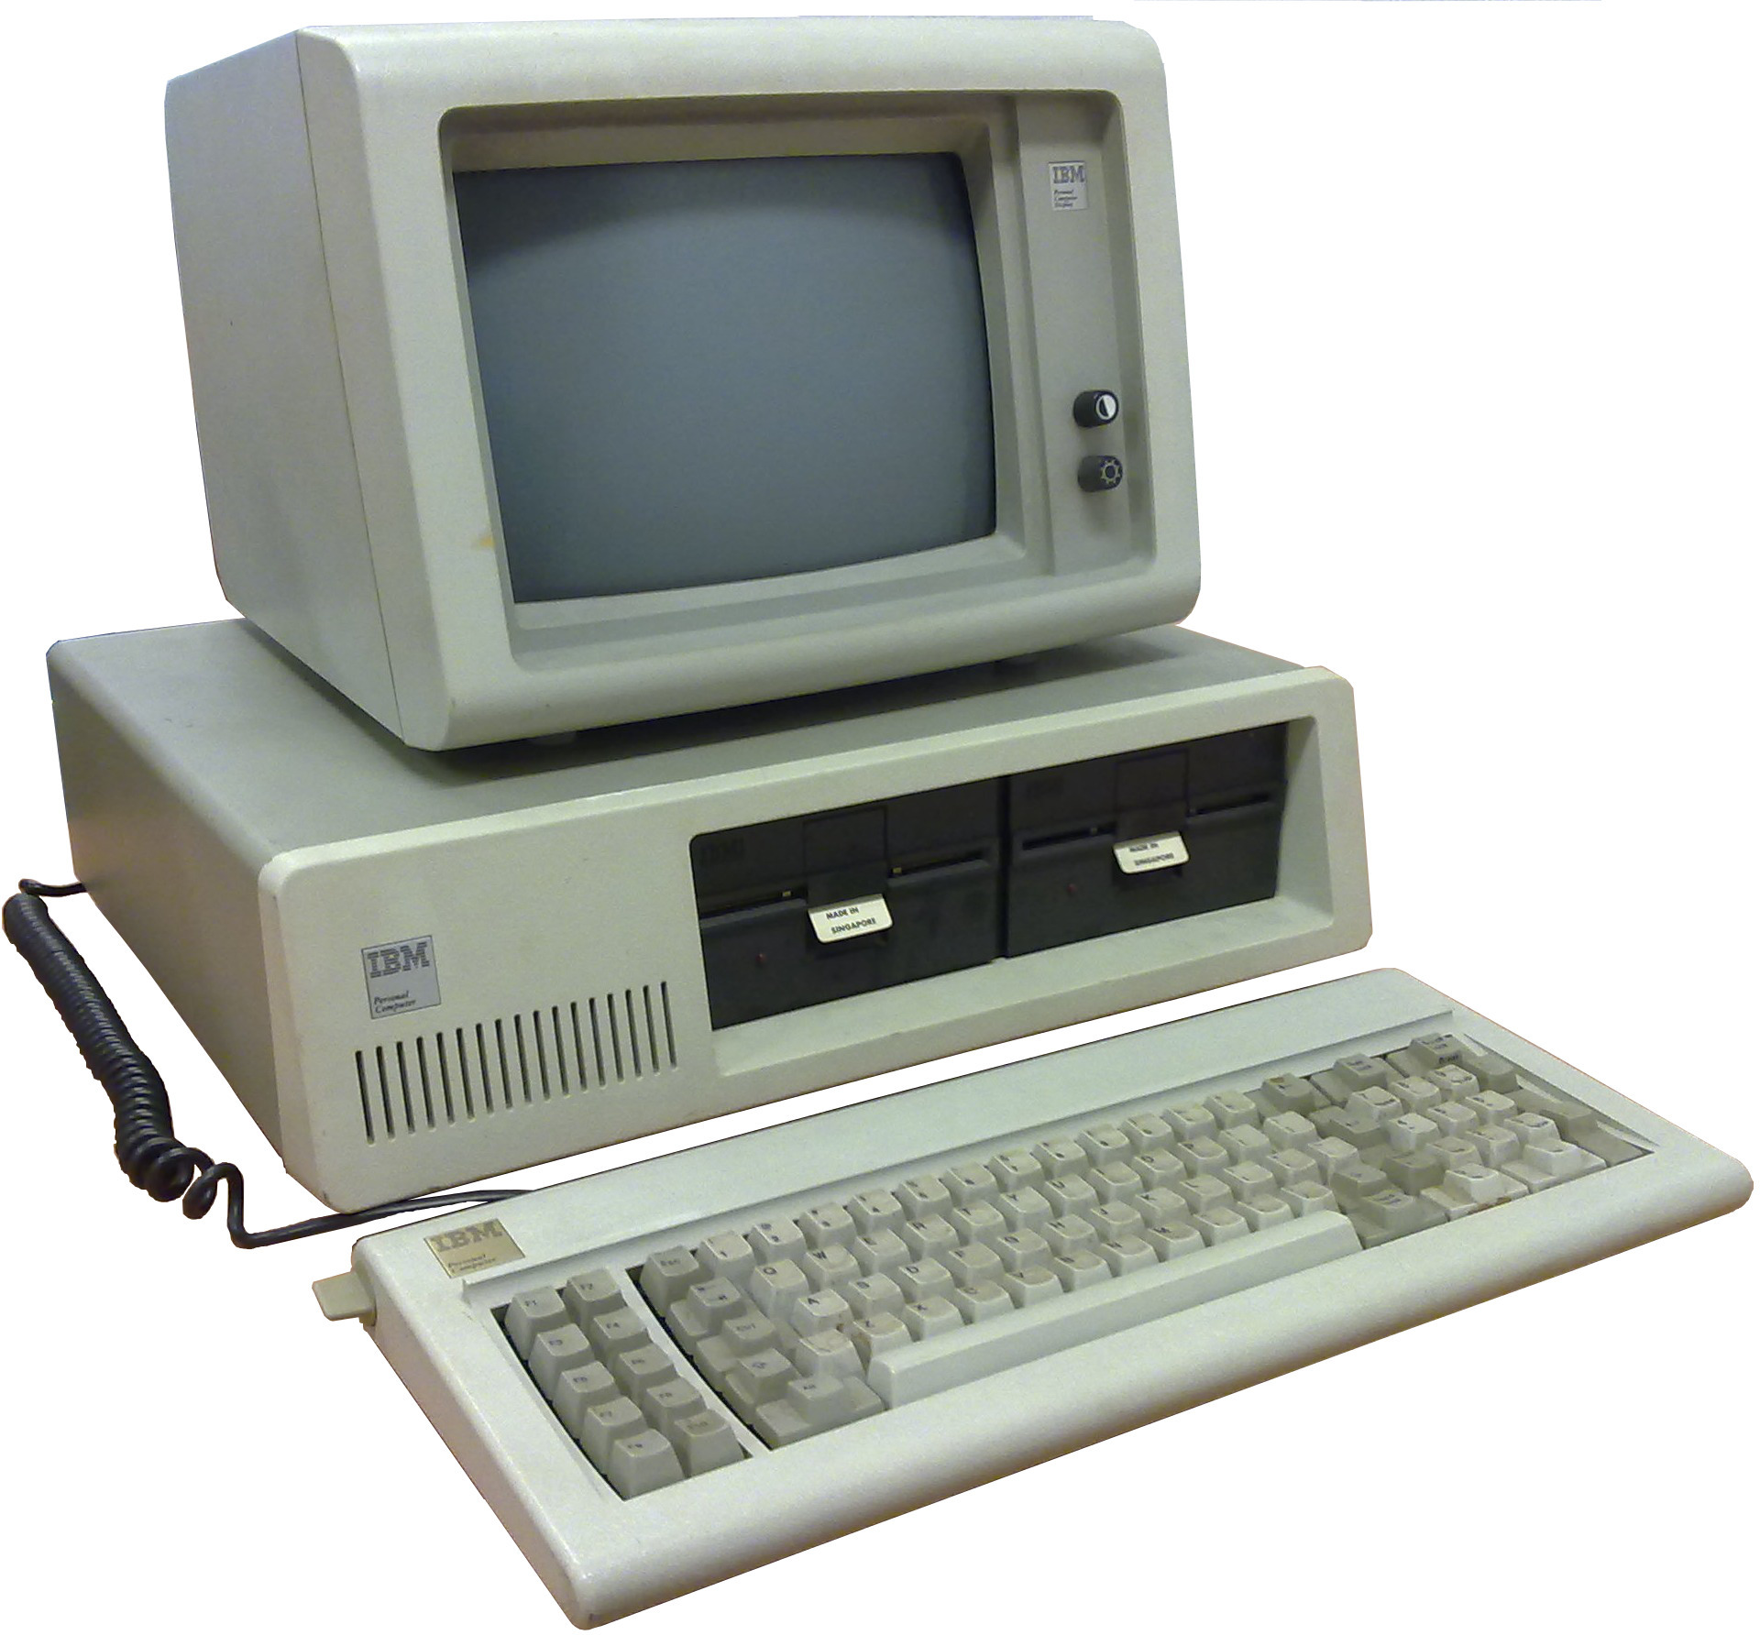
Booting
The BIOS is code contained in read-only memory on the motherboard.
Early PCs had just enough code in the BIOS to read the first sector of the hard drive (the “boot sector”) and run that code.
The boot sector had just enough code to read the OS loader from a file in the right place on the drive (or floppy disk).
The OS loader loaded the balance of the code and launched the operating system.
https://commons.wikimedia.org/wiki/File:Ibm_pc_5150.jpg

Slide 4
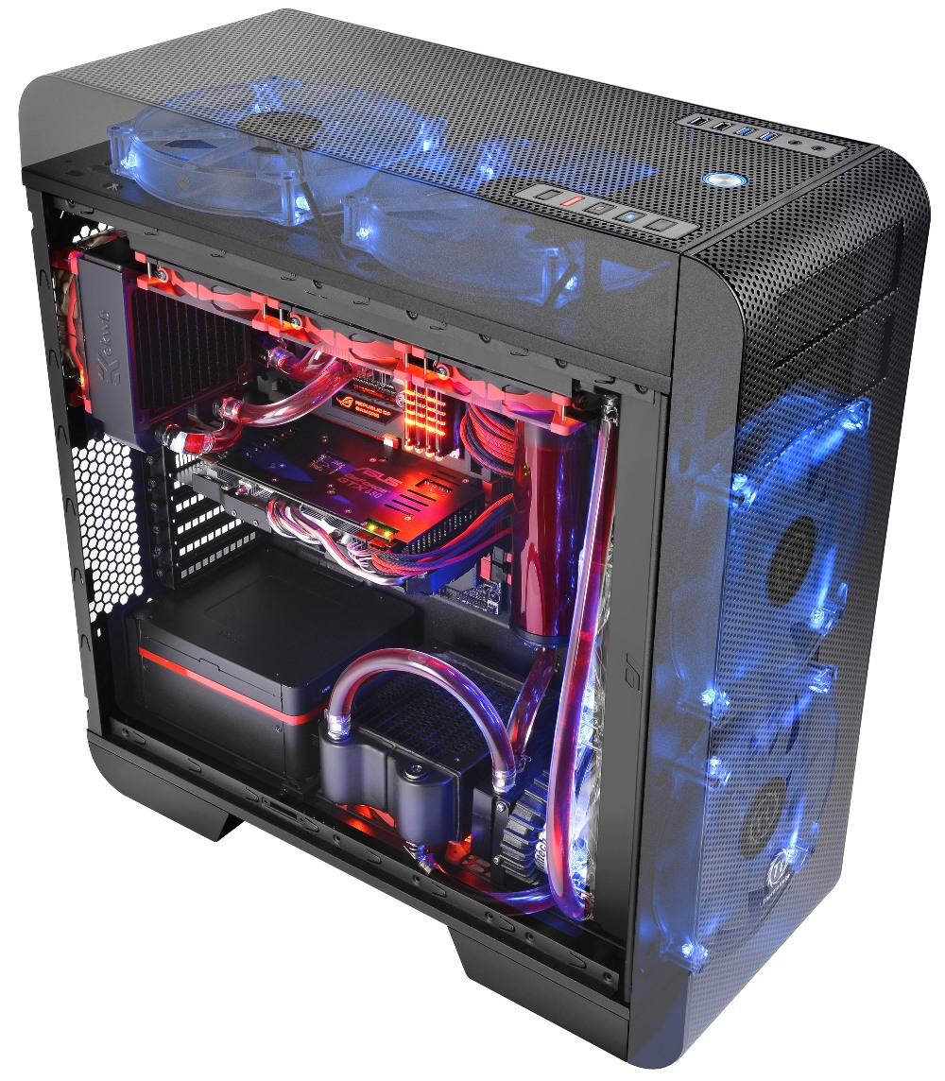
Contemporary Booting
The process is still mostly the same even though contemporary computers have a lot more in their BIOS.
On an x86 processor, booting occurs in 16-bit “Real Mode”. Once the kernel is loaded (whether Windows, Linux, or something else) it switches to 32-bit or 64-bit “Protected Mode.”
https://cerebral-overload.com/2014/01/thermaltake-releases-innovational-full-tower-pc-case-core-v71/

Slide 5
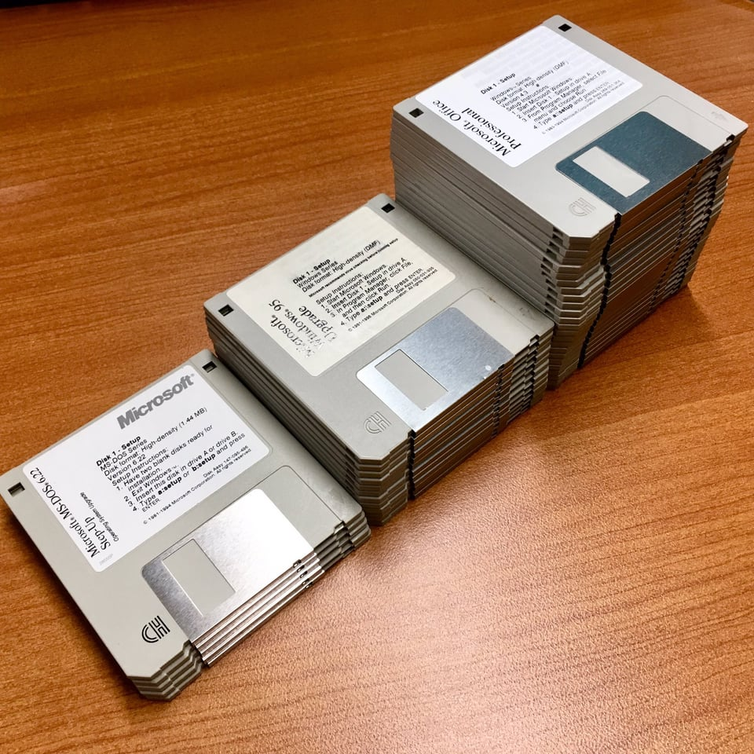
Installing an Operating System
The OS installer itself requires a minimal operating system.
The installation OS boots from physical installation media.
These days, you usually prepare a bootable USB Drive
Previously, you installed from a CD or DVD
Historically, you installed from a stack of floppy disks.
When installing to a virtual machine, we install from an ISO file which is simply an image of a CD or DVD.
The VM treats the ISO file as if it were an actual CD or DVD inserted into a drive.
https://www.reddit.com/r/nostalgia/comments/d1xki9/the_many_floppy_disks_used_to_install_microsoft/
DOS 6.22: 5 floppies
Windows 95: 13 floppies
Office Pro: Lots!
Notes:
ISO stands for “International Standards Organization”. They define thousands of standards. ISO 9660 is the standard for file system used on CD ROM disks and the .iso extension became associated with a disk image despite there being hundreds of other ISO standards that also apply to your computer. In fact, contemporary disks usually use the UDF file system rather than ISO 9660.

Slide 6
PXE Boot – Over the network!
PXE = Preboot eXecution Environment
Useful for an operating system image on lots of computers (like in a lab)
Useful for storage-less computers
Can be the basis of a high-security environment where computers have no local storage.

Slide 7
Demos

