Slide 1
VMs and Containers
IT&C 344 – S02

Slide 2
Virtualization
App A
App A
App B
Bins/ Libs
Bins/ Libs
Bins/ Libs
App A
App A
App B
App A
App A
App A
App B
App B
App A
App A
Guest OS
Guest OS
Guest OS
Virtualization Software
Bins/ Libs
Bins/ Libs
Bins/ Libs
Virtualization Software
Bins/ Libs
Bins/ Libs
Guest OS
Guest OS
Guest OS
Host OS
Host OS
Virtualization Software
Host Hardware
Host Hardware
Host Hardware
Virtual Machines (Type 2 Hypervisor)
Containers
Hypervisor (Type 1)

Slide 3

Windows Sandbox
Bundled with Windows Pro
A temporary VM that goes away when you exit
A great place for accessing suspicious websites or software
Also to avoid bloat from certain products (e.g. Adobe) 😬

Slide 4
VMCeption
Hardware running Proxmox
Your VM
Classmate’s VM
Windows
Ubuntu
Arch
Windows
Ubuntu

Slide 5
Virtual Machine States
VM Image
Virtual Machine (Running)
Snapshot
Disk Image
Config-uration
Boot
Disk Image
Config-uration
Save
Disk Image
Config-uration
Memory
HW
State
Memory Image
HW
Image
Configuration:
Processor (type, # of cores)
Memory
Mounted volumes (e.g. ISOs)
Network Connections
Simulated hardware (video, removable drives, etc.)

Slide 6
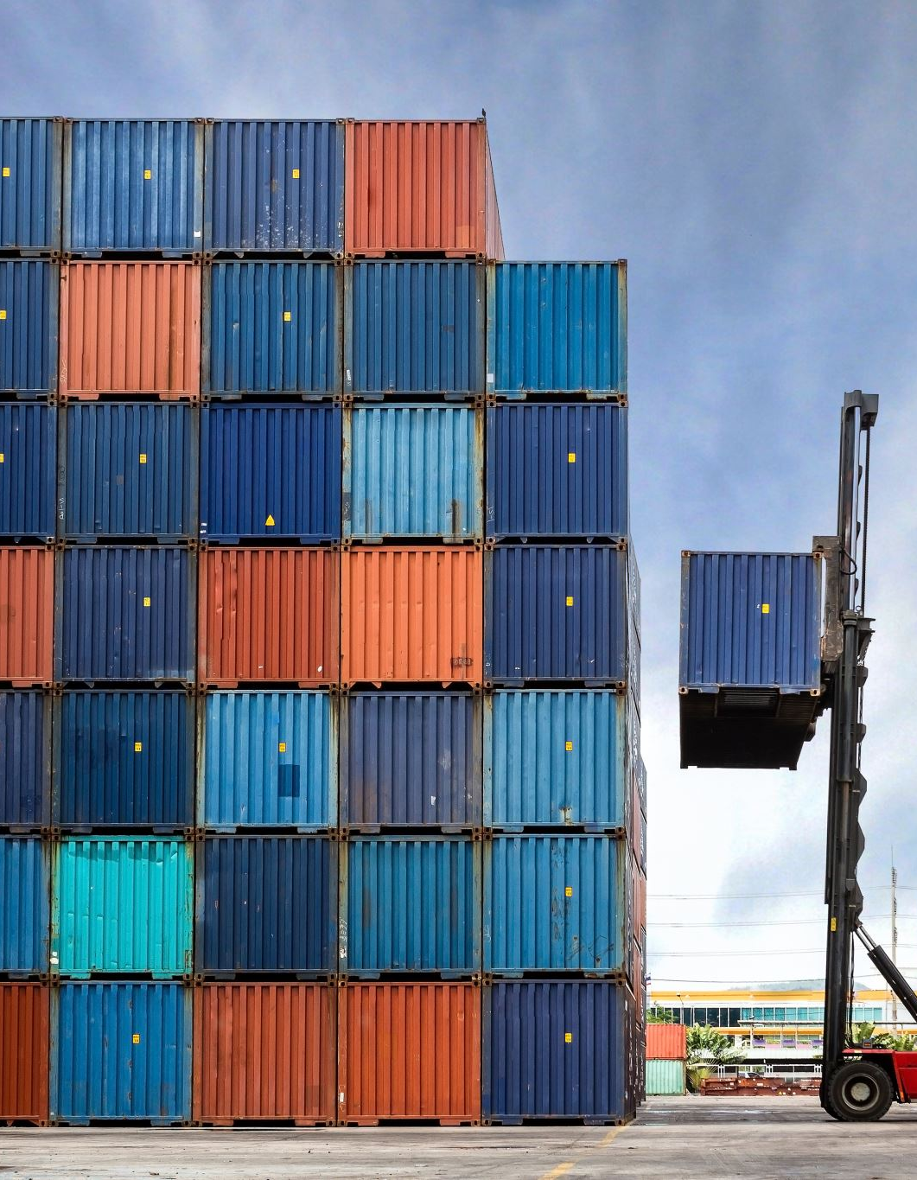
Containers
Most commonly used with Docker
Open Container Initiative (OCI) ensures compatibility between containerization software.
E.g. A container image built with docker will run on Podman

Slide 7
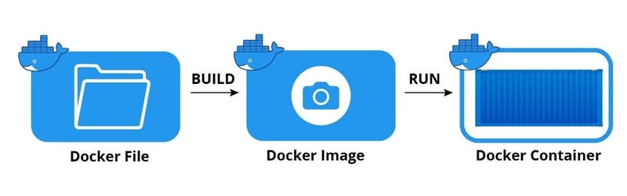
https://dev.to/paschalogu/how-i-deployed-my-website-as-a-container-3fje

Slide 8
Container Properties
Operating System
Linux
Windows
Architecture
386 (32-bit)
amd64 (x86 64-bit)
arm32
arm64
By default, the architecture will be the same as your computer. So if you build on MacOS, you’ll get arm64 architecture.

Slide 9
Docker Commands
docker run
Run a container, possibly mapping ports and volumes, possibly executing a command.
docker ps
Show running containers
-a: Show all containers
docker container prune
Remove all stopped containers
docker compose up
Start a compose file that may have multiple containers, virtual networks and so forth.
-d: run detached
docker compose down
Stop a running set of containers
-v: Delete all volumes (clean up)

Slide 10
Docker Hub
The default library of container images
Others exist and you can make your own
Create an account and you can push images to Docker Hub and run them easily, anywhere.
Container naming
namespace/name:tag
Namespace and tag are optional. Namespace is usually your docker hub userid. Tag is often (but not always) a version number.

