Slide 1
Account and Resource Management 2 Access Control
IT&C 344 – S05

Slide 2



Access Control Elements
Permissions*
Users
Assets
Files, Folders, Computers, Devices, Database Tables, etc.
Groups
*A Role is a named set of permissions

Slide 3

User or Account
An entity that can log into the system with a credential.
Typically, a person but can be an agent such as another computer or a software package.

Slide 4

Group
A named set of users

Slide 5

Asset and Privilege
A user or group can be granted privileges on an entity.
Privileges may depend on the type of entity.
E.g. Files have read, write, and execute privileges
Groups may have read and update privileges
A set of privileges composes a role

Slide 6

Windows
A user may belong to zero or many groups
A user must be in the administrators group to be able to manage groups, privileges, and other users among other things
Files and directories have an owner which may be a user or group. The owner can change other privileges
Users and groups can be granted specific sets of privileges to files and folders.
By default, a file or folder inherits the permissions of its parent directory.

Slide 7

Linux (and most other Unix variants)
Every user must belong to at least one “default” group.
Users may belong to other groups.
There is a default user called “root” that has global administrative privileges.
By default all other users operate with limited privileges.
The “sudo” command can elevate a command to be run with elevated privileges. A user or a group they belong to must be listed in the “sudoers” configuration file to be able to use “sudo”.

Slide 8
Linux file privileges
Each file and directory has an owner and a group.
The group is the default group of the owner.
You can grant read, write, and execute privileges to the owner, to the group, or to everyone.
You can enable access control lists (ACLs) which allows specific privileges to be assigned to individual users and groups as with Windows. But ACLs are more difficult to administer than the default model.

Slide 9



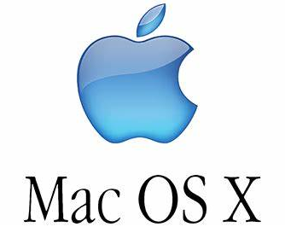
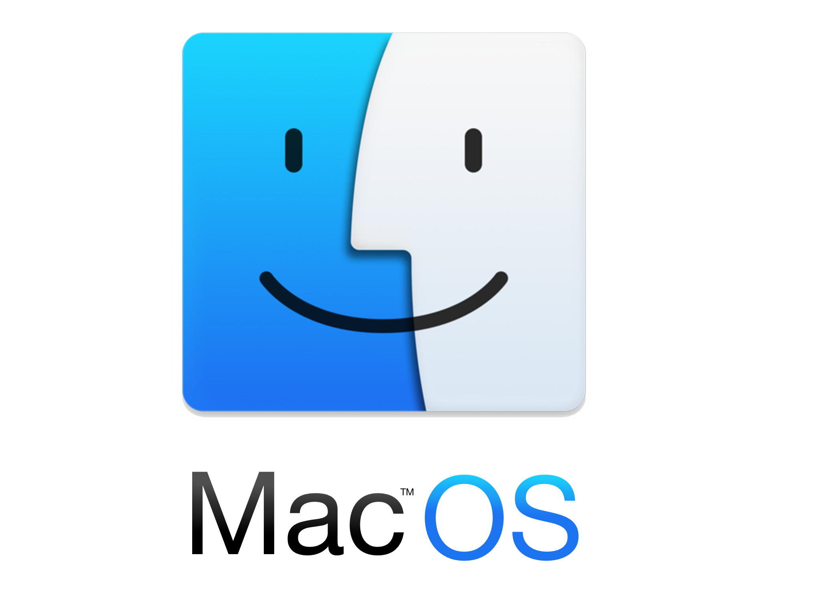
What about MacOS?
In essence, it works just like Linux because OS X is a Unix derivative.
GUI tools to make access controls more friendly.
Mach kernel

Slide 10
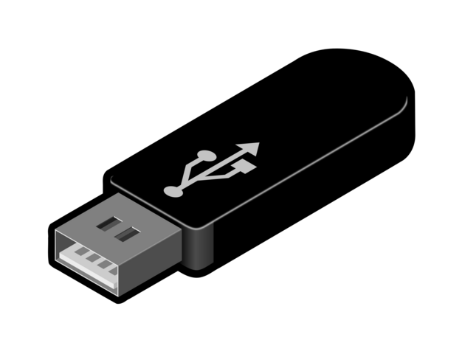

Flash drives and thumb drives?
Typically, thumb drives are formatted with a FAT file system (FAT, FAT32, EXFAT). These file systems do not store privileges and so all files are accessible to all users.
You can format flash drives with other file systems. More on this when we get to the unit on file systems.

