Slide 1
Backup Planning
IT&C 344 – S06

Slide 2
CIAAN
Integrity
Which are protected by backups?
Confidentiality
Availability
Nonrepudiation
Authentication

Slide 3
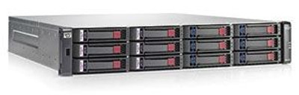
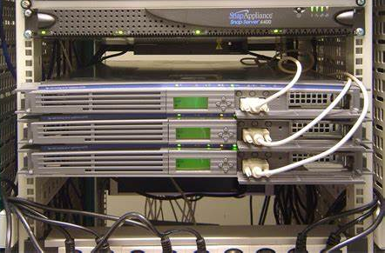

Redundancy vs. Backup
RAID: Redundant Drives
Redundant Servers
Redundant Data Centers
Notes:
RAID keeps systems up when there’s a hardware failure. It doesn’t substitute for backup because data corruption gets replicated across the RAID drives. Likewise, ransomware can encrypt the contents of a RAID setup.
Redundant servers can sometimes substitute for backup if each server keeps a full and independent copy of the files. However, it’s vulnerable to a physical problem such as a natural disaster.
If you place the redundant servers in different data centers (located in different earthquake zones) then you can have a substitute for backup.

Slide 4





Types of Backups
Image Backup
Full image or only sectors in use
File-by-file backup
Differential backup
Items changed since last full backup
Incremental backup
Items changed since last full or incremental backcup

Slide 5
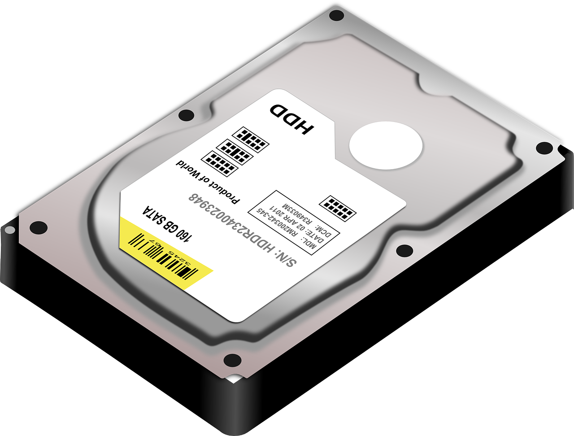
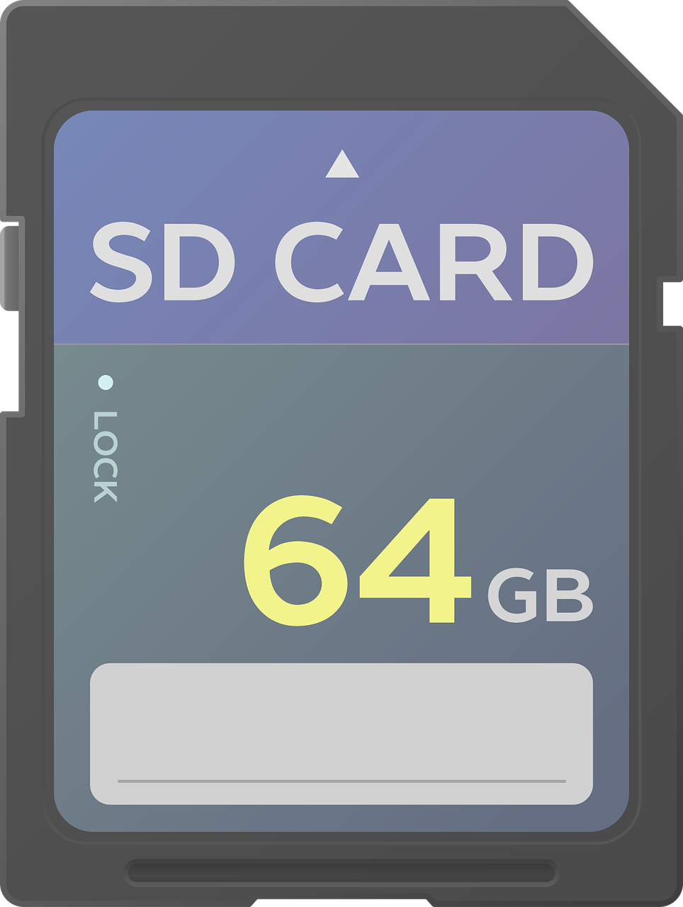

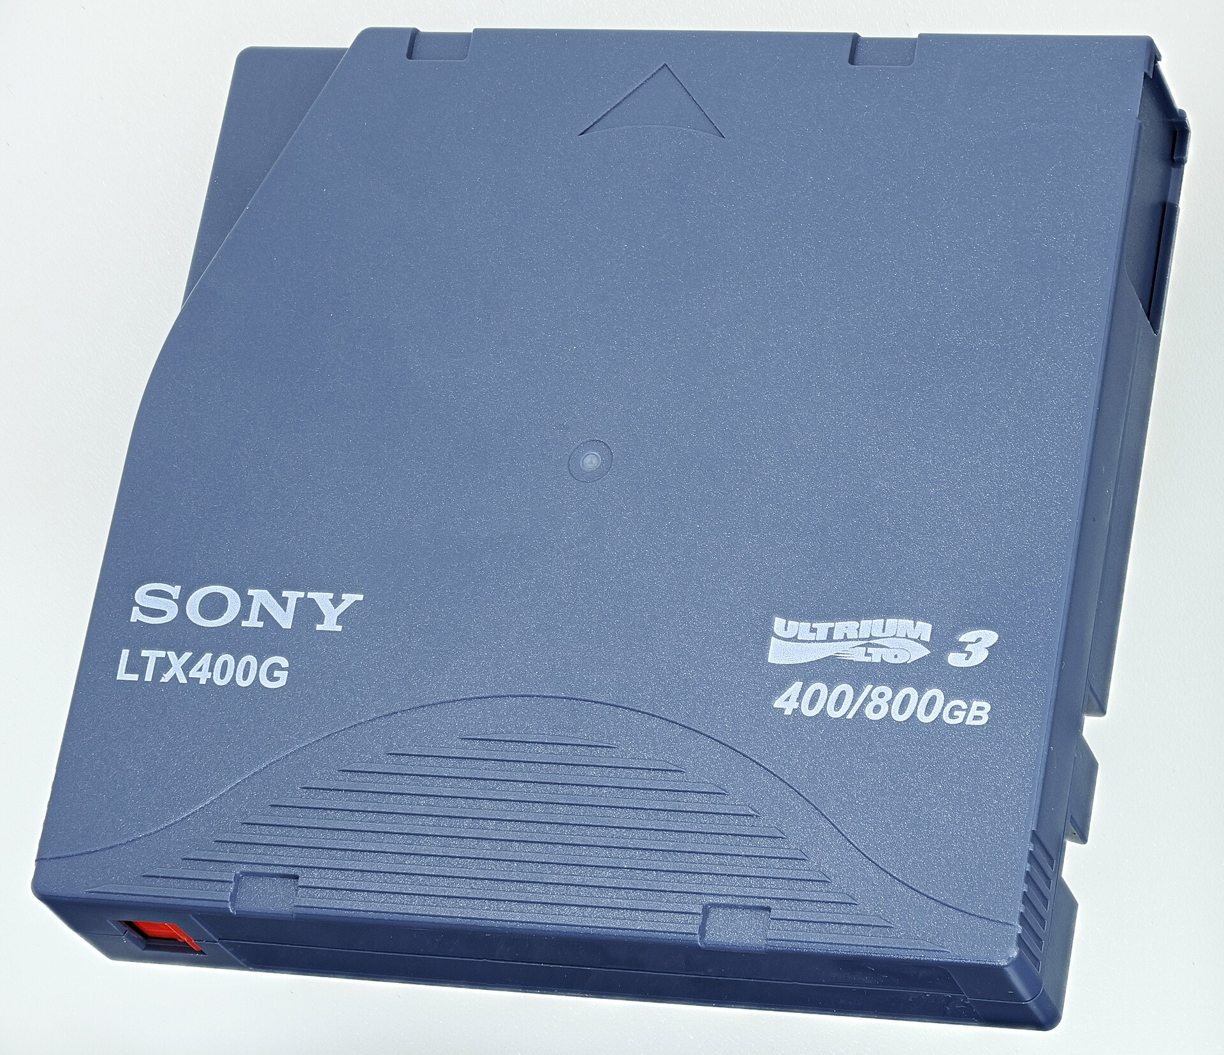
Backup Media
Hard drive (hot swappable)
Flash media
Optical media
Magnetic tape
(Pixabay)
(Pixabay)
(Wikimedia Commons)
(Wikimedia Commons)

Slide 6
LTO Tape
“Linear Tape Open”
LTO-8
12 TB Uncompressed, 30 TB Compressed
9.25 hours to read or write the whole tape
LTO-9
18 TB Uncompressed, 45 TB Compressed
12.5 hours to read or write the whole tape
(Wikimedia Commons)

Slide 7

No cost to upload.
0.4 cents per month per gigabyte storage cost.
Approx 1 cent per gigabyte retrieval cost.
Cost depends on how rapidly you want the data back. Standard is three to five hours.
Similar services from other vendors. E.g. Azure Archive Storage

Slide 8

Database Backup
A database may be constantly writing data
A conventional backup of the database file will not be consistent unless you shut down the database for the backup.
Accordingly, database servers have built-in “Hot Backup” features.
Database servers also keep a transaction log.
You can restore a database to any point in time by restoring the most recent full backup and then replaying the transaction log up to the desired point.
Notes:
Implications. If you don’t do periodic full backups, the transaction log gets really big.
Transaction logs may also need to be backed up.

Slide 9
Backup Planning: What do you need to consider?
How much data?
Where are the backups physically located?
Earthquake zones.
Fire protection.
How are the backups secured?
Do they contain sensitive data?
What does it take to restore from backup?
Are passwords or keys needed?
Do they use special media?
How long to restore from backup?
Notes:
Agilix – we had so much data online that it would take 30 days to restore from backup.

Slide 10

Components of a Backup Plan
Data Assessment: What data need to be backed up
Types of Backup: Which methods (image, full, incremental, differential) should be used with each dataset.
Backup Frequency: Continuous, daily, weekly, etc.
Backup Media: Disk, Flash, Optical, Tape, Online
Off-Site Storage
Restoration Testing: Periodically test your ability to restore backups.
Security: Physical security, Encryption and Key Management

Slide 11

Backup Lab
You will set up one VM as a backup server and four VMs to be backed up.
A “troll” will attempt to corrupt your system. You will use your backups to maintain integrity.
You submit a writeup of your lab activity.
Kickoff today.

