Slide 1
Modern Operating Systems
IT&C 344 – S07

Slide 2

Final Project
You will form teams of 3-4 people
You may select your own team members or join a pool to be assigned to a team.
Four Graded Components
Working Project
Final Presentation
Documentation
Peer Evaluation (must be submitted by all team members)
Project Options
Create your own Linux Distro
Create a Kubernetes Cluster
Modify an Operating System to contain needed Tools
Create a Resource Monitoring Dashboard
Build a Process Scheduling Simulator
Another OS-related project as approved by your instructor.
Details will be posted in LearningSuite shortly

Slide 3

Operating System history is mostly useful for understanding why certain features were developed and where they appear on our systems.

Slide 4
OS | Year | Mem Space | Reg Size | Kernel | Task Model | CLI | GUI | Network | File Systems | Other
PC-DOS | 1981 | 20 bit 640K | 16 bit | DOS | Single-Tasking | command.com |  |  | FAT
MS-DOS 3.1 | 1984 | 20 bit 640K | 16 bit | DOS | Single-Tasking | command.com |  | 3rd Party | FAT FAT16
Windows 1.0 | 1985 | 20 bit 640K | 16 bit | DOS | Single-Tasking | command.com | Windows | 3rd Party | FAT FAT16 | Not very usable
Windows 3.1 | 1992 | 20 bit 640K | 16 bit | DOS | Cooperative Multitasking | command.com | Windows | NBF | FAT FAT16 | First popular
Windows 95 | 1995 | 32 bit | 32 bit | DOS | Preemptive Multitasking | command.com | Windows | NBF IP | FAT FAT16 | More reliable
Windows 98 | 1998 | 32 bit | 32 bit | DOS | Preemptive Multitasking | command.com | Windows | NBF IP | FAT FAT16, 32 | Plug-and-play hardware
Windows XP | 2001 | 32 bit | 32 bit | NT | Preemptive Multitasking | cmd.exe | Windows | NBF IP | FAT12, 16, 32 NTFS | Extremely popular
Windows Vista | 2006 | 48 bit | 64 bit | NT | Preemptive Multitasking | cmd.exe | Windows | IP | FAT12, 16, 32 NTFS | Document Search Enhanced Security
Windows 7 | 2009 | 48 bit | 64 bit | NT | Preemptive Multitasking | cmd.exe PowerShell | Windows | IP | FAT12, 16, 32 NTFS | The “fixed” version of Vista.
Windows 8 | 2012 | 48 bit | 64 bit | NT | Preemptive Multitasking | cmd.exe PowerShell | Windows | IP | FAT12, 16, 32 NTFS | Tablet-Centric UX
Windows 10 | 2015 | 48 bit | 64 bit | NT | Preemptive Multitasking | cmd.exe PowerShell | Windows | IP | FAT12, 16, 32 NTFS, ReFS | WSL, WSL2
Windows 11 | 2021 | 48 bit | 64 bit | NT | Preemptive Multitasking | cmd.exe PowerShell | Windows | IP | FAT12, 16, 32 NTFS, ReFS | Enhanced hardware security
Notes:
NBF=NetBIOS frames. NetBIOS is a session-layer API while NBF is a Microsoft transport protocol supporting NetBIOS. In contemporary Windows installations, NBF has been replaced by NBT which is NetBIOS over TCP/IP.

Slide 5
OS | Year | Mem Space | Reg Size | Proc Family | Kernel | Task Model | CLI | GUI | Network | File Systems
MacOS | 1984 | 24 bit | 32 bit | 68000 | MacOS | Single- Tasking |  | QuickDraw |  | MFS
MacOS System 2.1 | 1985 | 24 bit | 32 bit | 68000 | MacOS | Single- Tasking |  | QuickDraw | AppleTalk | HFS
MacOS System 4.0 | 1987 | 24 bit | 32 bit | 68000 | MacOS | Task Switching |  | QuickDraw | AppleShare | HFS
MacOS System 6 | 1988 | 32 bit | 32 bit | 68000 | MacOS | Task Switching |  | QuickDraw | AppleShare | HFS
MacOS System 7 | 1991 | 32 bit | 32 bit | 68000 PowerPC | MacOS | Cooperative Multitasking |  | QuickDraw | AppleShare | HFS
MacOS System 8.1 | 1997 | 32 bit | 32 bit | PowerPC | MacOS | Cooperative Multitasking |  | Platinum | AppleShare IP | HFS+
Mac OS 9 | 1999 | 32 bit | 32 bit | PowerPC | MacOS | Cooperative Multitasking |  | Platinum | AppleShare IP | HFS+
Mac OS X | 2001 | 32 bit | 32 bit | PowerPC | Darwin | Preemptive Multitasking | Bash | Aqua | IP | HFS+
MacOS Tiger | 2005 | 48 bit | 64 bit | PowerPC x86 | Darwin | Preemptive Multitasking | Bash | Aqua | IP | Extended HFS+
MacOS Catalina | 2019 | 48 bit | 64 bit | x86 | Darwin | Preemptive Multitasking | Zsh | Aqua | IP | APFS
MacOS Big Sur | 2020 | 42 bit | 64 bit | x86 ARM | Darwin | Preemptive Multitasking | Zsh | Aqua | IP | APFS
MacOS Sequoia | 2024 | 42 bit | 64 bit | ARM | Darwin | Preemptive Multitasking | Zsh | Aqua | IP | APFS

Slide 6
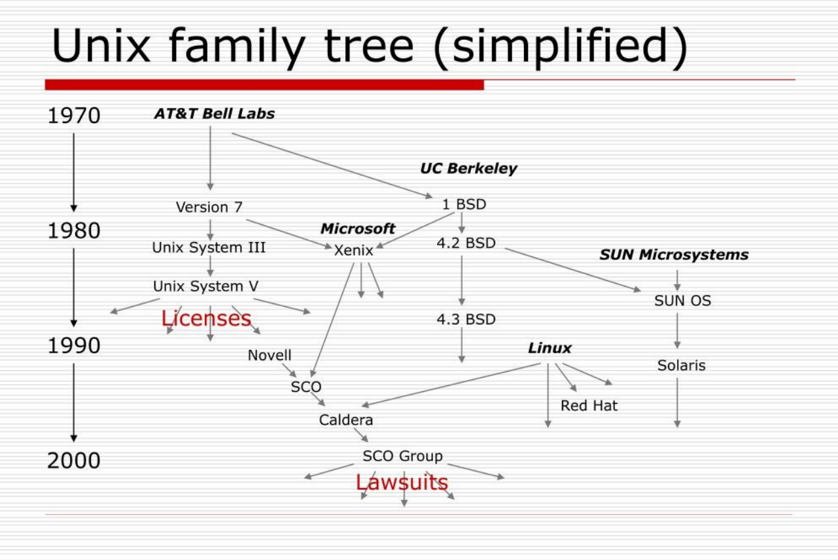

Slide 7
Unix / Linux Important Branches as of 2024
Linux
Open source kernel independently developed by Linus Torvalds
Most distros use the Gnu Project utilities
Basis of Android OS
BSD / FreeBSD
Open source kernel independently developed at UC Berkley
Basis of MacOS Darwin, Base OS for PfSense and OpnSense
Also uses the Gnu Project utilities
UnixWare
The only remaining distribution that is based on copyrighted Unix source code.
Small market share. Limited to 32-bit operations.

Slide 8
Task Models
Single Tasking
Single Tasking with Task-Switching
Cooperative Multitasking
Preemptive Multitasking

Slide 9
File Systems
Hierarchical Folders
MacOS: Data fork and Resource fork
NTFS: Multiple Streams
Access Controls

Slide 10
Command-Line Interfaces
DOS: command.com -> cmd.exe
Windows: PowerShell
Unix / Linux:
sh – Bourne Shell)
bash - “Bourne Again Shell”, open source
zsh – Z Shell, enhanced bash
csh, tcsh – C Shell
Others: fish, dash, ksh

Slide 11
Networking
Third-Party
Novell: Primarily focused on file servers and printer sharing
Proprietary
Microsoft NetBIOS/NetBEUI
AppleTalk, AppleShare
Standardized and Interoperable
IP (TCP/IP)

