Slide 1
File System Basics
IT&C 344 – S10

Slide 2
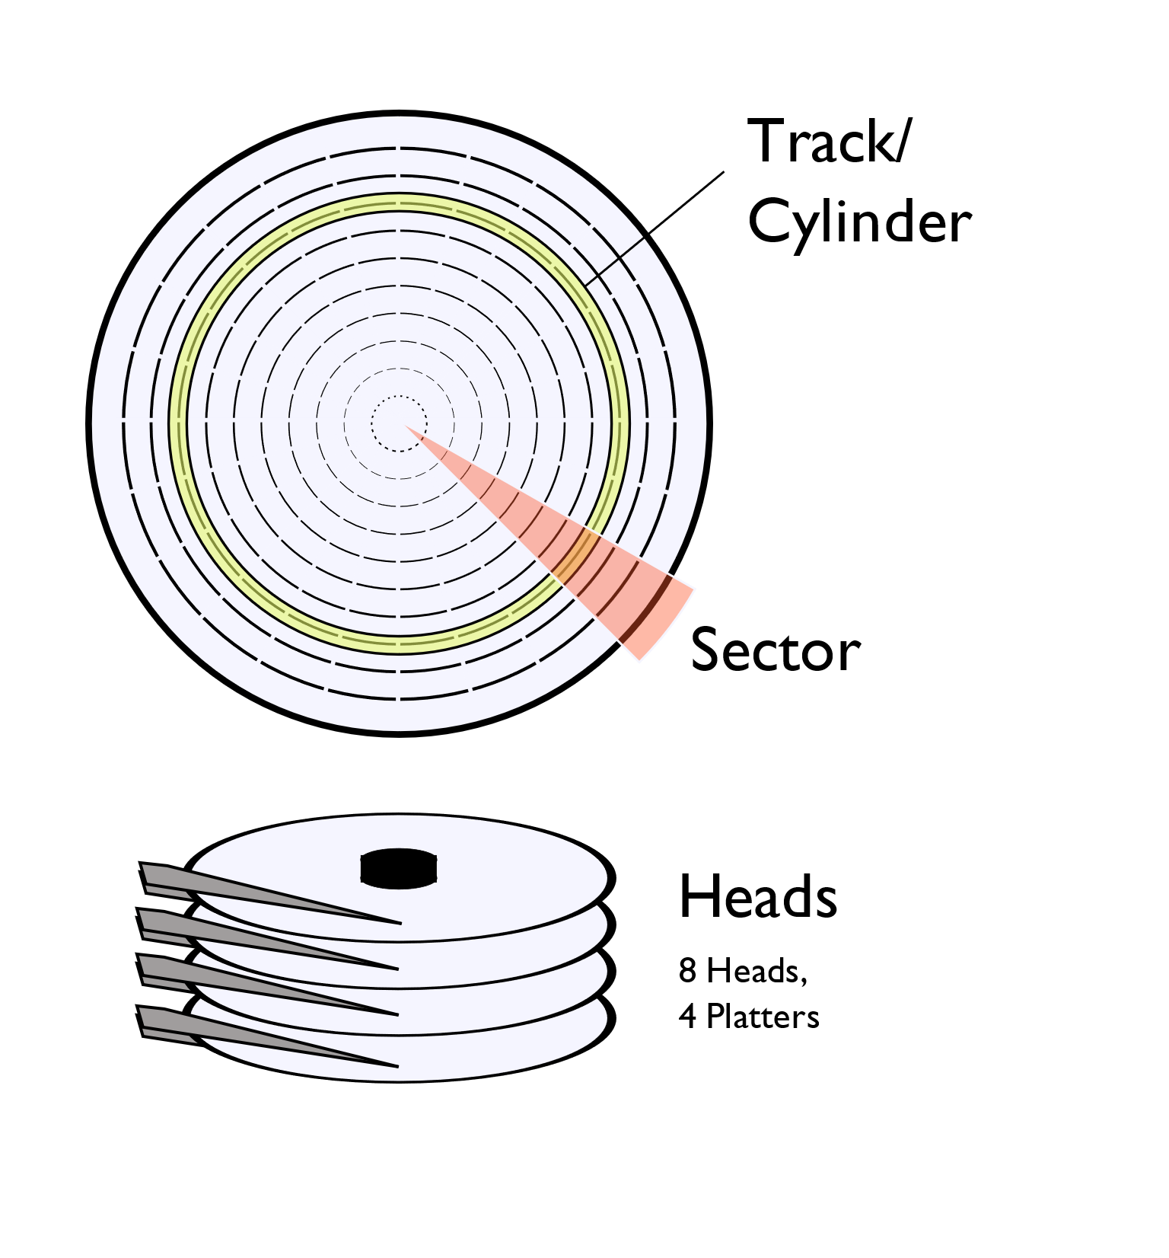
Magnetic Disk Storage
Magnetic disc drives have a set of platters. Each platter has two surfaces and there is a read/write head for each surface.
Each surface has a set of concentric tracks. The same track across all surfaces is a cylinder.
Each track is divided into sectors. Reading and writing is done one sector at a time.
By LionKimbro - Own work, Public Domain, https://commons.wikimedia.org/w/index.php?curid=331092

Slide 3
Access time is the sum of:
Seek time: time it takes the heads to move to the right track.
Rotational latency: time it takes for the disk to rotate until the right sector is under the heads.
Transfer time: time it takes to read the sectors from the disk.
By LionKimbro - Own work, Public Domain, https://commons.wikimedia.org/w/index.php?curid=331092

Slide 4
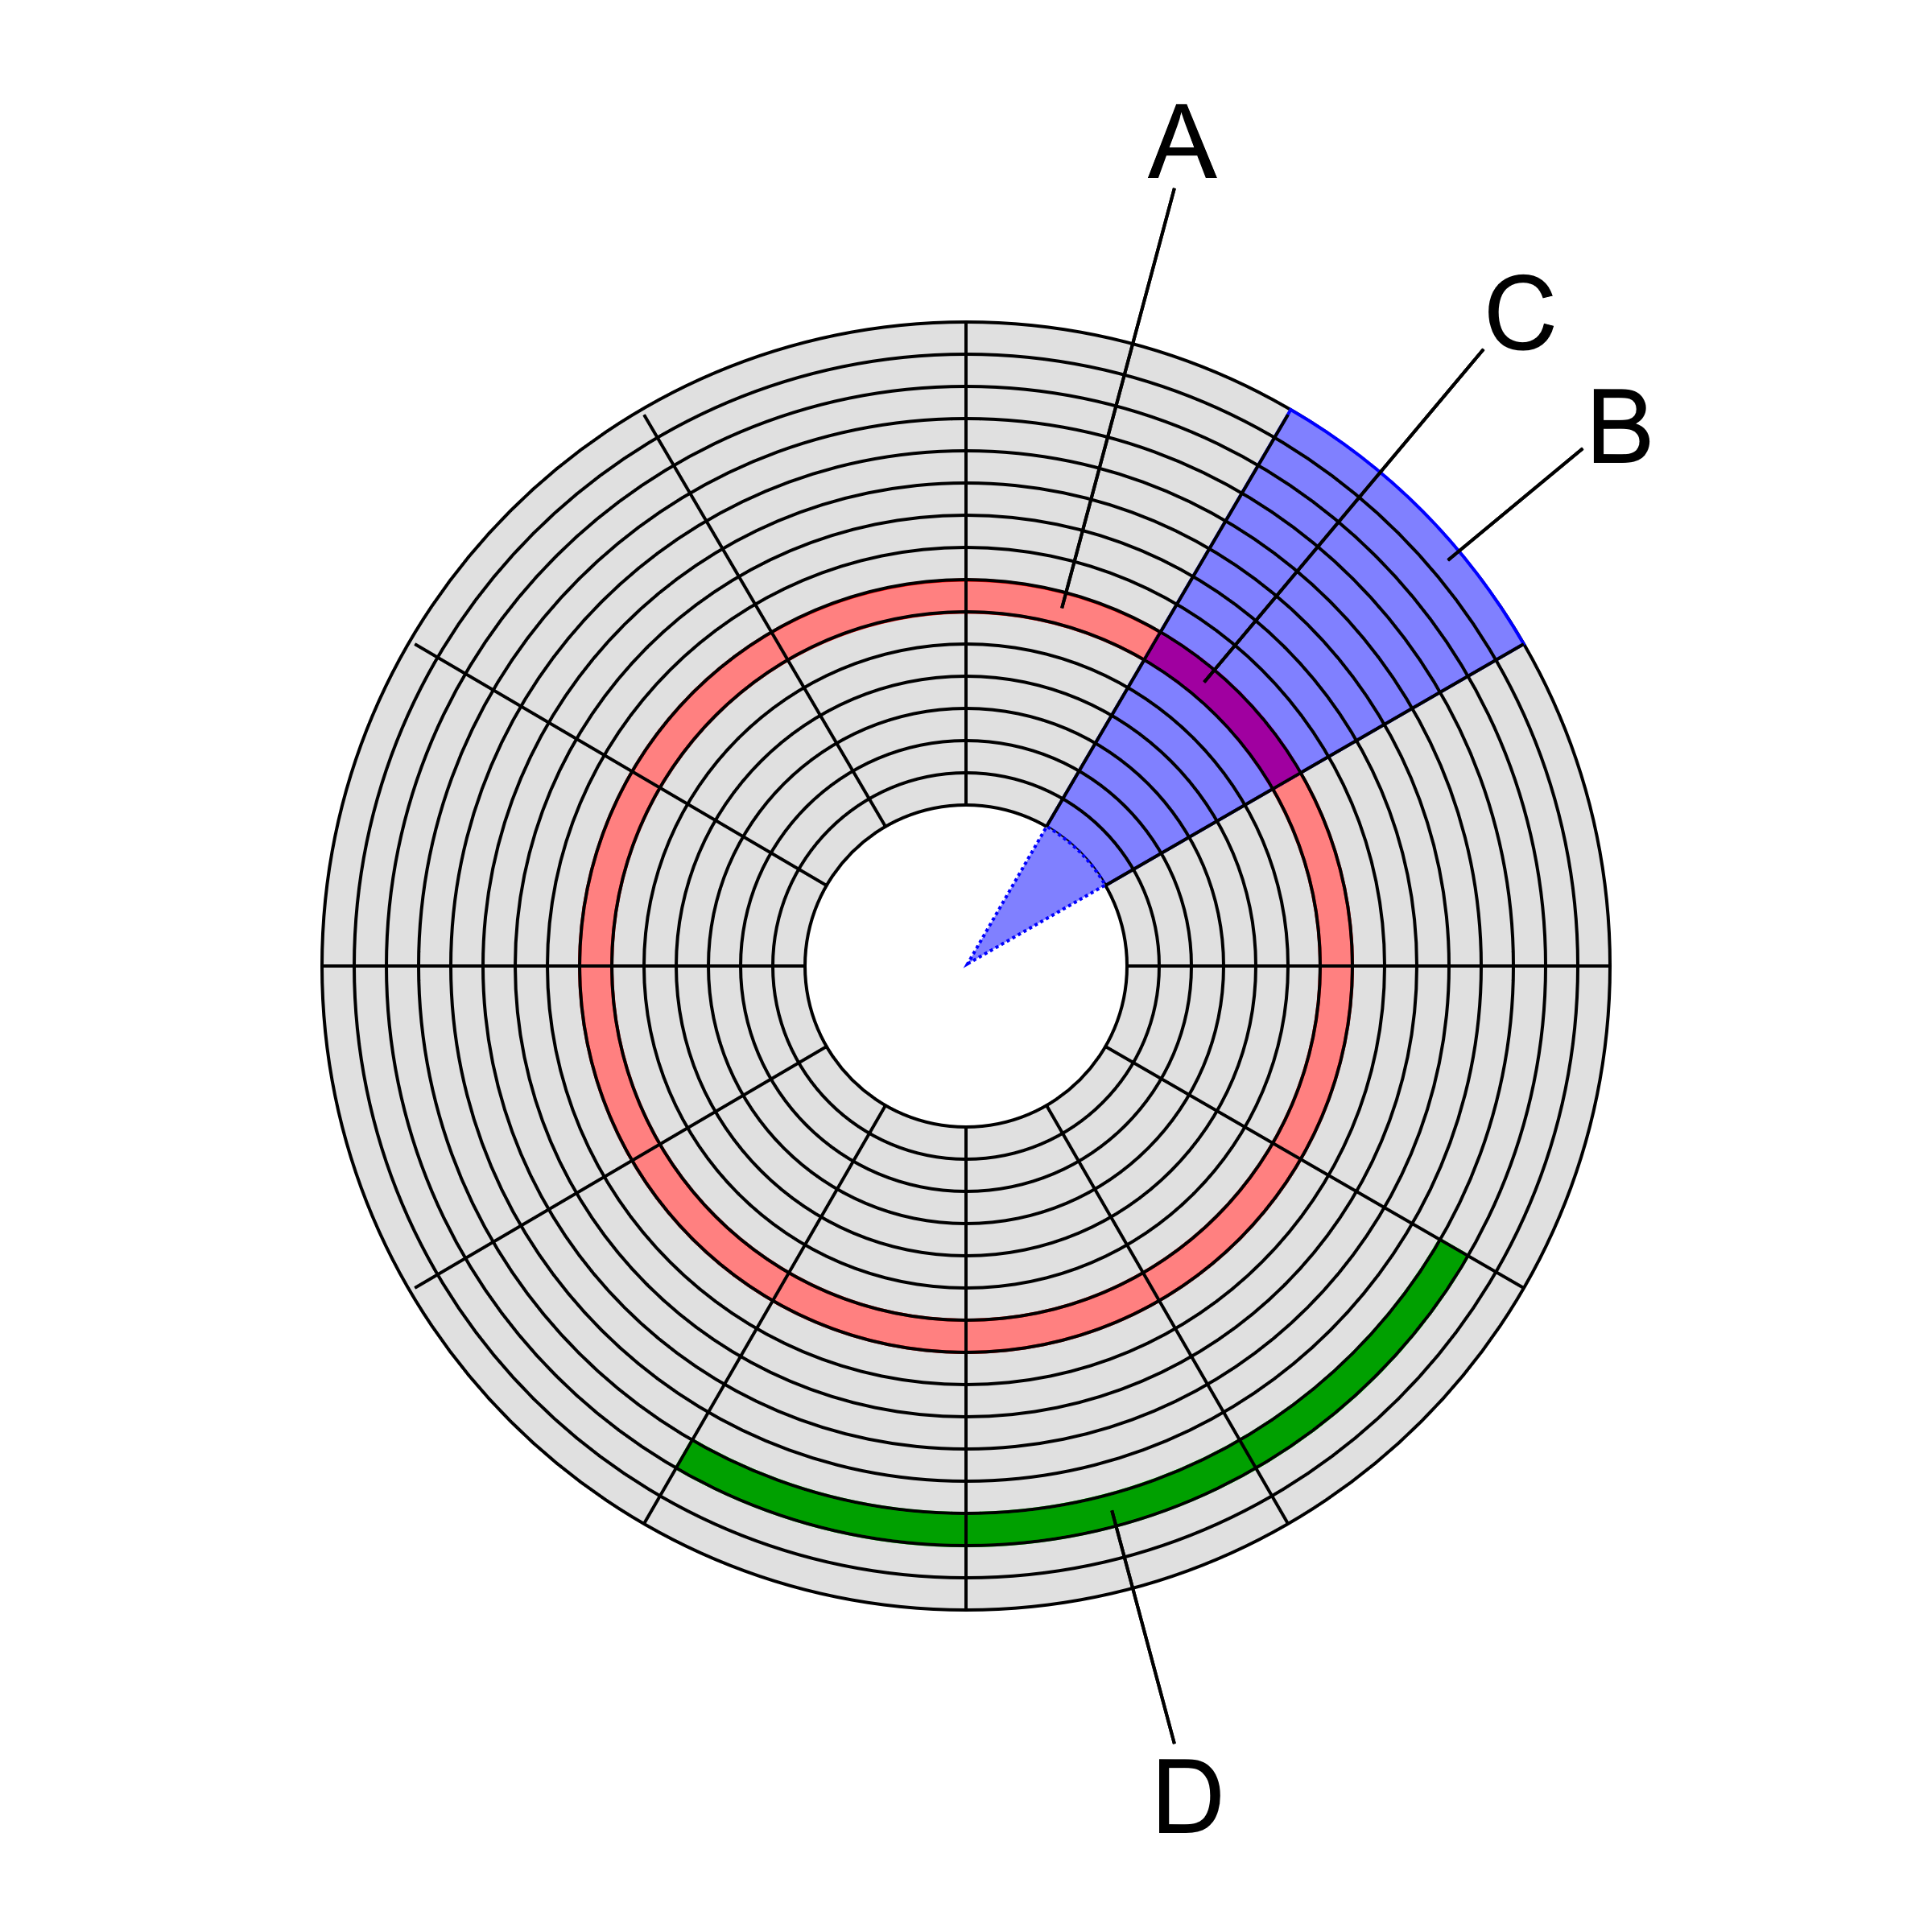
Formatting
Formatting a disk is the process of preparing it to hold files and folders.
Low-level formatting lays out the magnetic tracks and sectors of the disk. For contemporary disks it is done at the factory using special equipment. It used to be that was the first task after installing the hardware.
A: Track
B: Geometrical sector
C: Disk sector
D: Cluster
By Heron2/MistWiz, Public Domain, https://commons.wikimedia.org/w/index.php?curid=3663963

Slide 5

Bad Sectors
No disk surface is perfect, all have bad sectors.
File systems have ways to mark bad sectors and that used to be done during formatting.
Today’s disks have extra sectors and the built-in hardware substitutes an extra sector for each bad one. Thus, disks appear to be perfect even though they are not.
Image by OpenClipart-Vectors from Pixabay

Slide 6
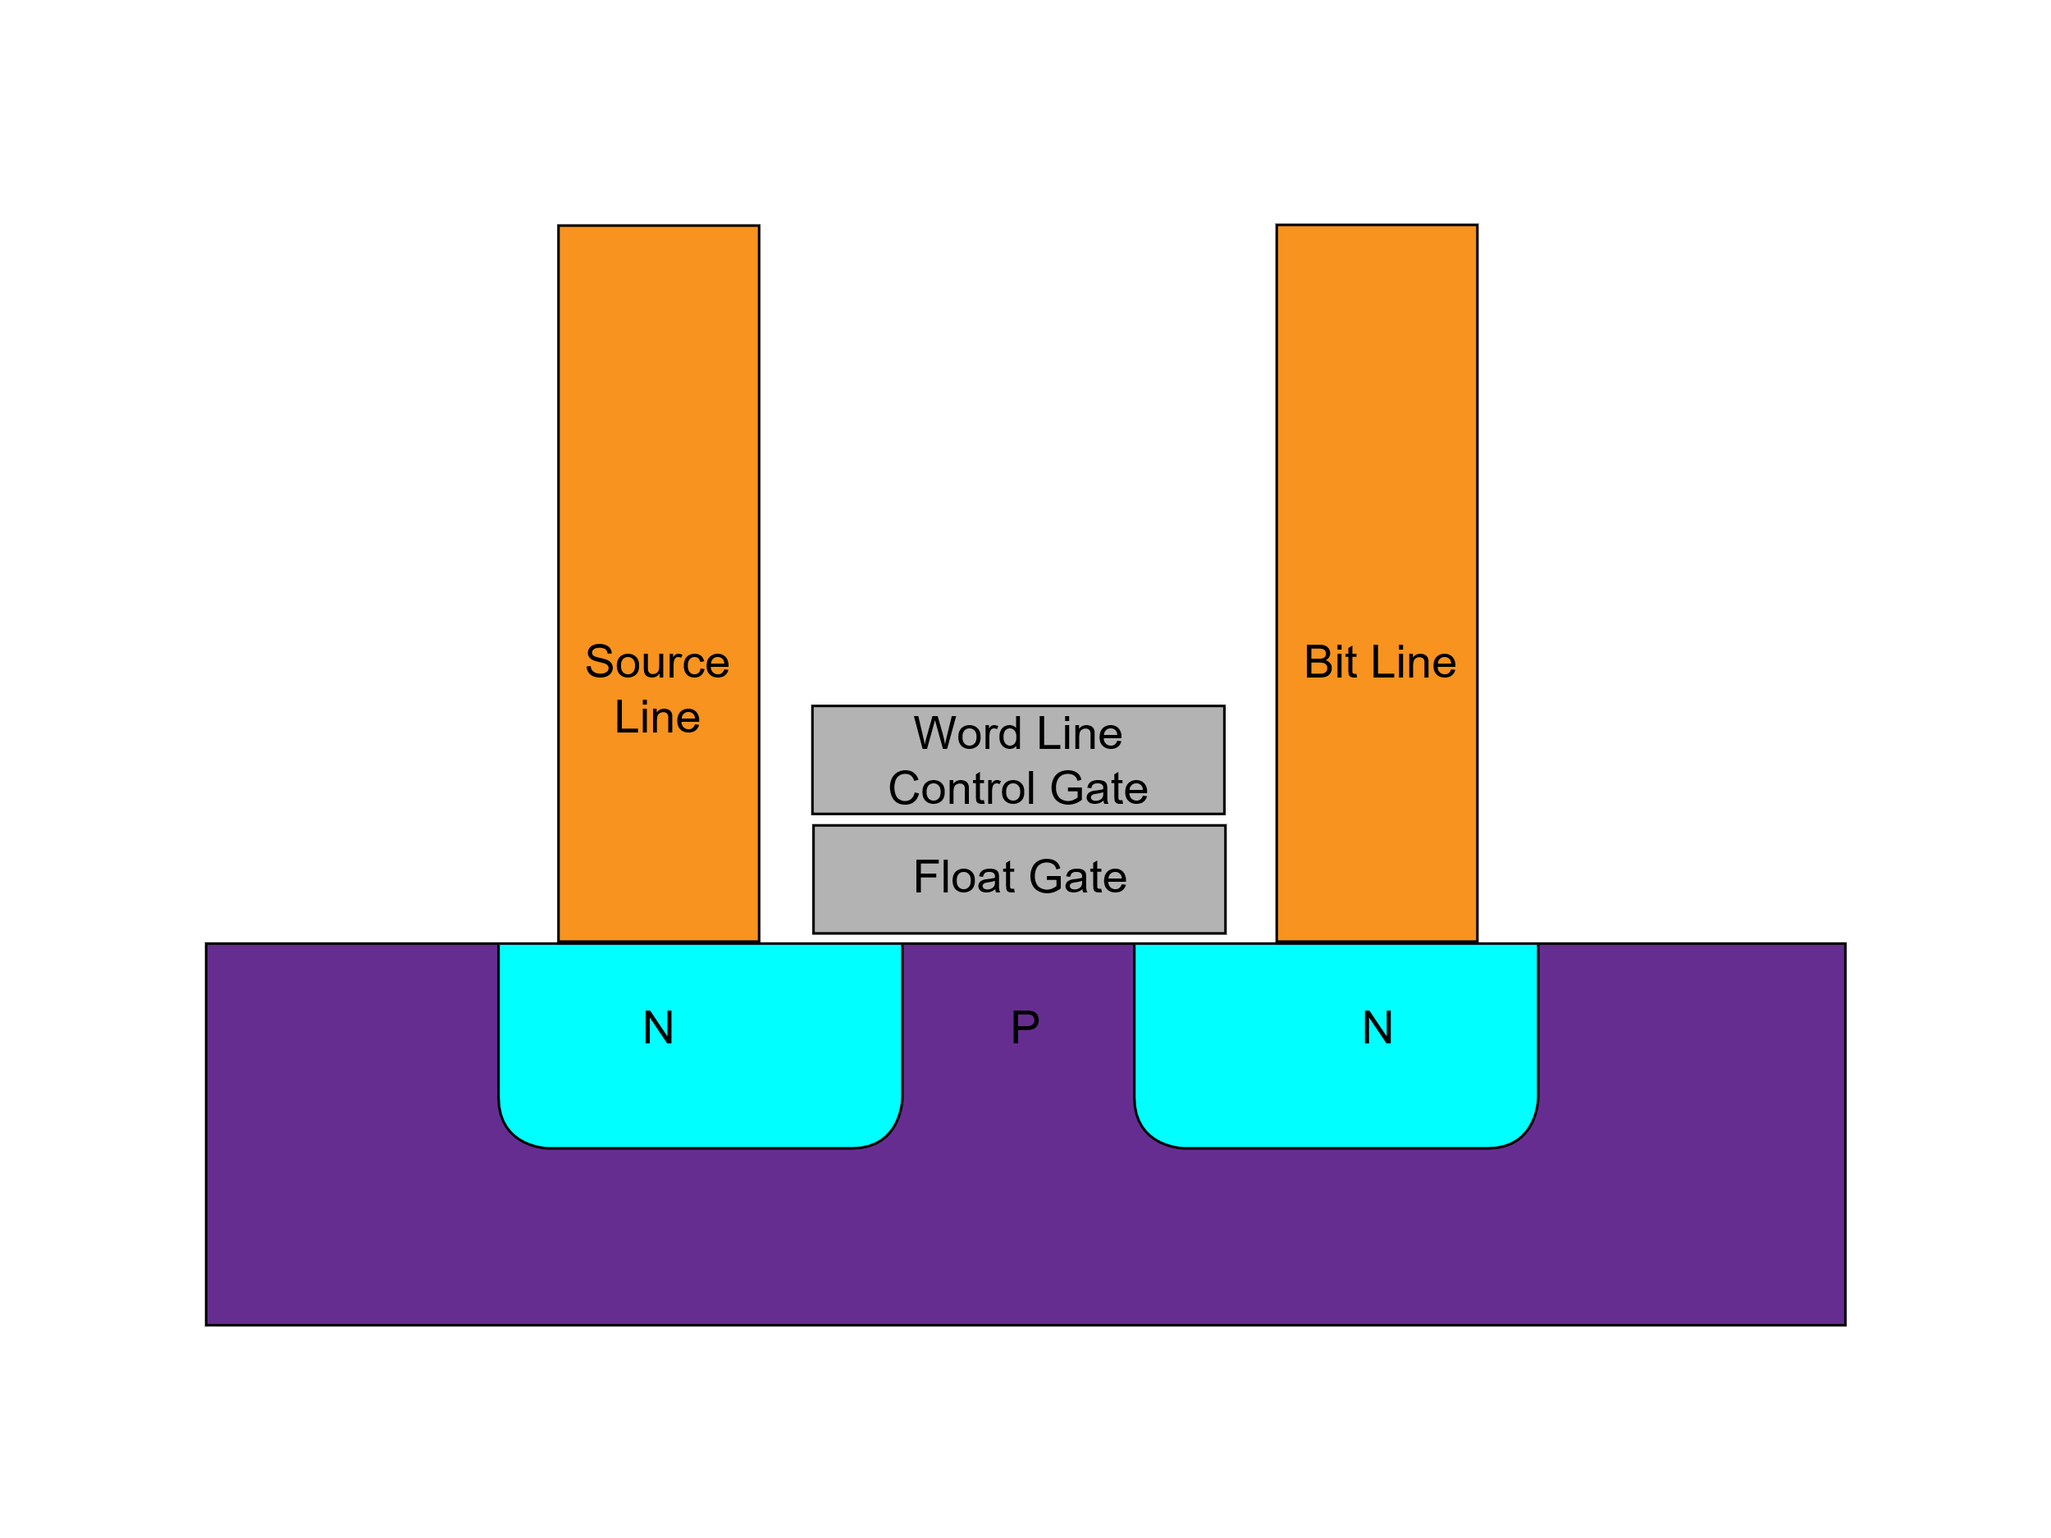
Flash Media
Flash media store data as an electrical charge within a solid-state chip.
Since there are no moving parts, there is no seek time nor rotational latency. Only transfer time which depends on how fast the chips are made to operate.
Flash drives are composed of blocks which are equivalent to sectors.
Blocks can wear out after too many writes. Flash drives map logical block numbers to physical ones and spread writes evenly across the whole drive.
Flash cell structure By Cyferz at English Wikipedia, CC BY 2.5,
https://commons.wikimedia.org/w/index.php?curid=47813471

Slide 7
Drive Partitions
Drive (Hard Disk or Flash)
Partition Table
A drive is typically divided into partitions, each of which may contain a file system.
DOS and Windows originally defined the MBR (older) and GPT (newer) partition table formats. They have since been adopted by most operating systems.
The operating system manifests each partition as a separate volume or logical drive.
Partition 1 (Drive C:)
Partition 2 (Drive D:)
Partition 3 (Hidden)

Slide 8
File System: Logical Organization
Root Directory
Directory A
Directory B
Directory C
File X
File Y
Directory D
File W
File V
Directory E
Directory F
File U
File T
File S

Slide 9
Initializing a File System
High-Level Formatting lays out a file system on a Volume.
Storage is allocated one allocation unit at a time.
An allocation unit, also known as a cluster or block is a set of consecutive sectors. Sectors are usually 512 bytes in size and allocation units are usually 4KiB in size. Therefore, a cluster is usually 8 sectors in size.
An allocation table keeps track of which clusters are available and which are in use.
The root directory contains pointers to files and to other directories.
Files are allocated one cluster at a time. So, on average, there are 2Kib of wasted space per file.

Slide 10
File Systems
A file system is a binary structure for organizing files and allocating storage on a volume. There are many different formats.
Commonly-used file systems:
Windows: FAT (FAT12, FAT16, FAT32, and exFAT), NTFS, and ReFS
Linux: FAT32, exFAT, UFS, EXT
MacOS: FAT32, exFAT, Mac OS Extended FS, APFS

Slide 11

Optical Disks
Optical disks, CD, DVD, and Blu-Ray, have one spiral track that starts at the center and moves outward.
Optical disk drives can spin the disk at different speeds depending on what they are doing (reading, burning, seeking, etc.)
Since optical disks are typically written all at once (burning) or mass-produced (stamped), files are laid out contiguously, one after another, and there is no need to keep track of unused clusters.
Optical file systems are ISO 9660 (older) and UDF (newer). Both are supported by Windows, MacOS, and Linux.

