Slide 1
File Systems: Advanced Features
IT&C 344 – S11

Slide 2
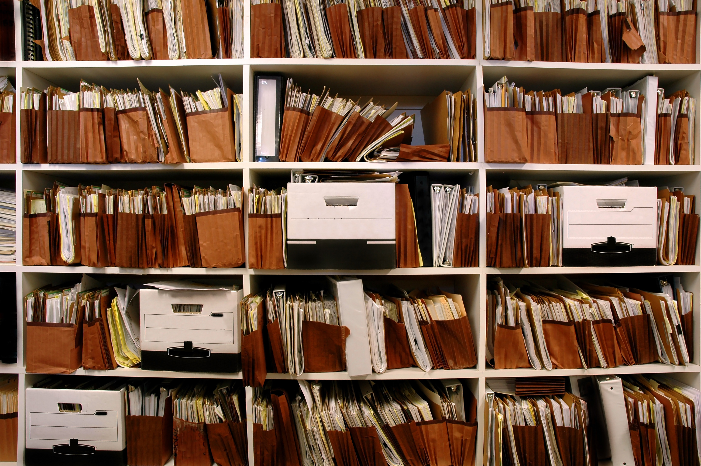
File System Metadata
Filename
File Size (in bytes)
Date Created
Date Modified
Date Accessed
Access Permissions
When a file is copied or moved, some or all metadata will change.
Access permissions may be changed or not copied.
Date accessed will be updated to now.

Slide 3
Filename Extensions
DOS filenames were originally limited to 8 characters with a three-character extension. They were also exclusively upper-case. E.g. MYFILE.TXT
The extension indicated the purpose of the file.
The C programming language encouraged extensions with filenames like main.c or main.h
There is no standards body governing extensions.
PAGE.HTM
My-Awesome-Page.html
Photo.jpg
Photo.jpeg

Slide 4
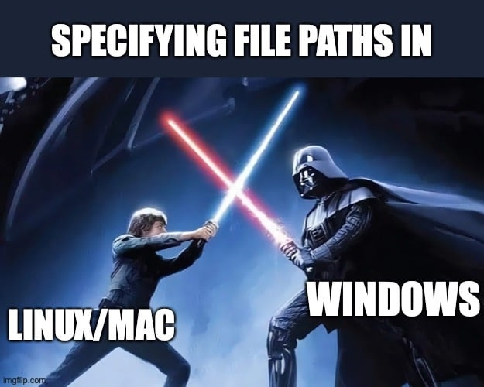
Path Separators
\ Windows uses backslashes
/ Linux and MacOS use forward slashes
/ Windows and most Windows apps will tolerate forward slashes
: Prior to OS X, MacOS used colons
/ The web uses forward slashes

Slide 5

MacOS File Forks
Data Fork
Resource Fork
“Unstructured” traditional contents of a file (code, text, database, etc.
(Only unstructured in that it doesn’t use an OS-specified structure. Databases, JSON, XML, etc. all have structure.)
Structured data such as icons, images, fonts, and more.
Particularly used by MacOS applications that keep images and messages in the resource fork.
Notes:
Since 2002 Apple seems to be slowly moving away from using a resource fork.

Slide 6

Preserving the Resource Fork
In a .ZIP file the resource forks of each file are stored in the __MACOSX folder (which is hidden on MacOS).
On a FAT file system, the resource forks are stored in a “companion file”. For example, the resource fork for “example.txt” would be stored in “._example.txt”.

Slide 7
NTFS Alternative Data Streams (ADS)
Needed at least one extra stream so that Windows Server could act as a file server for MacOS
They decided to add multiple streams
Few uses but some interesting ones
Demo
View and alter streams
Download a word file and a .exe
Launch each and see what happens
Look at alternate stream
101101010110101000101001010010101101

Slide 8
Hard and Soft Links
Root Directory
No longer a strict hierarchy. Instead, a directed graph.
Directory A
Directory B
Directory C
File X
File Y
Directory D
File W
File V
Directory E
Directory F
File U
File T
File S

Slide 9

Hard Links
Soft Links
Links to the file content.
All links (names, paths) to a file are equal whether original or added.
The file doesn’t go away until you delete all links.
Links must be on the same disk volume.
Links to the file path.
Links are subordinate to the original filename.
The file goes away when its original or primary instance is deleted. At that point all links are broken.
Links can cross disk volumes.
Hard links are handled within the file system. Soft links are also encoded within the file system but require some OS support.

Slide 10
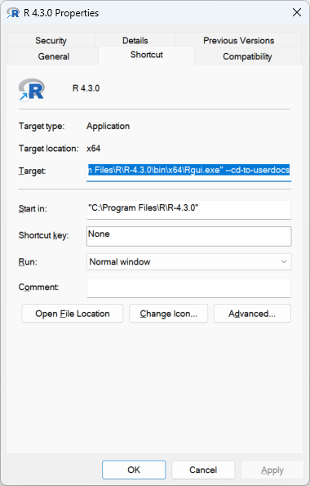
Windows Shortcuts
Like links but managed by the Windows File Explorer.
A file with a .lnk extension
Contains metadata:
Target: A complete command line, not just a filename.
Startup Directory
Icon
Window Type (normal, minimized, maximized, etc.)
Compatibility modes

Slide 11

Time and Date Resolution and Timezone
NTFS
Stored in UTC time
All times: 100 ns resolution
Access times are cached and written back. May be delayed by as much as an hour.
FAT
Stored in Local time
Create Time: 10 millisecond resolution
Write Time: 2 second resolution
Access Time: 1 day resolution
Linux ext file system (prior to ext4)
Stored in UTC time
All times: 1 second resolution
Support for creation time is inconsistent
The 32-bit UNIX time epoch will roll over on January 19, 2038 at 3:14:07 a.m.
Ext4 has nanosecond resolution and will roll over in 2446.

