Slide 1
Securing Access to Data on a Computer
IT&C 344 – S12

Slide 2

But first… a demo

Slide 3
Securing Data
Authentication and Authorization
Encryption
Malware Protection

Slide 4


Authentication Credentials
Something You Know (e.g. Password)
*****|
Something You Have (Key, Token, Phone, etc.)
Something You Are (Biometric)
Notes:
Ask the students, what are the three ways of authenticating a person.

Slide 5


Authorization
Access Control List

Slide 6

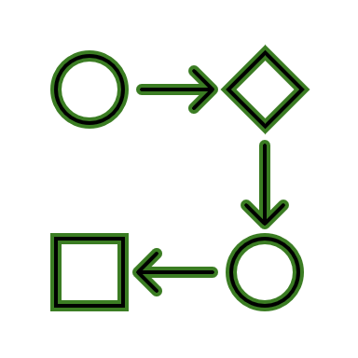

Where Should Data Be Encrypted?
Storage
(data at rest)
Processing
(data in memory)
Transmission (data in transit)
Notes:
Data are typically encrypted in storage and transmission but not in processing. It’s impractical to encrypt data in main memory and that is also not an area of vulnerability due to processor memory protections.

Slide 7

Anti-Malware
Browser Antivirus
All major browsers have built-in scanning of downloads.
Computer Antivirus
Microsoft Defender (formerly Windows Defender)
Apple XProtect
Third-Party
Firewall Antivirus
Firewalls may include virus filters but HTTPS encryption hides traffic from the firewall. So you have to set it up as an HTTP proxy.

