Slide 1
Security Policy
IT&C 344 – S14

Slide 2
Originality of Work

Slide 3
AI Detectors and False Positives: AI detectors used to identify AI-generated content in student assignments have a small error rate, but even a 1-2% false positive rate can have significant consequences for students.
Impact on Students: Students, including those with developmental disabilities or learning English as a second language, are at higher risk of being falsely accused of cheating.
Case Study: The article highlights the story of Moira Olmsted, who was falsely accused of using AI to write an assignment due to her writing style, which was influenced by her autism spectrum disorder.
Widespread Use: About two-thirds of teachers report using AI detection tools regularly, reflecting the growing reliance on technology to monitor academic integrity.
Accuracy Concerns: Tests on essays submitted before the release of ChatGPT showed that AI detectors falsely flagged some essays as AI-generated.
Microsoft Copilot summary of “AI Detectors Falsely Accuse Students of Cheating – With Big Consequences”. https://www.bloomberg.com/news/features/2024-10-18/do-ai-detectors-work-students-face-false-cheating-accusations

Slide 4
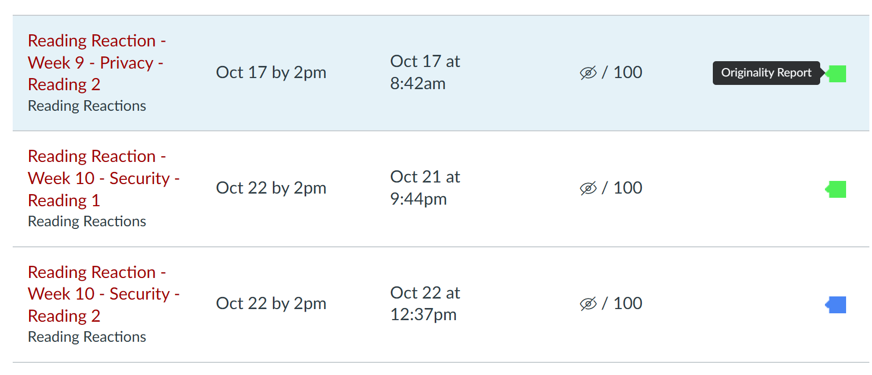

Slide 5
Security Policy

Slide 6
Questions to Inform a Security Policy
?
What must be protected?
From whom should data be protected?
What costs are associated with security being breached and data being lost or stolen?
How likely is it that a threat will actually occur?
What’s the likelihood of a natural disaster?
What are the convenience costs associated with protection?

Slide 7
Components of a Security Policy
Privacy policy
Acceptable use policy
Authentication policy
Internet use policy
Access policy
Auditing policy
Data protection

Slide 8
What is the Effect of Each Policy?
Privacy policy
Acceptable use policy
Authentication policy
Internet use policy
Access policy
Auditing policy
Data protection
Who cares?
Who implements?
Who is constrained?
What is the consequence of violating the policy?

