Slide 1
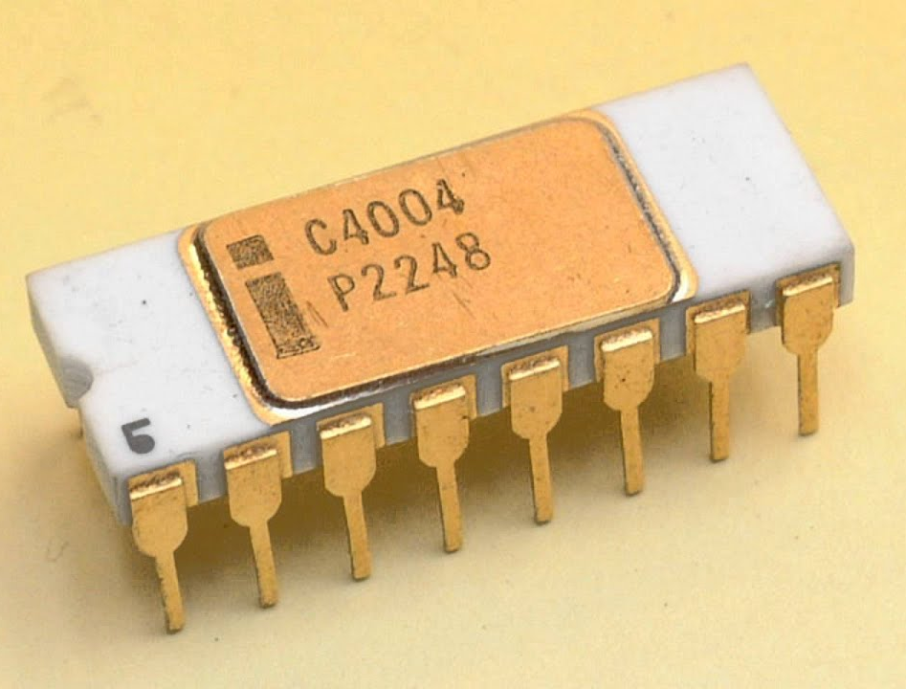
Microprocessor
An entire Central Processing Unit (CPU) contained on a single chip.

Slide 2
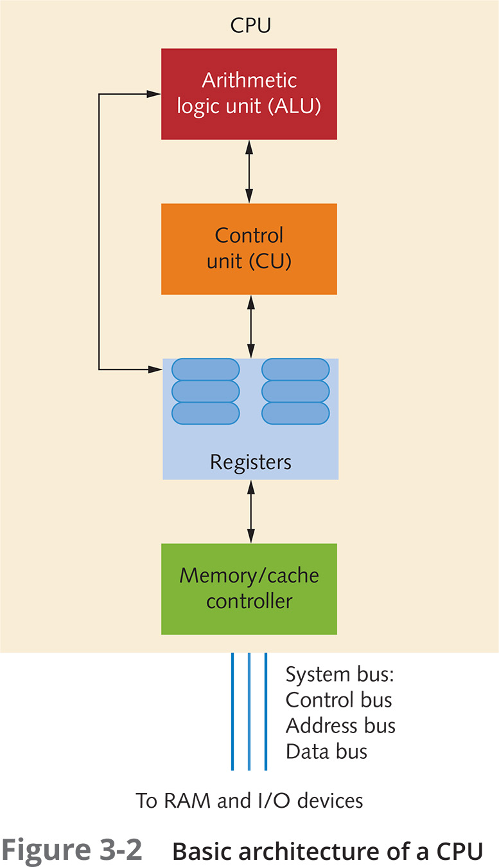
Processors and Cores and Execution Units
Processor Core
Contemporary processors typically have between 4 and 16 cores.
Some processors have only 1 or 2.
The AMD Threadripper 7995WX has 96 cores.

Slide 3
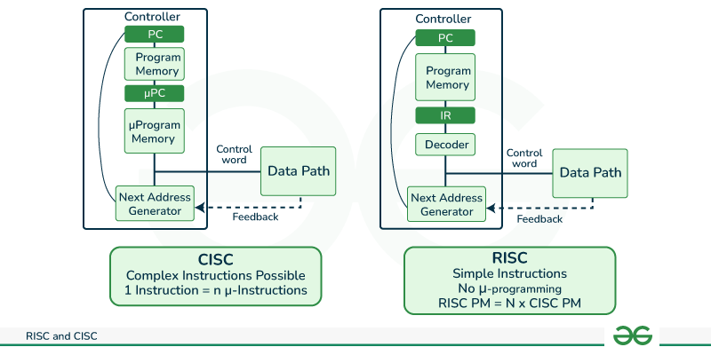
CISC vs RISC
https://www.geeksforgeeks.org/computer-organization-risc-and-cisc/

Slide 4
CISC vs RISC
Complex Instruction Set Computer
Reduced Instruction Set Computer
add (a), (b)
mov ax, (a)
mov bx, (b)
add ax, bx
mov bx, (b)
1 instruction: 4 clocks.
4 instructions: 1 clock each.

Slide 5
Popular Architectures
Contemporary
x86 - CISC
ARM – RISC (Apple M1, Qualcomm Snapdragon, others)
RISC-V – RISC (of course)
AVR – RISC (Microcontrollers, Harvard Architecture)
Historic
Intel Itanium – RISC
68000 – CISC (first Macintosh)
IBM PowerPC – RISC (later Macs, others)

Slide 6
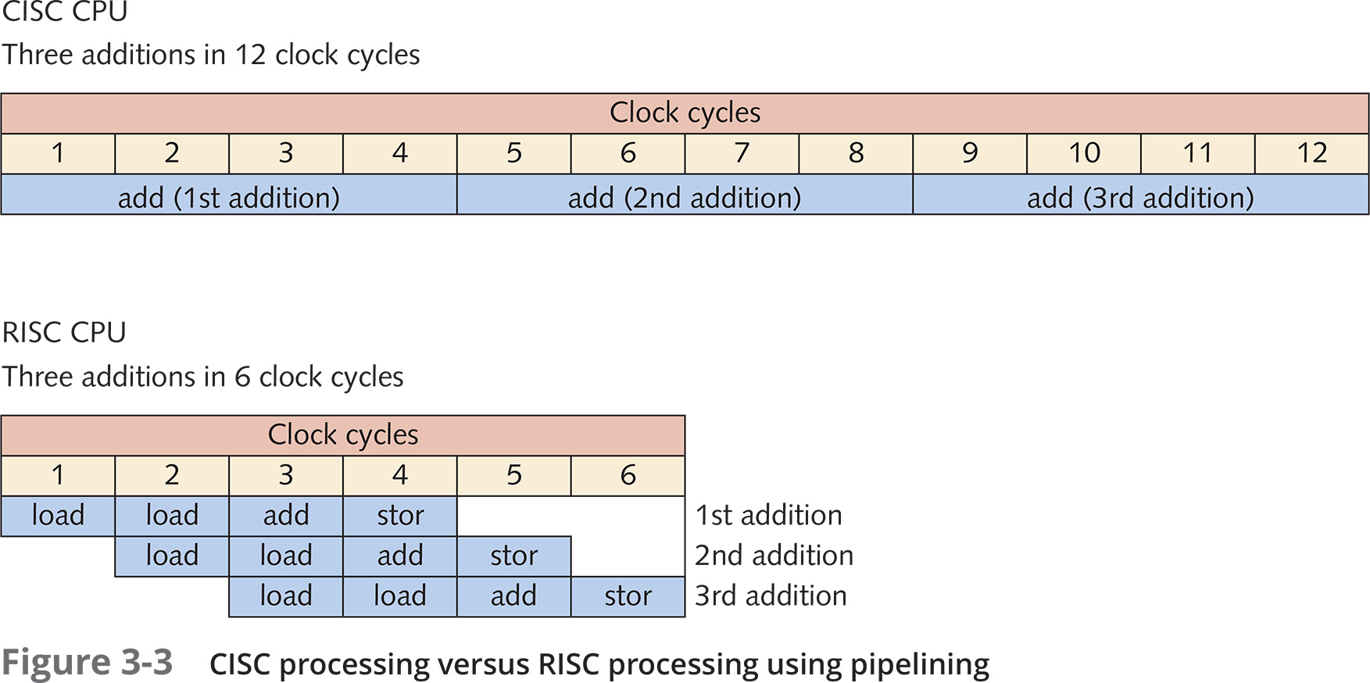
Pipelining
Except that, contrary to the textbook, contemporary CISC processors do an excellent job of pipelining.

Slide 7
Von Neumann Architecture
Harvard Architecture
Arithmetic Logic Unit (ALU)
Arithmetic Logic Unit (ALU)
Control Unit
Control Unit
Memory
Code Memory
Data Memory
Input / Output (I/O)
Input / Output (I/O)

Slide 8
Memory Space
Virtual Memory
Physical Memory
0
Code
Data
User Space
Stack
Heap
Kernel Space
Memory is mapped one page at a time.
Pages are typically 4KiB in size
End of Memory

Slide 9
Cache Memory Architecture (As of 2024)
 | Level 1 | Level 2 | Level 3 | Level 4
Location | On-chip | On-Chip | On-Chip | External
Allocation | Per-Core | Per-Core | Per-Processor Chip | Per Computer
Speed | Processor Speed | Very Fast | Fast | Faster than main memory
Size | Very Small | Small | Big | Very Big
Nots |  |  |  | Rarely used in 2024

Slide 10
Specs: 14th Gen Core i7 (i7-14700)
Total Cores | 20
Performance Cores | 8
Efficient Cores | 12
Total Threads | 28 (Performance cores are hyper-threaded)
Base clock frequency | 2.1 Ghz (performance cores)
L1 Cache | 80KiB (per performance core) 96Kib (per efficiency core)
L2 Cache | 2 MiB (per core) 4MiB (per efficiency “module”)
L3 Cache | 33 MiB (shared)
https://www.techpowerup.com/cpu-specs/core-i7-14700.c3442

