Slide 1
Network Fundamentals
IT&C 344 – S19

Slide 2
OSI
TCP/IP
7. Application
Application
6. Presentation
5. Session
4. Transport
Transport (TCP, UDP)
Layer 4 and up are mostly software.
3. Network
Internetwork (IP)
Routing happens in Layer 3.
Network hubs, switches, and access points are in Layer 2.
2. Data Link
Link
1. Physical
Physical
Cables, fiber, and radio are in Layer 1

Slide 3
void send_udp_message() {
const char *ip_address = "192.168.145.36";
const char *message = "Hello";
int port = 7;
// Create a UDP socket
int sock = socket(AF_INET, SOCK_DGRAM, 0);
// Set up the destination address
struct sockaddr_in dest_addr;
memset(&dest_addr, 0, sizeof(dest_addr)); // This is C, zeroing isn't automatic
dest_addr.sin_family = AF_INET; // Address family
dest_addr.sin_port = htons(port); // Port number in network order
inet_pton(AF_INET, ip_address, &dest_addr.sin_addr) // Parse the IP address
// Send the message
sendto(sock, message, strlen(message), 0, (struct sockaddr*)&dest_addr, sizeof(dest_addr));
// Close the socket
close(sock);
}

Slide 4
Layer 5: Application
Data
Hello

Slide 5
Layer 4: Transport (UDP)
UDP Header
Data
Source Port: 29345 Destination Port: 7
Length: 5
Checksum: 0x3F9D
Hello

Slide 6
Layer 3: Internetwork (IP)
IP Header
UDP Header
Data
Version: 4
HeaderLength: 20
TotalPacketLength: 33
Length: 5
FragmentId: 0
FragmentOffset: 0
TimeToLive: 30
Protocol: 17 (UDP)
Checksum: 0x4829
SrcAddress: 192.168.145.60
DstAddress: 192.168.145.36
Source Port: 29345 Destination Port: 7
Length: 5
Checksum: 0x3F9D
Hello

Slide 7
Layer 2: Link (Ethernet)
Ethernet Header
IP Header
UDP Header
Data
DstMAC: 00-0C-29-94-55-05
SrcMAC: 00-00-92-C7-23-4F
EtherType: 0x0800 (IPv4)
QualityOfService: (Optional)
VLanId: (Optional)
Version: 4
HeaderLength: 20
TotalPacketLength: 33
Length: 5
FragmentId: 0
FragmentOffset: 0
TimeToLive: 30
Protocol: 17 (UDP)
Checksum: 0x4829
SrcAddress: 192.168.145.60
DstAddress: 192.168.145.36
Source Port: 29345 Destination Port: 7
Length: 5
Checksum: 0x3F9D
Hello

Slide 8
void echo() {
int port = 7;
int buffer_size = 1024;
char buffer[buffer_size];
// Create a UDP socket
int sock = socket(AF_INET, SOCK_DGRAM, 0);
// Set up the server address
struct sockaddr_in server_addr;
memset(&server_addr, 0, sizeof(server_addr));
server_addr.sin_family = AF_INET;
server_addr.sin_port = htons(port);
server_addr.sin_addr.s_addr = INADDR_ANY;
// Bind the socket to the port
bind(sock, (struct sockaddr*)&server_addr, sizeof(server_addr));
// Echo any received packets back to the sender
while (1) {
struct sockaddr_in client_addr;
socklen_t client_addr_len = sizeof(client_addr);
ssize_t bytes_received =
recvfrom(sock, buffer, buffer_size, 0, (struct sockaddr*)&client_addr, &client_addr_len);
// Send the received message back to the client
sendto(sock, buffer, bytes_received, 0, (struct sockaddr*)&client_addr, client_addr_len);
}
}

Slide 9
Internet Protocol (IP) Addresses are at Layer 3 in the protocol stack.
IPv4 Addressing
IPv4 addresses are 32-bits, 4-bytes long.
IPv4 Notation is four decimal numbers in the range of 0-255 each representing one byte of the 4-byte value.
CIDR notation follows the IP address with a slash and the number of 1’s in the subnet mask.
CIDR: 192.168.145.36/16
IPv4 Address: 192.168.145.36
Subnet Mask: 255.255.0.0
Network ID: 192.168.0.0
Host ID: 0.0.145.36
IPv6 Addressing
IPv6 Address: 2001:0db8:0000:0000:0000:8a2e:9370:7334
Condensed: 2001:0db8::8a2e:9370:7334
Network ID: 2001:0db8:0000:0000
Host ID: 0000:8a2e:9370:7334
IPv6 addresses are 128-bits, 16-bytes long.
IPv6 Notation is eight sets of 4-digit hexadecimal numbers.
The subnet mask is fixed with 64 bits in the Network ID and 64 bits in the Host ID

Slide 10
MAC Addresses are at Layer 2 in the protocol stack.
MAC addresses are 48-bits, 6-bytes long.
MAC Notation is six 2-digit hexadecimal numbers delimited by dashes.
Media Access Control (MAC) Address 00-09-8c-00-69-63
Broadcast Address
ff-ff-ff-ff-ff-ff
Locally-Administered Address
01-00-a7-d3-d9-42
The first three bytes in a Universally Administered Address (UAA) are the manufacturer’s Organizationally Unique Identifier (OUI).
The manufacturer ensures the the remaining three bytes are unique.
If the least-significant bit of the first byte is a 1. Then it’s a Locally Administered Address (LAA) which is typically generated randomly while checking for collisions.
Notes:
Which kind of MAC address would your router likely have?
Which kind of MAC address would a virtual machine likely have?

Slide 11
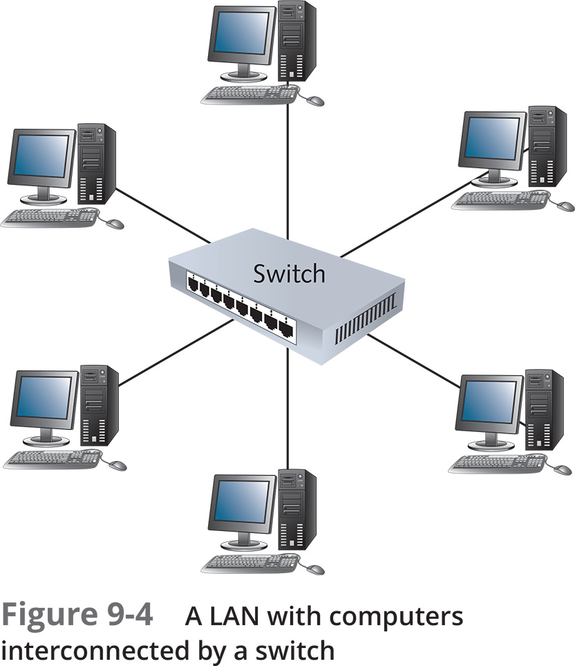
Local-Area Network (LAN)
Every device can communicate with every other device on the LAN.

Slide 12
ARP: Finding the MAC address of a device
Broadcast a message on the LAN asking which device has the specified IP address.
The device with the specified IP address responds. The MAC address is a natural part of the response.
Devices cache the IP to MAC mapping so that they don’t have to request with every packet sent.

Slide 13
Demo
> arp -a

Slide 14
Send direct or through a router?
Sender Address: 192.168.145.27
Receiver Address: 192.168.145.36
Subnet Mask: 255.255.0.0
Sender NetID: 192.168.0.0
Receiver NetID: 192.168.0.0
Sender Address: 192.168.145.27
Receiver Address: 228.43.27.104
Subnet Mask: 255.255.0.0
Sender NetID: 192.168.0.0
Receiver NetID: 228.43.0.0
Send directly to the receiver.
Send to the “default gateway.”

Slide 15
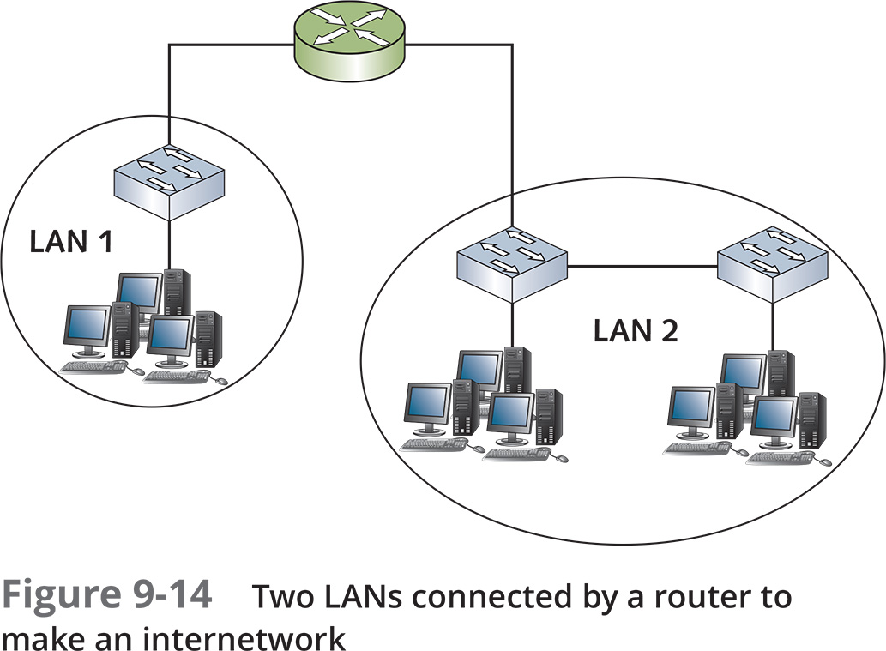
Router
A home router connects your home network to the internet.
It has one simple rule. If it’s not on the LAN then send it to the WAN (Wide-Area Network).

Slide 16
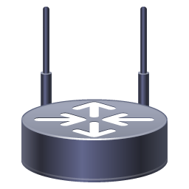



Internet Routers
Internet core routers must decide on the best way to route each packet. They continuously exchange information because “best” is a variable condition.
Wireless Router
Computer
Internet Routers and Links
Server
Notes:
For this diagram I’m using the Cisco icon library. https://www.cisco.com/c/en/us/about/brand-center/network-topology-icons.html

Slide 17
Demo
> tracert www.byu.edu
> tracert www.uq.edu.au

Slide 18
Who Owns the Internet?
And how can warring countries still both be on the Internet?
And how does my ISP give me a unique IP address?

Slide 19
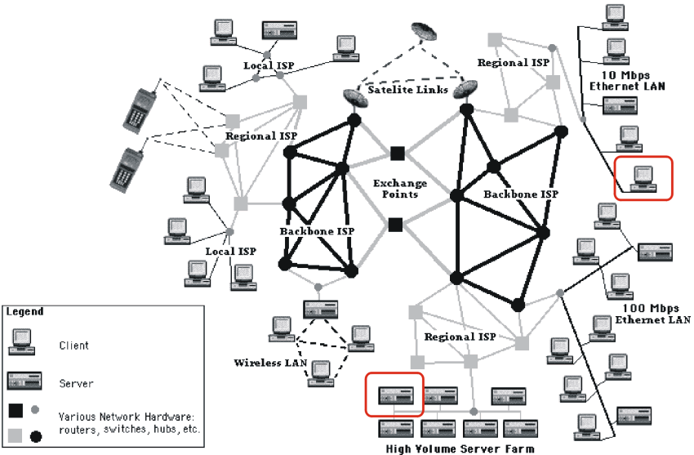
Notes:
The Internet is best thought of as the hardware, though it is also the network protocols like IP/TCP.

Slide 20
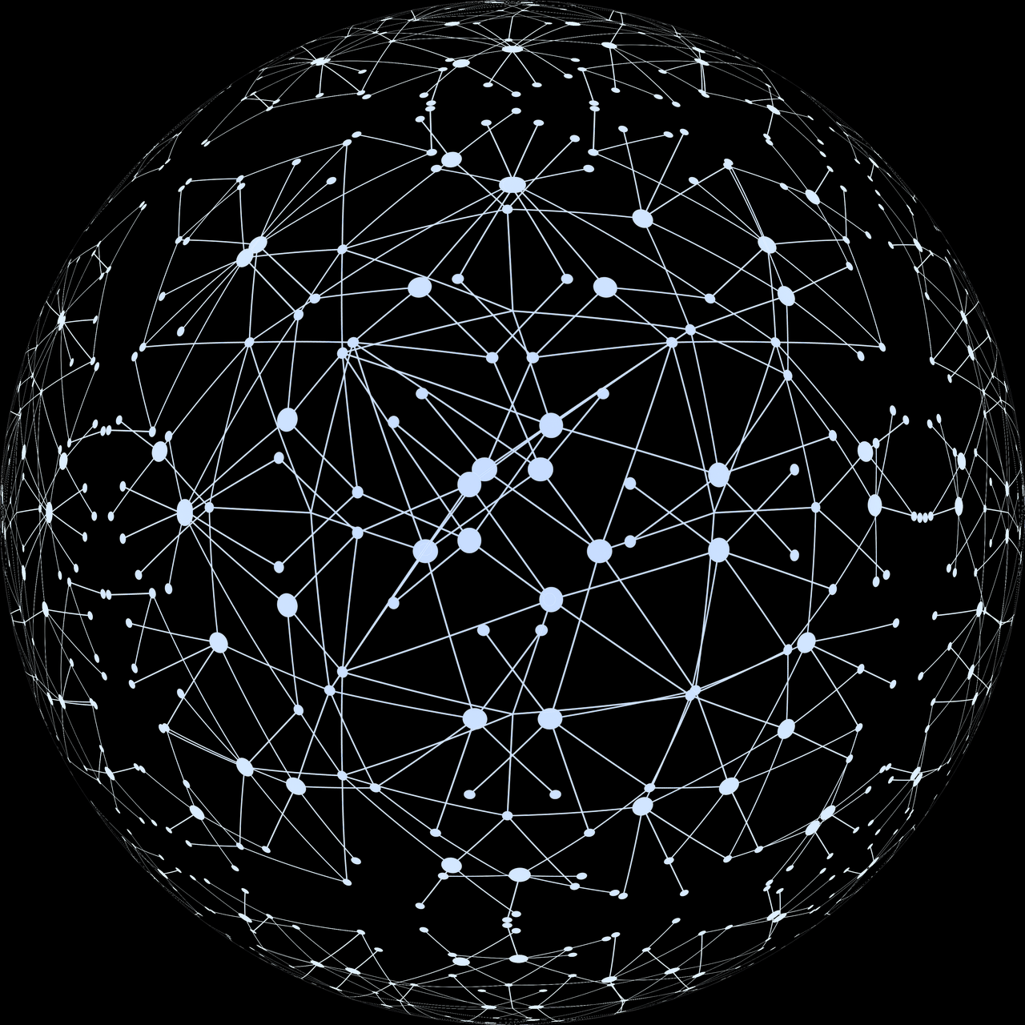
Tier 1 Networks (Backbones)
An Internet Protocol (IP) network that can reach every other Tier 1 network without paying any fees for the exchange of traffic. (https://en.wikipedia.org/wiki/Tier_1_network)
There are 16 of them:
AT&T (USA)
Comcast (USA)
Deutsche Telekom (Germany)
GTT Communications (USA)
Liberty Global (Netherlands)
Lumen (USA) (Formerly CenturyLink, Level3)
NTT Communications (Japan)
Orange (France)
PCCW Global (Hong Kong)
T-Mobile US (USA) (Formerly Sprint)
Tata (India)
Telecom Italia Sparkle (Italy)
Arelion (Sweden) (Formerly Telia)
Telxius (Spain)
Verizon (USA) (Formerly UUNET)
Zayo (USA) (Formerly AboveNet

Slide 21

Internet Assigned Numbers Authority
“The global coordination of the DNS Root, IP addressing and other internet protocol resources is performed as the Internet Assigned Numbers Authority (IANA) functions.”
Manages the DNS root zone assignments (Top-Level Domains)
Manages the Central IP Address Pool and assigns ranges to internet service providers.
A function of ICANN: The Internet Corporation for Assigned Names and Numbers. A California-based not-for-profit that is governed by an “international multistakeholder group.”
http://www.iana.org

Slide 22
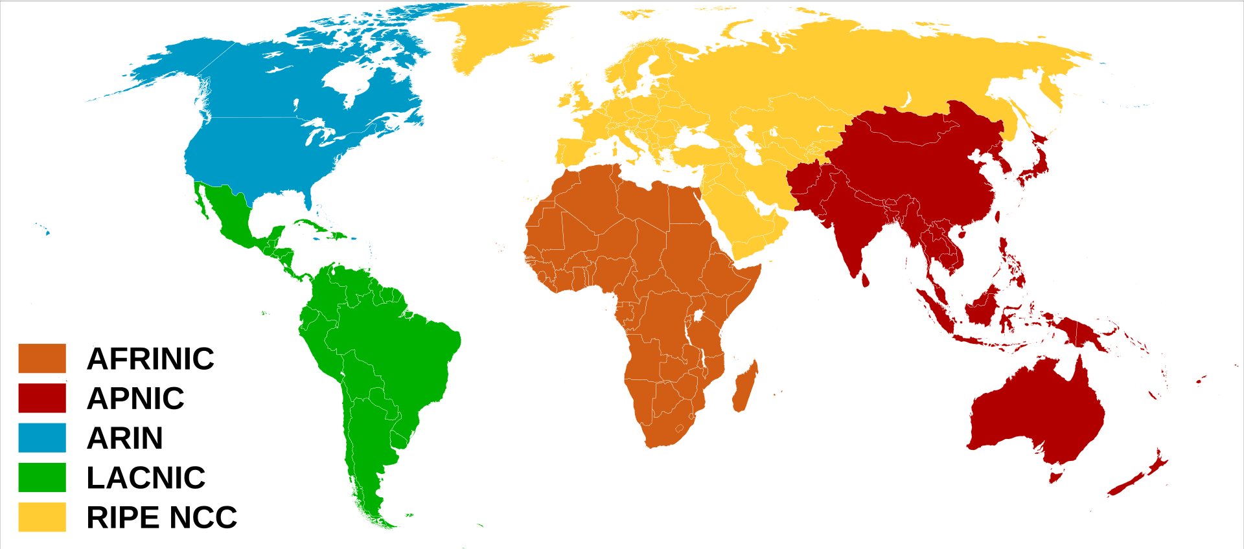
IANA Allocates IP Addresses to Five Regional Registries
African Network Information Centre (AFRINIC) - Ebene, Mauritius
All of Africa
American Registry for Internet Numbers (ARIN) - Chantilly, Virginia
Antarctica, Canda, U.S., and some Caribbean
Asia Pacific Network Information centre (APNIC) – Brisbane, Australia
East, South, and Southeast Asia, and Oceania
Latin America and Caribbean Network Informaiton Centre (LACNIC) – Montevideo, Uruguay
Latin America and some Caribbean
Réseaux IP Européens Network Coordination Centre (RIPE NCC) – Amsterdam, Netherlands
Central and West Asia, Europe, and Russia

