Slide 1
Hardening – Part 1
IT&C 515R – Applications of Cybersecurity Training

Slide 2


Slide 3
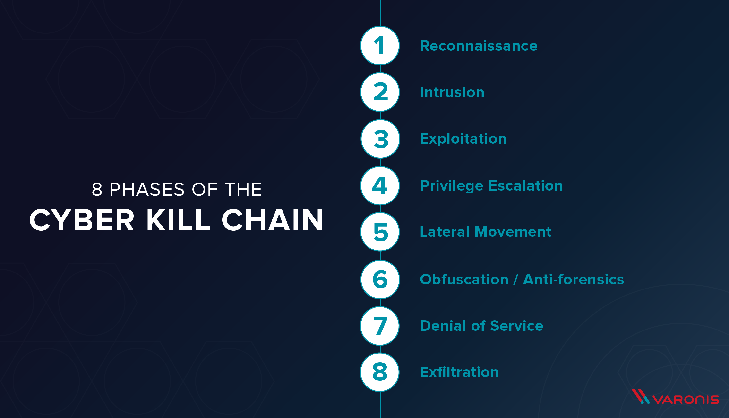

Slide 4
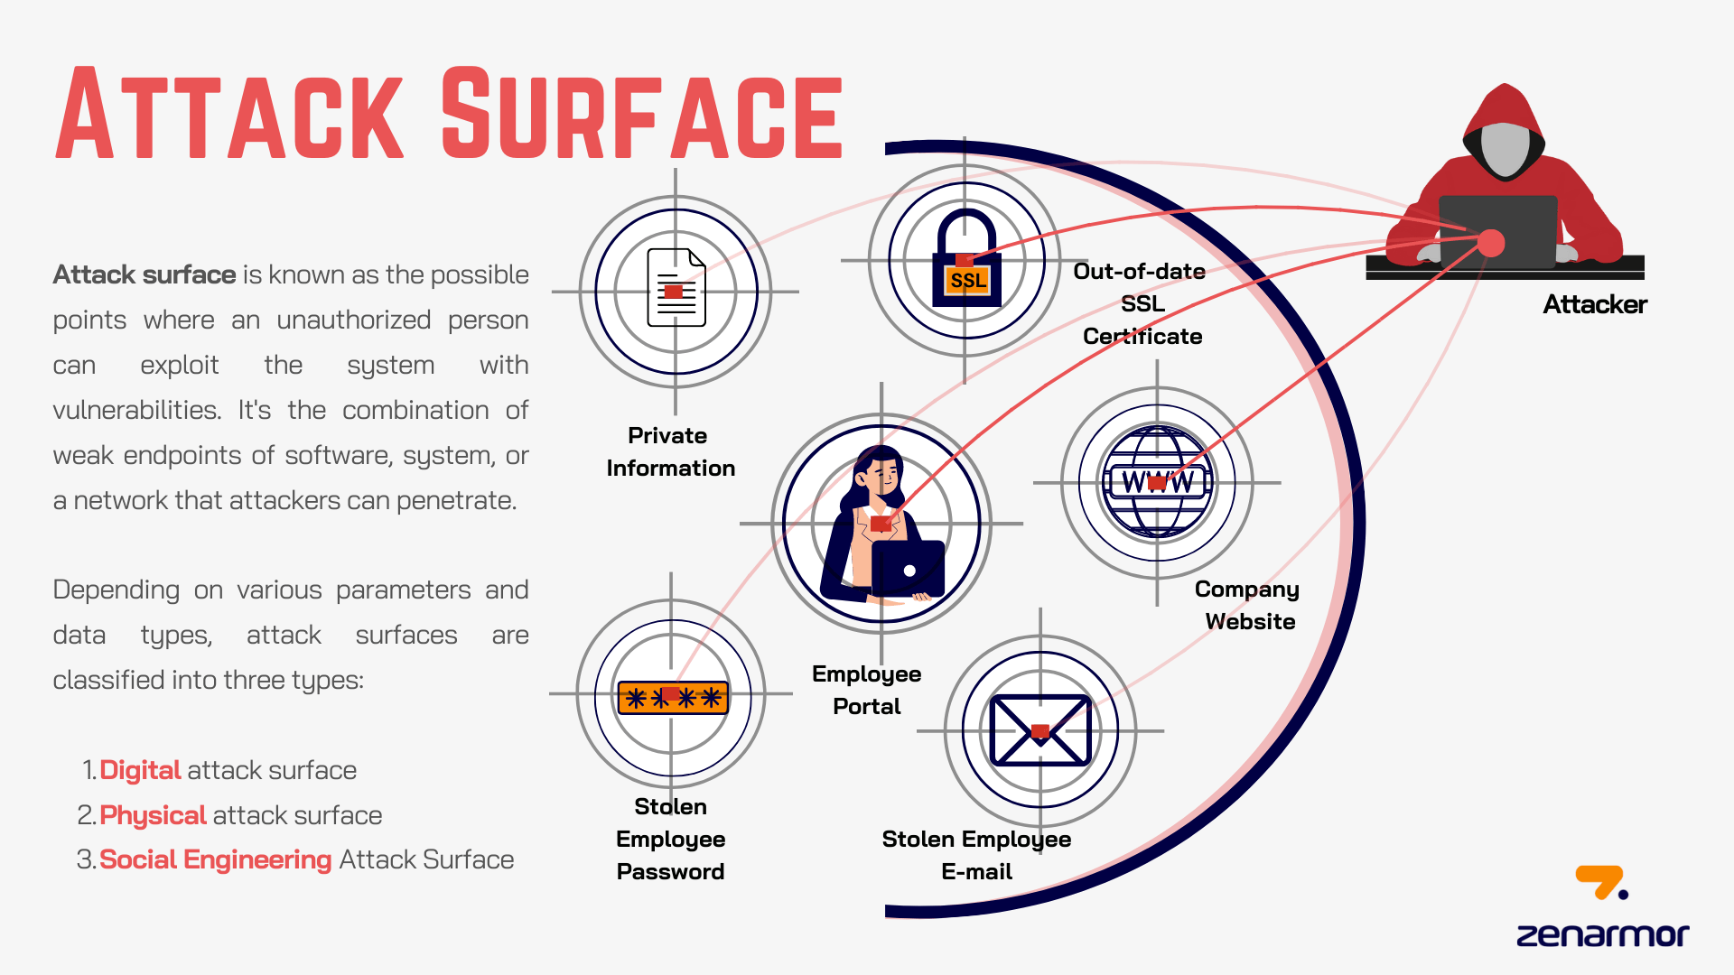

Slide 5
Tabletop Exercise: Hardening a Pre-Compromised Linux System
Your organization's security team has discovered indicators of compromise (IoC) on a Linux server hosting critical applications. The server is still operational, but forensic analysis suggests an attacker may have gained a foothold. The team must assess the extent of the compromise, contain the threat, and implement hardening measures to prevent further exploitation.

Slide 6
Objectives
Identify signs of compromise and determine attacker persistence.
Contain and mitigate the active threat while maintaining business continuity.
Harden the system to prevent future attacks.
Evaluate lessons learned and update security policies.

Slide 7

Group Activity
Get into groups of 2-3 and plan out how you would approach the initial hardening of the system

Slide 8
Critical Actions for a Compromised Machine
Change your password and reset any compromised user credentials.
Check for currently active users and terminate any unauthorized sessions.
Review user groups and permissions; remove unauthorized users.
Inspect and remove unauthorized cron jobs and custom systemd services.
Verify binary integrity against known good hashes.
Audit installed packages and running processes, removing unnecessary or malicious ones.
Analyze system logs for suspicious activity or network traffic.
Check for password or key loggers.
Change all passwords again after system integrity is verified.
Configure and enforce firewall rules.
Audit file and folder permissions for least privilege access.
Update all packages to the latest versions.

Slide 9
Words of Cauation
There are system files in Linux that may appear suspicious but are essential for the OS and critical processes.
Deleting them without verification can break the system or disrupt functionality.
Always confirm with your team or research online before removing a malicious file you suspect.

