Slide 1
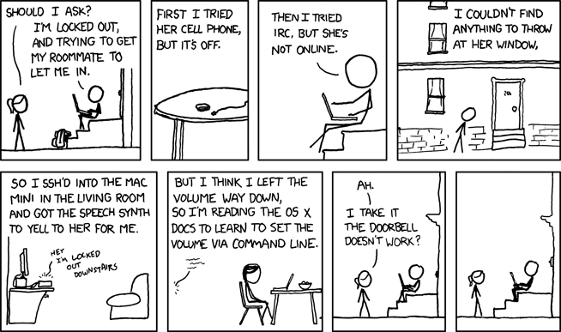
Lecture 5 – Secure Shell (SSH)
IT&C 515R – Applications of Cybersecurity

Slide 2
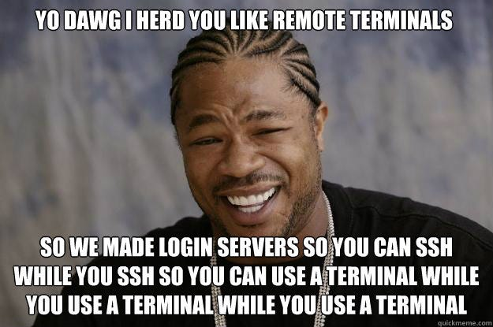
What is Secure Shell (SSH)?
SSH is a cryptographic network protocol used for securely operating network services over an unsecured network. It provides a secure channel for communication between a client and a server.
Key Features of SSH
Encrypted Communication
Remote Command Execution
Real-World Applications
Server Management
File Transfers
Remote Automation
Secure Tunneling

Slide 3

SSH Components
Client: Initiates connections.
Server: Handles requests.
Service: `sshd` (OpenSSH Daemon)

Slide 4
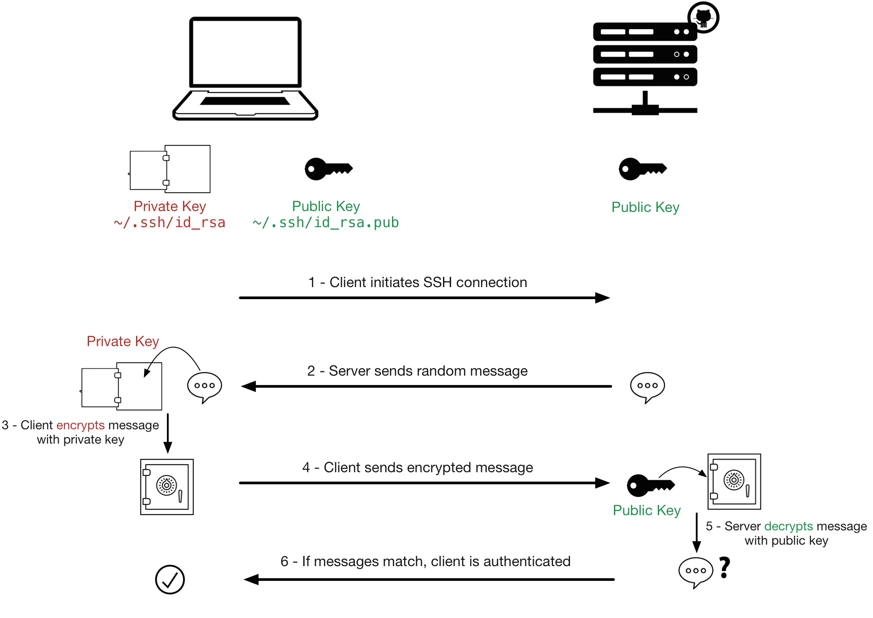
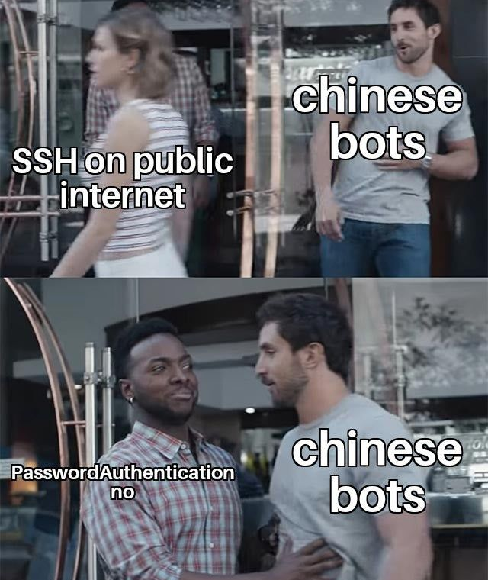
SSH Key Based Authentication

Slide 5

SSH Configuration
Server Configuration File (`/etc/ssh/sshd_config`)
Key options:
PermitRootLogin: Disable root access.
PasswordAuthentication: Enable or disable password-based logins.
MaxAuthTries: Limit login attempts.
MaxSessions: Maximum number of concurrent SSH sessions

Slide 6

SSH Configuration
Generate Key command: `ssh-keygen -t rsa`
NEVER generate the key on the remote host. The private key should never be on the remote host
Copy key to the remote host `ssh-copy-id user@server`

Slide 7

Troubleshooting SSH
Common Issues
Port blocking by firewall.
Incorrect permissions on `.ssh` directory or `authorized_keys` file
Syntax errors in conf files

Slide 8

Questions

