Slide 1
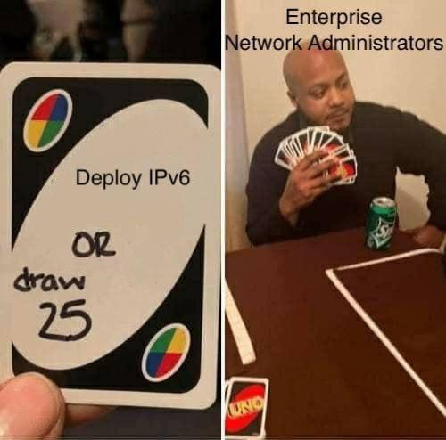
Lecture 8 – Routers
IT&C 515R – Applications of Cybersecurity Training

Slide 2
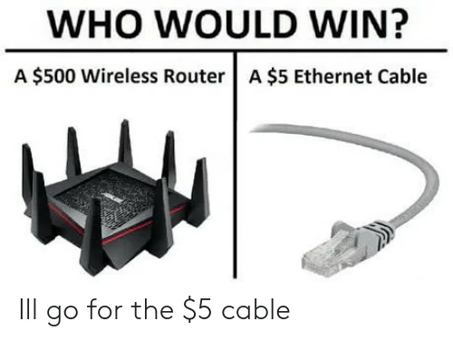
What is a Router?
A router is a networking device that forwards data packets between computer networks.
Key Functions:
Connects multiple networks.
Directs data packets using IP addresses.
Provides traffic management.

Slide 3
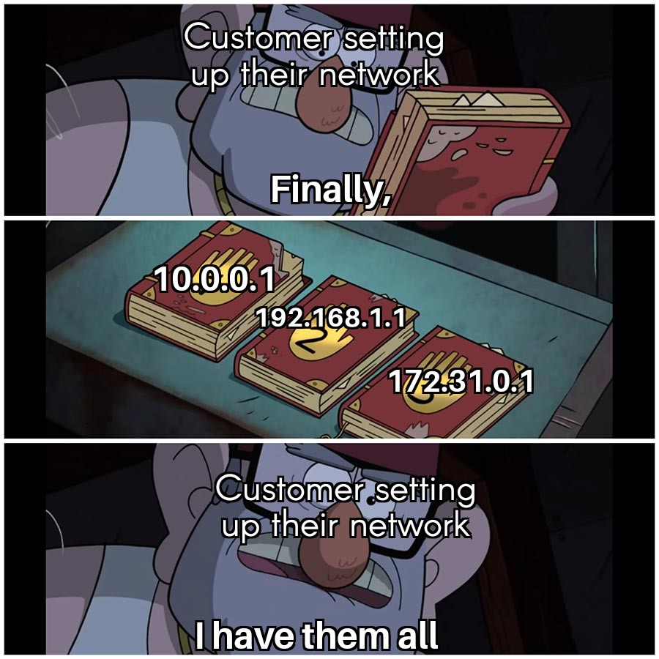
How Routers Work
Routing Process:
Receives data packets.
Inspects destination IP addresses.
Determines the best path using a routing table.
Forwards packets to the next network or device.
Routing Protocols:
Static Routing: Manually configured
Dynamic Routing: Uses protocols like OSPF, BGP, RIP

Slide 4
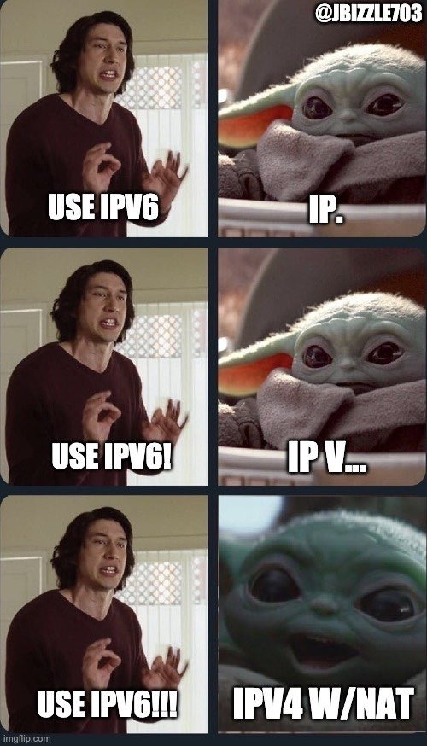
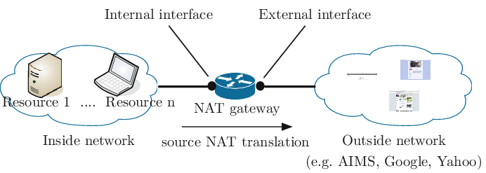
NAT

Slide 5
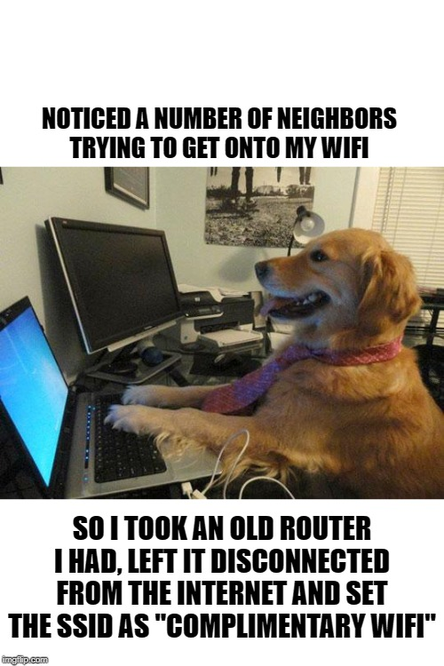
Questions

