Slide 1
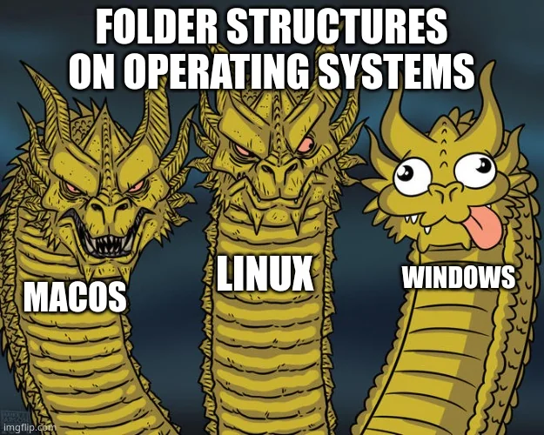
Lecture 4 – OS Structure
IT&C 515R – Applications of Cybersecurity Training

Slide 2

Linux Distributions For This Class
Ubuntu: Debian-based, user-friendly
CentOS: RHEL-based, enterprise focus (deprecated in favor of CentOS Stream)
Rocky Linux: Community-driven RHEL-compatible alternative

Slide 3
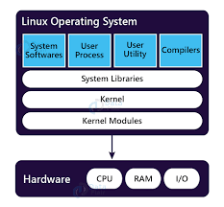
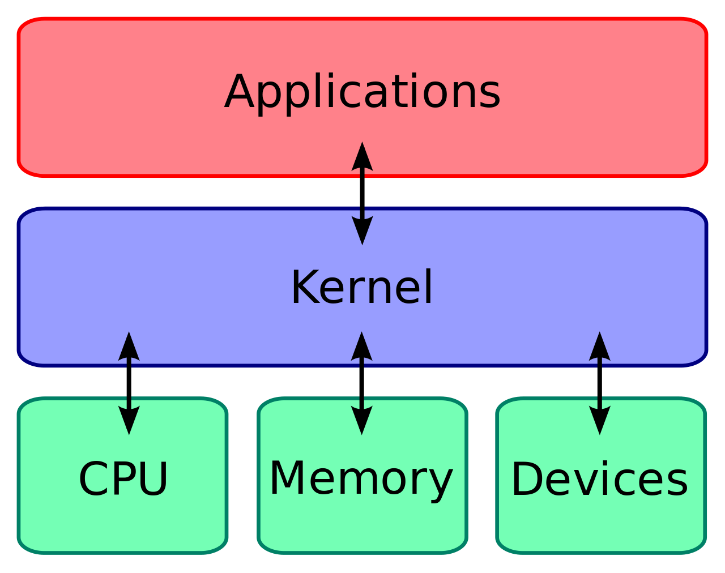
Linux Operating System

Slide 4
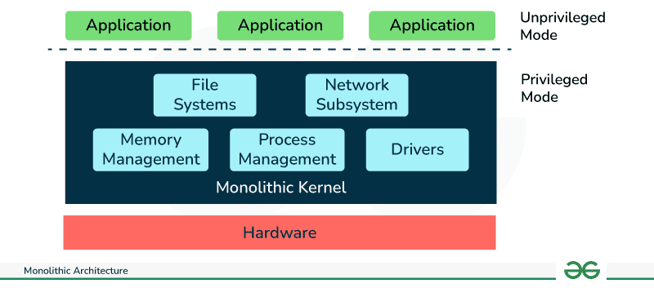
Monolithic Kernel System

Slide 5
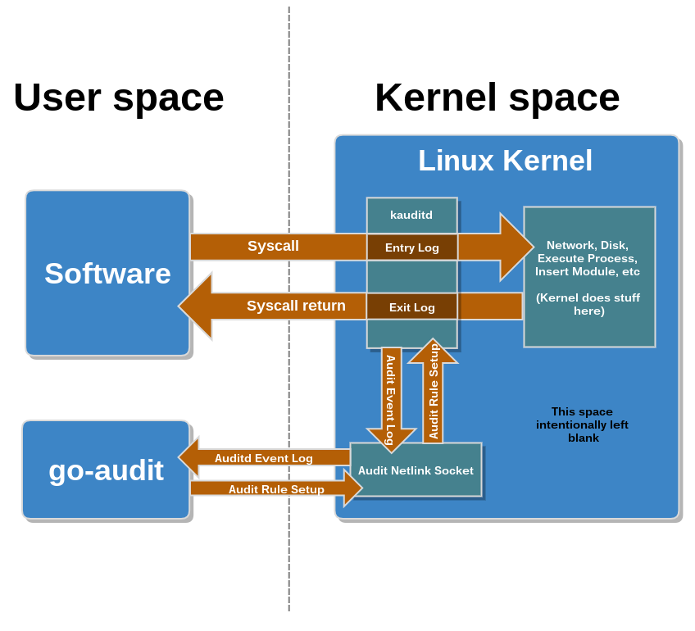
System Calls

Slide 6
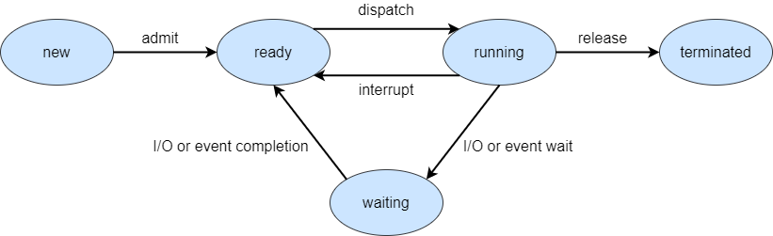
Process States

Slide 7
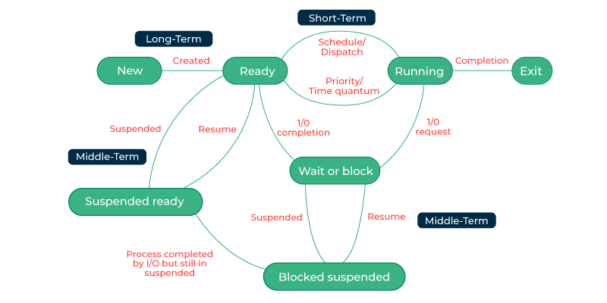
Process Scheduling

Slide 8
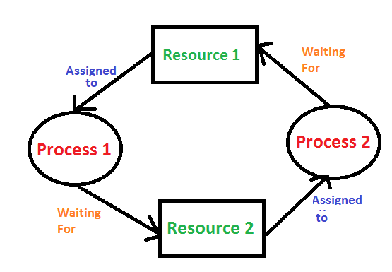
Deadlock

Slide 9

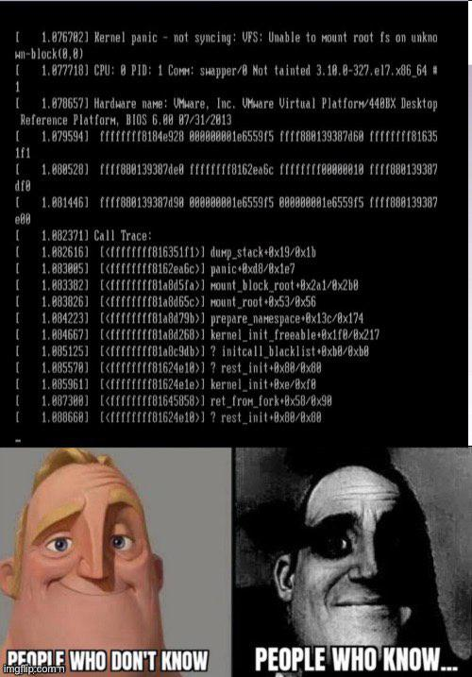

Slide 10
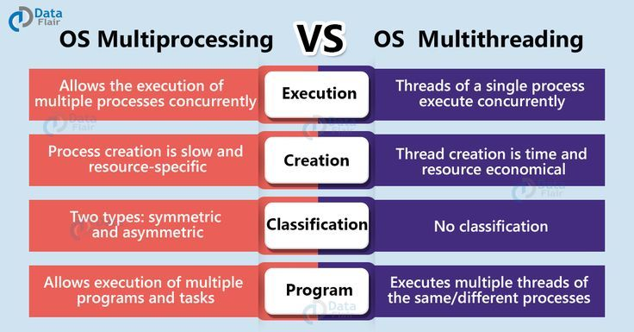
Multiprocessing vs Multithreading

Slide 11
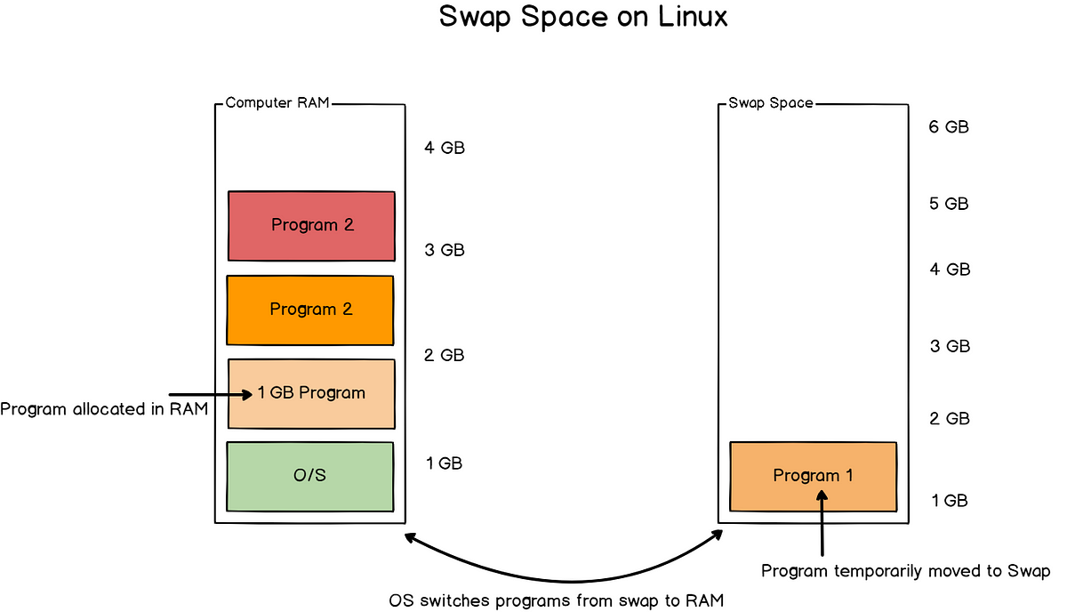
Swap Space

Slide 12
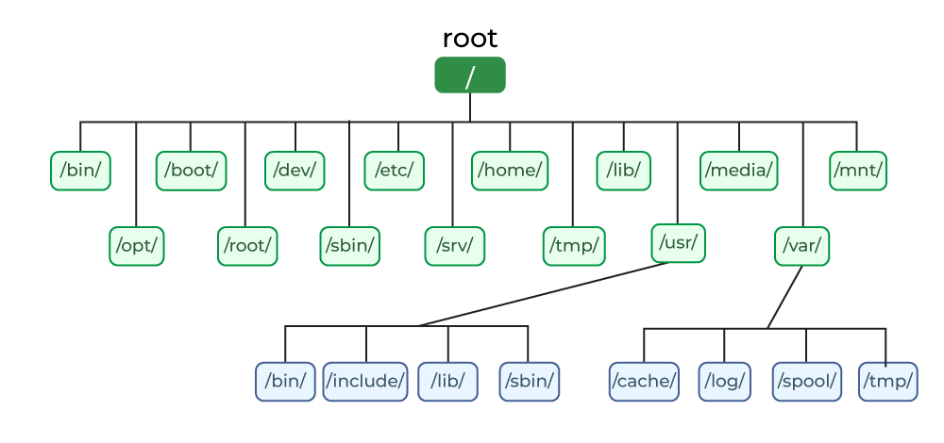
Folder Structure

Slide 13
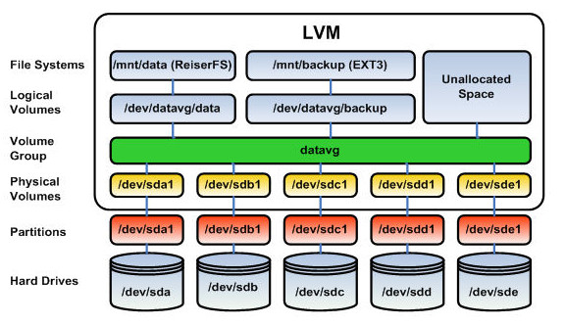
Partitioning and Logical Volume Management

Slide 14
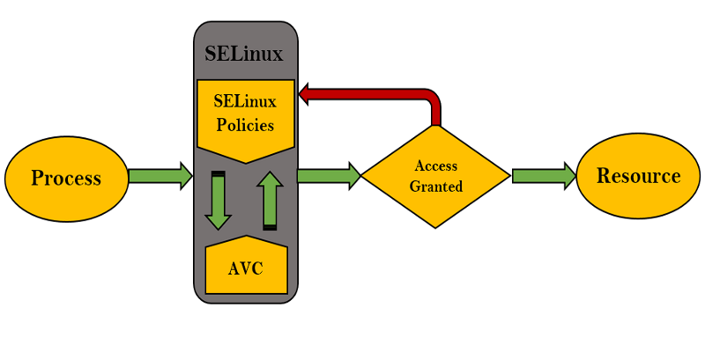
SELinux

Slide 15

Questions

