Slide 1

Lecture 2 – CLI
IT&C 515R – Applications of Cybersecurity Training

Slide 2

What is the Command Line Interface (CLI)?
The CLI is a text-based interface that allows users to interact with their computer.
Key Elements of the CLI
Shell
Commands
Importance in Modern Computing
Efficiency and Speed
Automation and Scripting
Remote System Management
Access to Advanced Tools

Slide 3


Operating System Philosophy: A Meme Perspective
"With great power comes great responsibility." Linux trusts you to make informed decisions, even risky ones, while Windows tries to shield you from yourself.

Slide 4
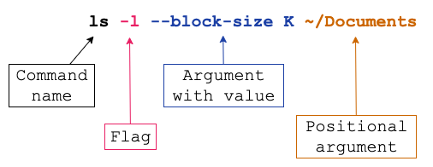
Anatomy of a command

Slide 5

Basic Commands - Navigation
man (manual)
cd (Change Directory)
pwd (Print Working Directory)
ls (List)
-a (All files, including hidden ones)
-l (Long format)

Slide 6
Basic Commands – File Operations
cp <source> <Destination> (Copy)
mv <source> <Destination> (Move/Rename)
rm <file> (Remove/Delete)
touch <file> (Create files)
cat (concatenate/print files)
nano <file> (open file to edit)

Slide 7
Basic Commands – System Information
whoami (current user)
who (current users logged in)
top (real-time system's performance)
df (Disk Free – disk used/remaining)

Slide 8
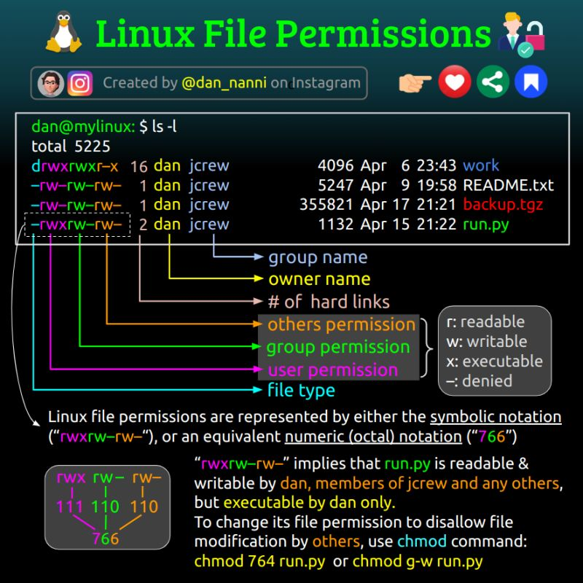
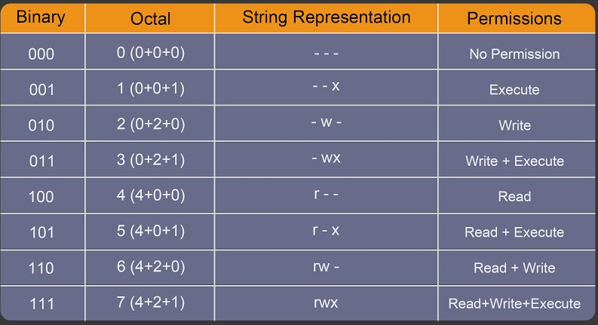
Linux File Permissions

Slide 9
Basic Commands – Owners and Permissions
chmod <permission> <file> (change file permissions)
chown <user>:<group> <file> (change file owner and group)

Slide 10
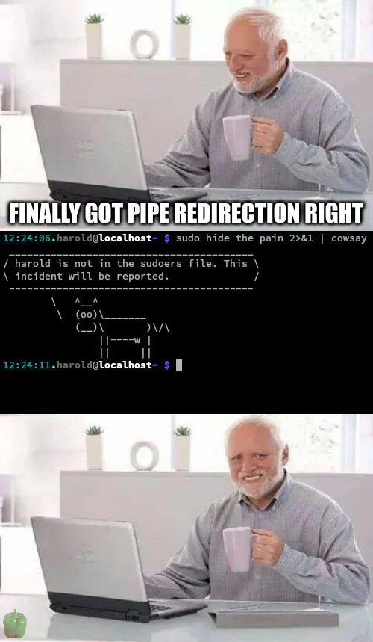
Redirection and Pipelines
> (Output Redirection) - Redirects the output of a command to a file, overwriting its contents if the file already exists.
>> (Append Output) - Redirects the output of a command to a file, appending its contents if the file already exists.
< (Input Redirection)
| (Pipe) - Allow the output of one command to be used as the input for another command.
Examples:
ls -l | sort
grep "warning" log.txt | sort | uniq | wc -l
cat file.txt | grep “error” | sort > errors_sorted.txt
cat file2.txt | grep “error” | sort >> errors_sorted.txt
wc < file.txt

Slide 11

Shortcuts
Up Arrow / Down Arrow - Scroll through previous commands in history.
Ctrl + R - Search through command history interactively.
!! - Execute the last command again.
sudo !! - Execute the last command with sudo
!n - Execute the nth command from the history.
!string - Re-run the most recent command starting with string.

Slide 12

Questions

