Slide 1
Lecture 6 - FTP
IT&C 515R – Applications of Cybersecurity Training

Slide 2
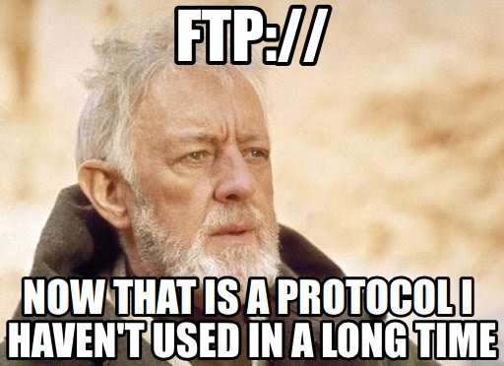
What is File Transfer Protocol (FTP)?
FTP is a standard network protocol used to transfer files between a client and a server over a network.
Purpose:
Facilitate the exchange of files, whether for personal, development, or enterprise purposes.
Supports features like file upload, download, and directory management.

Slide 3
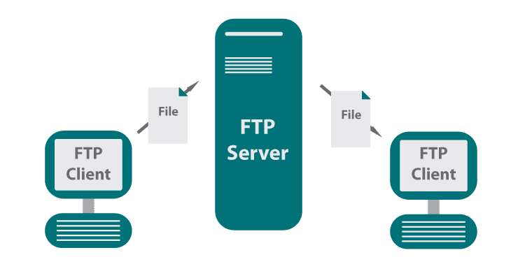
How It Works
FTP uses a client-server model:
The client connects to the server to upload or download files.
The server manages access, permissions, and file storage.
Communication occurs over two channels:
Command Channel: Handles commands and responses.
Data Channel: Transfers file contents.

Slide 4
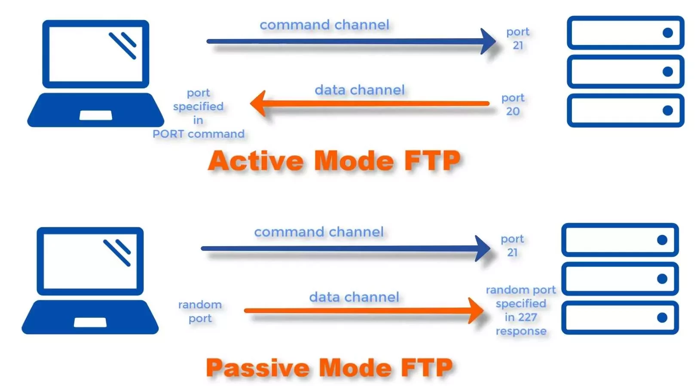

Slide 5
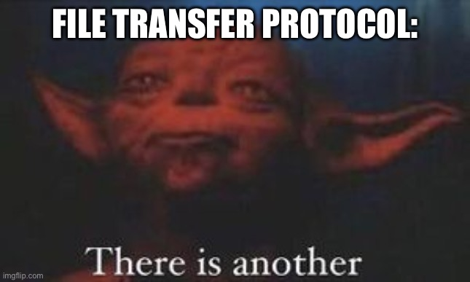
What is VSFTPD?
VSFTPD stands for Very Secure FTP Daemon. It is a highly secure and fast FTP server for Unix-based systems.
Purpose:
Provides a secure and reliable solution for file transfer services using the FTP protocol.
Mitigates the security risks inherent in traditional FTP implementations.

Slide 6
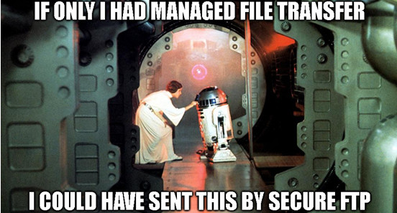
Key Features of VSFTPD
Security:
Strong focus on minimizing vulnerabilities.
Implements secure user isolation with chroot jail.
Supports SSL/TLS encryption for FTPS.
Optional anonymous access for distributing public files while ensuring strict access control.

Slide 7
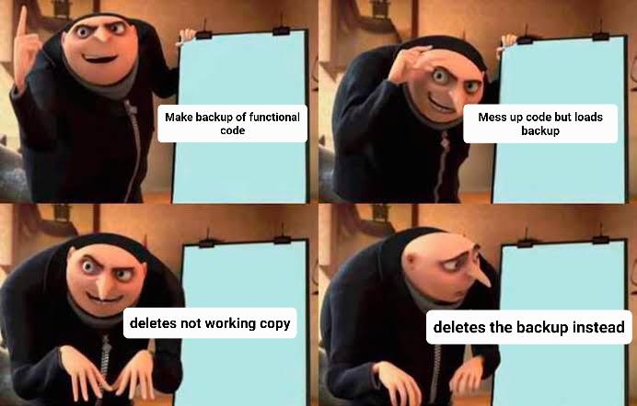
VSFTPD Config
connect_from_port_20=YES​
anon_mkdir_write_enable=NO​
anon_mkdir_write_enable=NO​
write_enable=YES​
anonymous_enable=NO​
userlist_enable=YES
userlist_deny=NO
userlist_file=/etc/vsftpd.userlist
local_root=/mnt/files

Slide 8
VSFTPD Config
Make sure you make a backup of the config to a safe location BEFORE modifying it and after getting it working.

Slide 9

Questions

