Slide 1

Lecture 3: Networking
IT&C 515R – Applications of Cybersecurity Training

Slide 2

What is a network?
A network is a collection of interconnected devices (computers, servers, printers, etc.)
These devices communicate through various transmission media (wired or wireless).

Slide 3
Importance of Networking
Facilitates communication and collaboration: Email, video conferencing, and instant messaging.
Enhances resource sharing: Access to files, applications, and hardware devices.
Supports remote work and telecommuting: VPNs and cloud services.
Drives business operations: E-commerce, databases, and customer relationship management.

Slide 4
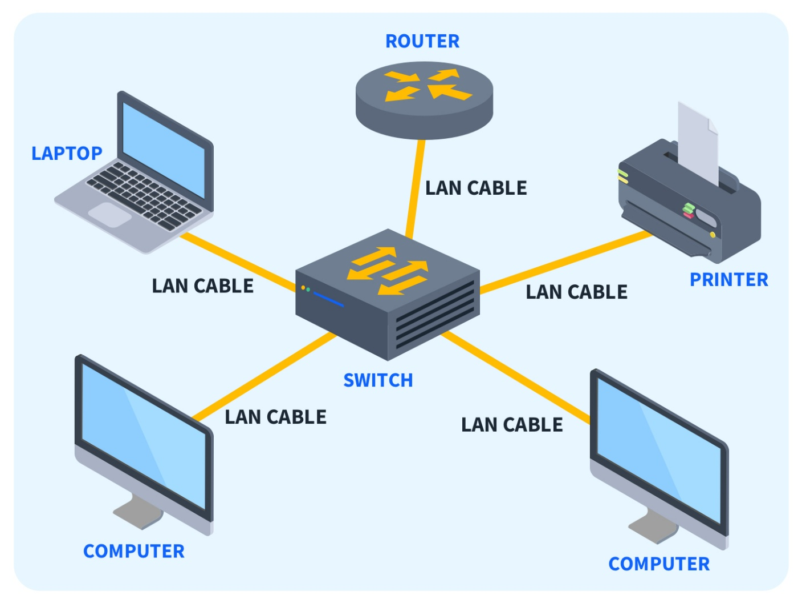
Local Area Network (LAN)

Slide 5
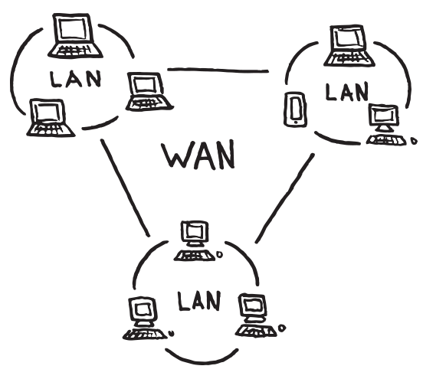
Wide Area Network (WAN)

Slide 6
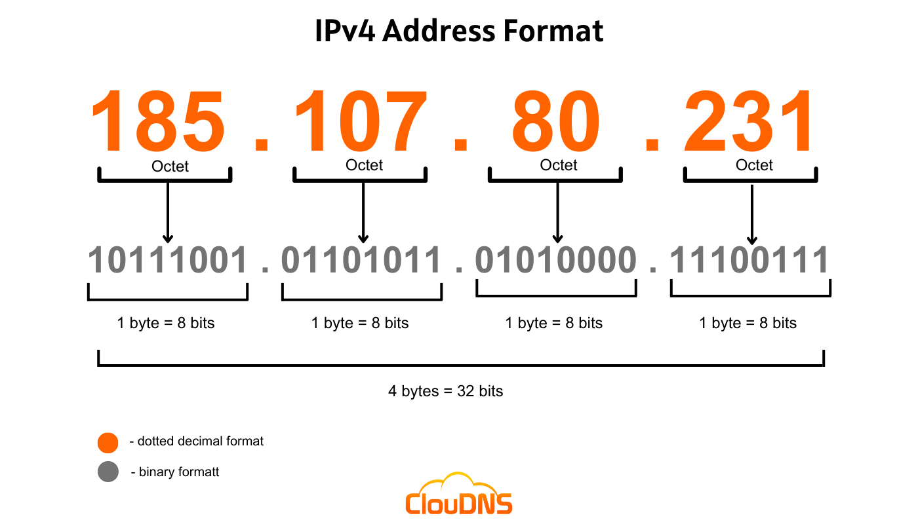
IP Addresses

Slide 7
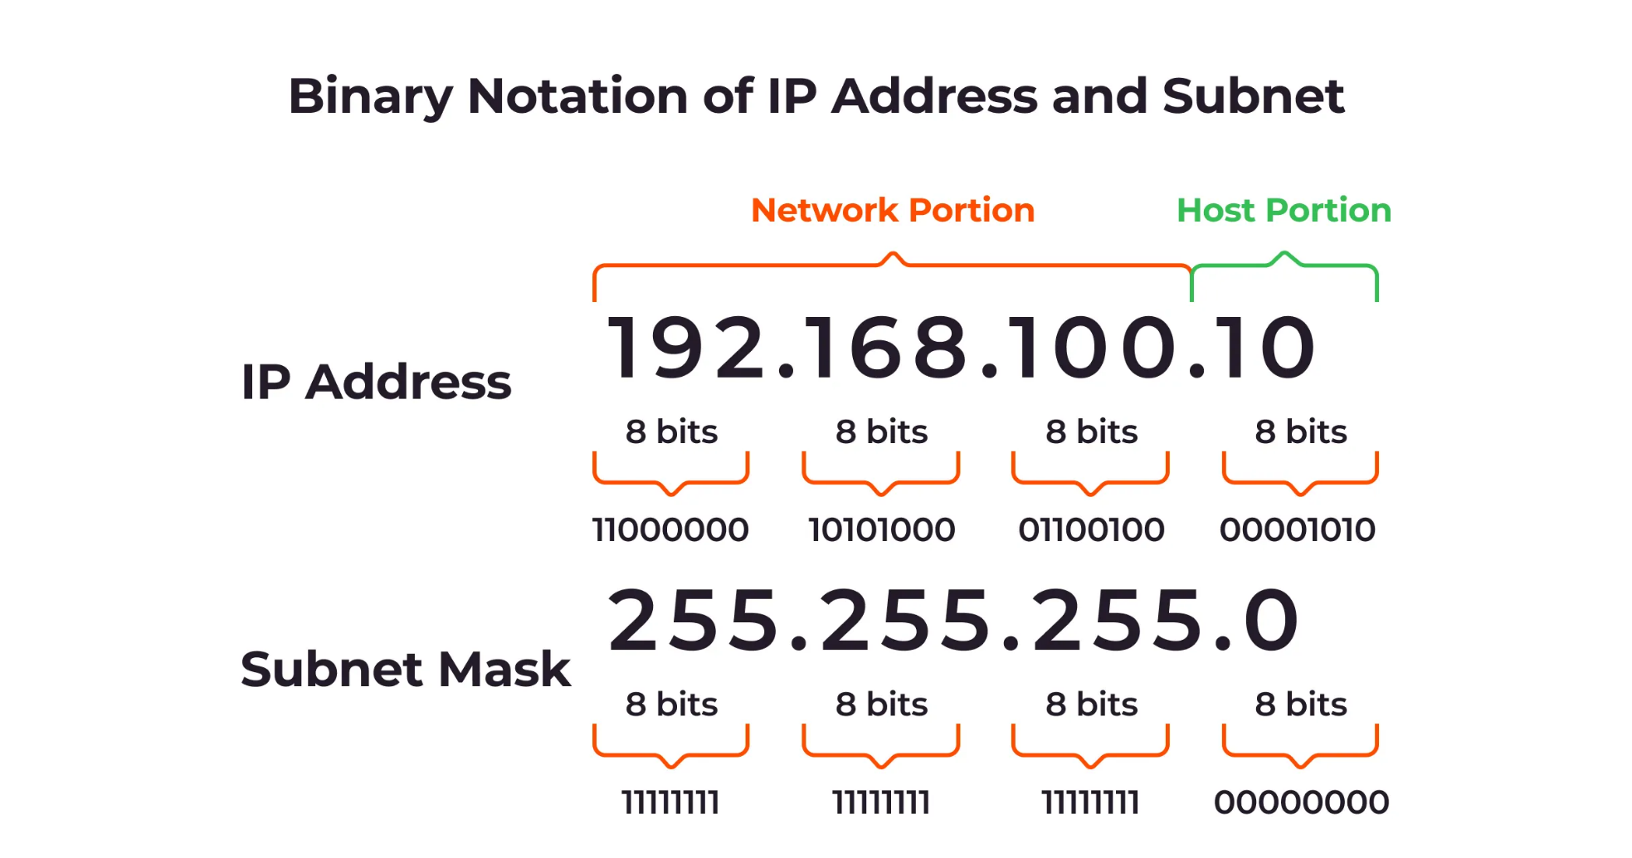
Subnetting

Slide 8
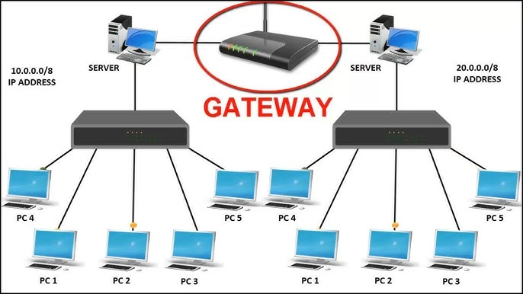
Gateway

Slide 9
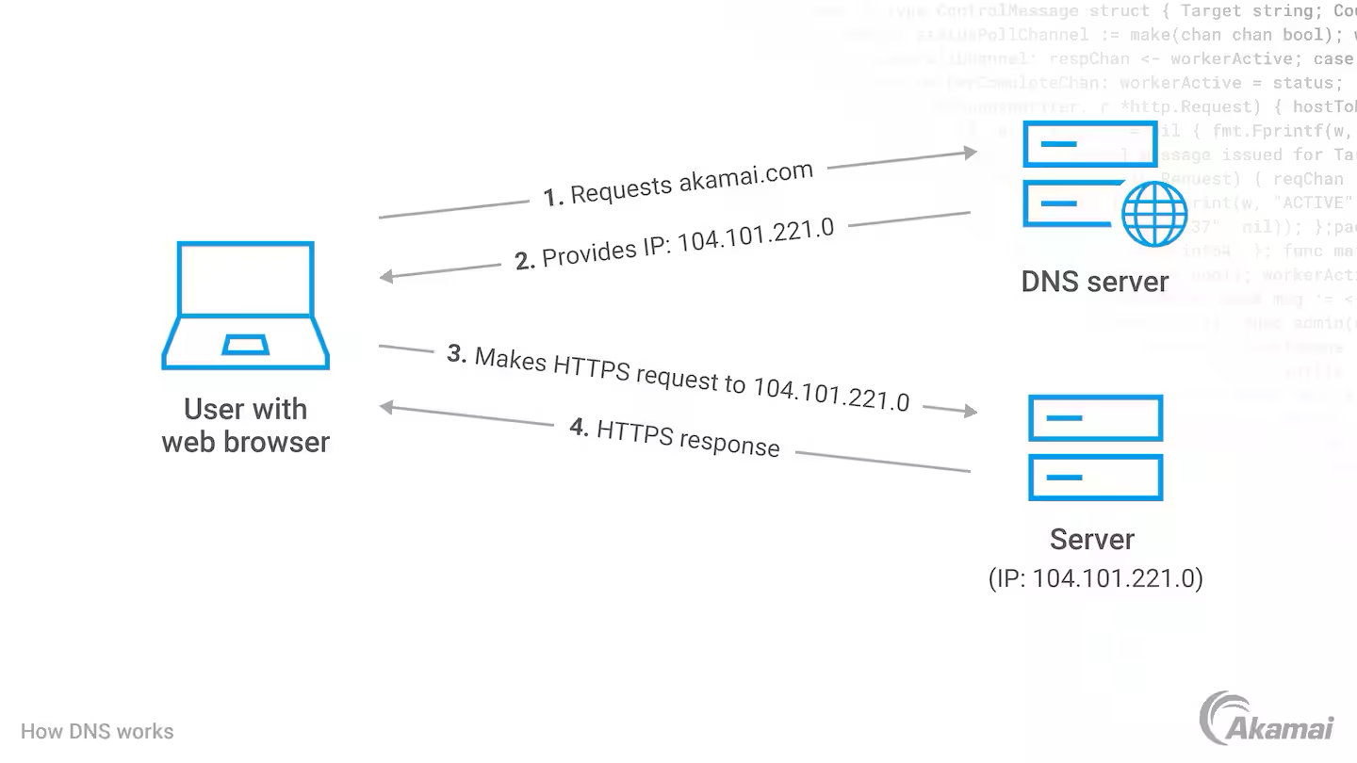
Domain Name System (DNS)

Slide 10
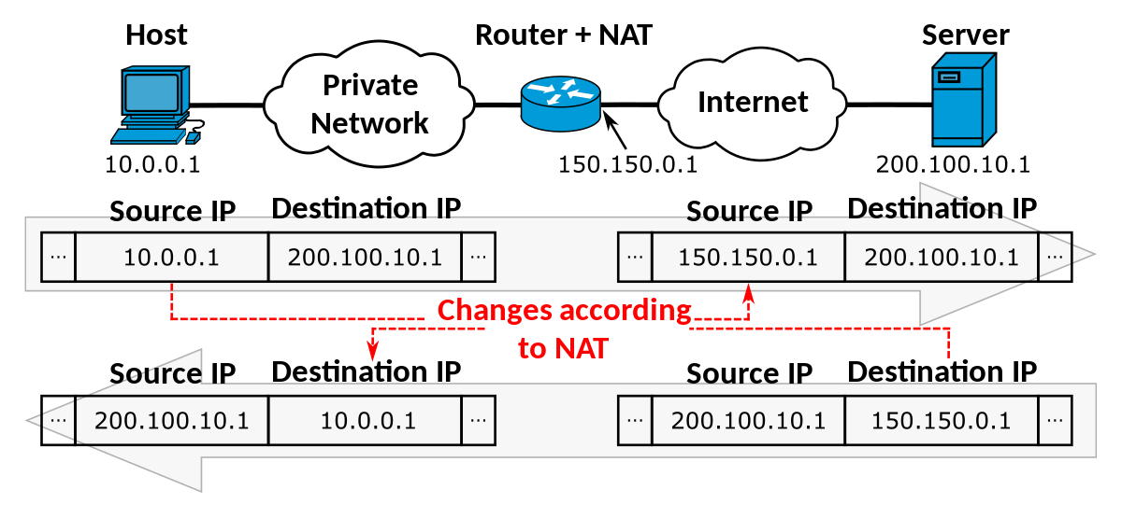
Network Address Translation (NAT)

Slide 11

TCP VS UDP

Slide 12
