Slide 1

Lecture 9 - Firewalls
IT&C 515R – Applications of Cybersecurity Training

Slide 2
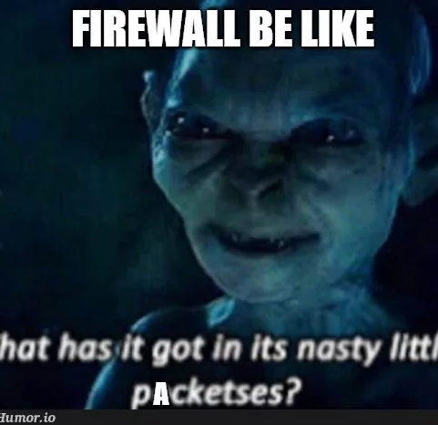
What is a Firewall?
A firewall is a network security system that monitors and controls incoming and outgoing network traffic based on security rules.
Key Functions:
Blocks unauthorized access
Filters traffic based on policies
Logs and monitors traffic.

Slide 3

Types of Firewalls
Host-Based Firewalls: Protect individual devices (e.g., Linux firewalls).
Network Firewalls: Protect entire networks (e.g., hardware appliances).
Packet-Filtering Firewalls: Analyze headers to allow or block traffic.
Stateful Firewalls: Track connection states for more advanced filtering.

Slide 4

Linux Firewall Tools Overview
UFW (Uncomplicated Firewall): Simplified interface for iptables.
iptables: A low-level, rule-based packet filtering system.
Firewalld: A dynamic, modern firewall management tool.

Slide 5

UFW
UFW is a user-friendly interface for managing iptables firewall rules
Designed to be easy to use, even for beginners.​
Default Deny Incoming
Default Allow Outgoing
Application Integration
New rules apply to new connections not existing

Slide 6

Firewalld
firewalld is a dynamic firewall management tool for Linux systems
Zones: firewalld organizes rules into predefined zones such as public, internal, and external.
Rule Types
Default Zone Rules​
Service Rules
Port Rules
ICMP Rules
Masquerade and Forwarding

Slide 7

iptables
iptables allows users to filter and control network packets based on various criteria, including IP addresses, ports, and protocols.​
Rule Types:​
Input Rules
Output Rules
Forward Rules

Slide 8

Questions

