Slide 1
Introduction & Syllabus
IT&C 151R – Applications of Cybersecurity Training (ACT)

Slide 2
Prerequisites & Textbook
None. However, IT&C 101 and IT&C 247 would be advantageous.
There is no required textbook for this course. Reading assignments will be listed on the Learning Suite Schedule and be free to access for all students.

Slide 3
Learning Outcomes
Securely configure and debug errors in common services and systems such as SSH, FTP, DNS, Web servers, Database servers, Backup Servers, Routers & Firewalls
Develop methodical approaches to diagnose and solve complex problems
Apply best practices to identify and mitigate common vulnerabilities and implement defensive measures at the host and network levels

Slide 4
Learning Outcomes
Monitor systems for signs of compromise through log analysis, configuration validation, and observing network traffic
Demonstrate sound practices for preventing and responding to malicious programs, configurations, and/or users in a competitive environment
Collaborate effectively as part of a security team and clearly communicate essential tasks, findings, and recommendations in a constrained environment
Use standard tools and custom scripts to perform basic security automation tasks such as user creation, modification & auditing of configurations, and general threat hunting.

Slide 5
Assignments
7 Fortnightly Reflections - 7%
6 Memes - 3%
10 Homework Assignment- 20%
10 Individual Labs - 40%
2 Team Labs - 10% - These will be on a Saturday
3 Exams (2 Midterms, 1 Final) - 20%

Slide 6
Grading Scheme
Pass (C)
Represents the minimum amount of work to pass an assignment
Merit (B)
Indicates a good standard of work above the basic pass level.
Distinction (A)
Signifies an exceptional level of performance and represents the highest possible grade within an assessment or program.

Slide 7
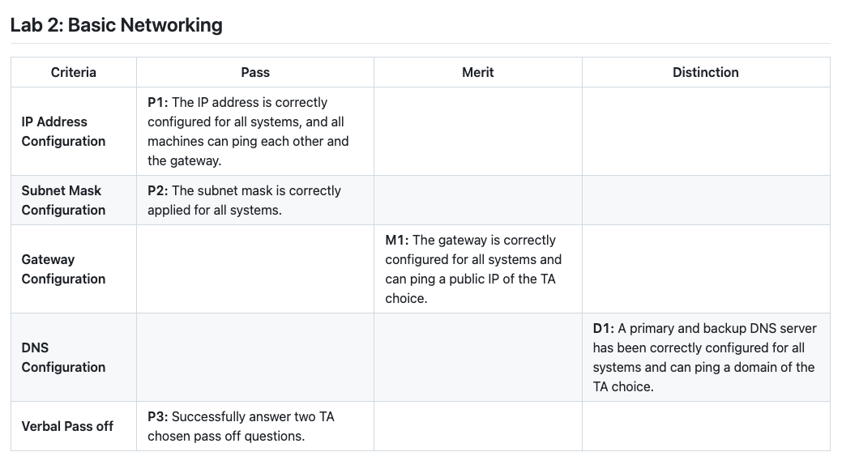
Lab Resources

Slide 8
Late work
You will be given 4 grace days for the entire semester. Grace days may be used on:
Biweekly Reflections
Memes
Individual Labs
Grace days may not be used on:
Homework assignments
Team labs
Exams
If you run out of grace days or choose not to use them the late penalty will be 10% a day up to 50%. Late penalties only apply to the same assignments grace days can be used for. All other assignments will not be accepted late.

Slide 9
Lab Resources
Homework Questions
Class Resources Repository
Classmates/Teammates
Internet Resources
Teaching Assistants
Please reach out to the TAs only after making a genuine effort to resolve the issue independently. Their role is to guide your learning, not to provide immediate solutions. Proactively approach challenges to develop your problem-solving skills.

Slide 10
Importance of Problem-Solving Skills
Why Problem-Solving and Critical Thinking Matter:
Fundamental to your education and personal growth.
Aligns with the Aims of a BYU Education:
Key Benefits:
Essential for sound reasoning, effective communication, and intellectual depth.
Prepares you to succeed in both academic and real-world challenges.
Promotes lifelong learning and confidence to contribute meaningfully.

Slide 11
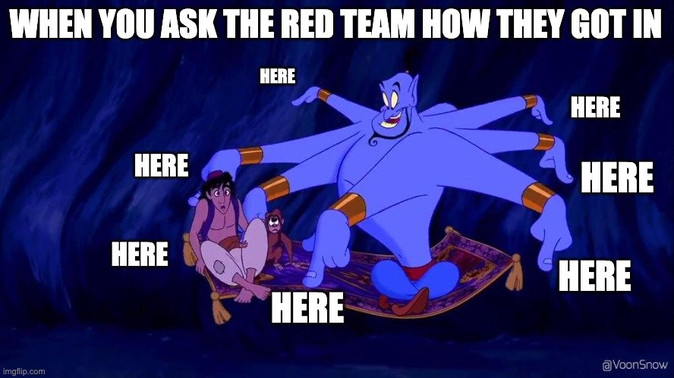
NCAE Cyber Games
Participation is highly recommended, but it is optional for this class.

Slide 12

What are the NCAE Cyber Games?
NCAE Cyber Games is a cyber security competition for college students who have never participated in a competition or hackathon before. Cyber competitions are a great way to build your skills and learn about the industry, but they can be intimidating if you’ve never tried one before.

Slide 13

Why do it?
If you’re thinking about pursuing a career in cybersecurity, participating in cyber competitions provide several big benefits:
It Looks Great On Your Resume
It Helps You Find Your Place In The Field
It Helps Build Your Network
It's Fun

Slide 14
What You Will Learn
Detecting and Defending Against Active Attacks
Troubleshooting and Problem Solving
Critical Thinking
Setting Up and Securing Services
SSH
FTP Servers
Web Servers
Databases
Backups
Routers
Firewalls

Slide 15
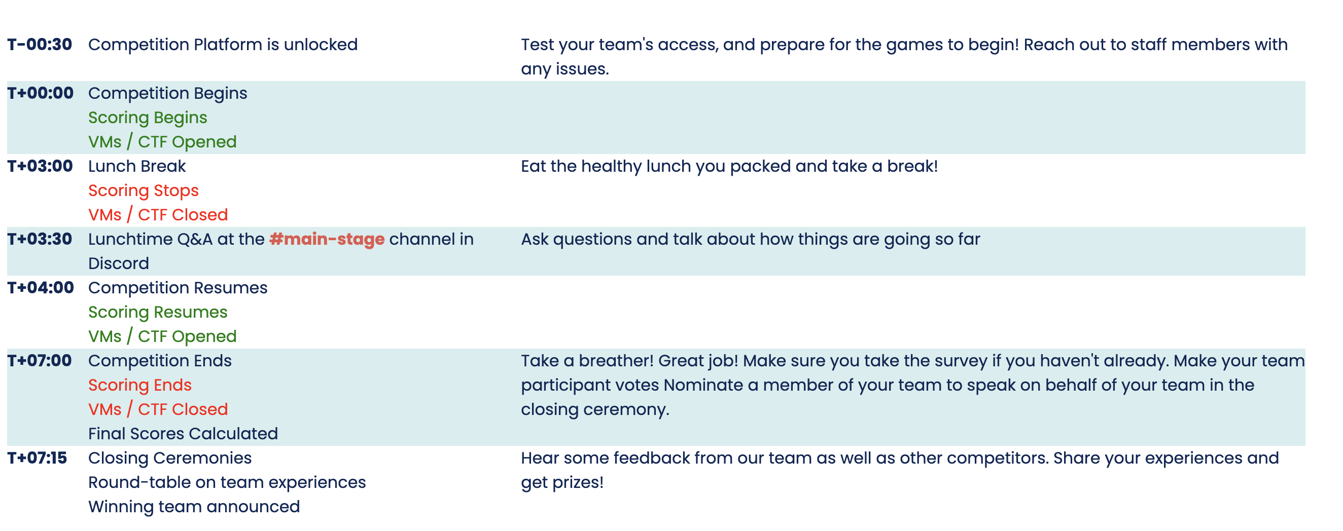
Competition Schedule
Totaled to be about 8 hours

Slide 16
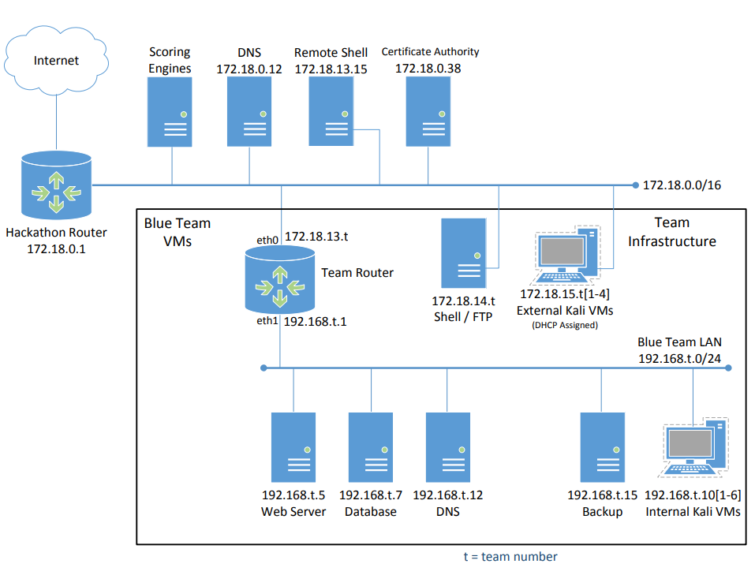

Slide 17
Who's Eligible?
Participants must be:
Actively enrolled students at the institution they are representing
New to cybersecurity competitions
Here to learn, grow, and experience an entry-level competition
Participants are not allowed to participate if they:
Have participated in the NCAE Cyber Games Competition twice previously
Have participated as a team member or alternate to any more advanced competitions

Slide 18

Upcoming Assignments
Vulnerability Report 1 & Lab 1 – CLI – Thursday 16th
Homework 1 – Basic Networking & Homework 2 – OS Structure – Friday 17th BEFORE CLASS

Slide 19

Questions?

