Slide 1
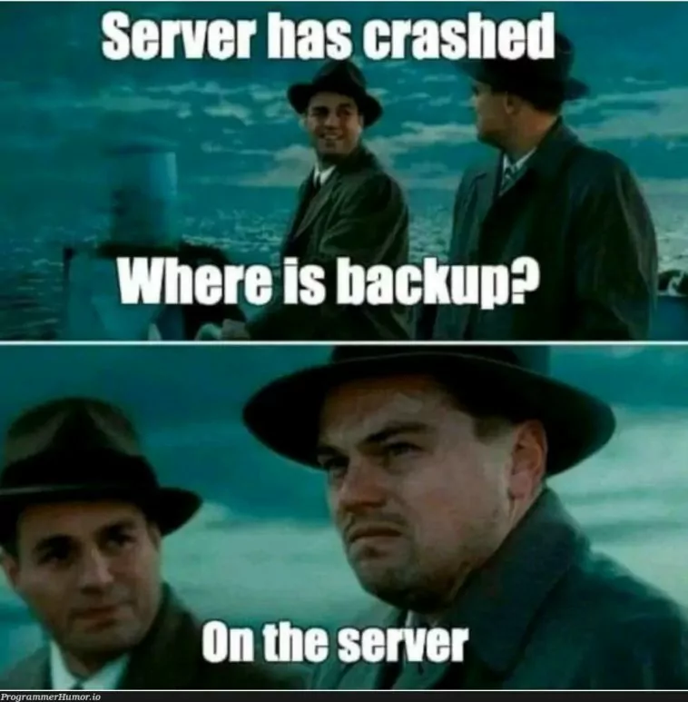
Lecture 11 - Backups
IT&C 515R – Applications of Cybersecurity Training

Slide 2
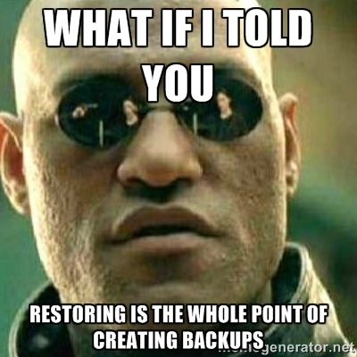
What Are Backups?
A backup is a copy of data stored separately to protect against loss, corruption, or accidental deletion.
Importance:
Safeguards against hardware failure
Protects against accidental deletion or corruption
Ensures business continuity in case of disasters AKA the Redteam
Types of Backups:
Full Backup
Incremental Backup
Differential Backup

Slide 3
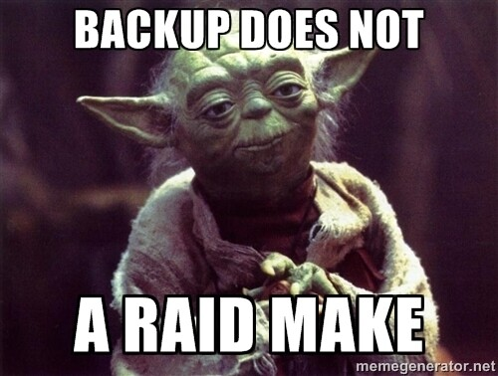
What is RAID?
Redundant Array of Independent Disks (RAID) is a data storage virtualization technology.
Protects against hardware failure but does not prevent data loss due to other factors like accidental deletion.
RAID is NOT a Backup

Slide 4

What is Rsync?
Rsync is a command-line utility for efficiently syncing files and directories between locations.
Key Features:
Incremental file transfers
Fast and efficient
Preserves file permissions, ownership, and timestamps
Common Use Cases:
Backing up files locally
Syncing data to remote servers
Automating periodic backups

Slide 5
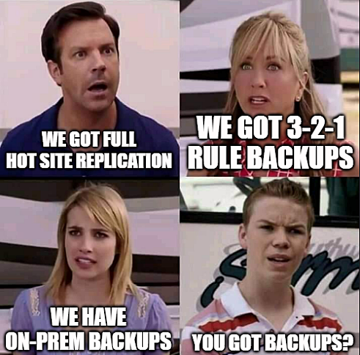
Best Practices for Backups
Follow the 3-2-1 Rule
3 copies of your data
2 different storage media
1 copy offsite
Use Encryption
Protect sensitive data at rest and in transit
Test Your Backups
Periodically verify that backups are complete and restorable
Automate the Process
Use tools like Rsync, Rclone, or dedicated backup software

Slide 6
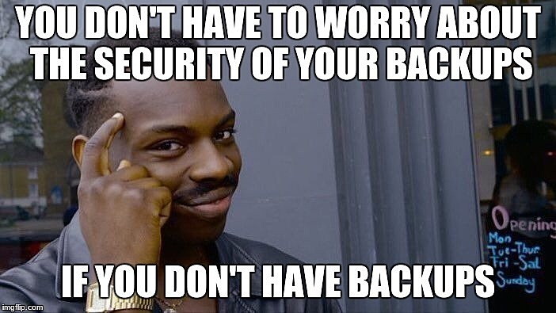
Questions

