Slide 1
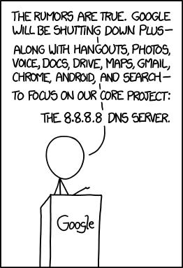
Lecture 7 - DNS
IT&C 515R – Applications of Cybersecurity Training

Slide 2
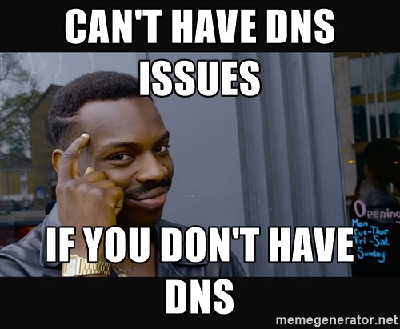
What is Domain Name System (DNS)?
Maps human-readable domain names (e.g., example.com) to IP addresses (e.g., 192.168.1.1).
Hierarchical and distributed database.
Key Concepts:
Hostname resolution: Connecting names to resources.
Domain hierarchy: Root (.), TLD (.com), and subdomains (www).

Slide 3
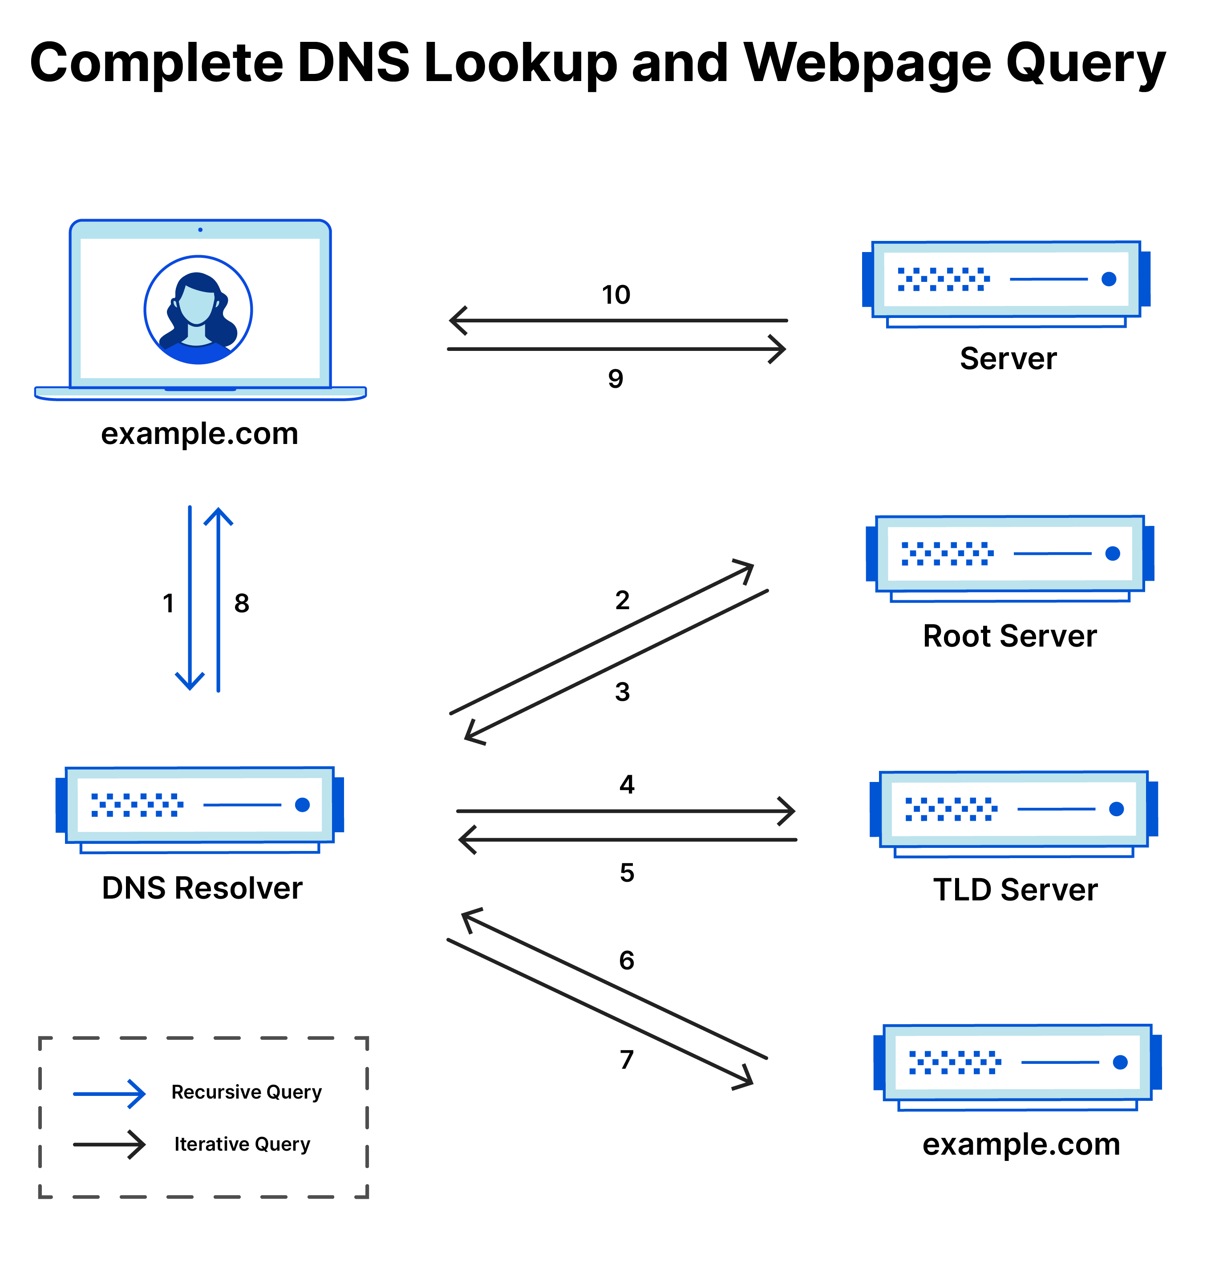
How it works

Slide 4
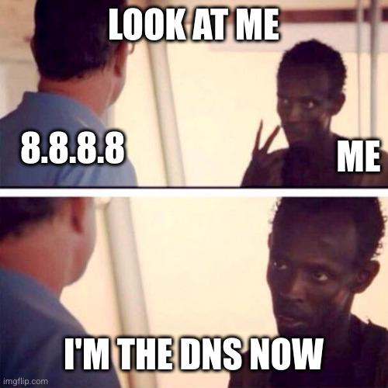
What is BIND9?
BIND: Berkeley Internet Name Domain.
Most widely used DNS server software.
Supports authoritative, recursive, and caching DNS.
Features:
Zone management.
Flexible configuration for enterprise and personal use.
Secure DNS features (DNSSEC).

Slide 5

DNS Record Types
Type | Purpose | Example
A | Maps a domain to an IPv4. | example.com → 192.168.1.1
AAAA | Maps a domain to an IPv6. | example.com → 2001:db8::1
CNAME | Alias of another domain. | www → example.com
MX | Mail exchange record. | Mail → mail.example.com
TXT | Text data for services (e.g., SPF). | SPF → v=spf1 +all
PTR | Maps an IP address to a domain | 192.168.1.1 → example.com

Slide 6
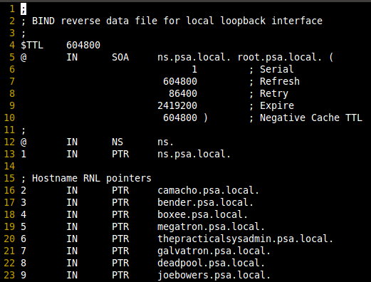
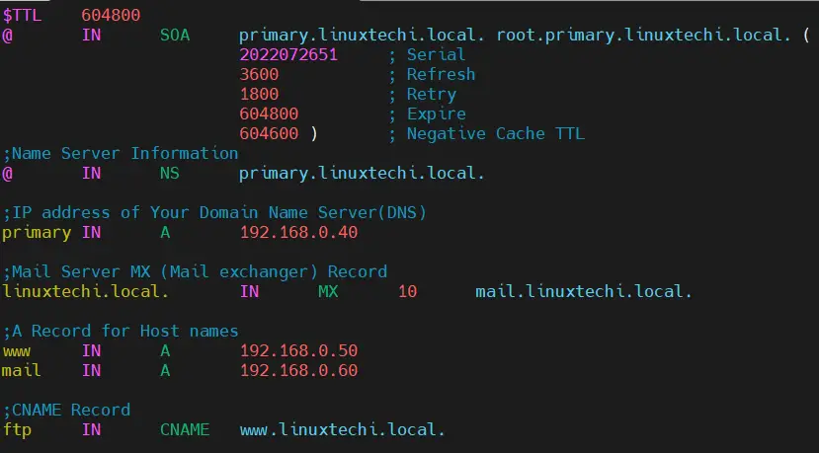
Zone File Examples

Slide 7
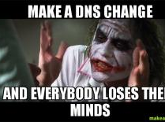
Troubleshooting BIND92
Zone file errors: Typos or missing entries in zone files.
Permissions: Ensure BIND9 has access to zone files.
Check syntax:
sudo named-checkconf
sudo named-checkzone example.com /etc/bind/zones/db.example.com

