Slide 1
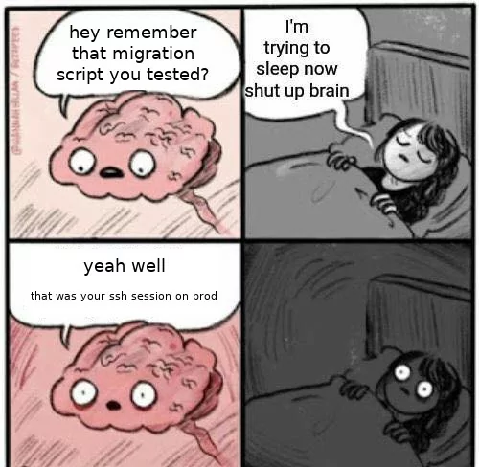
Lecture 16 – Script Writing
IT&C 515R – Applications of Cybersecurity Training

Slide 2
Script Approval
Before you begin creating your script the idea needs to be approved to ensure it meets the minimum requirements. Your script must work on both Ubuntu and CentOS 7.
Ideas
Automated Firewall Configuration
Checksum Integrity Verifier
Database Security Checker
DNS Setup
FTP Security Checker
Open Port Enumerator
Process Monitor for Suspicious Activity
Sensitive File Scanner
SSH Security Checker
Suspicious Network Activity Logger
User Account Monitoring

Slide 3

Scheduling and Automation
Use tools like cron or system
* * * * * bash /path/to/script.sh – run the bash script every minute
*\2 * * * * python3 /path/to/script.py – run the python script every 2 minutes

Slide 4
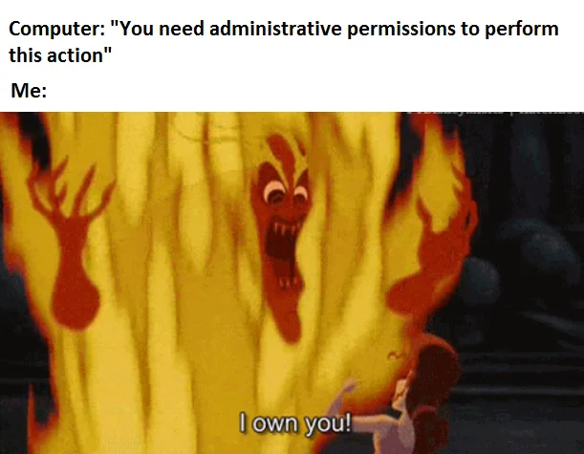
File permissions
Does it need sudo?
What user is running the task?
Standard permissions will typically be 700

Slide 5
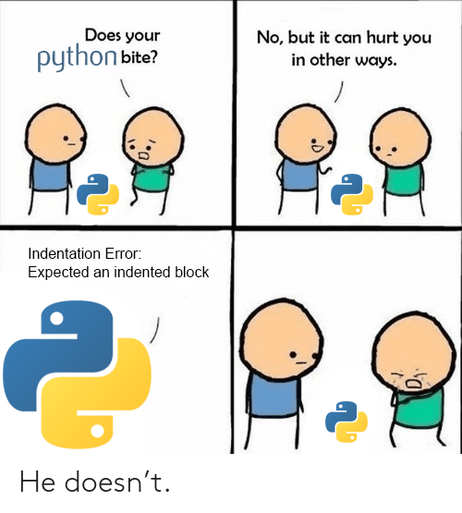
Basic Python Syntax

Slide 6
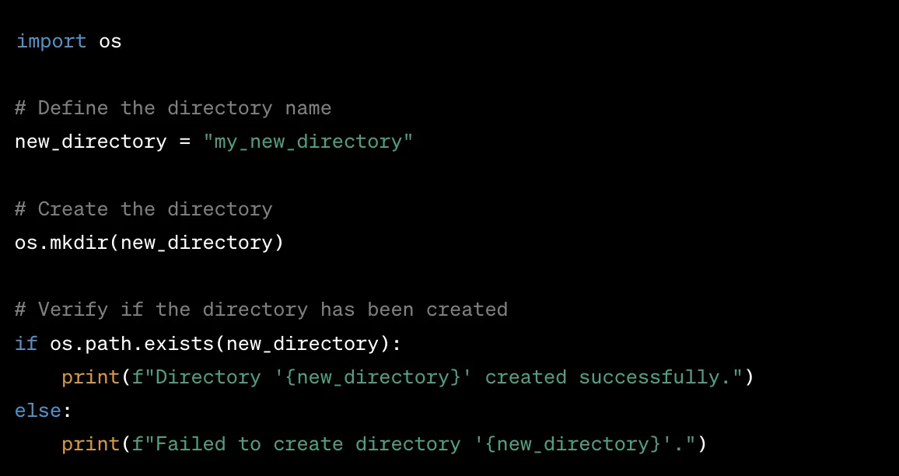
Basic Python Syntax

Slide 7


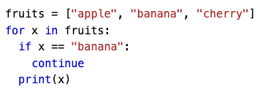
Basic Python Syntax

Slide 8
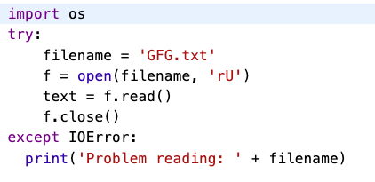
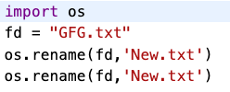
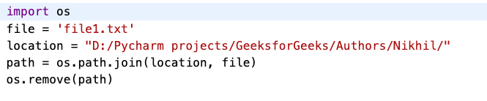
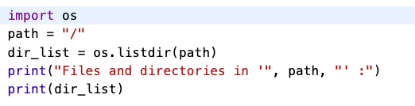
Python Interacting with the OS

Slide 9

Basic Bash Syntax

Slide 10
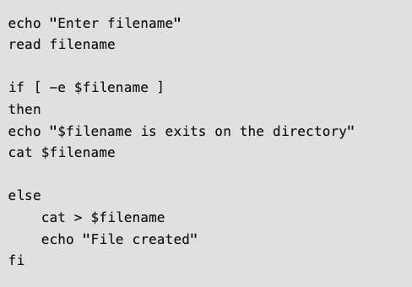
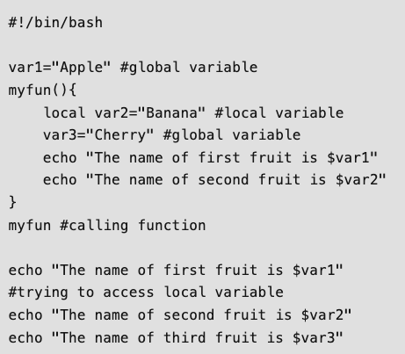
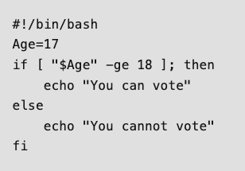
Basic Bash Syntax

Slide 11

Questions

