Slide 1
Mars Rover Arm Weight Optimization
Tim Nysetvold, ME 578 HW 7

Slide 2
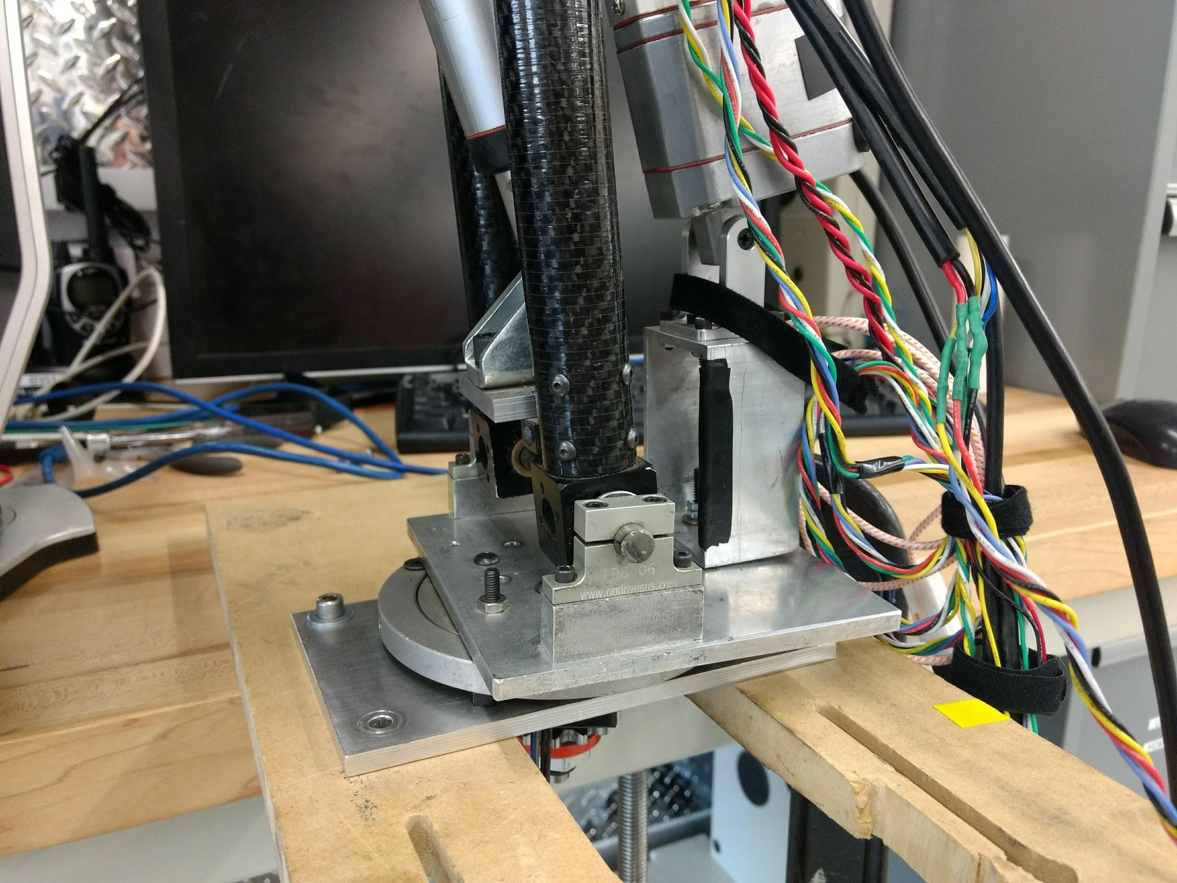
The Part Selected

Slide 3
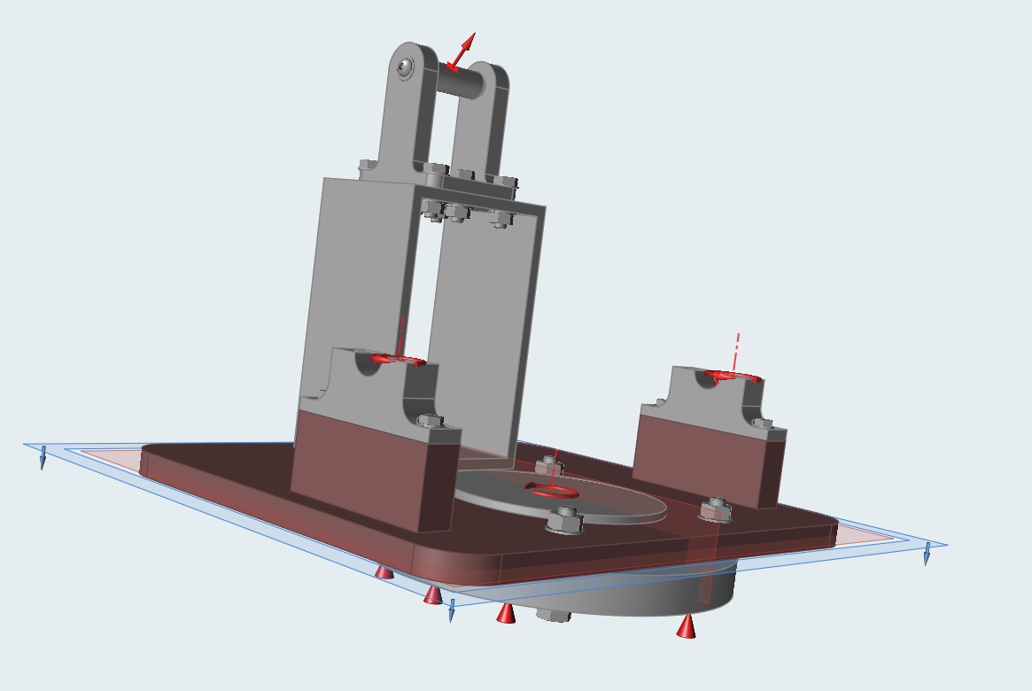
The Part Selected

Slide 4
The Problem
The current arm attachment to the rover is heavy and bulky
Mars Rover has a 50 kg weight limit
Although an assembly is available, it does not appear any FEA has been performed
Large portions of the support structure appear useless

Slide 5
Methodology
Import assembly from SolidWorks into Inspire (had to convert to .x_t file to make the conversion)
Delete all fasteners and replace with Inspire fasteners and joints
Not sure why Inspire doesn’t seem to play well with pre-existing fasteners
Ensure contacts are correct
Some were not correctly assumed by the compiler
Select base plate and shoulder brackets as design space
Generate loads
Used knowledge of arm to make estimates of maximum loads on different pieces
Several loads are designed to fail the parts immediately above the design space
Used 1.2x factor of safety
Required symmetry along center line

Slide 6
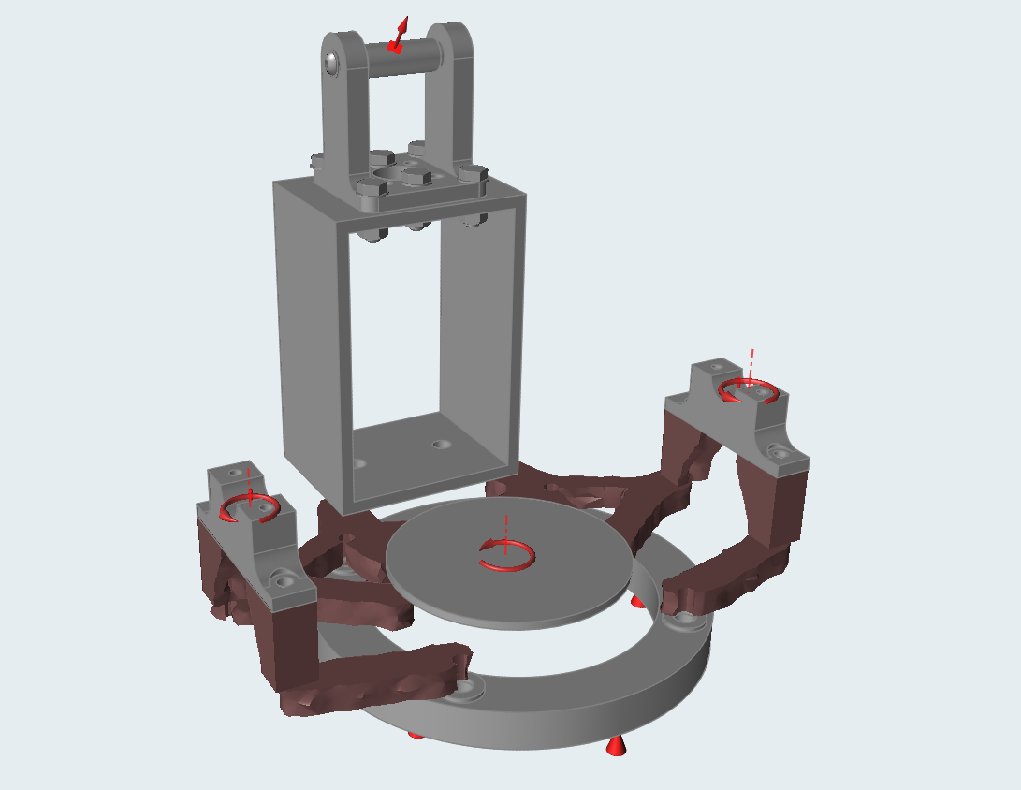
Results

Slide 7
Results
Not sure why bolts for bracket system are not connected
Fortunately, an easy fix
Not all bolts are completely surrounded by material
Probably should have removed those areas from the design space
With a little more time, could also optimize bracket system
Surprised that bracket has so little support from plate, but analysis works out
Factor of safety met
Halves weight
Manufacturable shape

