Slide 1
Product Redesign

Slide 2
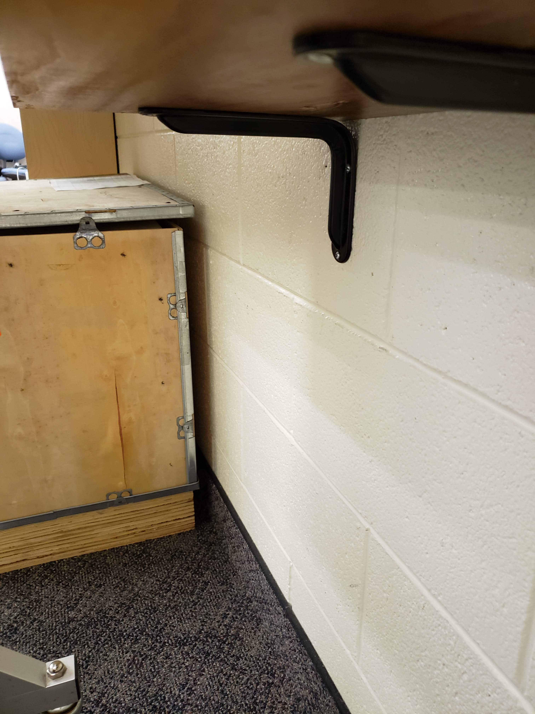
Product: Shelf support bracket
Simple brackets used to support shelves in my lab
Only able to support light object
Begins to noticeably deflect after only a few pounds of force applied

Slide 3
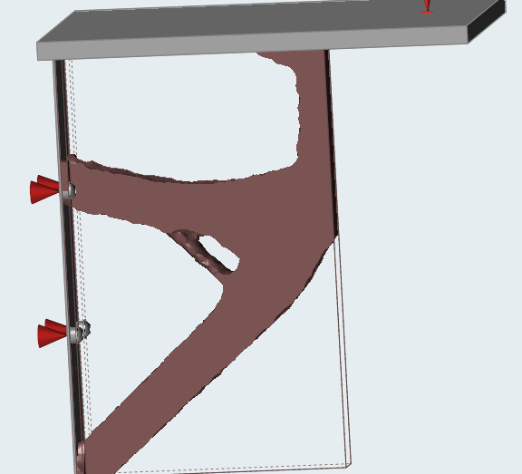
Optimized Design
Designed with a load case of 20 lbs. (much more than the current limit)
Removes the need for tow fasteners in the wall
It appears that if the design space was not limited the original shape, it would continue on the same path to the edge of the part

