Slide 1
Door Towel Hanger Topological Optimization
ME 578, HW 7
Carsten Christensen

Slide 2
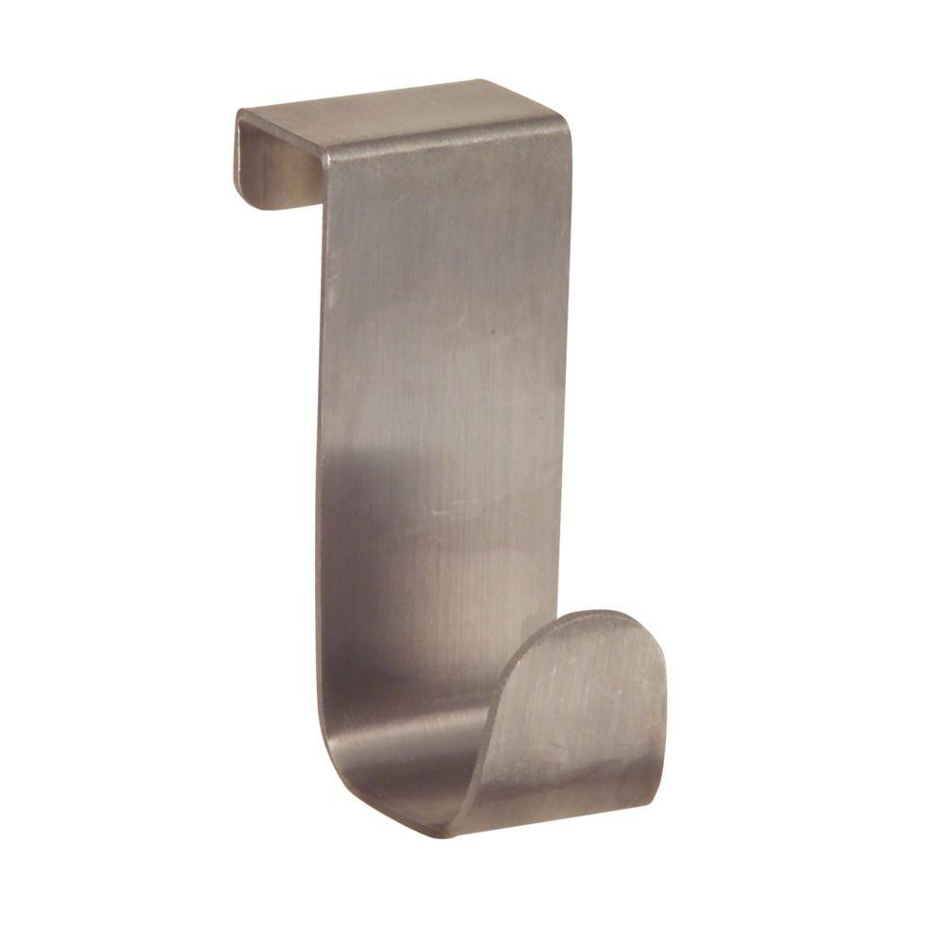
Problem Statement
Door-mounted towel hangars come in a variety of shapes, sizes, and materials.
I have used metal hangars and been pleased with their performance, though when they sometimes fall off, they can hurt toes or damage flooring. Plastic hangars are much less of a hazard, but tend to snap when an exceptionally wet towel is placed on them (I’ve never had one that lasted more than a few weeks).
I want to design a door-mounted towel hangar that can be 3D printed from ABS or PLA and that is sufficiently strong to hold up to 10 pounds (a VERY wet towel).

Slide 3
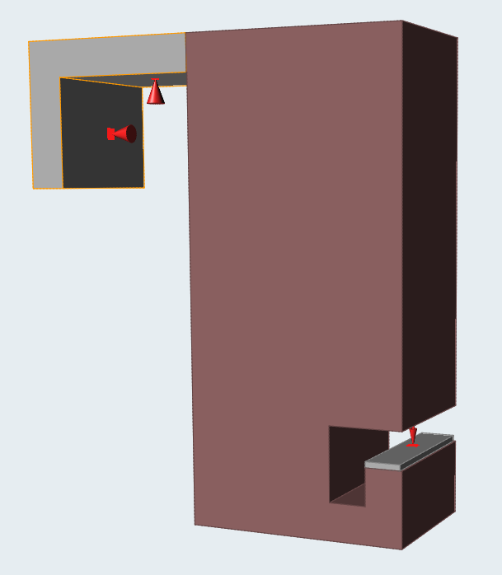
Part Design
I first designed the basic part in SolidWork, forming the basic design geometries of the design part. I then did some postprocessing in Inspire to define the actual design space (shown at left) and separate it from the contact surfaces.

Slide 4
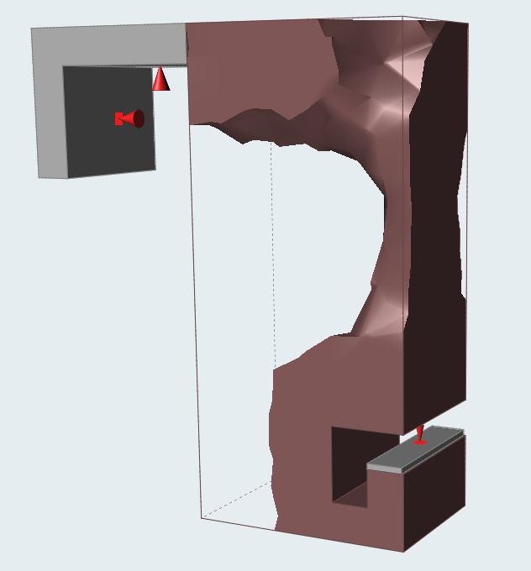
Optimization: Maximize Stiffness
I first conducted a topological optimization in Inspire using a 0.02 m (2 cm) minimum thickness and the maximize stiffness setting to increase the speed of the analysis. The resulting topology is shown at left.

Slide 5
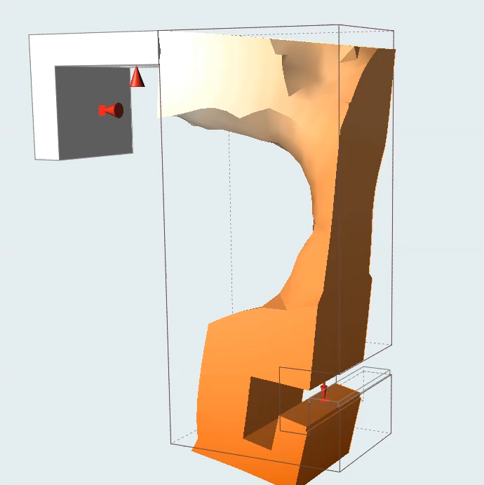
Results and Discussion: Maximize Stiffness
I found the s-shaped pattern of the recommended design to be interesting, as it imitates some of the designs found in nature
The part would undergo a maximum deflection of about 0.5 in. (video left), with the maximum stress occurring along the top bridge of the part, where the design space connects to the door mount. The maximum stress was an order of magnitude less than the yield stress of ABS.
While the part was strong, the s-shape, in particular the slender segment in the middle, made me think that it could perhaps be more compliant and slimmer.

Slide 6
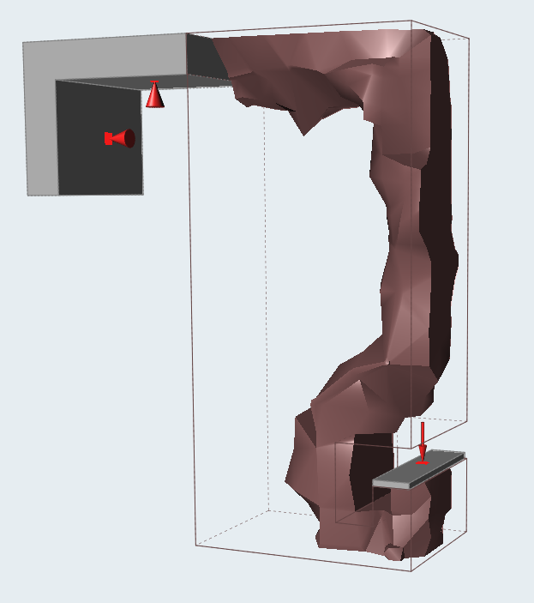
Optimization: Minimize Mass
I then conducted a topological optimization in Inspire using the minimize mass setting with a minimum factor of safety of 2.0 and a minimum part thickness of 0.02 m to increase the speed of the analysis. The resulting topology is shown at left.

Slide 7
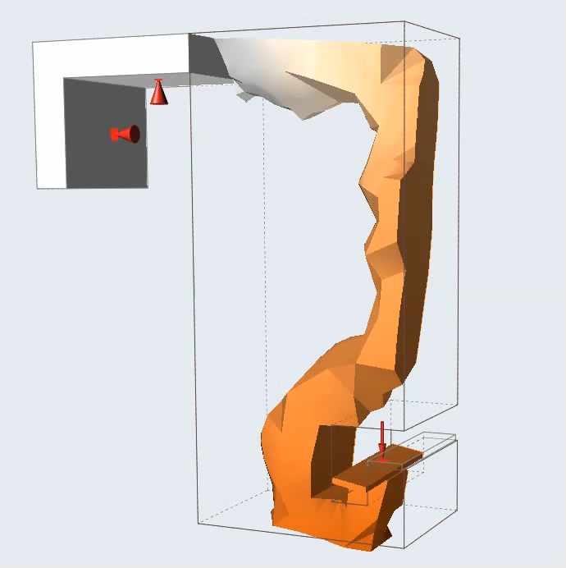
Results and Discussion: Minimize Mass
This round of optimization produced a much better design, eliminating the unnecessary material around the sides of the part and making, of all things, a perfect hook.
As with the first round of optimization, the part would undergo a maximum deflection of about 0.5 in. (video left), with the maximum stress occurring along the top bridge of the part, where the design space connects to the door mount. The maximum stress is one fourth of the yield strength of ABS (max stress is 10 Mpa, yield stress is 45 MPa).
The part is still strong enough to hold a 10 lb weight, but requires significantly less material and is thus cheaper to manufacture and, dare I say, more attractive.
With both optimized designs, the door would provide a failsafe mechanical stop if creep caused the hook to deflect more than intended due to an extra heavy load.

Slide 8
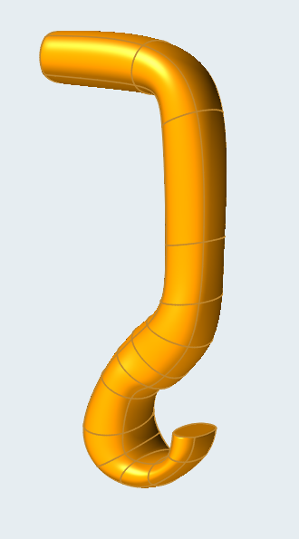
Final Design

