Slide 1
Inspire Product Redesign
Landon Willey

Slide 2
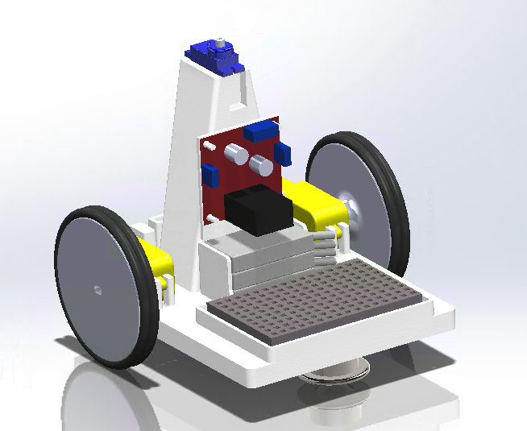
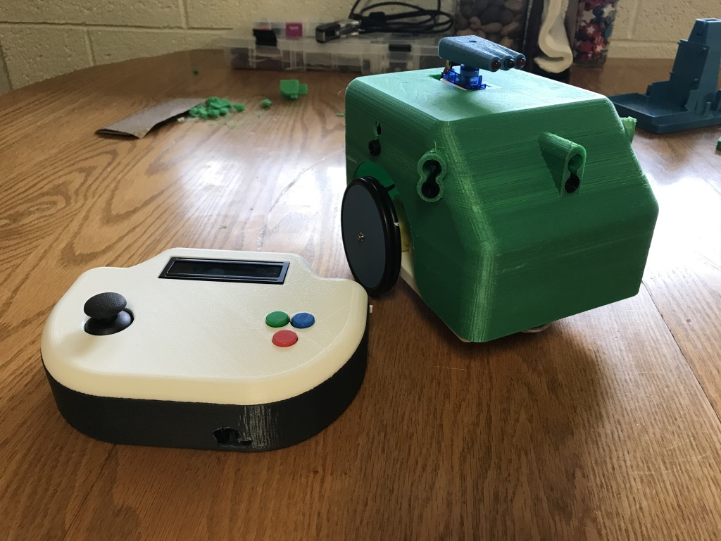
Problem Statement
Minimize the mass of the chassis for a laser tag robot
Original design is about 0.1 x 0.15 x 0.1 m
The part will be manufactured via 3D printer
Minimal mass will reduce the cost of filament to produce the part

Slide 3
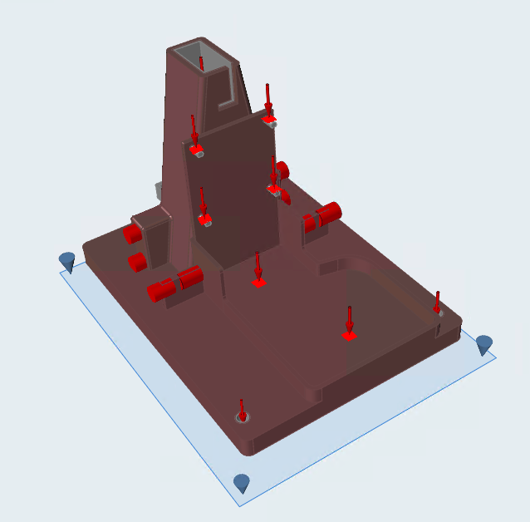
Inspire Tools
Geometry
Push/Pull: Created tool parts to separate the design space from the required sections
Intersect: Used the tool parts to separate the design space
Structure
Supports: Modeled motor contacts and roller wheel as pin supports
Loads: Simulated hanging PCB, servo, and outer structure as point loads
Gravity: Simulated the weight of the structure
Overhang: Constrained the overhang to less than 45 degrees to allow for 3D printing

Slide 4
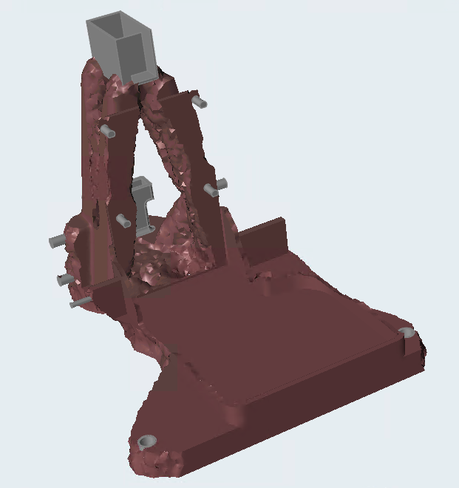
Results
Minimize mass with a safety factor of 2.0 was unable to produce a structure, but minimize stiffness was able to generate with a design
Weight was reduced from 0.32 kg to 0.16 kg
50% reduction
$11 savings per part at $0.07/gram
Structure appears feasible to 3D print after smoothing
Support structure of some features would not be sufficient to achieve necessary tolerances (i.e. for the motor mounts)

Slide 5
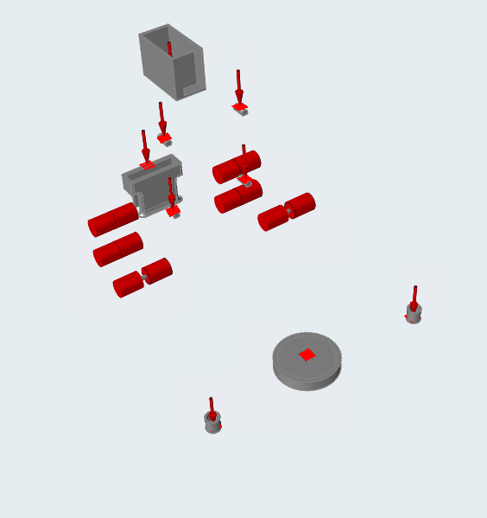
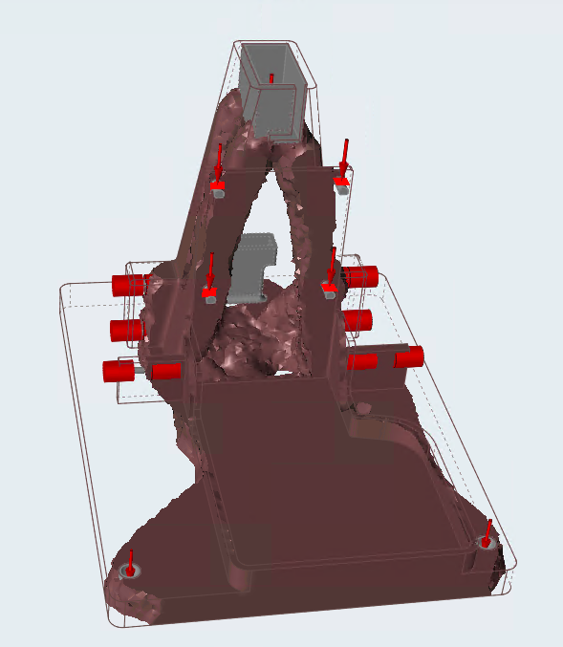
Discussion
The inability to produce a structure when attempting to minimize mass was a common problem with the optimization of other objects as well
Three total objects were attempted (robot base and two different styles of shelves)
In each case when the minimize mass was set as the objective, the program suggested the use of more realistic loads, but gave no further information as to why the structure couldn’t be optimized
Min Mass
Max Stiff

Slide 6
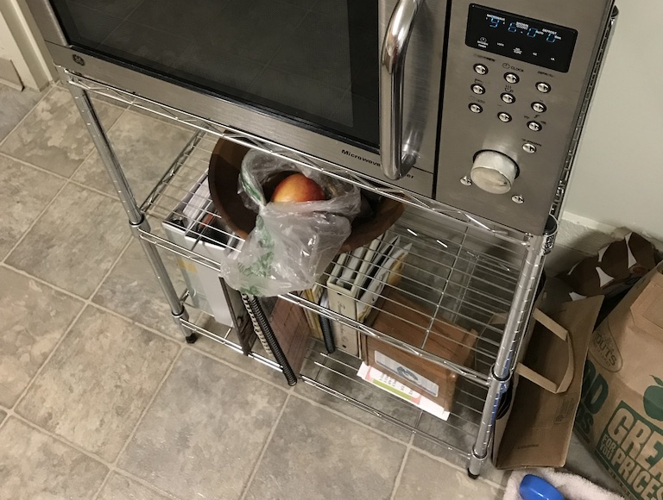
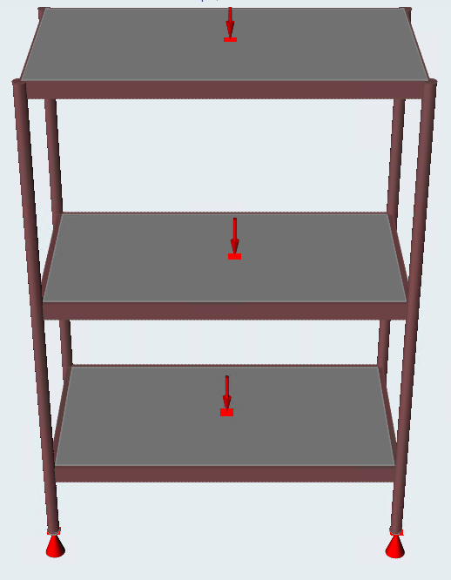
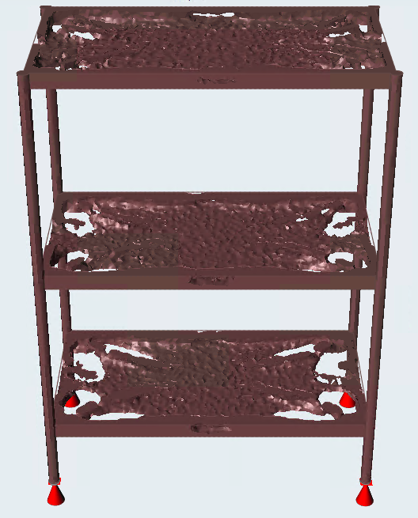
Discussion
The minimum member size combined with runtime was a major limiting factor of the program
Printer has a tolerance of 0.4 mm, but Inspire couldn’t do less than 2.3 mm
Smallest minimum member size with <30 minute runtime was 6 mm
For the first product optimization I attempted—the shelf shown to the right—the actual shelf had 1/16 in. diameter members, but the smallest possible member size in Inspire was 1/3 in., and increased to 1 in. to reduce runtime below 30 minutes

Slide 7
Discussion
The uniqueness of the shape determined depended heavily on the object being optimized
Nearly all of the examples for Inspire use truss-like structures that seem to be easily optimized by the program
For the robot chassis, the result for the turret tower was fairly innovative, yet the result for the base was slightly less so
The design for the shelf was essentially a thinner shelf; the manufacturer’s wire-frame construction was more unique than Inspire’s result
The results for the robot chassis could be significantly improved with more detail
A more precise measurement of loads and their locations would likely improve the optimization results
In some places where the optimization used the entire structure, such as the turret tower, a larger design space may result in a more optimal design

Slide 8
Conclusions
Inspire is an effective tool to be able to reduce mass, even with the difficulties with the minimize mass objective optimizations
Minimum member size and runtime are two of the greatest limiting factors of the software
Inspire is able to optimize some types of structures better than others
To truly optimize a design, a more advanced knowledge of how to set the design up is required, especially when it comes to isolating the best design space

