Slide 1
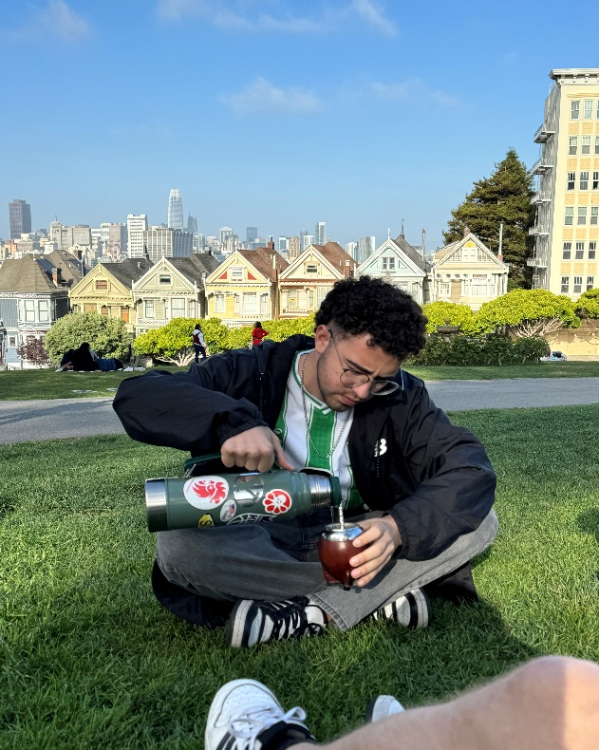
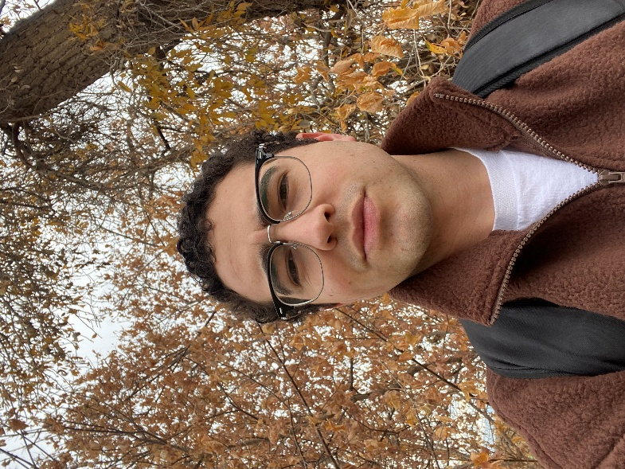
Matías Hernández
Quality Assurance Team
Since February 2026
Born: Durazno, Uruguay | Favorite BoM Person: Captain Moroni
Raised: Durazno, Uruguay | Favorite Hymn: I believe in Christ
No. Siblings: 3 | Favorite Activity: Soccer
Favorite Church Calling || Mission Location: Uruguay Montevideo West | Favorite Food: Paella or Milanesas
Second Language: English | Favorite Animal: Snow Leopard
Major: Construction Management | Favorite Movie: Gladiator
Year in School: Sophomore | Favorite Artist: Duko and Justin Bieber
Favorite Scripture: D&C 58:42 | Favorite Boss: Alan Openshaw

