Slide 1
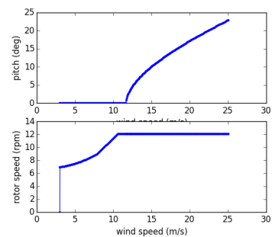
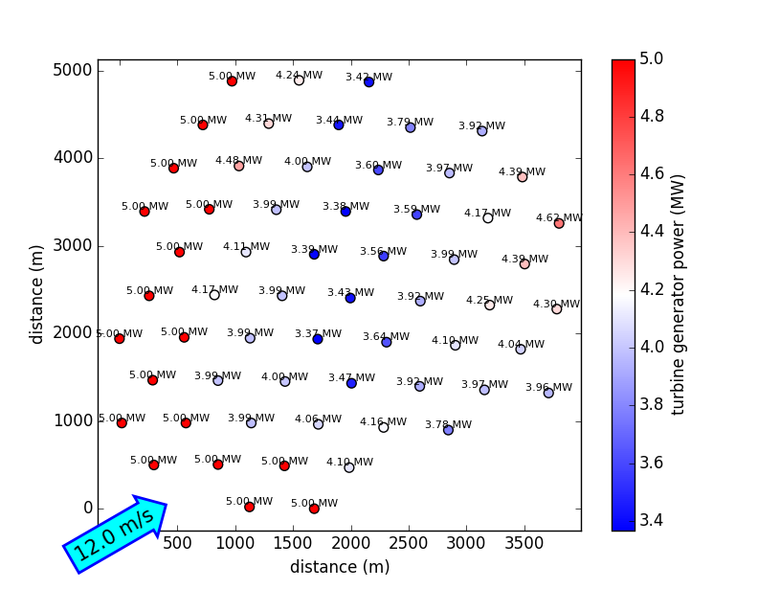
1
Coupled model: Control + CCBlade BEM + FLORIS wake model in OpenMDAO/WISDEM
wind speed at turbines
fixedPointIterator
wind speed at turbines
FLORIS
CaseIterator
CaseIterator
wt_layout
(Combined properties of turbines needed for FLORIS.)
Generic power and speed controller
turbine properties
turbine
CCBlade
rotor speed, pitch
axial ind., CP,
rotor diameter
Power
of
turbines
turbine
CCBlade
uses BroydenSolver
rotor diameter, air density, viscosity, blade properties, etc.
turbine positions
freestream wind speed + direction
2
Legend:
Assembly
Component
Variable Tree
Solvers
Example results for Princess Amalia Windpark
3
Potential:
Being able to perform full comparison with SOWFA for below- and above-rated
Full AEP evaluation with/without wake control
Combined optimization turbine design/selection, controls and layout
See also: https://github.com/WISDEM/FLORISSE/tree/develop for work in progress.

