Slide 1
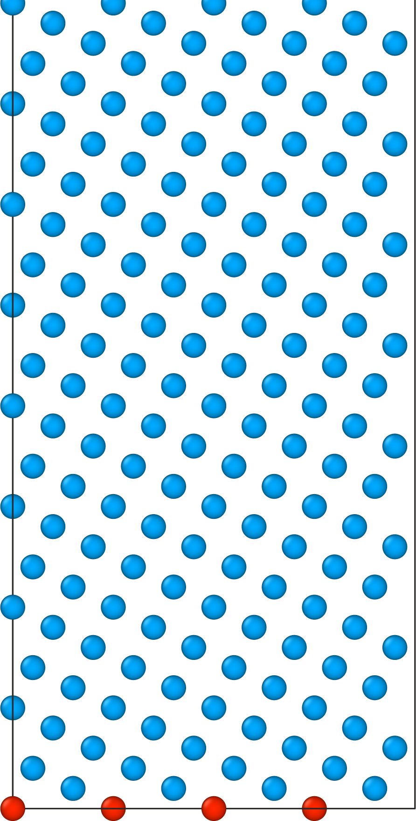
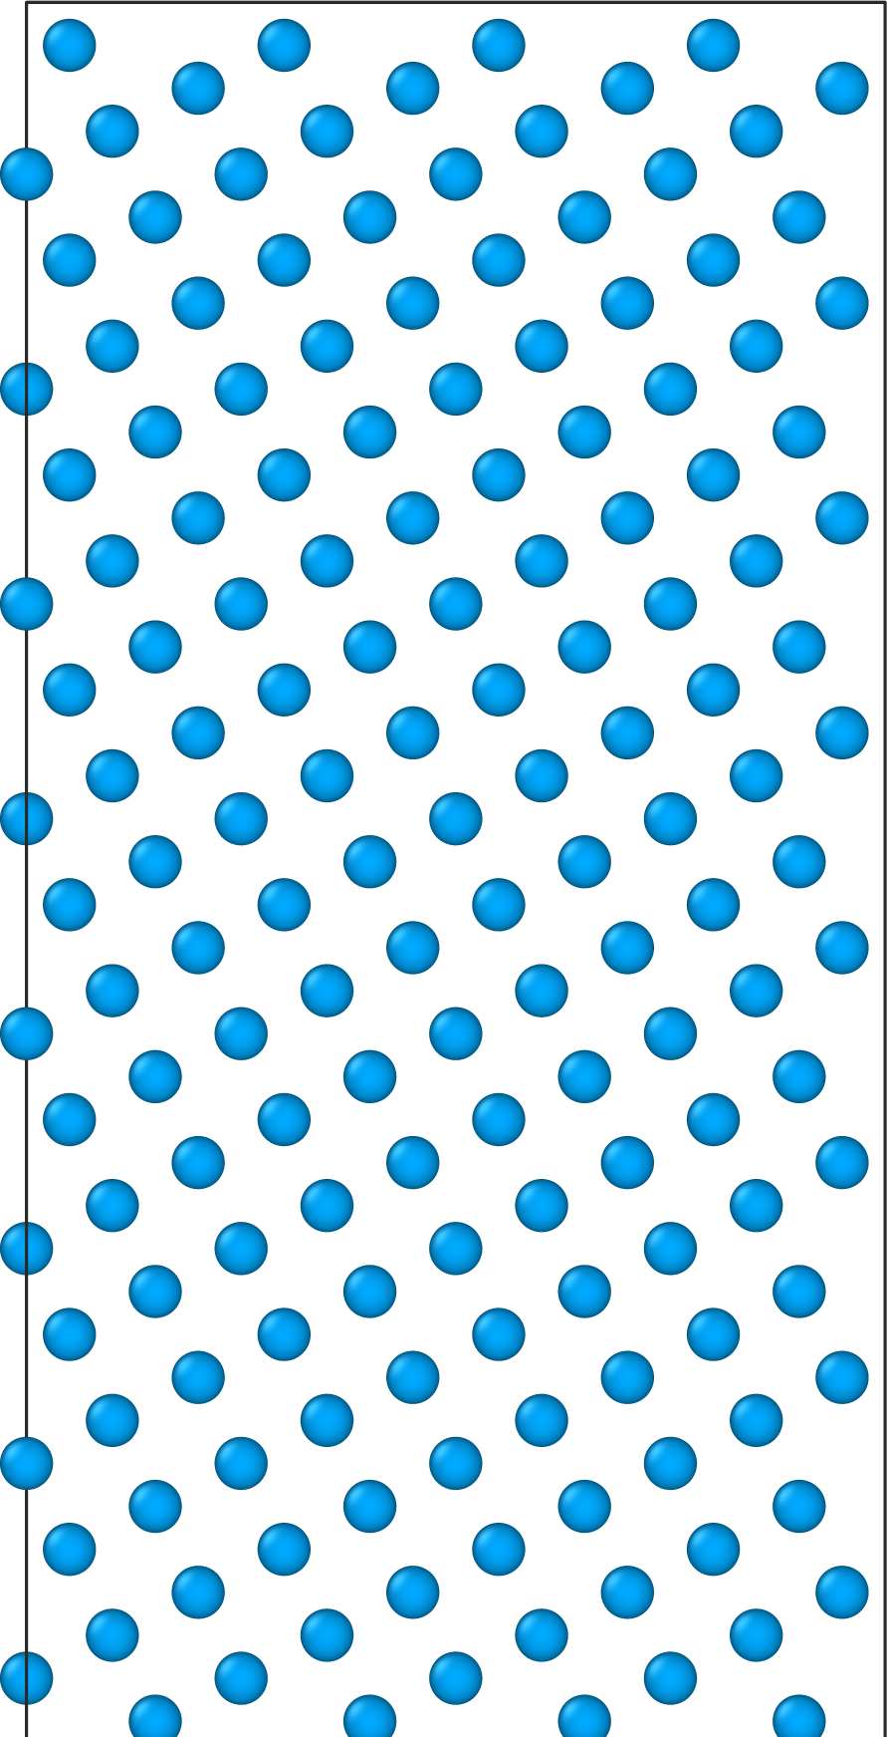
Schematic of GRIP parameters
vacuum (space above slabs)
ngrid divides the unit cell into N uniform increments to sample translations (dx, dy).
[n] samples atomic density between (frac_min, frac_max) in 1 GB layer (red atoms).
MD sampling is inclusive of the gb_gap region.
When inserting interstitials:
It might make sense to set gb_gap to 0 or very small.
inter_t usually does not have to be very large.
Upper region moves together
pad (for relaxation and included in E_{gb} calculation)
gb_thick (perturbation and MD sampling region)
inter_t (search for interstitial sites)
gb_gap (space between slabs)
inter_t (search for interstitial sites)
gb_thick (perturbation and MD sampling region)
pad (for relaxation and included in E_{gb} calculation)
Lower region is always frozen

