Slide 1

HELLO WORLD
FROM LONDONERS
Group 11
Bowen Zhang, Chia-Yin Lu, Fei Xu, Yunjing Hu
May 22th, 2019

Slide 2

Worldwide Connection

Slide 3

Cosmopolitan Community

Slide 4

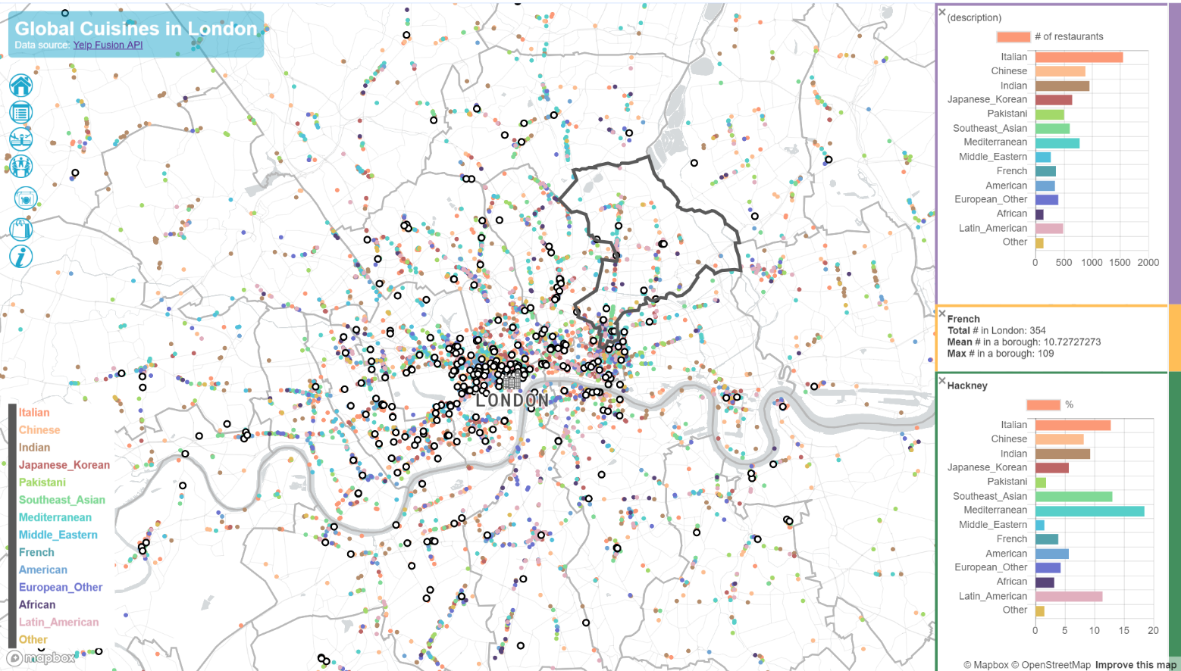
Global Foodcourt
Data Source: Yelp API
What kinds of cuisines can you enjoy?
Where can you find them?
How are them distributed in different districts?

Slide 5

International Shopping Centre

