Slide 1
A Revised Deep Learning Semi-parametric Regression for Enhanced Causal Inference with Heterogeneous Treatment Effects
Speaker: Shuai Yuan

Slide 2
Part 01
Background Introduction

Slide 3
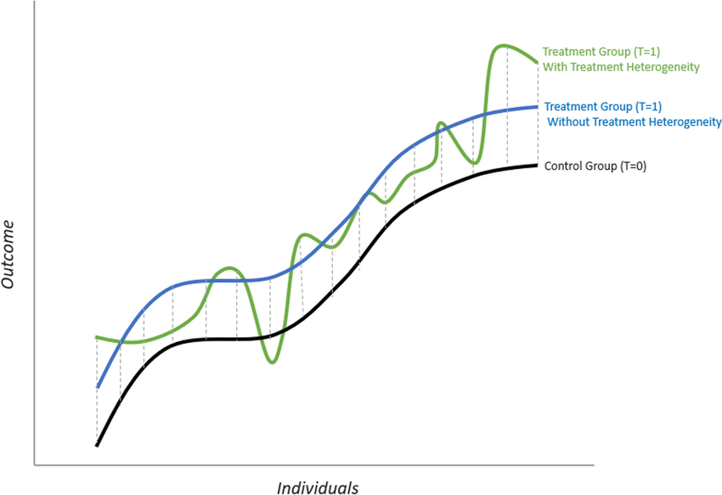
1.1
Background Introduction
Heterogeneous Treatment Effect (HTE):
τ(x) = E(Y(1)-Y(0) | X=x)
Why estimating HTE?
Tailor therapies to individuals or subgroups who benefit most.
Challenges:
Can only observe Y(1) or Y(0)
Confounders
Gong, X., Hu, M., Basu, M., & Zhao, L. (2021)

Slide 4
1.2
Background Introduction
Aim: Estimate treatment effect of lung transplant type on FEV1
Treatment (Z): Bilateral-Lung Transplant vs. Single-Lung Transplant
Outcome (Y): Post-transplant Forced Expiratory Volume in 1 second (FEV1)
Confounders(X): Donor’s & Patient’s height, weight, race, gender, age, time ...

Slide 5
Part 02
Research Methods
.

Slide 6

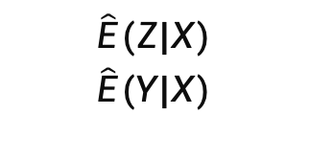
2.1
Research method: Weighted-deepTL
DNN and the other ML methods
DNN and the other ML methods
Input: X, Y, Z
$$\hat{E}(Z|X)$$
$$\hat{E}(Y|X)$$
$$\hat{τ}(x)$$

Slide 7
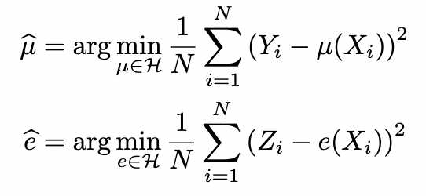

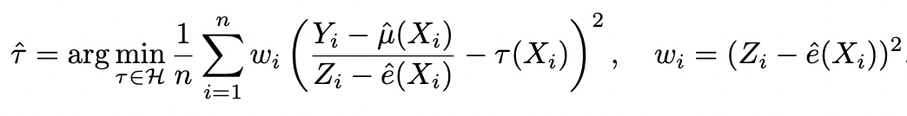
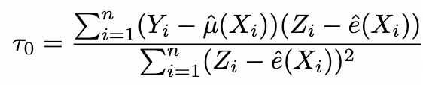
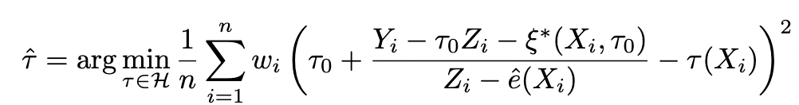
2.2
Research method: Weighted-deepTL
Estimate μ = E(Y|X) and e = E(Z|X) by minimizing loss functions:
Semi-Parametric model after Robinson-transformation:
Revised version (add a global plug-in τ₀):

Slide 8
Part 03
Data Set

Slide 9
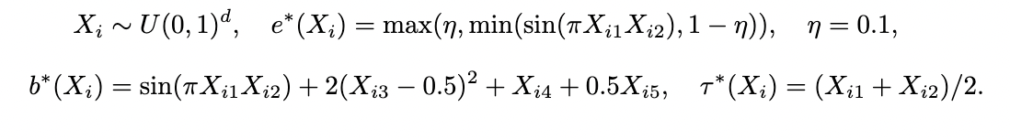
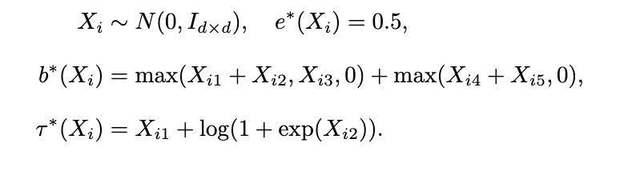
3.1
Simulation Data Set
Scenario A: Complex nuisance components but a simple treatment effect function.
Scenario B: A randomized trial where treatment is independent of covariates.

Slide 10
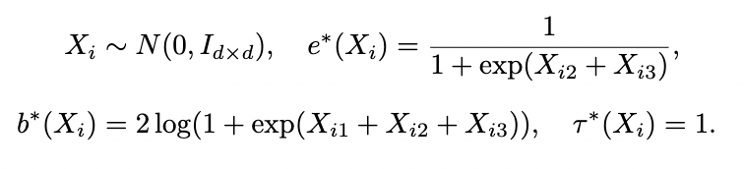
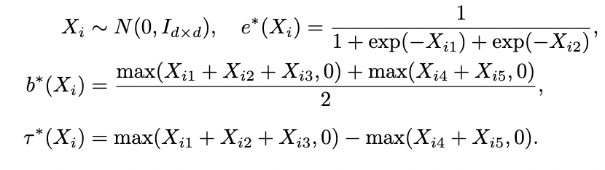
3.1
Simulation Data Set
Scenario C: Strong confounding but an easily estimated propensity score.
Scenario D: No correlation between treatment and control responses.

Slide 11
3.2
Lung Transplant Data Set
Data source: United Network for Organ Sharing (UNOS)
Z: Lung Tranplant Type (BLT = 1, SLT = 0)
Y: FEV1, measured at the second follow-up visit
X: 26 potential confounders (height, weight, race, gender, age, time ...)
Total sample size N = 20920 (14671 BLT, 6249 SLT)
Non-missing sample size n = 14306 (9758 BLT, 4548 SLT)

Slide 12
Part 04
Results &
Discussion

Slide 13
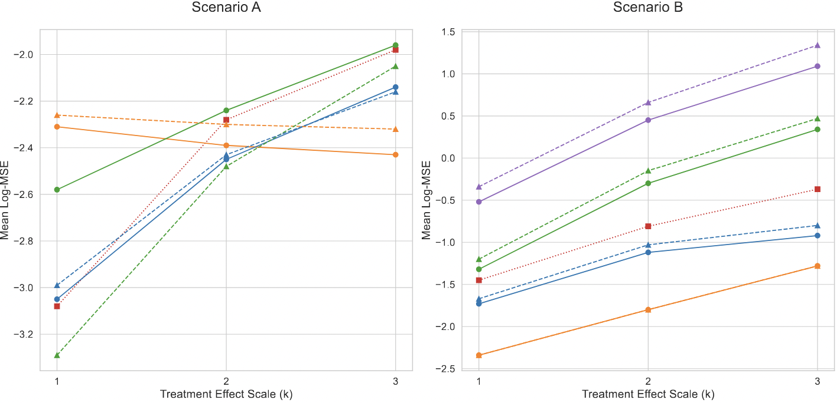
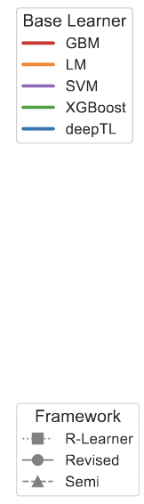
4.1
Results: Simulation

Slide 14
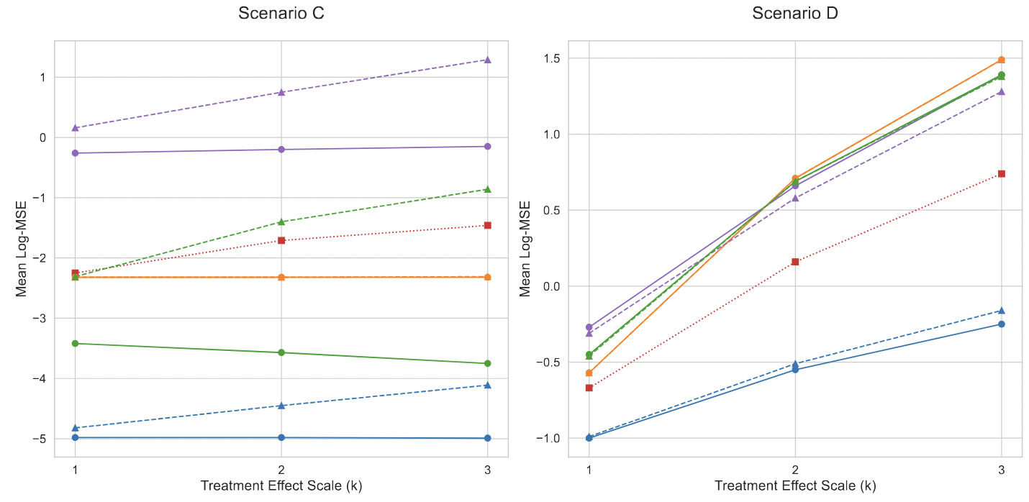
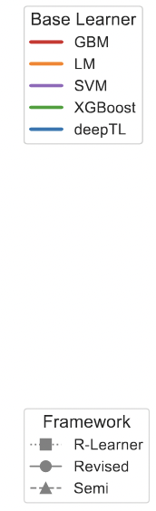
4.1
Results: Simulation

Slide 15
4.1
Discussions: Simulation
Proposed methods (weighted-deepTL) constantly performs well across scenarios
Effectively adjust for confounding structure, outperform in Scenario C and D
Revised framework further improve the performance of models
Remain time-consuming and blackbox (lack of interpretability)
Not the best choice for simple structure (Scenario A and B)
May need more scenarios to test the model’s generalizability

Slide 16
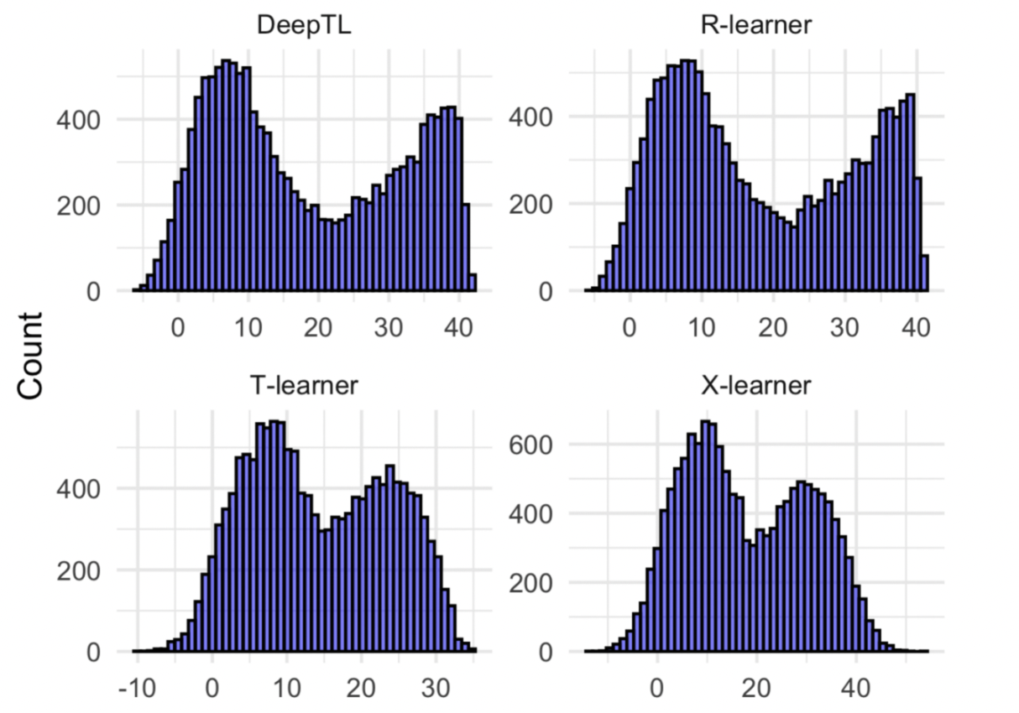
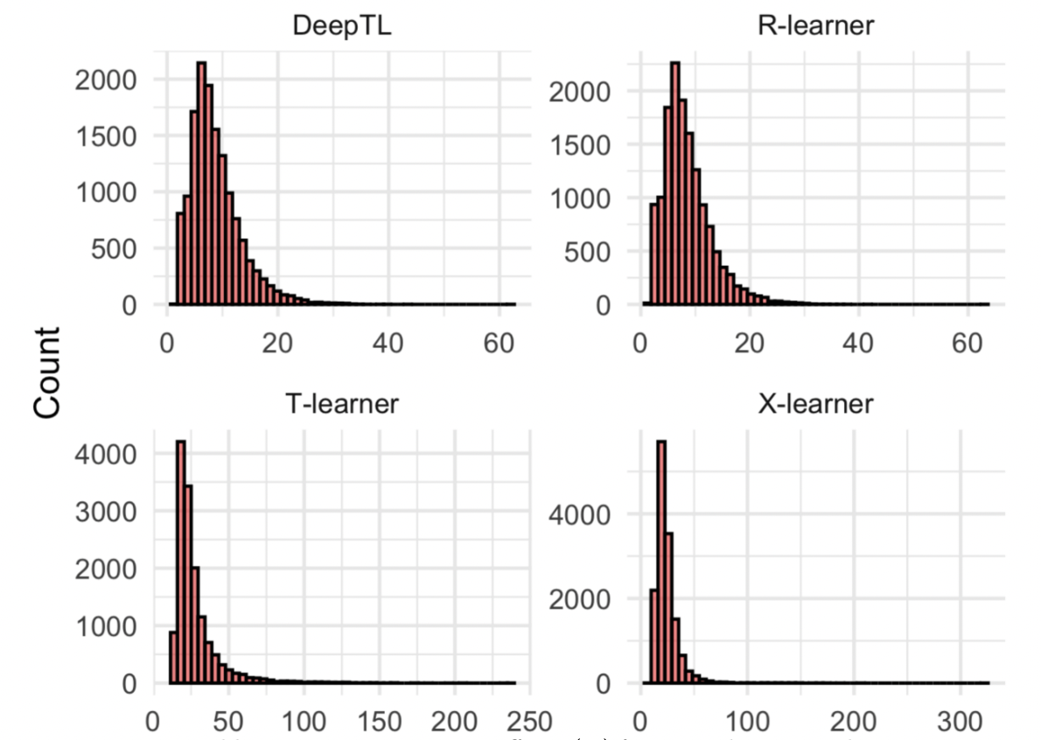

4.2
Initial Results: Lung Transplant Data
$\hat{τ}$(X)
Bootstrap Var($\hat{τ}$(X))

Slide 17
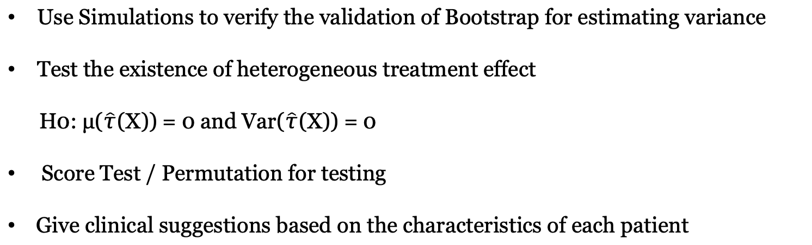
4.2
Discussions & Future work
Use Simulations to verify the validation of Bootstrap for estimating variance
Test the existence of heterogeneous treatment effect
H0: μ($\hat{τ}$(X)) = 0 and Var($\hat{τ}$(X)) = 0
Score Test / Permutation for testing
Give clinical suggestions based on the characteristics of each patient

Slide 18
Thanks

Slide 19
5
Reference
Cintron, D. W., Adler, N. E., Gottlieb, L. M., Hagan, E., Tan, M. L., Vlahov, D., Glymour, M. M.,
and Matthay, E. C. (2022). Heterogeneous treatment effects in social policy studies: An assessment of
contemporary articles in the health and social sciences. Annals of Epidemiology, 70:79–88.
Dicker, L. H. (2012). Residual variance and the signal-to-noise ratio in high-dimensional linear models. arXiv
preprint arXiv:1209.0012.
Farag´o, A. and Lugosi, G. (1993). Strong universal consistency of neural network classifiers. IEEE Transac-
tions on Information Theory, 39(4):1146–1151.
Force, S. D., Kilgo, P., Neujahr, D. C., Pelaez, A., Pickens, A., Fernandez, F. G., Miller, D. L., and Lawrence,
C. (2011). Bilateral lung transplantation offers better long-term survival, compared with single-lung
transplantation, for younger patients with idiopathic pulmonary fibrosis. Annals of Thoracic Surgery,
91(1):244–249.
Franklin, J. M., Eddings, W., Glynn, R. J., and Schneeweiss, S. (2015). Regularized regression versus the
high-dimensional propensity score for confounding adjustment in secondary database analyses. American
Journal of Epidemiology, 182(7):651.

Slide 20
Friedman, J. H. (1991). Multivariate adaptive regression splines. The Annals of Statistics, 19(1):1–67.
Friedman, J. H. (2001). Greedy function approximation: A gradient boosting machine. Annals of statistics,29(5):1189–1232.
Hahn, P. R., Murray, J. S., and Carvalho, C. M. (2020). Bayesian regression tree models for causal inference:Regularization, confounding, and heterogeneous effects. Bayesian Analysis, 15(3):965–1056.
Hornik, K., Stinchcombe, M., and White, H. (1989). Multilayer feedforward networks are universal approximators. Neural Networks, 2(5):359–366.
Kent, D. M., Steyerberg, E., and David, v. K. (2018). Personalized evidence based medicine: predictive
approaches to heterogeneous treatment effects. BMJ : British Medical Journal (Online), 363.
Koch, B., Vock, D. M., and Wolfson, J. (2018). Covariate selection with group lasso and doubly robust
estimation of causal effects. Biometrics, 74(1):8–17.
K¨unzel, S. R., Sekhon, J. S., Bickel, P. J., and Yu, B. (2019). Metalearners for estimating heterogeneous treatment effects using machine learning. Proceedings of the National Academy of Sciences, 116(10):4156–4165.

Slide 21
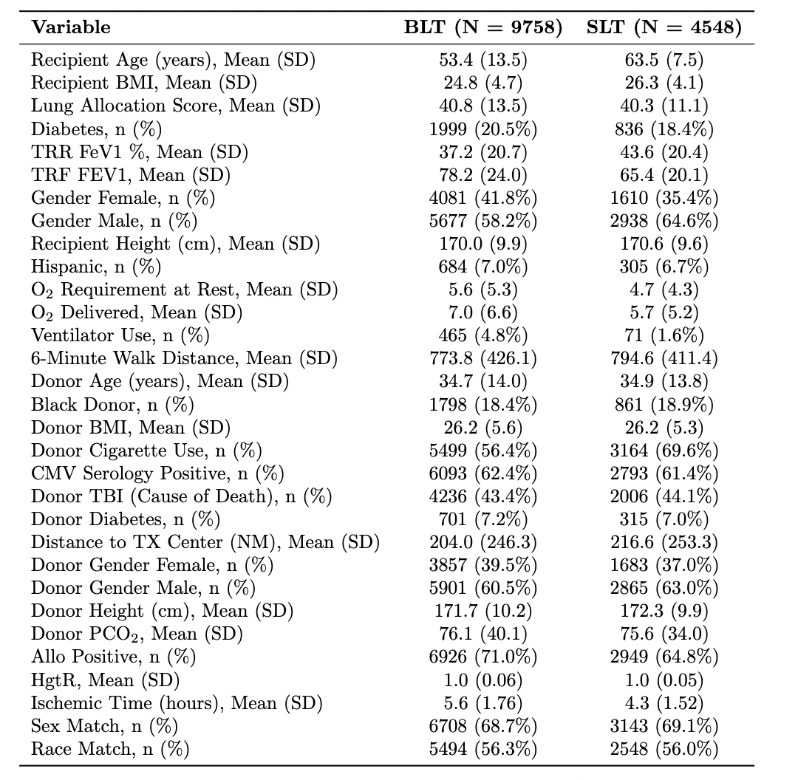
6
Supplementary
26 Confounders selected by
Group Lasso and Doubly Robust Estimation (Koch et al., 2018)

