Slide 1
Customer Churn Analysis
Business Performance Analysis for ABC Communications Ltd
Prepared by Mouhamadou Moustapha BA, Junior Data Analyst
AnalystLab Africa — Data Analytics Internship Programme | Week 1

Slide 2
The Business Problem
ABC Communications Ltd has engaged our team to understand why customers leave, and what can be done to retain them.
7,043
26.5%
6
Customers analysed
Overall churn rate
Business questions answered

Slide 3
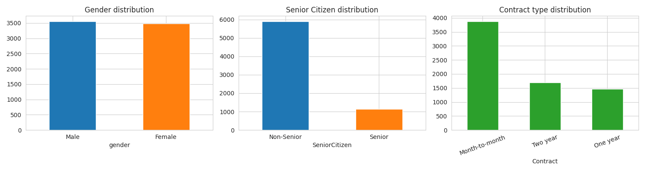
What Does the Customer Base Look Like?
Evenly split by gender; skews heavily non-senior (83.8%). Month-to-month is the dominant contract type at 55% — and, as shown next, also the riskiest.

Slide 4
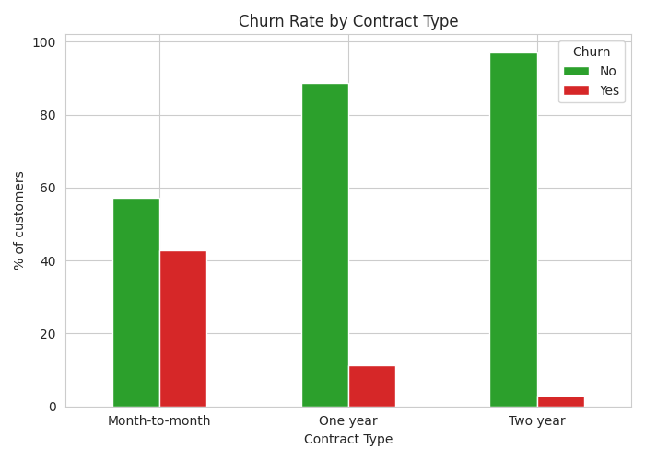
Contract Type Is the #1 Churn Driver
Month-to-month
42.7%
One year
11.3%
Two year
2.8%
Month-to-month customers churn 15x more than two-year contract holders.

Slide 5
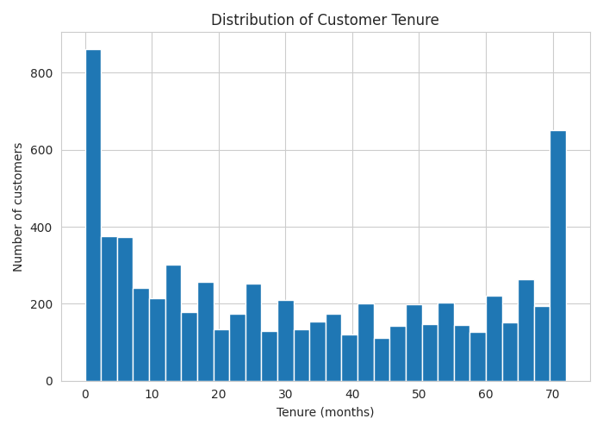
Does Tenure Affect Loyalty?
Median tenure at churn
10 months
Median tenure retained
38 months
The first year is the critical retention window.

Slide 6
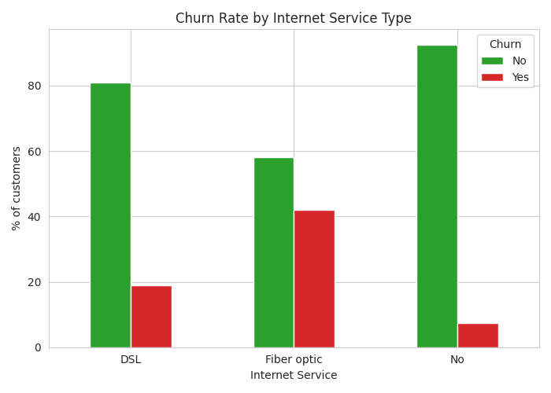
Which Services Influence Churn?
Fiber optic — ABC's premium internet tier — churns at 41.9%, more than double DSL (19.0%). This points to a price or reliability gap rather than lack of demand.
Customers who churn also pay more on average ($74.44/mo vs $61.27/mo for retained customers) — reinforcing price sensitivity as a factor.

Slide 7
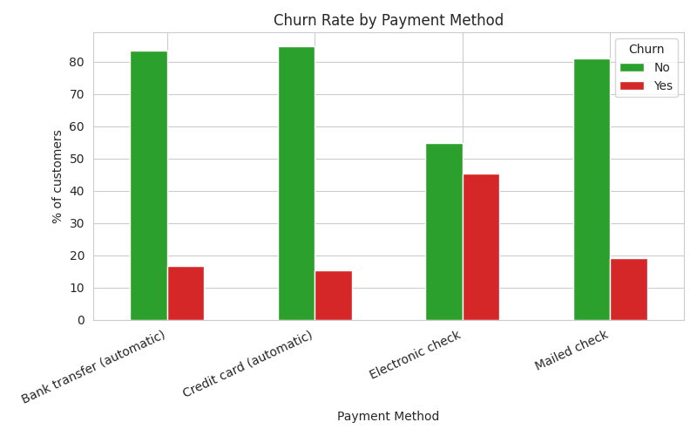
Which Payment Methods Have Higher Churn?
Electronic check
45.3%
Automated methods (avg.)
~17.0%
Manual payment removes the friction of cancelling — no recurring charge to actively stop.

Slide 8
Key Business Insights
1
Contract type is the dominant churn driver (42.7% vs 2.8%)
2
The first 12 months are the highest-risk retention window
3
Fiber optic customers churn at double the rate of DSL customers
4
Electronic check users churn nearly 3x more than automated payers
5
Senior citizens churn at almost double the rate of non-seniors (41.7% vs 23.6%)

Slide 9
Risks & Opportunities
Risks
Opportunities
Revenue concentration: 55% of customers sit in the highest-churn contract tier Premium product underperforming: fiber optic churn risks reputational damage on ABC's highest-margin service Wasted acquisition cost: early-tenure churn means customers leave before covering acquisition spend
Contract migration campaigns: incentivize month-to-month customers to commit to annual/two-year plans Payment automation push: encourage electronic check users toward automatic payment methods First-year retention program: structured onboarding for the highest-risk tenure window

Slide 10
Recommendations
1
Launch a contract upgrade incentive for month-to-month customers
2
Build a 90-day new customer retention program
3
Investigate fiber optic service quality and pricing perception
4
Incentivize migration to automatic payment methods
5
Create a dedicated senior citizen retention track
6
Deploy an early-warning churn risk score for the retention team

