Slide 1
UOX_#_spent
(#=A/B)
UOX_#_spent_cooled
(#=A/B)
Enrichment
Cooling
storage 7y
LWR A/B
storage
LWR A/B
DU
LWR A/B
Depleted U
storage
UOX
RU
LWR
separation
UOX_pu
UOX_#_spent_stored
(#=A/B)
Recycled U
storage
RU
SFR_#_spent_stored
(#=A/B)
SFR A/B
separation
fast_pu
SFR_#_spent
(#=A/B)
SFR_#_spent_cooled
(#=A/B)
SFR_fuel
Cooling
storage 7y
SFR A/B
storage
SFR A/B
SFR_FAB
A/B
SFR A/B

Slide 2
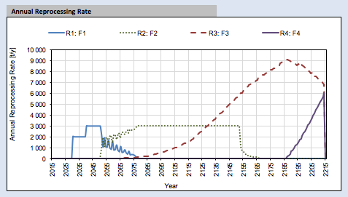
Annual Reprocessing rate
flow from storage_LWR_A/B & storage_SFR_AB
to the separation
UOX_#_spent
(#=A/B)
UOX_#_spent_cooled
(#=A/B)
Enrichment
Cooling
storage 7y
LWR A/B
storage
LWR A/B
DU
LWR A/B
Depleted U
storage
UOX
RU
LWR
separation
UOX_pu
UOX_#_spent_stored
(#=A/B)
Recycled U
storage
RU
SFR_#_spent_stored
(#=A/B)
SFR A/B
separation
fast_pu
SFR_#_spent
(#=A/B)
SFR_#_spent_cooled
(#=A/B)
SFR_fuel
Cooling
storage 7y
SFR A/B
storage
SFR A/B
SFR_FAB
A/B
SFR A/B

Slide 3
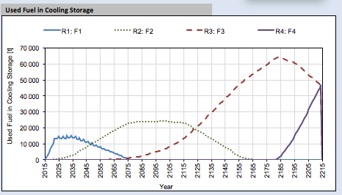
Used Fuel in Cooling Storage
Inventories of the cooling_storage
(LWR_A, LWR_B, SFR_A & SFR_B)
UOX_#_spent
(#=A/B)
UOX_#_spent_cooled
(#=A/B)
Enrichment
Cooling
storage 7y
LWR A/B
storage
LWR A/B
DU
LWR A/B
Depleted U
storage
UOX
RU
LWR
separation
UOX_pu
UOX_#_spent_stored
(#=A/B)
Recycled U
storage
RU
SFR_#_spent_stored
(#=A/B)
SFR A/B
separation
fast_pu
SFR_#_spent
(#=A/B)
SFR_#_spent_cooled
(#=A/B)
SFR_fuel
Cooling
storage 7y
SFR A/B
storage
SFR A/B
SFR_FAB
A/B
SFR A/B

Slide 4
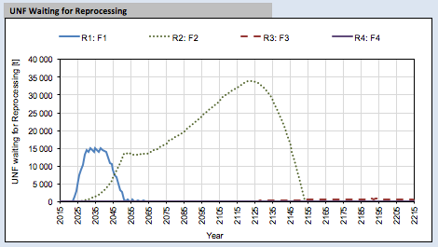
UNF Waiting for Reprocessing
Inventories of the storage
(LWR_A, LWR_B, SFR_A & SFR_B)
UOX_#_spent
(#=A/B)
UOX_#_spent_cooled
(#=A/B)
Enrichment
Cooling
storage 7y
LWR A/B
storage
LWR A/B
DU
LWR A/B
Depleted U
storage
UOX
RU
LWR
separation
UOX_pu
UOX_#_spent_stored
(#=A/B)
Recycled U
storage
RU
SFR_#_spent_stored
(#=A/B)
SFR A/B
separation
fast_pu
SFR_#_spent
(#=A/B)
SFR_#_spent_cooled
(#=A/B)
SFR_fuel
Cooling
storage 7y
SFR A/B
storage
SFR A/B
SFR_FAB
A/B
SFR A/B

Slide 5
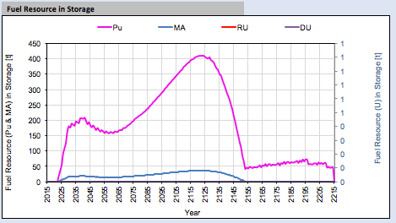
Fuel Resource in Storage
Inventories of AM & Pu All the storages (LWR_A, LWR_B, SFR_A & SFR_B)
DU from depleted U storage
RU from recycled U storage
UOX_#_spent
(#=A/B)
UOX_#_spent_cooled
(#=A/B)
Enrichment
Cooling
storage 7y
LWR A/B
storage
LWR A/B
DU
LWR A/B
Depleted U
storage
UOX
RU
LWR
separation
UOX_pu
UOX_#_spent_stored
(#=A/B)
Recycled U
storage
RU
SFR_#_spent_stored
(#=A/B)
SFR A/B
separation
fast_pu
SFR_#_spent
(#=A/B)
SFR_#_spent_cooled
(#=A/B)
SFR_fuel
Cooling
storage 7y
SFR A/B
storage
SFR A/B
SFR_FAB
A/B
SFR A/B

