Slide 1
Maintenance and Support
Maintenance, support, fix and improvement of Cyclus/Cycamore/Cymetric
Distribution through conda, required for remote Cyclus:
Allow to install Cyclus suite (and all its dependency) in one command:
‘conda install cyclus cycamore cymetric’
> Constant effort required for:
Debugging
Improvement
Easy installation for users
Easy deployment of remote Cyclus

Slide 2
Units
Add units support in Cyclus metrics:
Time series recording now accept a unit value
Inventory recording new also register mass unit
> Short/mid term goal:
Allow Cymetric (cyclus analysis tool) to deal with units
Allow user to specify an adequate set of units for their problems

Slide 3
Cost metadata
Add the capability to report extra cost associated to facility operation:
Cost type: “water”, “co2”, “manpower” -> any user defined string
Operation type: deployment/decommission/operation step/thoughput
> Short/mid term goal:
Allow user to compute non-mass related metrics:
Proliferation-resistance measurement
resource cost
…

Slide 4
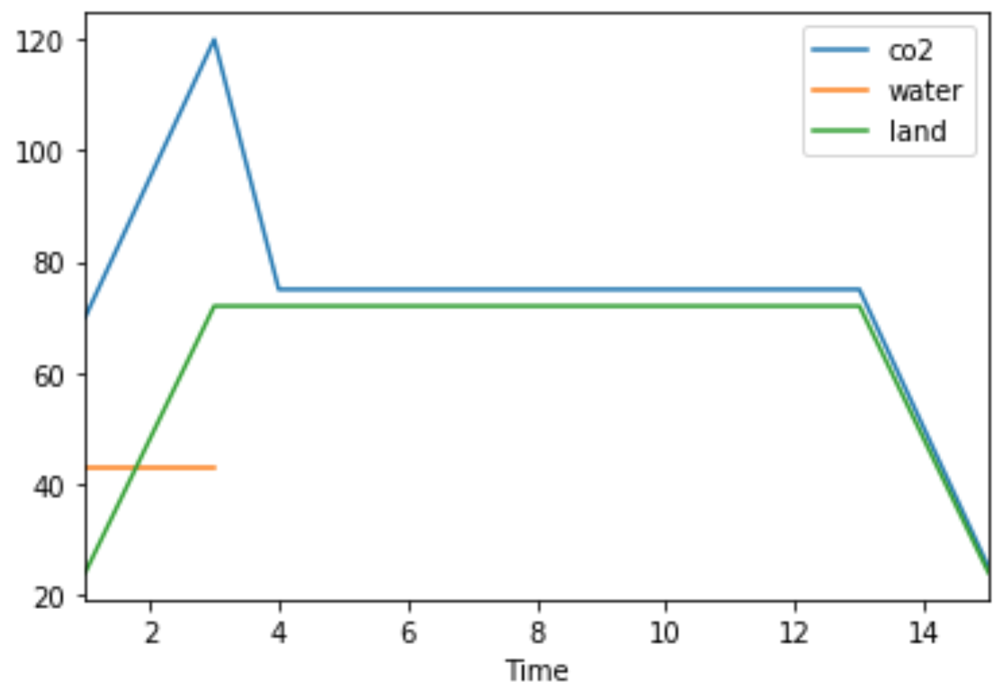
Cost metadata
User input
Output
Time series of the different cost over the simulation
(can be filtered per cost, per operation and facilities)
for each facility provide different cost per operations:
Example:
co2:
decommission: 25
deployment: 45
timestep: 35
Water:
Deployment: 43
Land:
Decommission: 24

