Slide 1
Species Delimitation Problems and Considerations
David Adelhelm, phyloseminar 2024

Slide 2
How to Fail at Species Delimitation (SD)
The Ideal SD Model, what should it include?

Slide 3
How to Fail at Species Delimitation (SD)
The Ideal SD Model, what should it include?
Popgen factors - Gene Flow and Pop Size
Phylo factors - Pattern and Timing of Diversification
Assignment Agnostic - Do you need to know which population/lineage a sample belongs to?

Slide 4
How to Fail at Species Delimitation
Simulation study? What should we keep in mind?

Slide 5
How to Fail at Species Delimitation
Simulation study? What should we keep in mind?
The characteristics of the simulated populations are highly informative to the ultimate conclusions. Must be tailored to your system
Are you using an extensive-enough set of models to test your hypothesis?
Population assignment?
What if we dont know the assignments? What can we do?

Slide 6
How to Fail at Species Delimitation
MSC, what is it?
The transition between cladogenesis and allelic coalescence?
BPP
RJMCMC?
Input?
Considerations?
SpedeSTEM
Input?
Considerations
Discovery vs Validation

Slide 7
How to Fail at Species Delimitation
Strategies for Complex Invesitgations?
Shortcomings of Validation methods
SpedeSTEM
BPP
Incongruence across results?
Many methods or one?
Conservative or Relaxed SD?
Sample Sizes
Integrating genetic and nongenetic data?

Slide 8
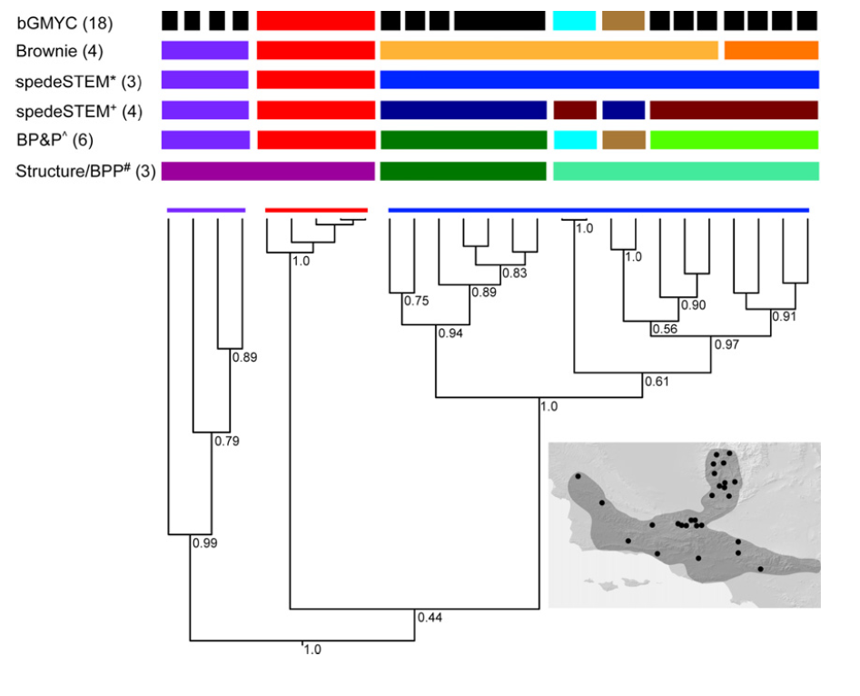
How to Fail at Species Delimitation

Slide 9
Species delimitation and relationships: The dance of the seven veils
The Different Veils
NuPt/NuMt
Hybridization
Lineage Sorting
Genome Organization
Demography
Selection
Phylogeo Structure
Consequences?

Slide 10
Species delimitation and relationships: The dance of the seven veils
How do we solve this?
Recommendation 1
Recommendation 2
Recommendation 3
Recommendation 4

