Slide 1
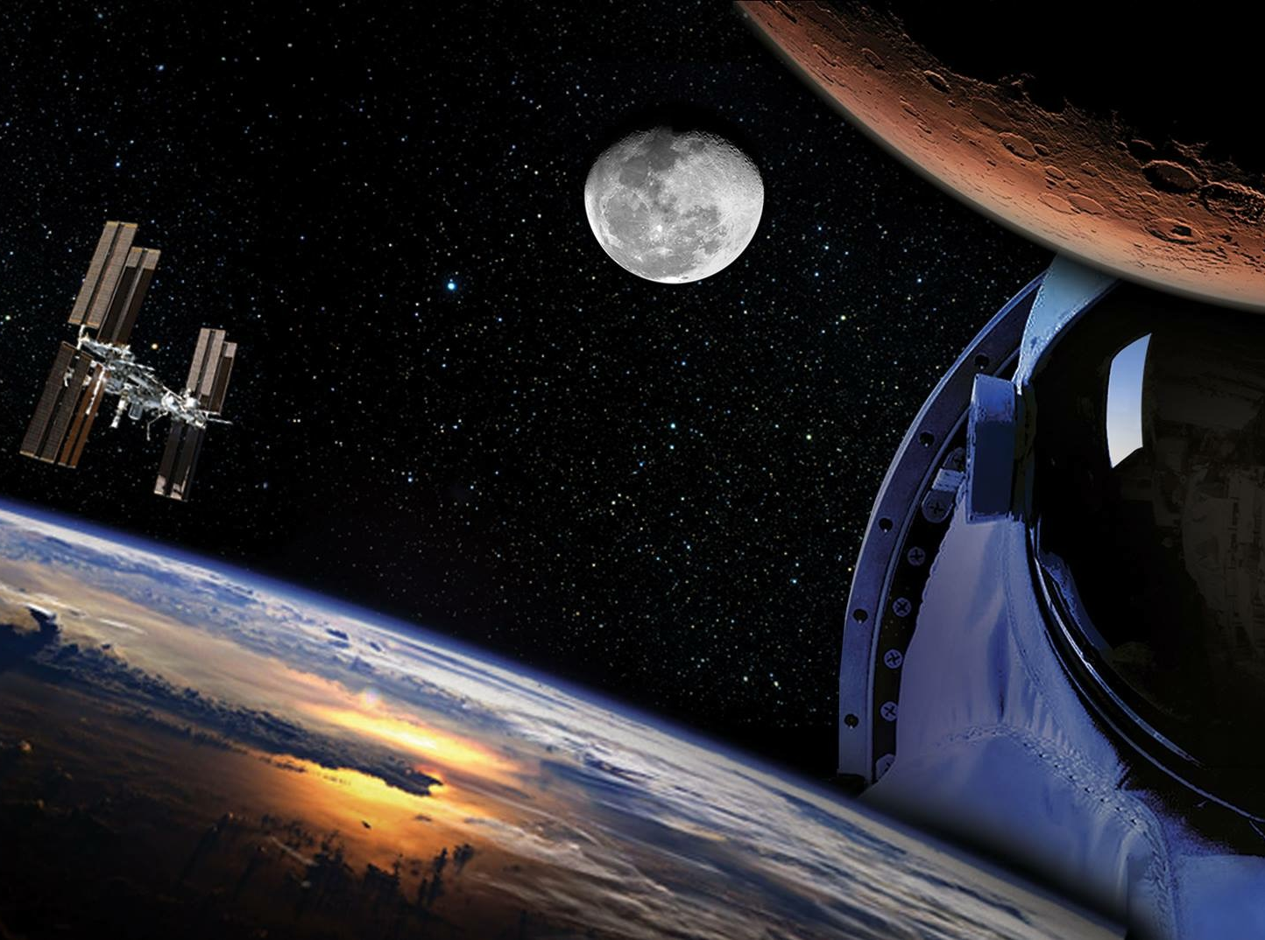

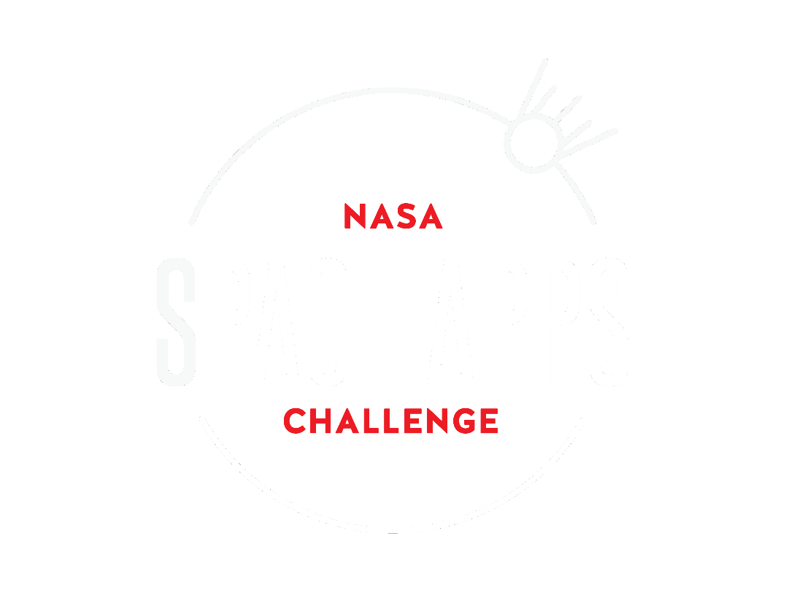
DECENTRAVERSE

Slide 2
A UNIVERSE OF BEAUTY AND WONDER
On the Shoulders of Giants
Create a game using images from the Hubble
Space Telescope as integral components!
Notes:
Decentraverse is aimed at providing an educational
and fun game which uses the Hubble Telescope
images and the corresponding researched facts as
fundamental components.

Slide 3
What is Decentraverse?
Top Trumps style game.
Uses Blockchain and IPFS.
Available for IPhone and Android.
Notes:
Videos, pictures and posts

Slide 4
DEMO

Slide 5
moving forward
Moving forward scripts will be created to harvest
images and statistics.
Notes:
Videos, pictures and posts

Slide 6
Lets make space great again!
Johnathan Rolleston, PA Consulting.

