Slide 1
ENGINEERING PHYSICS(EP)
Batch -17
251FA18054 - A.CHANDRA HANSITHA
251FA18104 - B.BHAVYA SRI
251FA18118 - CH.LIKITHA
251FA18436 - K.SAI VAMSI

Slide 2
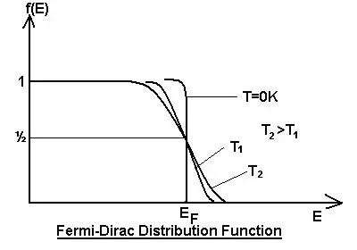

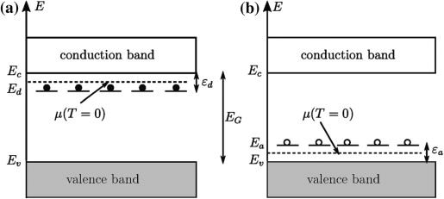
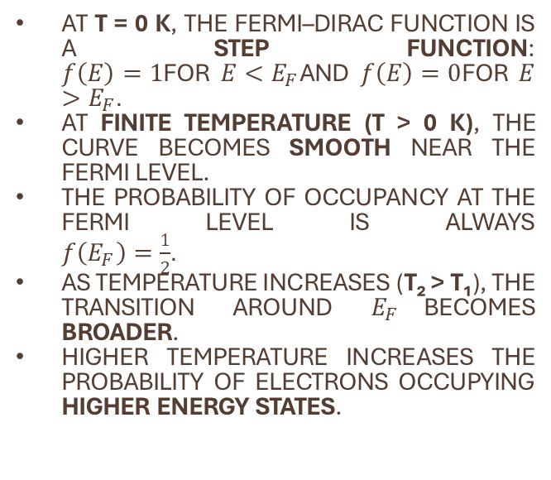
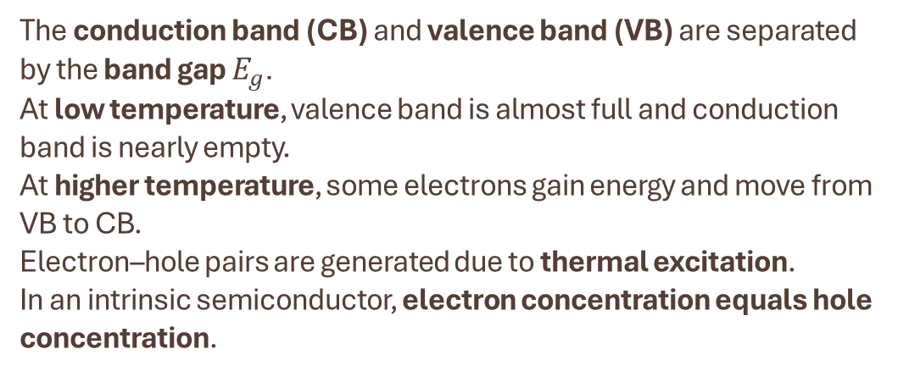
At T = 0 K, the Fermi–Dirac function is a step function:
$f\left(E\right)=1$for $E<E_{F}$and $f\left(E\right)=0$for $E>E_{F}$.
At finite temperature (T > 0 K), the curve becomes smooth near the Fermi level.
The probability of occupancy at the Fermi level is always
$f\left(E_{F}\right)=\frac{1}{2}$.
As temperature increases (T₂ > T₁), the transition around $E_{F}$becomes broader.
Higher temperature increases the probability of electrons occupying higher energy states.
The conduction band (CB) and valence band (VB) are separated by the band gap $E_{g}$.
At low temperature, valence band is almost full and conduction band is nearly empty.
At higher temperature, some electrons gain energy and move from VB to CB.
Electron–hole pairs are generated due to thermal excitation.
In an intrinsic semiconductor, electron concentration equals hole concentration.

Slide 3
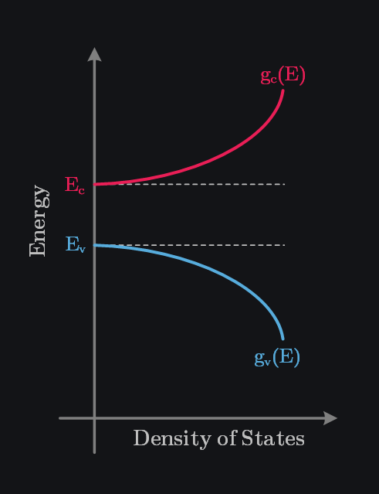
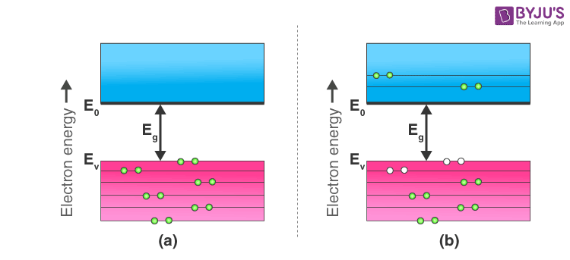
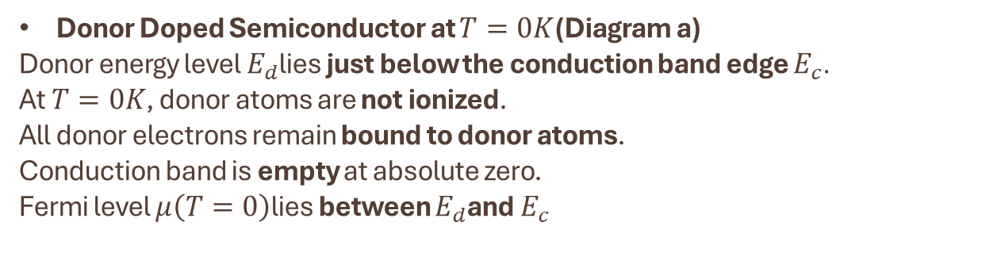
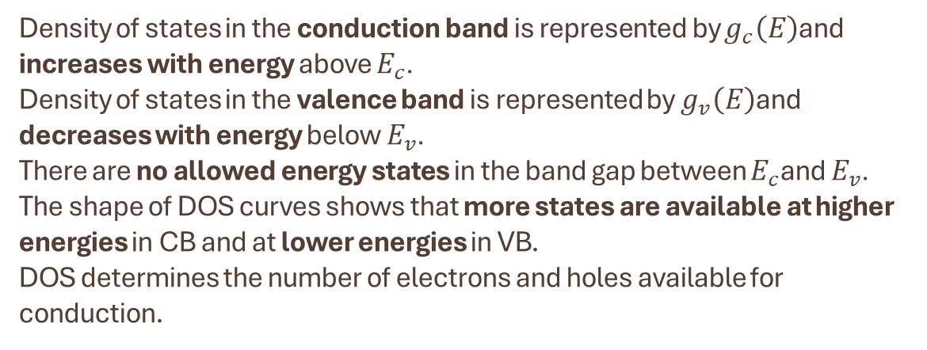
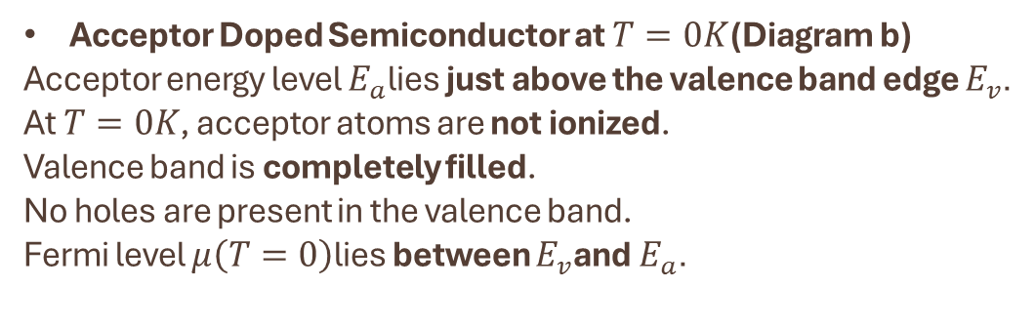
Density of states in the conduction band is represented by $g_{c}\left(E\right)$and increases with energy above $E_{c}$.
Density of states in the valence band is represented by $g_{v}\left(E\right)$and decreases with energy below $E_{v}$.
There are no allowed energy states in the band gap between $E_{c}$and $E_{v}$.
The shape of DOS curves shows that more states are available at higher energies in CB and at lower energies in VB.
DOS determines the number of electrons and holes available for conduction.
Donor Doped Semiconductor at $T=0K$(Diagram a)
Donor energy level $E_{d}$lies just below the conduction band edge $E_{c}$.
At $T=0K$, donor atoms are not ionized.
All donor electrons remain bound to donor atoms.
Conduction band is empty at absolute zero.
Fermi level $μ\left(T=0\right)$lies between $E_{d}$and $E_{c}$
Acceptor Doped Semiconductor at $T=0K$(Diagram b)
Acceptor energy level $E_{a}$lies just above the valence band edge $E_{v}$.
At $T=0K$, acceptor atoms are not ionized.
Valence band is completely filled.
No holes are present in the valence band.
Fermi level $μ\left(T=0\right)$lies between $E_{v}$and $E_{a}$.

Slide 4
thank you

