Slide 1

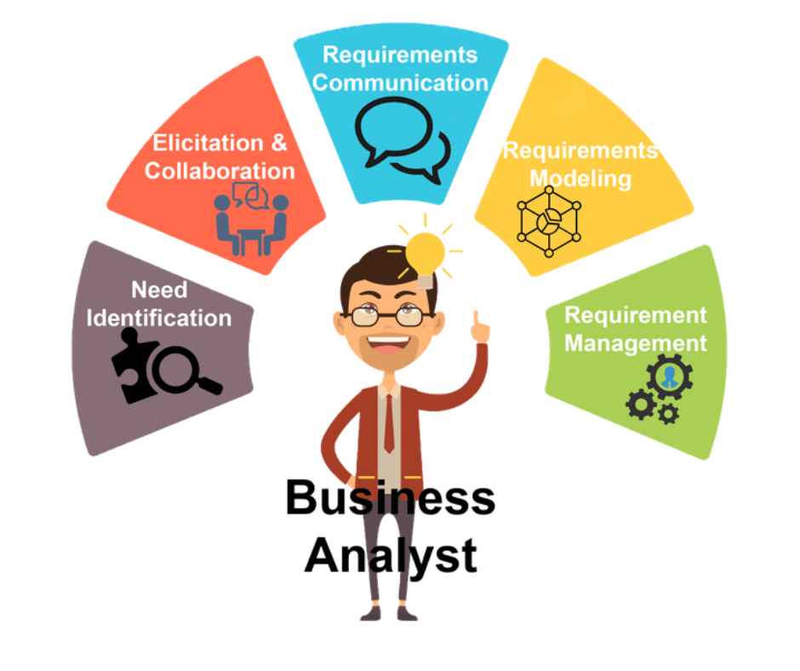
TrueCareer
Assessment-Driven Career
Guidance System
Business Analysis, Data Driven Recommendation,
and UI Prototype

Slide 2
From Career Guidance Problem to Data-Driven Prototype
TrueCareer was developed to address a common challenge among Vietnamese high school students: many students struggle to choose suitable majors, understand career paths, and find reliable guidance. TrueCareer combines: • Career assessment • Student profile analysis • K-Means student clustering • Major and course recommendation • Mentor matching • Streamlit dashboard • Axure UI prototype

Slide 3
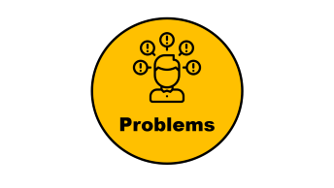





Business Analyst Scope
Product Definition

Slide 4

Problems

Slide 5



11
Việt Nam
12
Grade
• Difficulty choosing suitable majors and career paths • Career information is scattered across many sources • Limited understanding of future labor market demand • Limited time and experience for self-research and decision-making
Problems
Need strong professional background and 5+ years of experience. Mentor recommendation should be based on student needs, not random selection
coaching/ mentor

Slide 6

Goals &
Vision

Slide 7



Goal & Vision
Service packages
Mentor consultation
Future advertising
Help Vietnamese high school students make better academic and career decisions through assessment-based guidance.
Vision
Become a data-driven career guidance platform that combines student assessment, recommendation logic, and mentor support.

Slide 8

Business Objective

Slide 9






3 months
6 Months
200K
Business Objective
6 Months
> 70K

Slide 10

Business Cases

Slide 11



Business Cases
???
3-5
recommends majors, courses, and career paths
System suggests suitable mentor type
Raising income and personal branding
Sử dụng lần lượt/ gói thanh toán

Slide 12
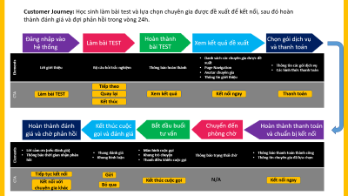
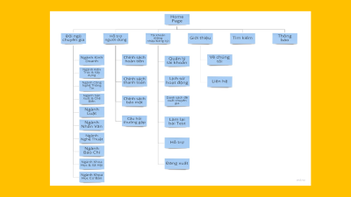
Customer Journey
Customer Journey
Card Sorting

Slide 13
Customer Journey: Students complete the assessment, select a recommended expert to connect with, then submit a review and wait for feedback within 24 hours
Log in to
the system
Take the
TEST
Complete
the TEST
View
recommended results
Choose service
& payment
Elements | Welcome message | Assessment questionnaire | Completion notification | Recommended expert list Page navigation Expert avatar Expert introduction | Service package info Payment methods
CTA
Take the TEST
Next
Back
View Results
Connect now
payment
End
Complete review &
await feedback
End call
& rate
Begin
counseling
session
Move to waiting
room
Complete payment
& prepare to connect
Elements | Thank you message (if rated) Feedback timeline notification | Star rating scale Comment box | Video call screen Chat panel Call controls | Waiting status notification | Payment success notification Selected expert info
CTA |  |  |  | N/A
Continue connecting
Submit
End call
Connect Now
Connect w/ other expert
Skip

Slide 14
Customer Journey: Học sinh làm bài test và lựa chọn chuyên gia được đề xuất để kết nối, sau đó hoàn thành đánh giá và đợi phản hồi trong vòng 24h.
Đăng nhập vào hệ thống
Làm bài TEST
Hoàn thành bài TEST
Xem kết quả đề xuất
Chọn gói dịch vụ và thanh toán
Elements | Lời giới thiệu | Bộ câu hỏi trắc nghiệm | Thông báo hoàn thành | Danh sách các chuyên gia được đề xuất Page Navigation Avatar chuyên gia Thông tin giới thiệu | Thông tin các gói dịch vụ Các hình thức thanh toán
CTA
Tiếp theo
Làm bài TEST
Quay lại
Xem kết quả
Kết nối ngay
Thanh toán
Kết thúc
Hoàn thành đánh giá và chờ phản hồi
Kết thúc cuộc gọi và đánh giá
Bắt đầu buổi tư vấn
Chuyển đến phòng chờ
Hoàn thành thanh toán và chuẩn bị kết nối
Elements | Lời cảm ơn (nếu đánh giá) Thông báo thời gian nhận phản hồi | Thang đánh giá Khung bình luận | Màn hình cuộc gọi Khung trò chuyện Thanh điều khiển cuộc gọi | Thông báo trạng thái chờ | Thông báo thanh toán thành công Thông tin chuyên gia đã lựa chọn
CTA |  |  |  | N/A
Tiếp tục kết nối
Gửi
Kết thúc cuộc gọi
Kết nối ngay
Kết nối với chuyên gia khác
Bỏ qua

Slide 15
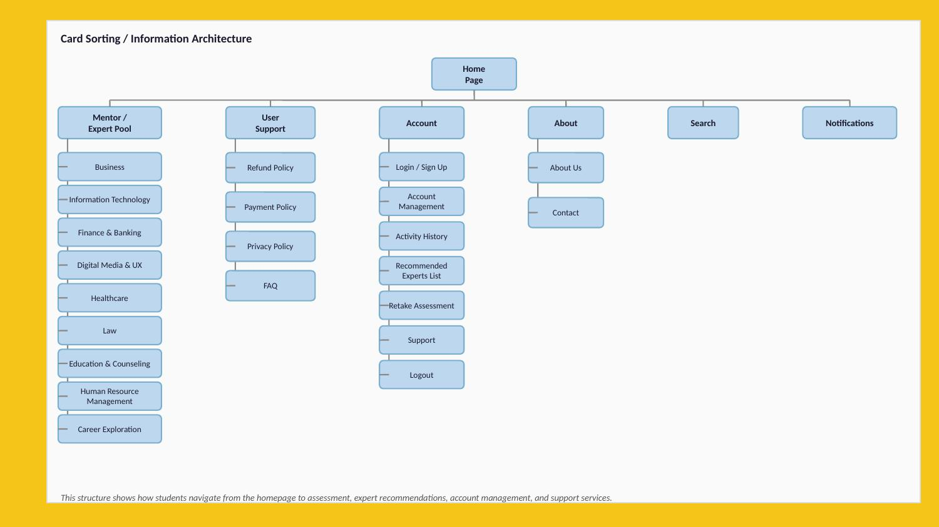

Slide 16
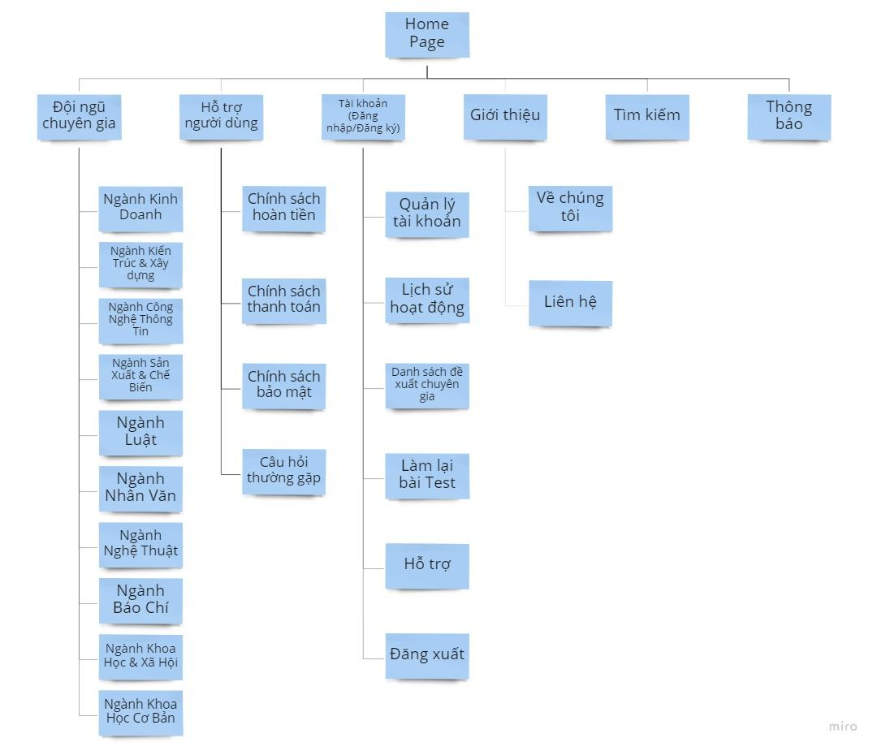

Slide 17
System Solution
TrueCareer solves the career guidance problem by connecting assessment data with recommendation logic.
Converts student assessment answers into structured feature scores
Uses K-Means clustering to group students into six orientation types
Recommends suitable majors, courses, mentor types, and career paths
Matches students with mentors based on recommended mentor type
System Solution

Slide 18
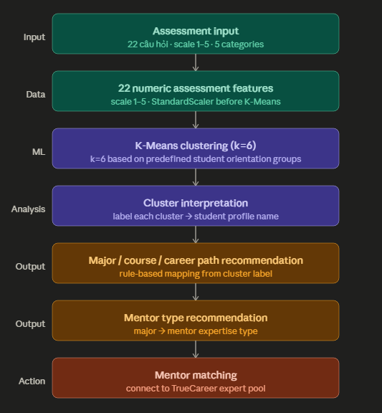
Data & Recommendation Logic
Key Point: K-Means is used for student clustering, while mentor matching is performed through rule-based mapping based on recommended_mentor_type.

Slide 19
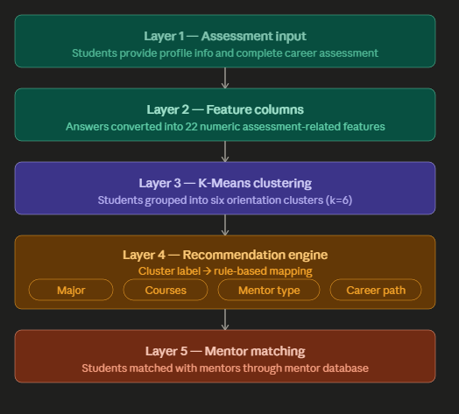
System Architecture

Slide 20

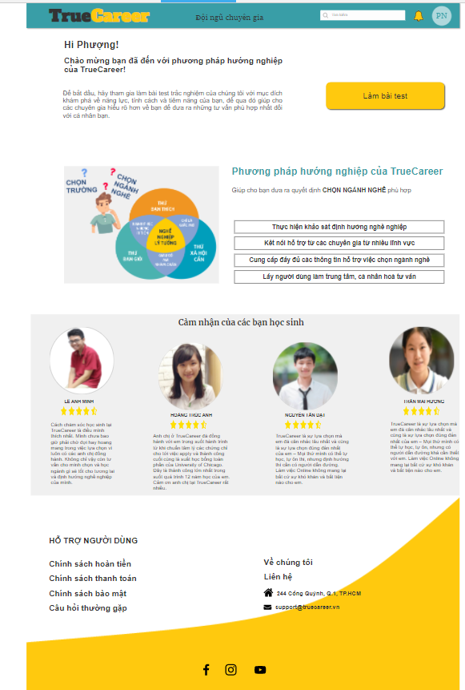
Axure prototype demonstrates the user journey from assessment to mentor recommendation and consultation flow.
Click Here
Prototype

Slide 21
GitHub Repository Includes
Vietnam-context synthetic dataset
Python preprocessing script
K-Means clustering script
Recommendation summary script
Mentor database
Streamlit dashboard code
Click Here
Dashboard Demonstrates
Student cluster distribution
Recommended major distribution
Student profile filtering
Student-to-mentor matching
Mentor-to-student grouping
Click Here
Streamlit Dashboard & GitHub Evidence

Slide 22
Limitations
Current dataset is synthetic
K-Means clustering is exploratory
Recommendation logic is rule-based
Axure UI and backend are not fully integrated yet
Real student feedback has not been collected
Future Improvements
Collect real assessment data
Add real-time assessment form
Expand mentor database
Improve recommendation accuracy
Connect UI prototype with backend system
Limitations & Future Improvements

Slide 23


