Slide 1
Multi-Omics TNBC Analysis
Generated on: 2025-08-15

Slide 2
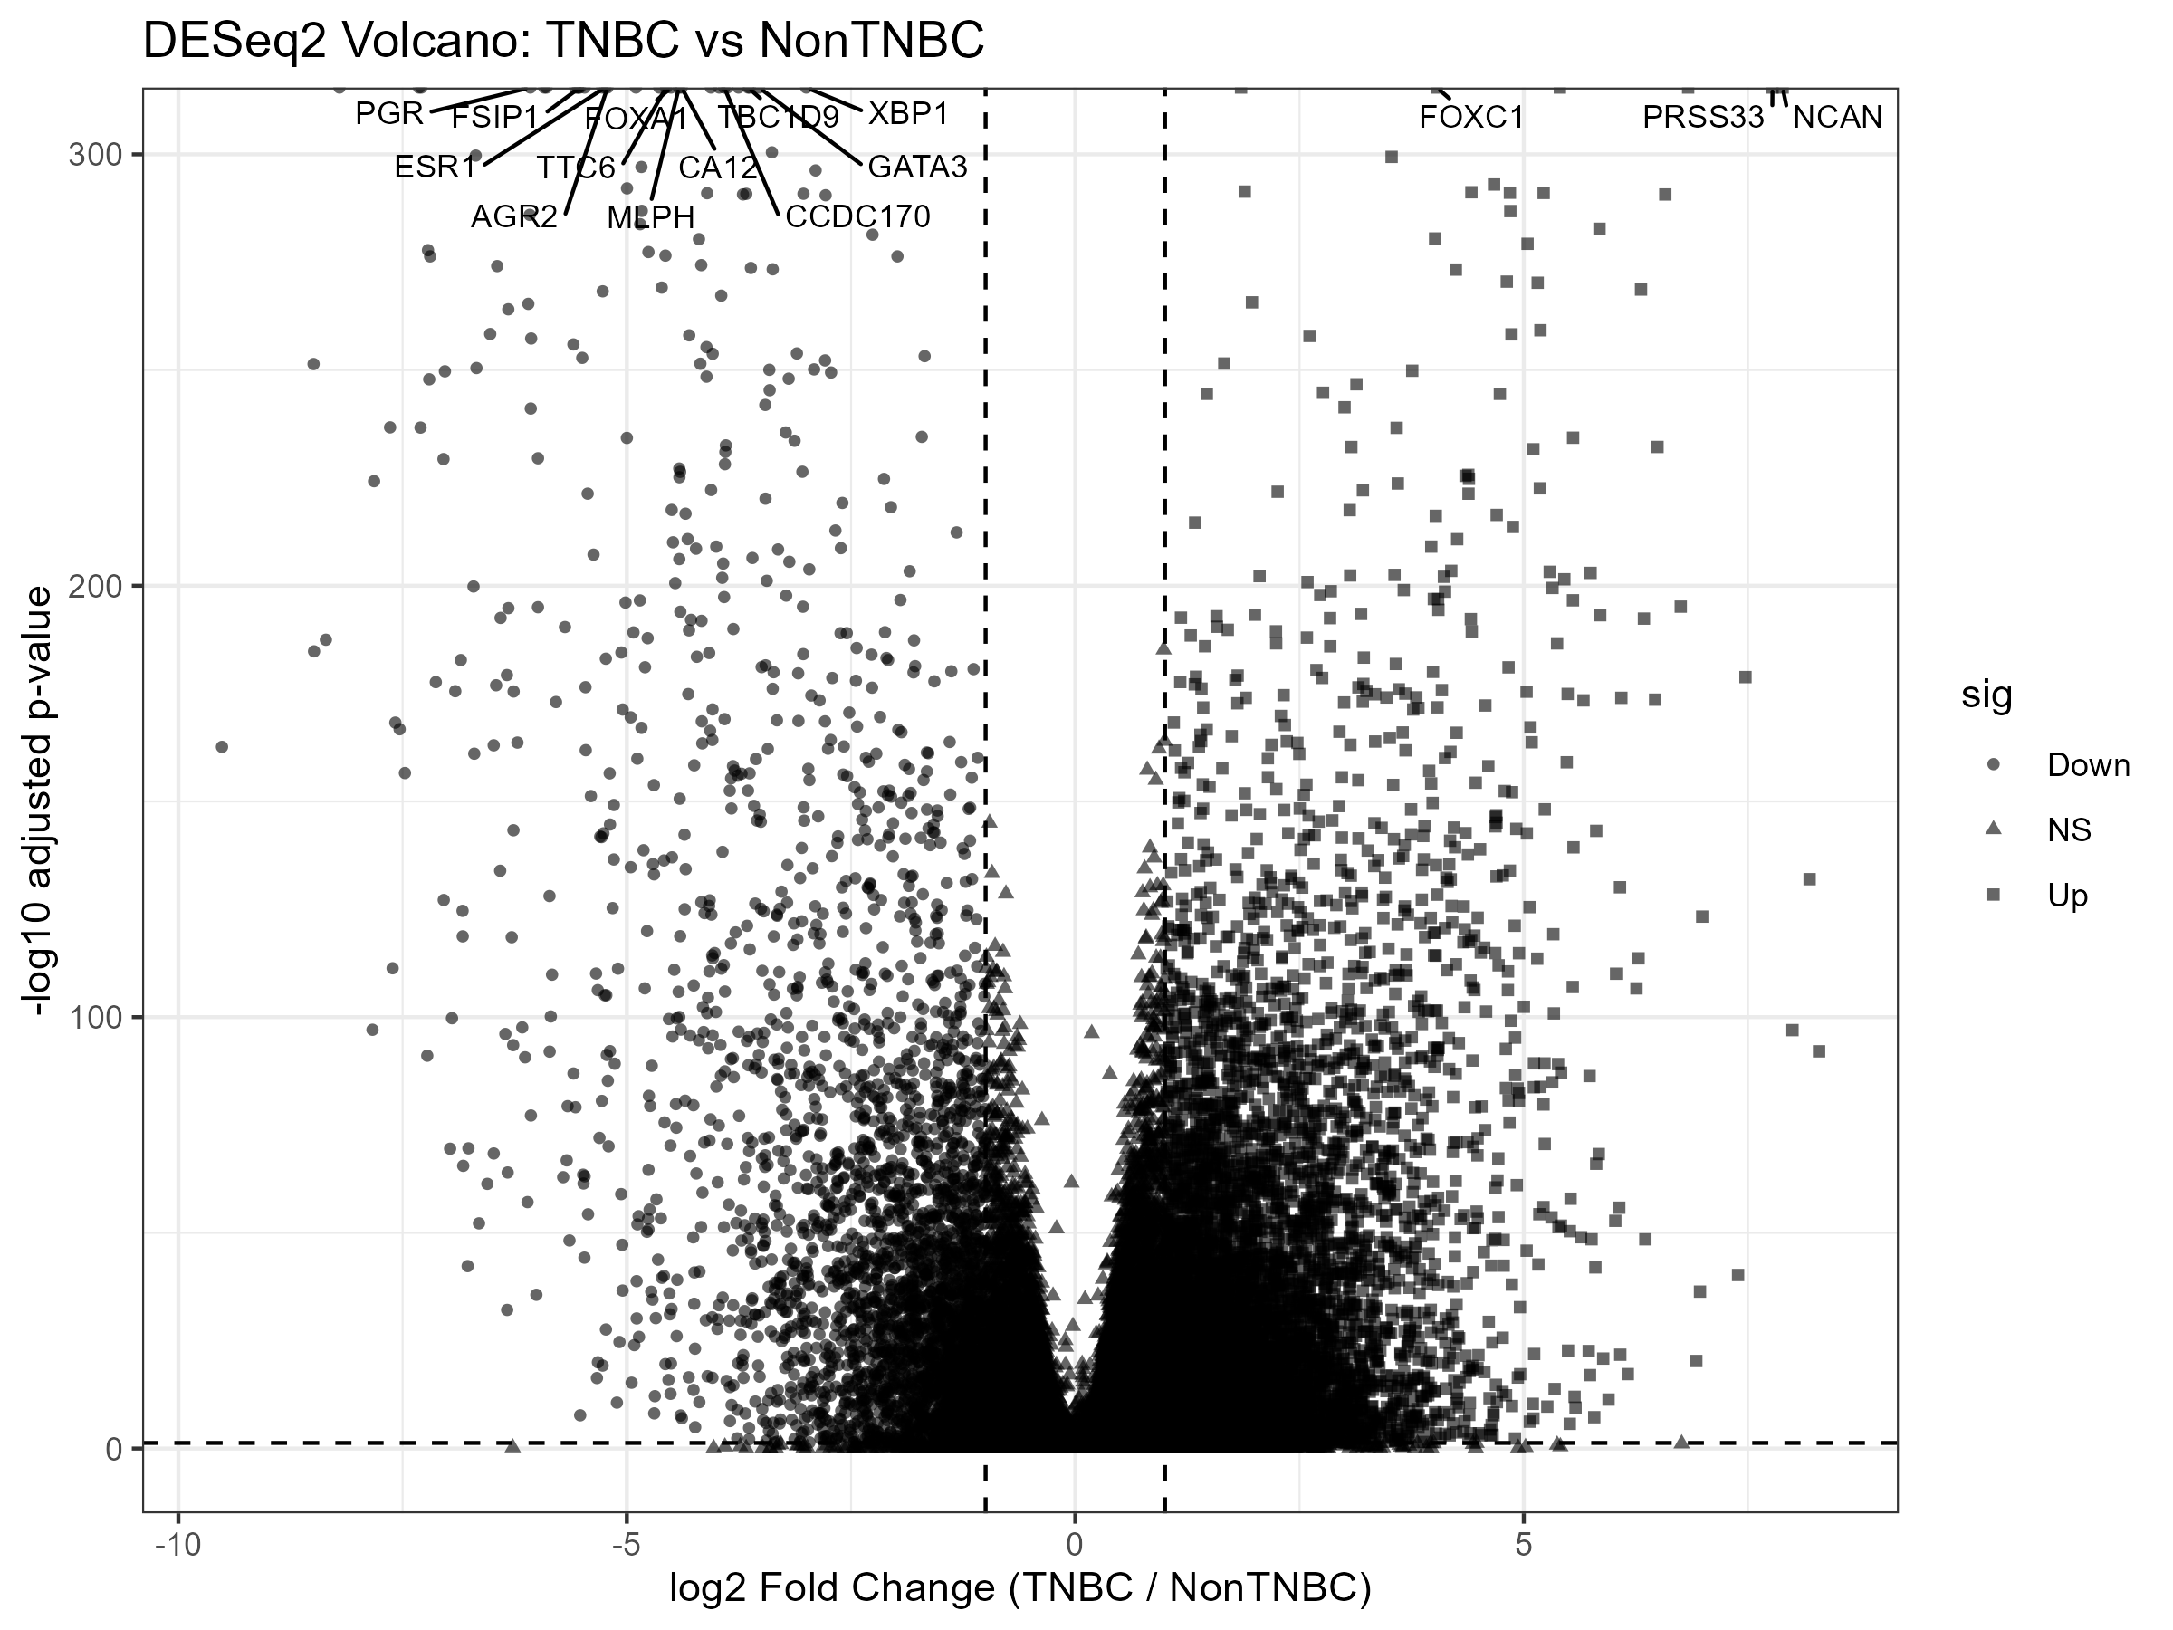
RNA-seq Volcano

Slide 3
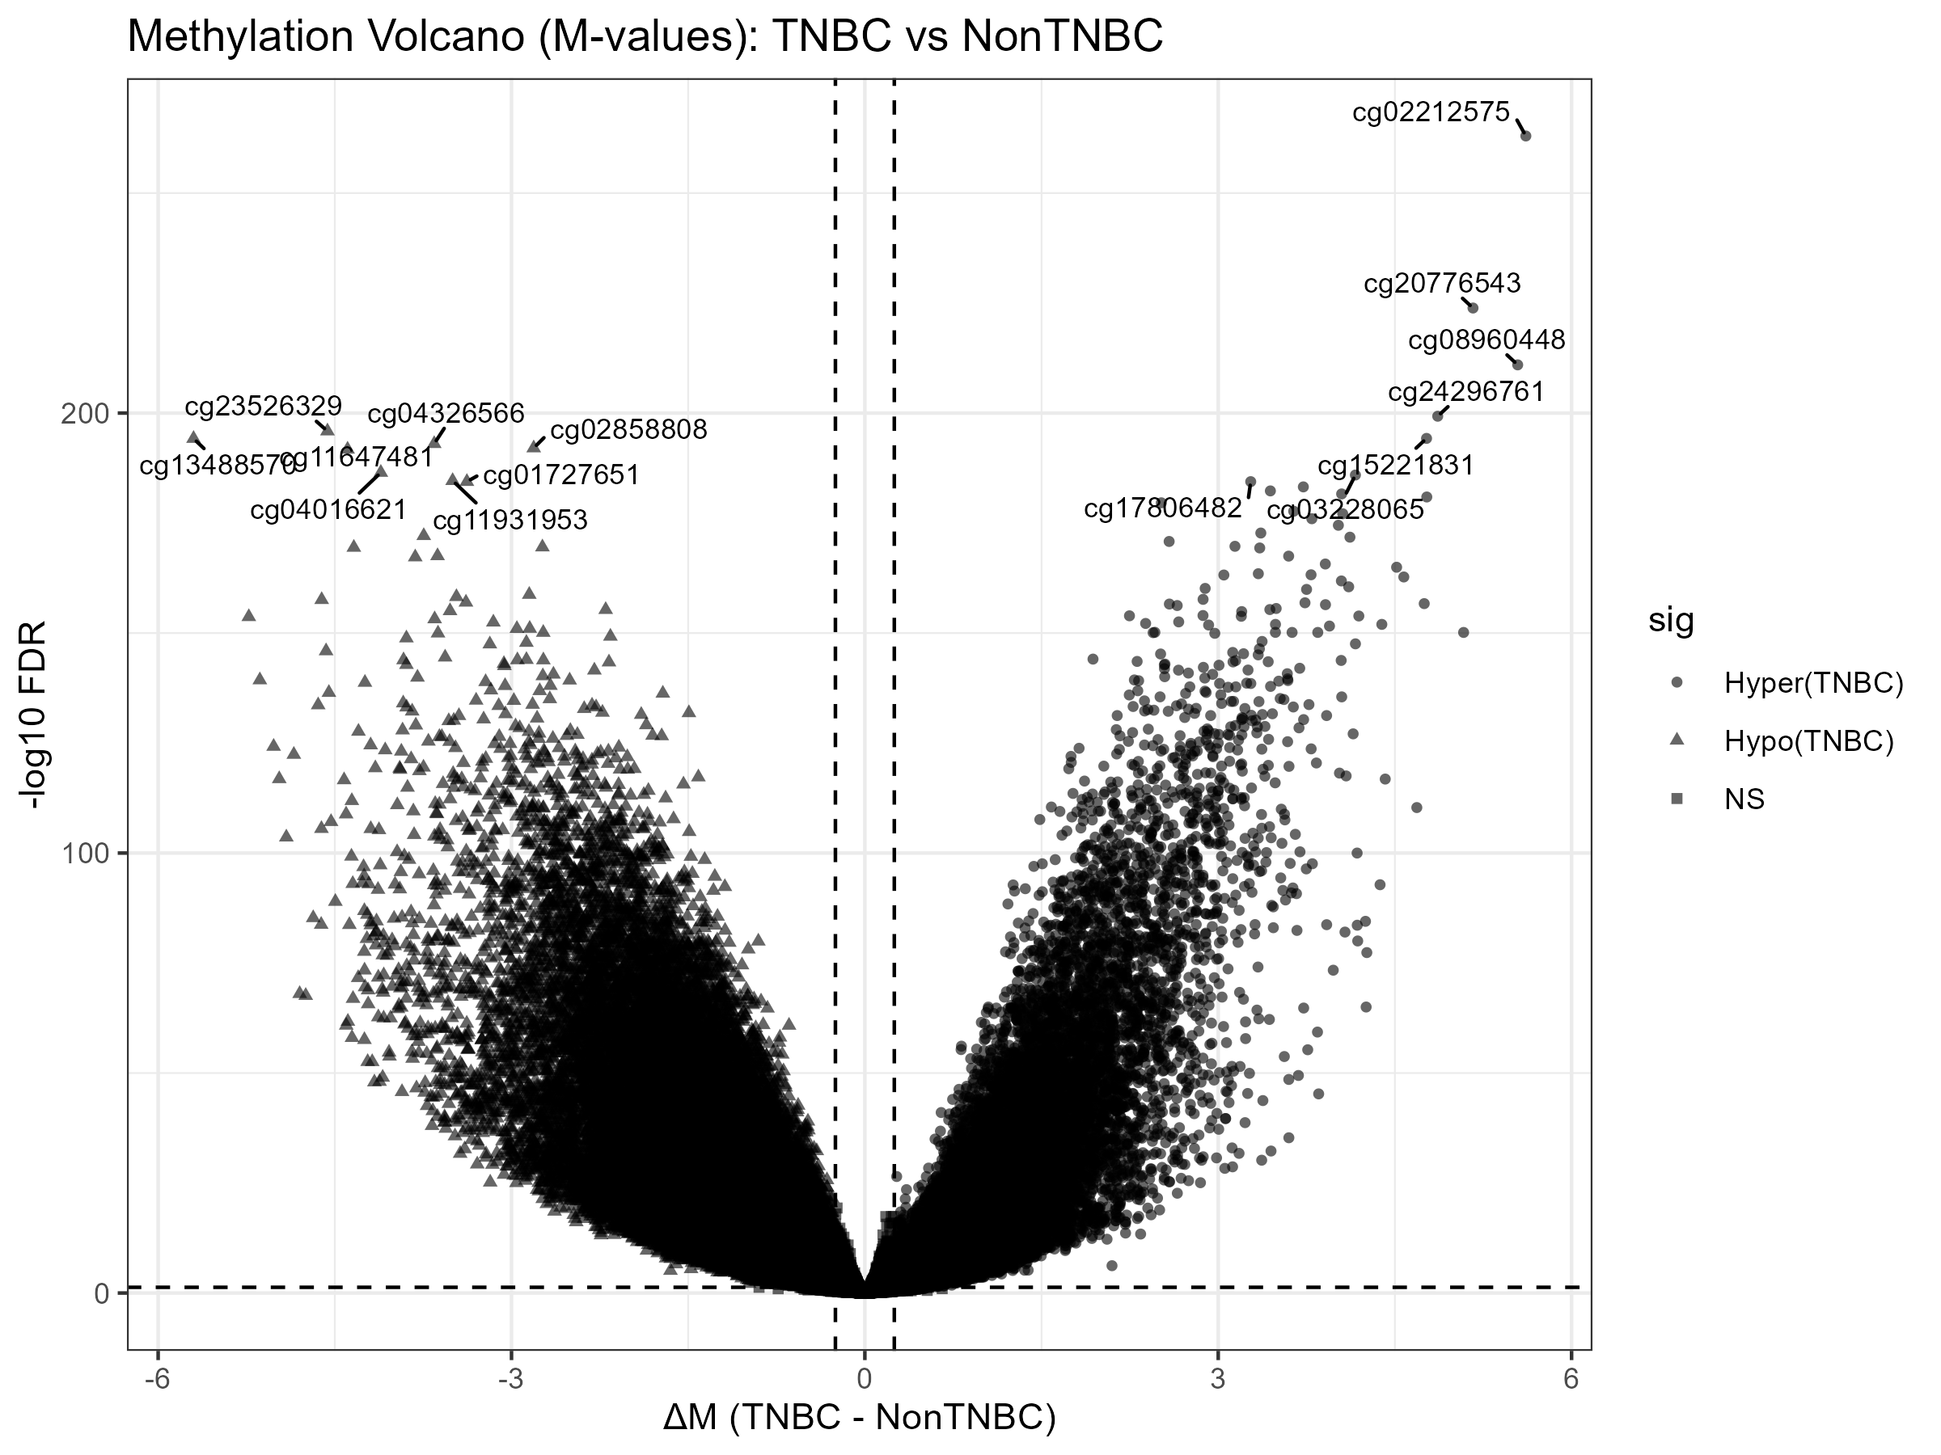
Methylation Volcano

Slide 4
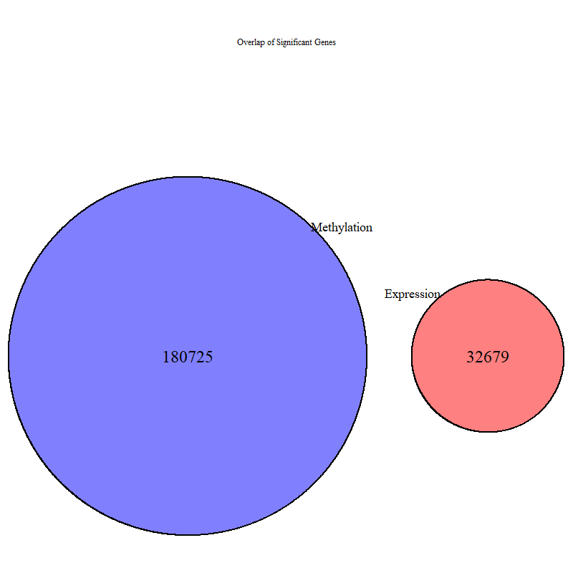
Overlap of Significant Sets

Slide 5
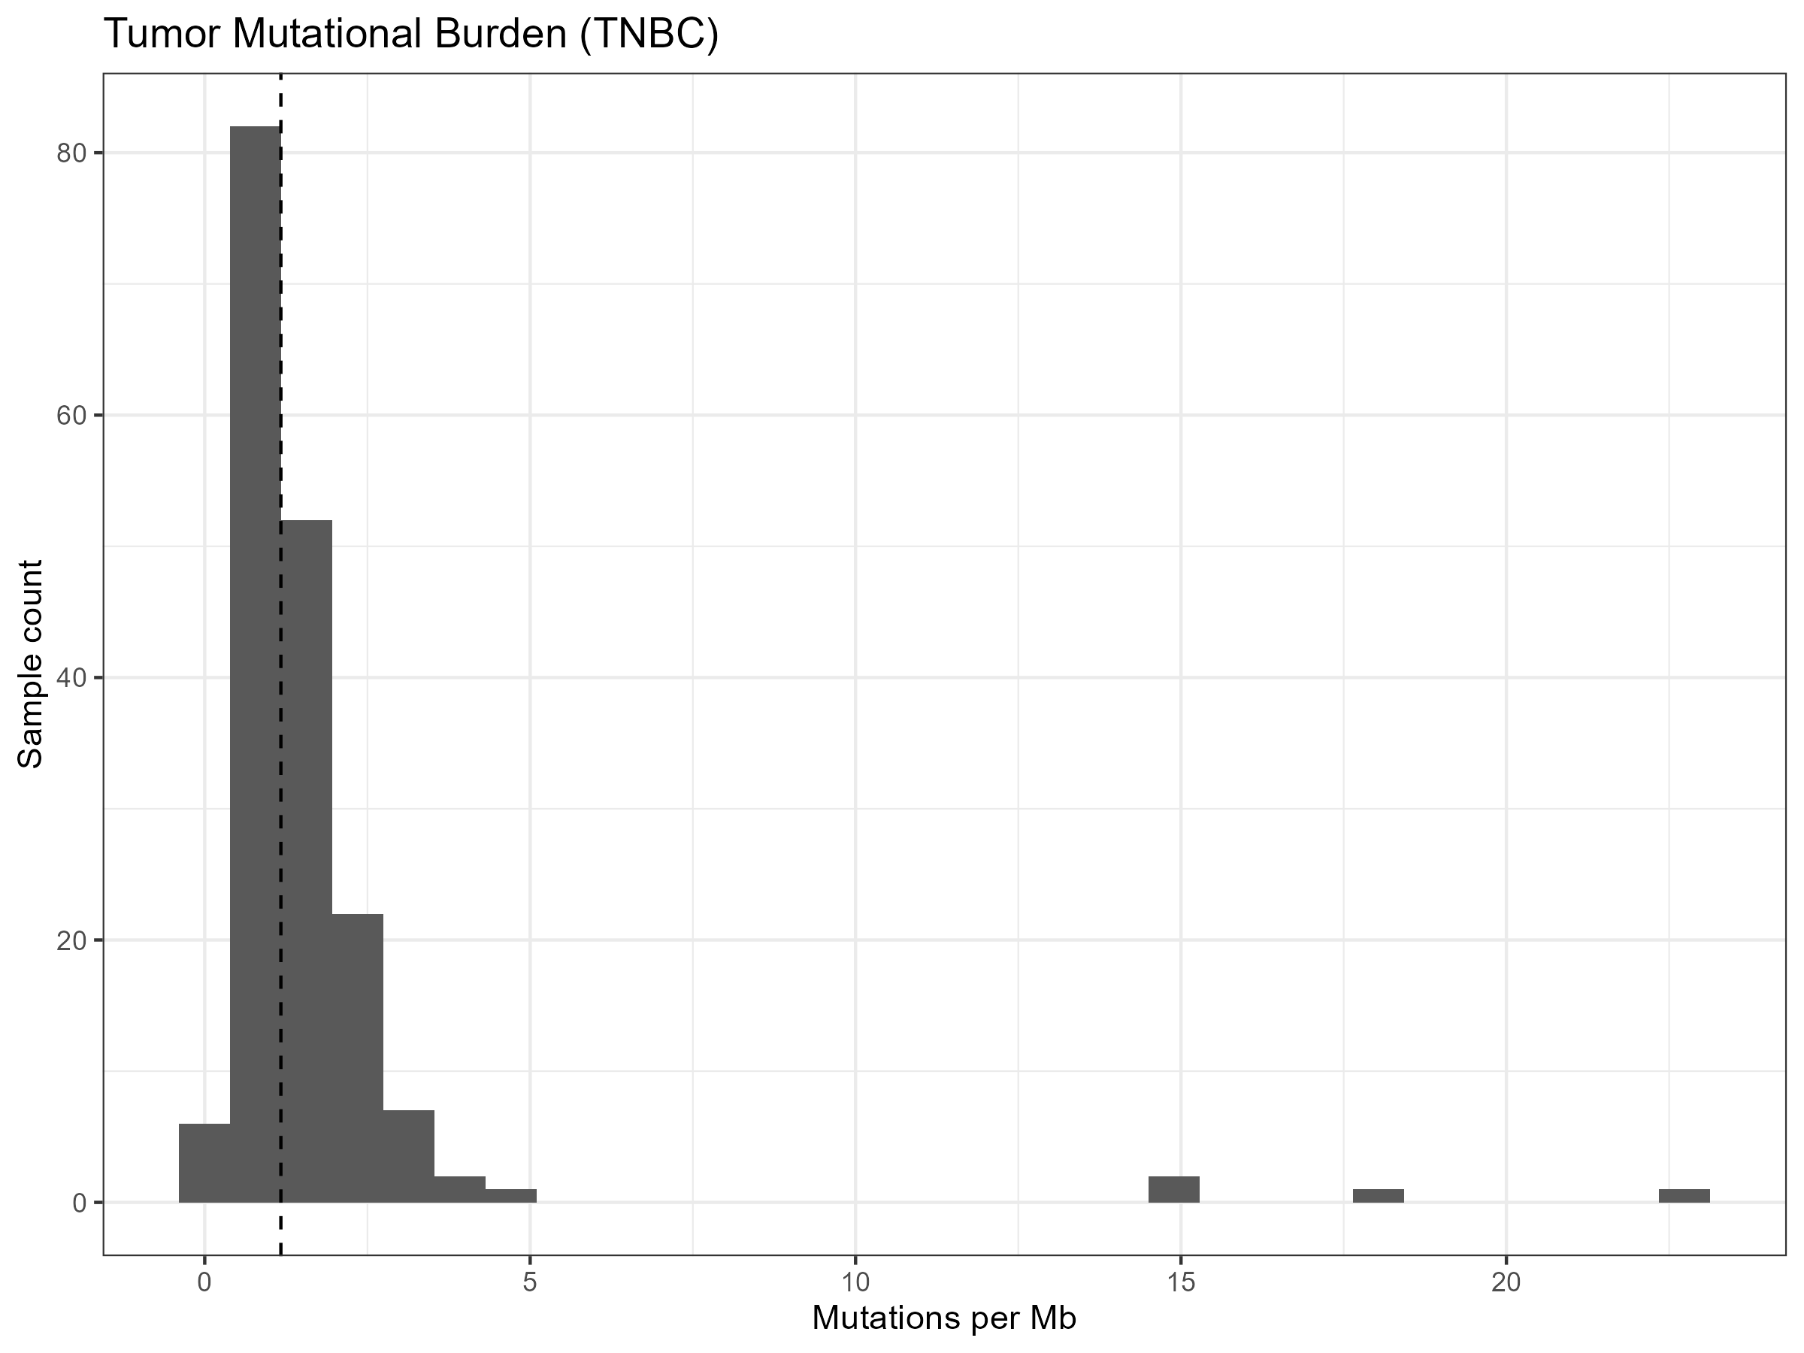
Tumor Mutational Burden

Slide 6
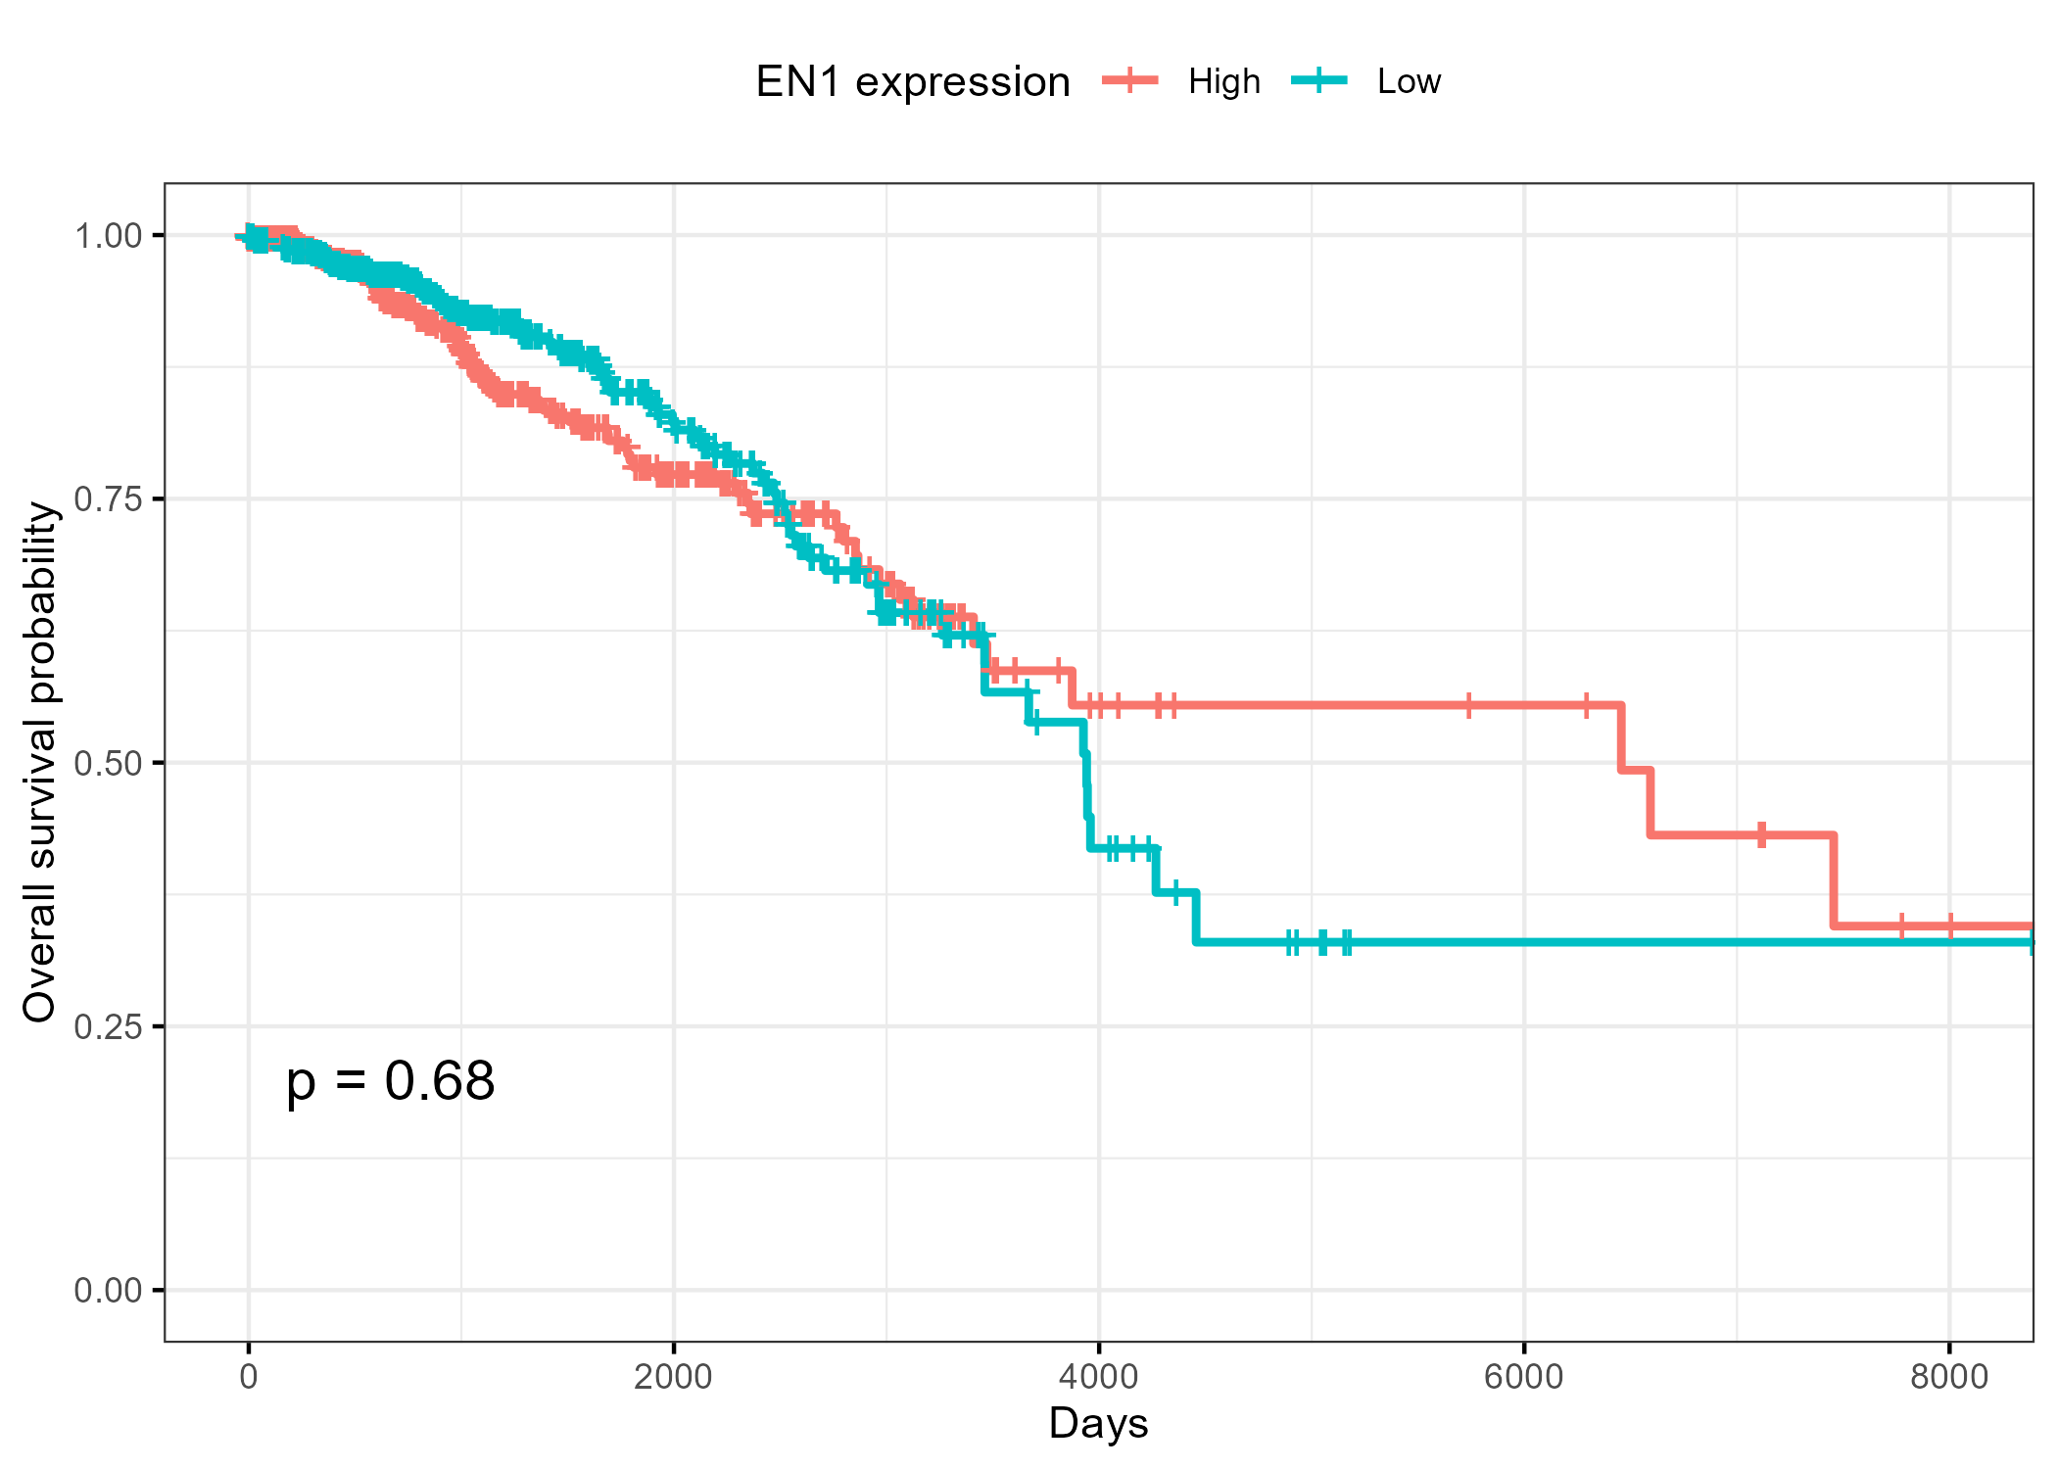
KM: KM_EN1_clean

Slide 7
KM: KM_EN1_clean

Slide 8
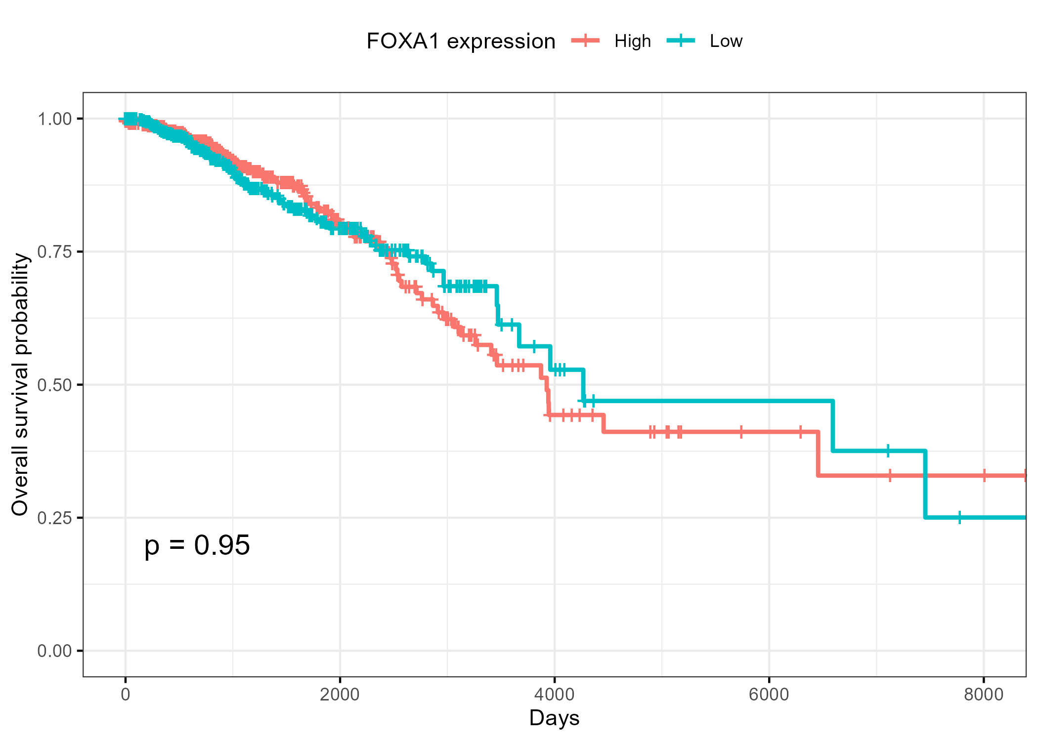
KM: KM_FOXA1_clean

Slide 9
KM: KM_FOXA1_clean

Slide 10
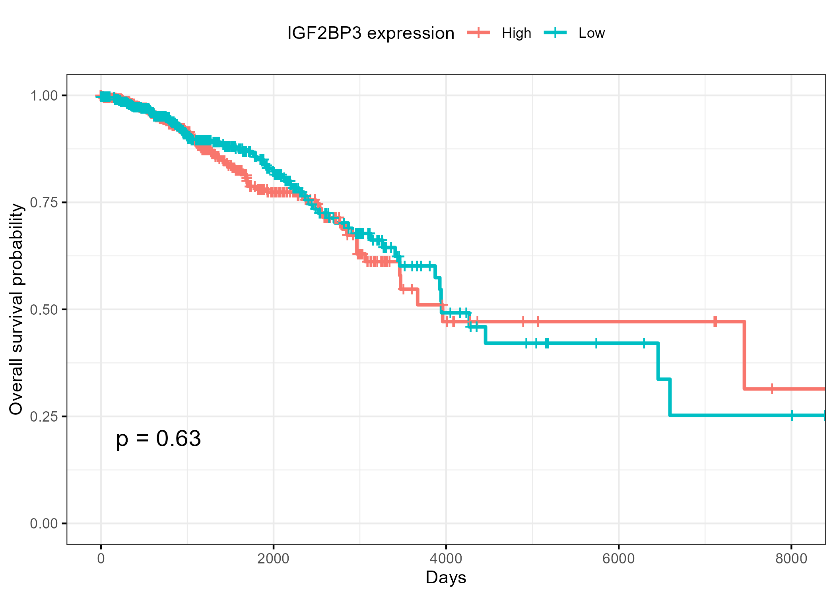
KM: KM_IGF2BP3_clean

Slide 11
KM: KM_IGF2BP3_clean

Slide 12
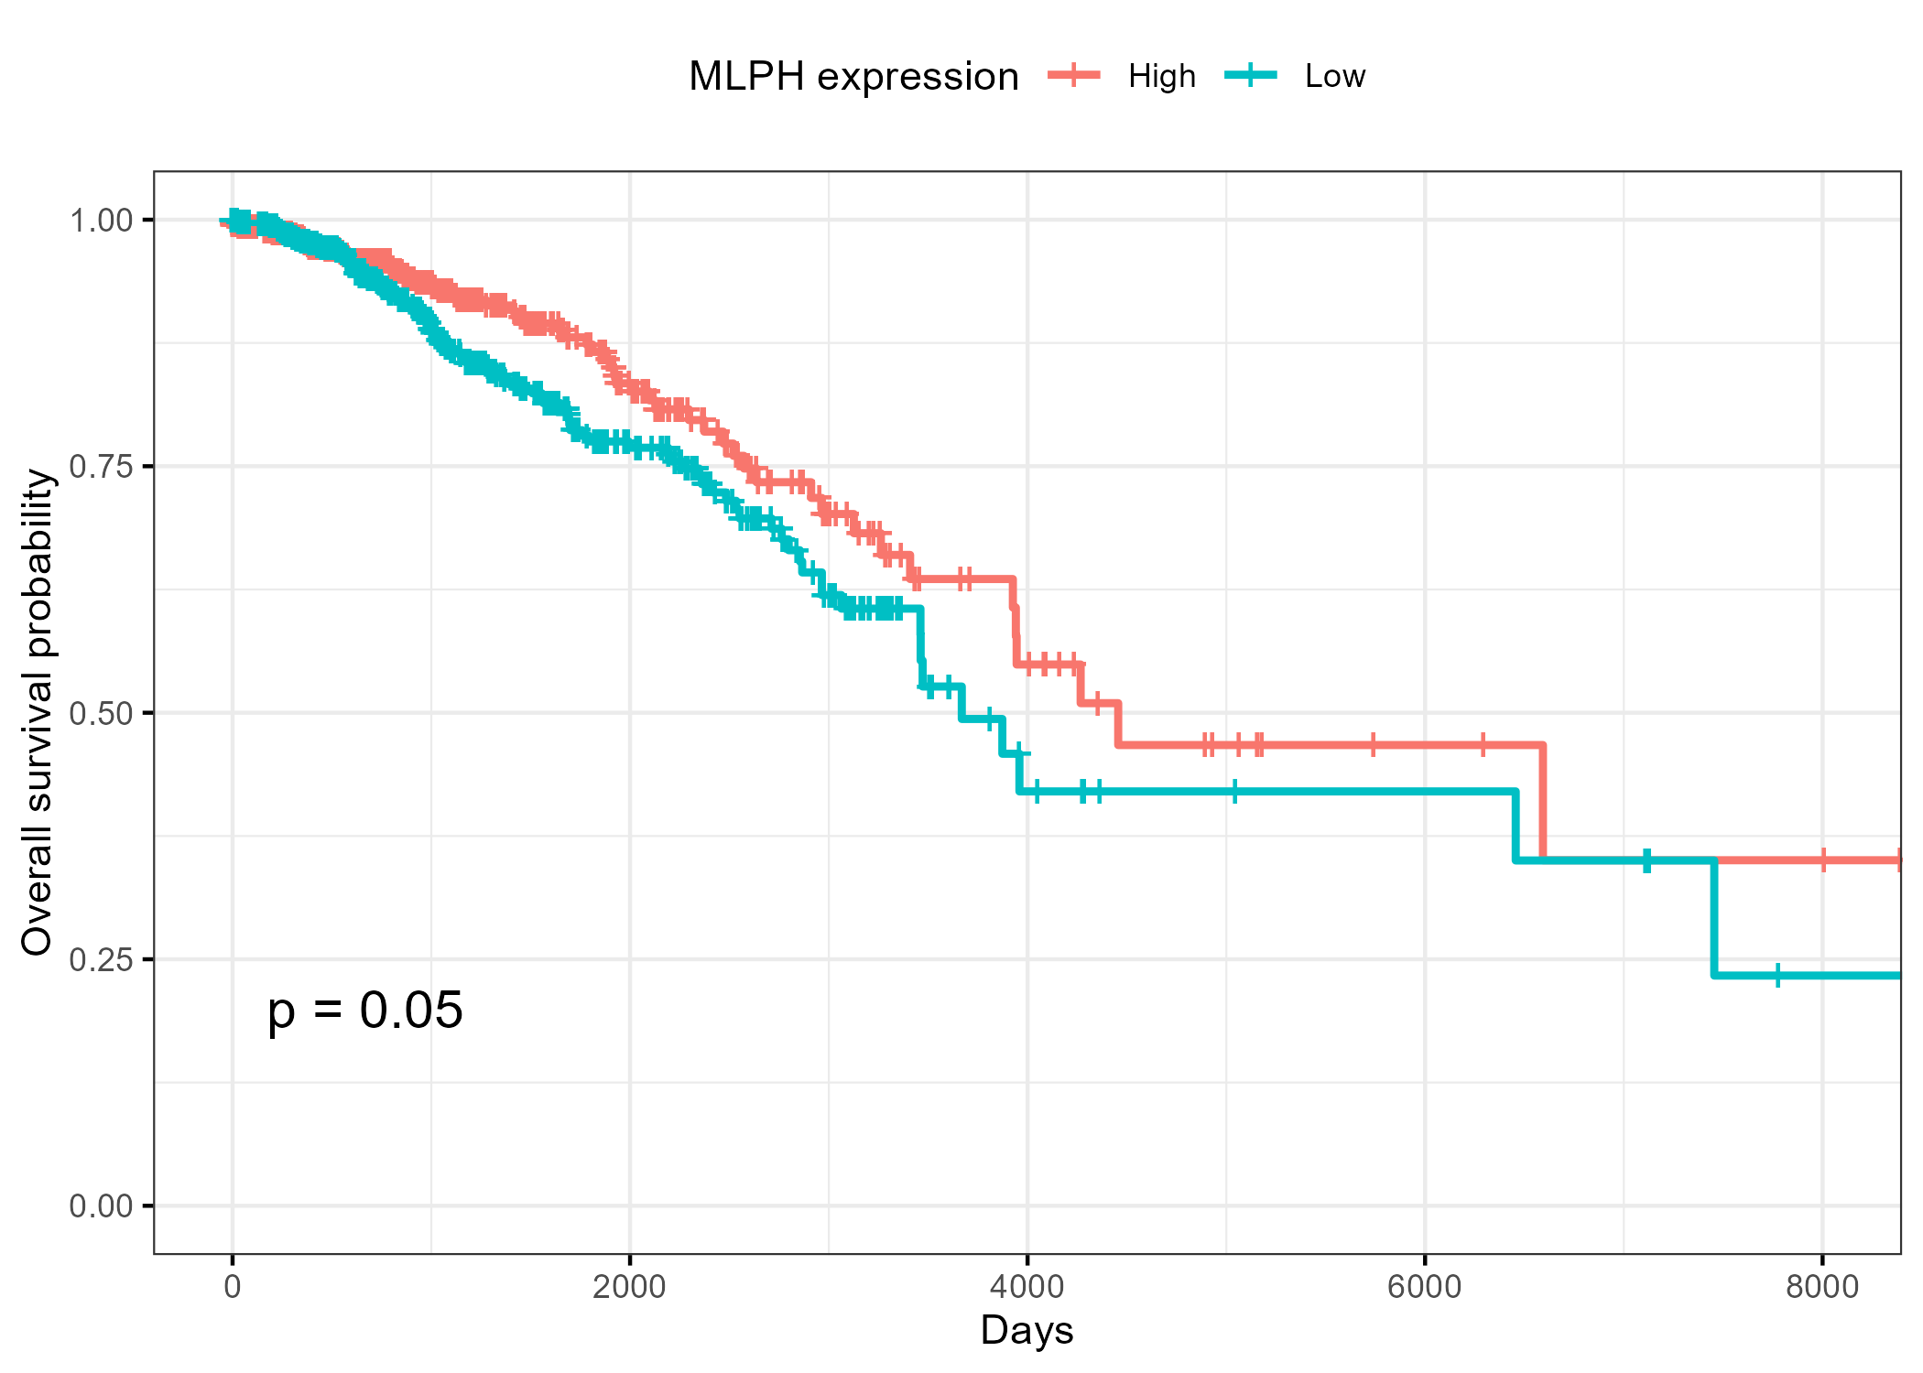
KM: KM_MLPH_clean

Slide 13
KM: KM_MLPH_clean

Slide 14
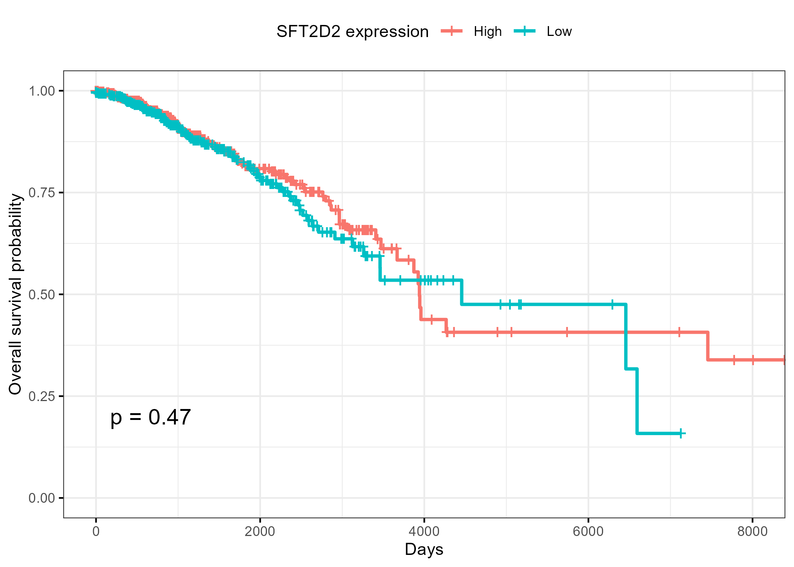
KM: KM_SFT2D2_clean

Slide 15
KM: KM_SFT2D2_clean

Slide 16
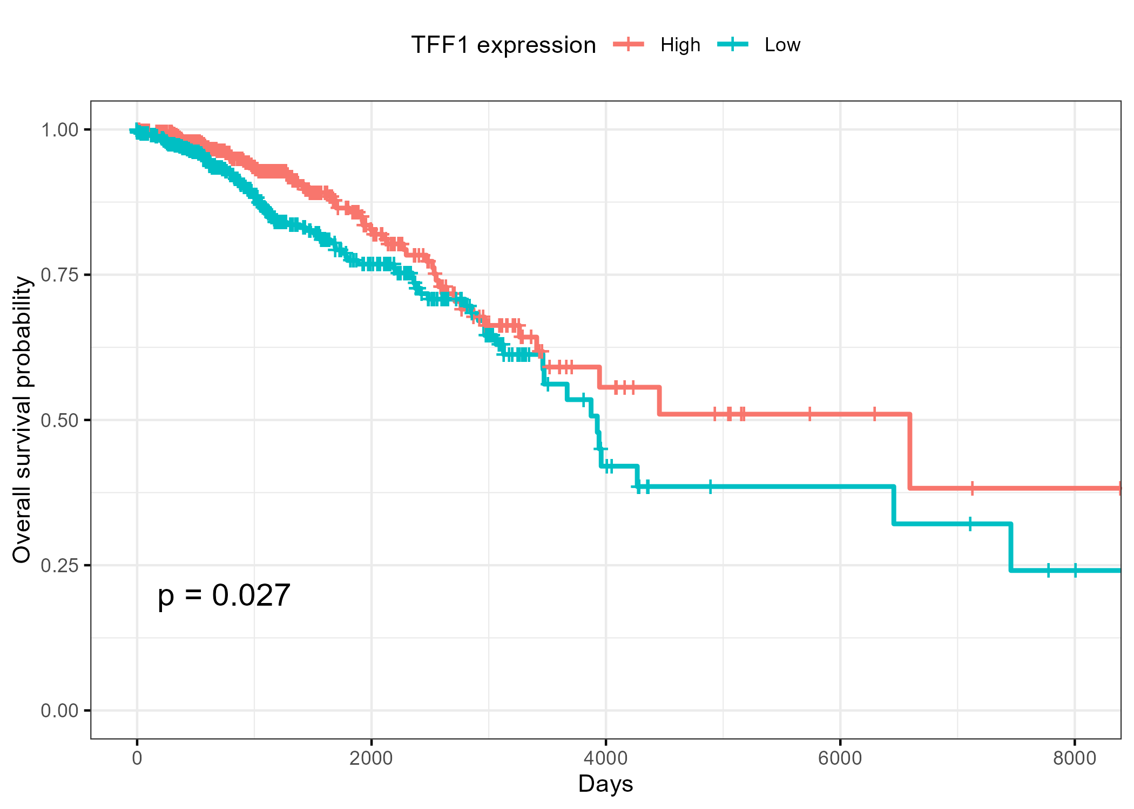
KM: KM_TFF1_clean

Slide 17
KM: KM_TFF1_clean

