Slide 1
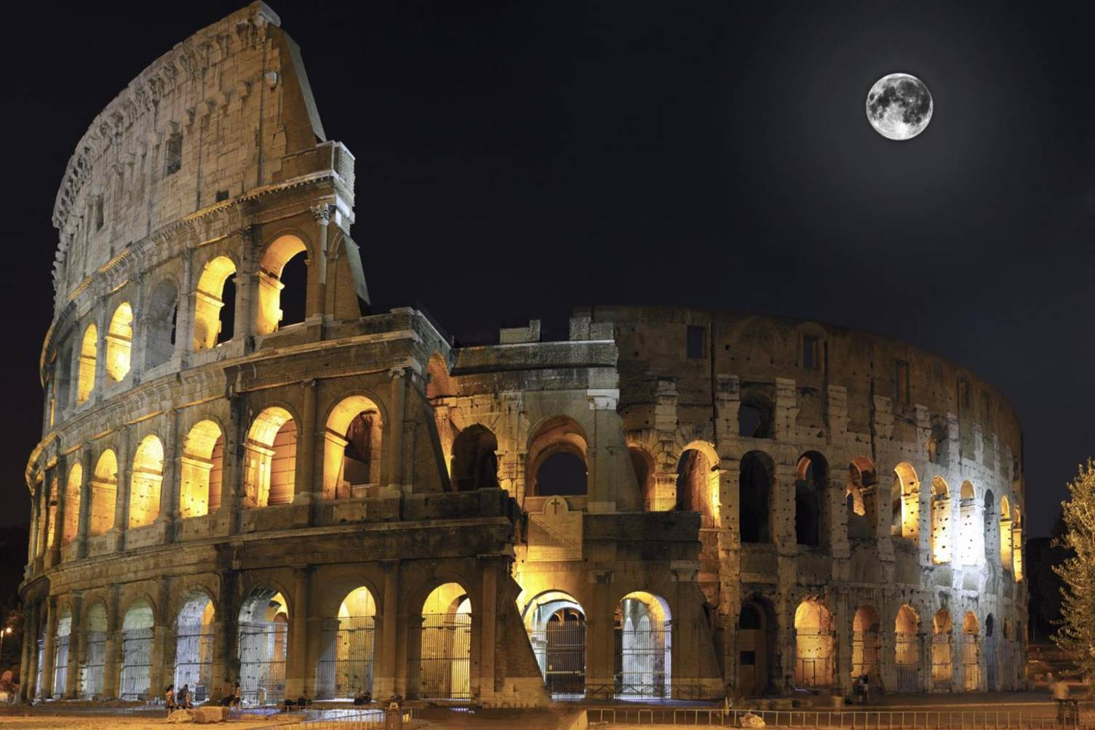
Is there still room for a pizzeria in Rome, Italy?
A data study by Charlotte Marjolein Baas, MSc

Slide 2
Introduction
Investigating whether (and where) opening a new pizzeria in Rome could be profitable
Finding areas without places where pizzas are sold
Finding possible locations for new pizzerias or Italian restaurants

Slide 3
Data acquisition and cleaning
Subdivide city of Rome
Find information on subdivisions (population, area and population density)
Find information on coordinates of subdivisions
Find relevant venues per subdivision within the range of 1500 meters from coordinates
Combine all information into one data frame

Slide 4
Methodology
Subdivisions of Rome and its population/density
Information on subdivisions of Rome (and their population/density) were found on wikipedia.org and stored into a data frame.

Slide 5
Methodology
Finding appropriate coordinate information
Information on the coordinates (latitude and longitude) of the subdivisions of Rome were found on Geonames.org and manually stored into a data frame.
This information was combined with the data frame created in the first step

Slide 6
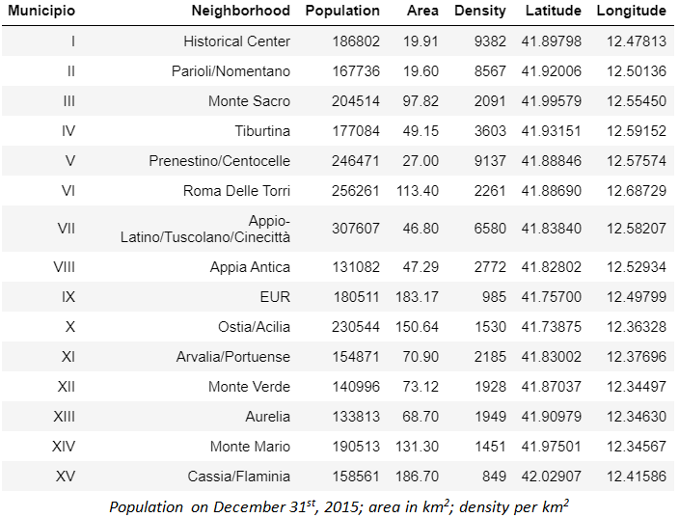
Methodology
Finding appropriate coordinate information (2)

Slide 7
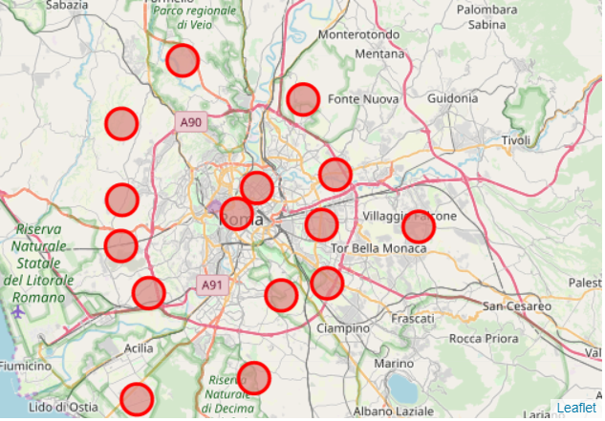
Methodology
Explore venues per subdivision
In order to explore the venues per subdivision, a map of Rome was drawn, showing each area of where the venues were searched, using a range of 1500 meters around the coordinates.

Slide 8
Methodology
Explore venues per subdivision (2)
With the use of the coordinates and FourSquare API, the top 100 venues were selected per subdivision and the relevant categories were included (pizza places and Italian restaurants). This resulted in data frames containing all venues within the selected categories per subdivision.

Slide 9
Methodology
Combining venue information with population/density information
The created data frames in step 2 and step 3 were combined into one. The amount of pizza places or Italian restaurants were added to the population information data frame, and a column with total number of relevant venues was created. The data was sorted on the latter and on the population density per area.

Slide 10
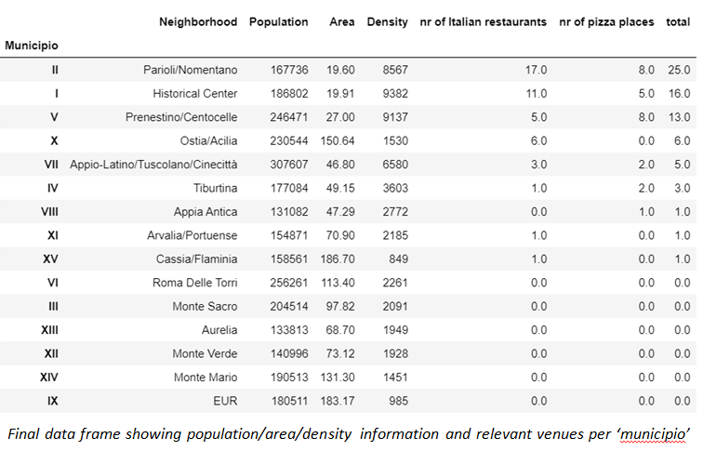
Methodology
Combining venue information with population/density information (2)

Slide 11
Results
Not all subdivisions contain relevant venues. Therefore, there should be room for a new pizzeria somewhere in Rome, Italy.
But where?

Slide 12
Discussion
Is there still room for a new pizzeria in Rome?
Yes, not all subdivisions have pizzerias or Italian restaurants.
Where would be the best place?
2 methods:
1) Choose closest area to the city centre with the least competition
2) Choose the most dense area with the least competition

Slide 13
Discussion
Where would be the best place?
Method 1: Choose closest area to the city centre with the least competition.
With this method Appia Antica comes out as best place to start a new pizzeria with only 1 competitor: an Italian restaurant.

Slide 14
Discussion
Where would be the best place?
Method 2: Choose the most dense area with the least competition .
With this method Appia Antica also comes out as best place to start a new pizzeria with a population density of 2772 people per square kilometre and only 1 competitor: an Italian restaurant.

Slide 15
Conclusion
Is there still room for a new pizzeria in Rome?
Yes, not all subdivisions have pizzerias or Italian restaurants.
Where would be the best place?
Appia Antica:
1) Closest to city centre with only 1 competitor
2) Highest population density of the areas with zero or one competitor

